Slide 1
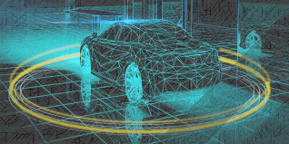
Automated Vehicles
By: Kristen Bake

Slide 2
History: Five Eras
1950-2000: Safety/Convenience Features
Cruise Control
Seat Belts
Antilock Brakes
2000-2010: Advanced Safety Features
Electronic Stability Control
Blind Spot Detection
Forward Collision Warning
Lane Departure Warning
2010-2016: Advanced Driver Assistance Features
Rearview Video Systems
Automatic Emergency Braking
Pedestrian Automatic Emergency Braking
Rear Cross Traffic Alter
Lane Centering Assist
2016-2025:
Partially Automated Features
Lane Keep Assist
Adaptive Crise Control
Traffic Jam Assist
2025+:
Fully Automated Safety Features

Slide 3
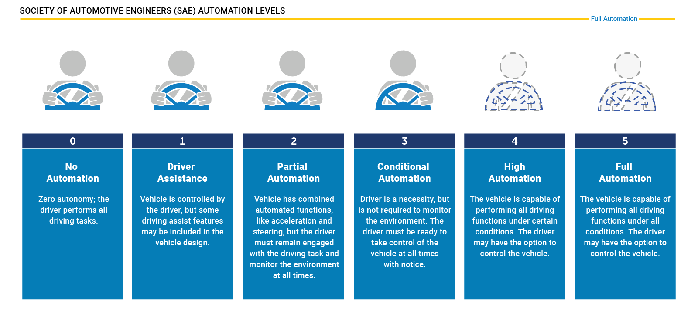
Levels of Automation

Slide 4
Benefits
Safety
Removing the driver or assisting the driver in the chain of events that can result in a crash will help to protect drivers and passengers, bicyclists, and pedestrians
Mobility
Could increase mobility for seniors, people with disabilities, and expand transportation options for underrepresented communities
Economic/Societal
Motor vehicle crashes cost billions each year- minimizing the number of crashes through automation could reduce this cost.
Environmental
Automated ride share could transform land use, and increased efficiency could reduce air pollutants
Efficiency/Convenience
Time spent in traffic delays increase fuel costs and vehicle transmissions- automated systems could reduce this time and increase efficiency and convenience

Slide 5
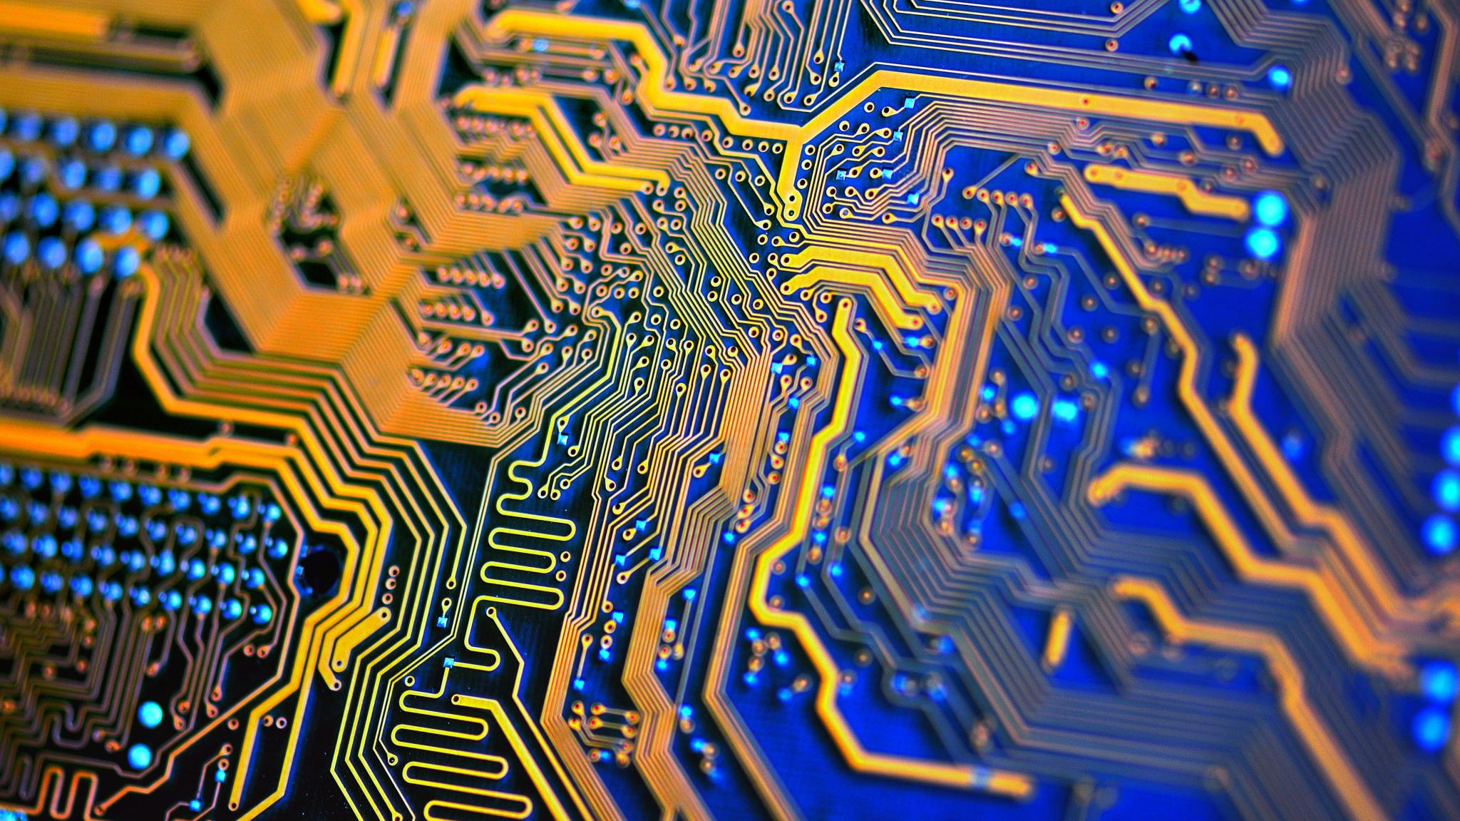
The Tech

Slide 6
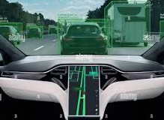
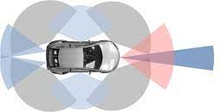
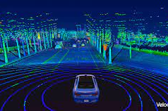
Sensors for Perception
Artificial Vision
Provides information such as spatial (shape, size, distance), dynamic (motion), and semantic (shape analysis)
Popular across domains for decades; low cost
Radar
High frequency electromagnetic waves measure distance to objects
Independent of light and weather conditions
LiDAR
Calculates distance with laser light pulse
Highly accurate distance measurements
Capable of creating accurate 3D digital maps

Slide 7
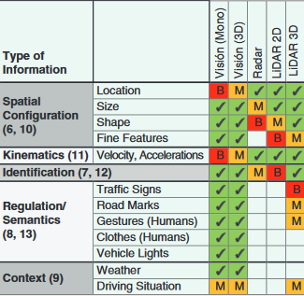
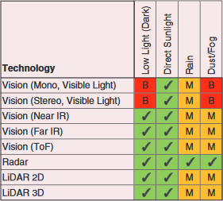
Differing Capabilities
Adequacy for relevant types of information
Artificial Vision
Highly dependent on environmental visibility
Radar
Differing reflectivity of various materials may result in false positives and false negatives
LiDAR
Difficulty detecting small objects (such as bars and wires)
Colored objects that absorb most radiation may be invisible (e.g., black cars)
Dependent on weather conditions
Robustness under atmospheric/environmental factors
Safety in Redundancy

Slide 8

Challenges of Partial Automation

Slide 9
Driver Safety and Intervention
Effects of Automation Use…
May Impact …
Inattention
Trust
Fatigue
Complexity
Skill Atrophy
Complacency
Takeover Readiness
“Automation Surprises”
Out-of-the-Loop

Slide 10
Interface Design
Controls and Displays
Transparency
Simplify
Prevention of Premature Engagement
Maintain Driver:
Skill
Wakefulness
Attentiveness
Relative freedom in iterative design and testing phases may allow for greater exploration and development of possible design solution

Slide 11
Public Acceptance
Overall Positive:
Most popular with young men in urban environments
Generally positive with older people (65+) as means of continued mobility
Impacted by:
Media Coverage
Familiarity
Cost/WTP
Risk vs. Benefit
Similarity in driving styles
Concerns:
Software Hacking
Data Sharing and Misuse
Safety
Legal
Perceived Loss of Control and Enjoyment

Slide 12
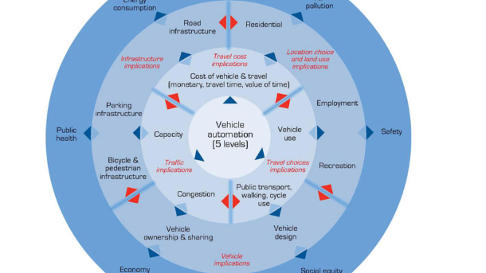
Implications

Slide 13
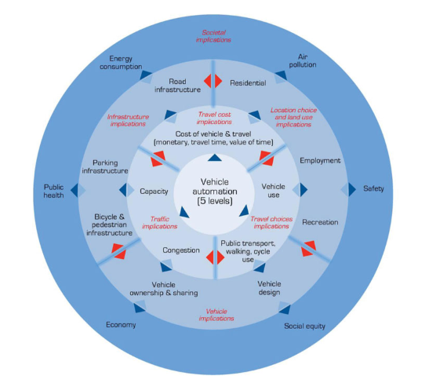
The Ripple Model (Milakis, van Arem, van Wee)
Used to conceptualize the sequential effects of the adoption on automated driving on several aspects of society
Not necessarily unidirectional

Slide 14
First-Order Implications
Travel Cost
Cost may reduce with time and widespread adoption
Time cost reduced
Value of time not perceived to increase
Road Capacity
Higher penetration rate will bring greater benefits
40% penetration rate threshold for significant benefits
Travel Choices
Increase in travel demand due to changes in destination choice, mode choice, and mobility
Shared Avs further Increase miles traveled

Slide 15
Second-Order Implications
Vehicle Ownership
Shared Avs could replace from 67% to over 90% of vehicles of equal mobility
Vary by penetration rate and presence or absence of public transportation
Land Use
Could trigger further urban expansion
Land used for parking shifted to peripheral zones
Transport Infrastructure
Shared Avs reduce parking space requirements over 90%
Vary on mode, penetration rate, and existing public transport

Slide 16
Third-Order Implications
Fuel Efficiency
Higher levels of automation and penetration rate could lead to higher fuel savings
Long-Term Energy Consumption and Air Pollution
Net effect uncertain
More efficient travel, but longer travel distance and increased travel by underserved populations
Emissions
Lower emissions, particularly in higher levels of automation, penetrations, and shared use
Economy
Jobs in transportation and logistics sector have high probability of becoming automated within 20 years
Public Health
Gap in the research!
Safety
Level 3+ may enhance traffic safety
Behavioral adaptation, software vulnerabilities may compromise traffic safety benefits
Full automation may not deliver high levels of benefits until high penetration rates are achieved
Social Equity
Increased safety and mobility for elderly
Up to 14% increase in travel demand
Possibility of social justice incorporation

Slide 17

Future Directions

Slide 18
Future Research and Focus
Long-Term Impact on Emissions, Pollution, Public Health, etc.
Methodology of Testing
Mapping Strategies
Sharing and Collaboration among Researchers
Factors Effecting or Impeding Acceptance
Solving Existing Challenges First

Slide 19

Thank You!

Slide 20
Sources

