Slide 1
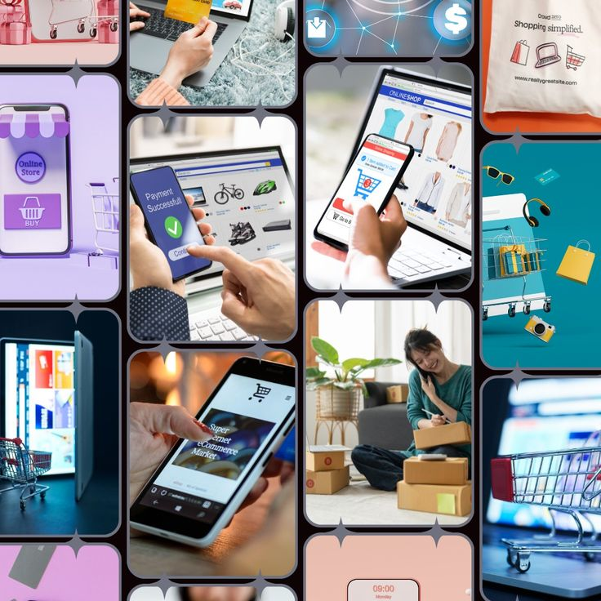
Customer Shopping Behavior Analysis
End-to-End Data Analytics Project using Python, PostgreSQL & Power BI

Slide 2
Executive Summary & Objectives
This project analyzes a retail customer shopping behavior dataset to identify purchasing trends, customer segments, product performance, and revenue opportunities.
Purchase Behavior
Product Performance
Discounts & Subscriptions
Understand customer purchasing patterns
Identify high-performing products and categories
Measure the impact of subscriptions and discounts
Customer Segmentation
Interactive Dashboard
Segment customers based on purchase history
Build a Power BI dashboard for decision-making

Slide 3
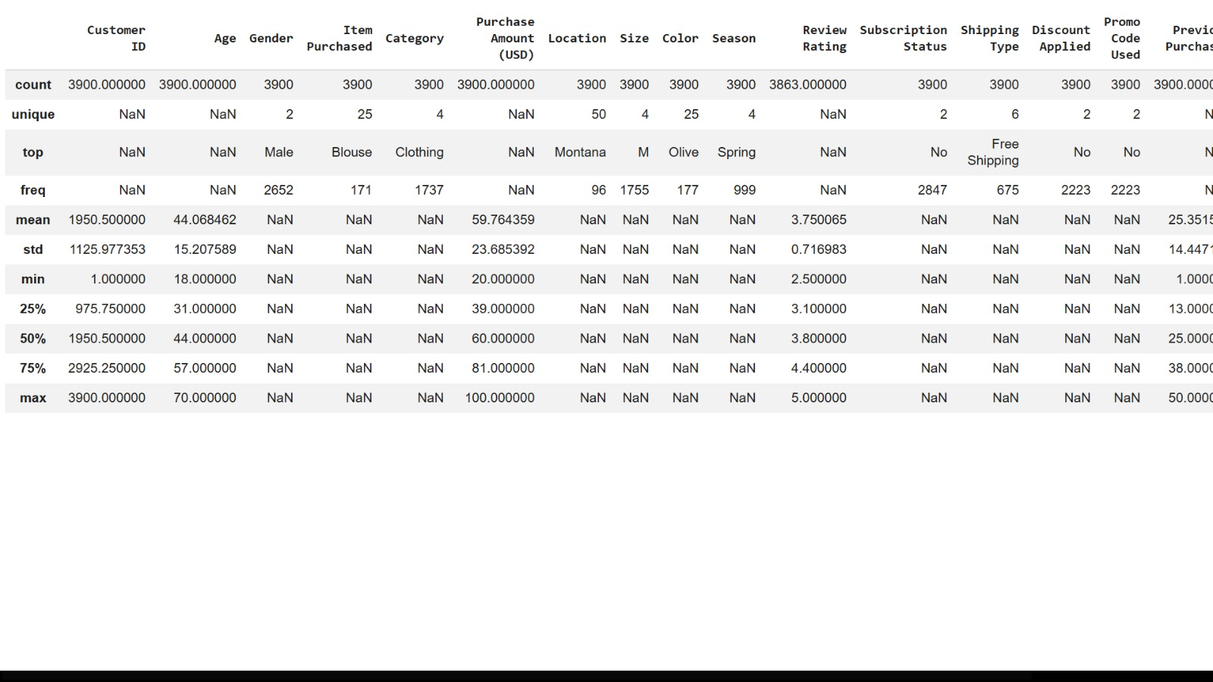
Technology Stack & Dataset
Technology Stack
Python (Pandas, NumPy, Matplotlib, Seaborn)
PostgreSQL
Power BI Desktop
Jupyter Notebook / VS Code
Git & GitHub
Dataset Summary
3,900+ records, 18 features
Customer ID, Age, Gender, Purchase Amount, Category, Review Rating, Subscription Status, Discount Applied, Shipping Type, Payment Method, Frequency of Purchases

Slide 4
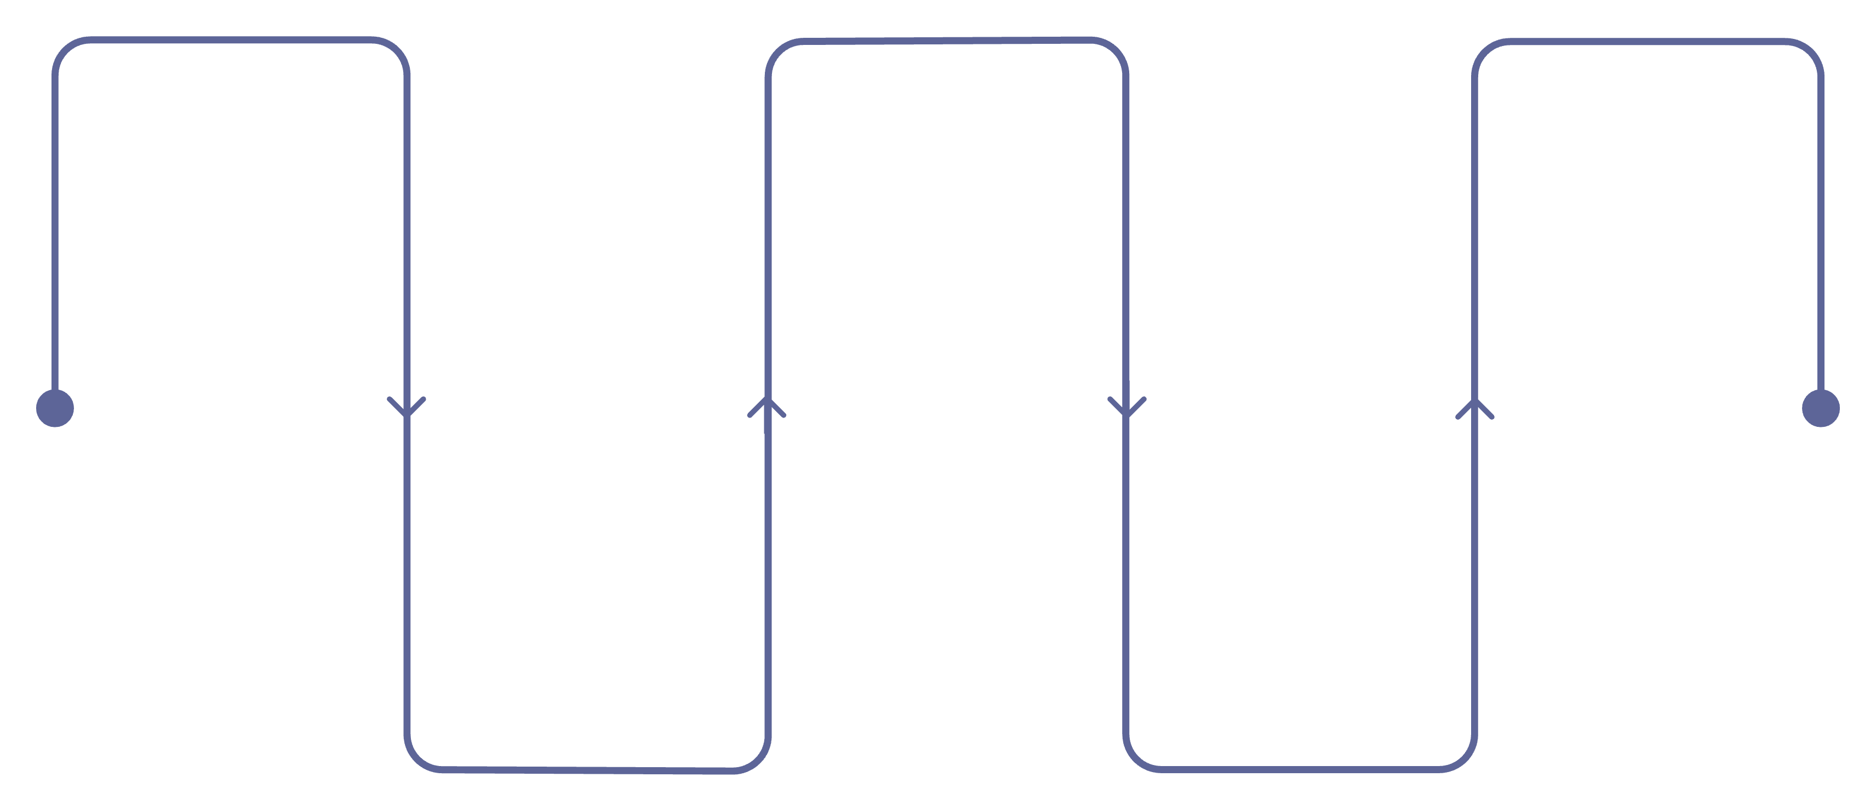
Project Workflow
Raw CSV
EDA
Power BI
Explore patterns and anomalies
Visualize metrics and trends
Source retail transaction files
Data Cleaning
PostgreSQL
Python preprocessing and validation
Store cleaned, structured data
A complete end-to-end pipeline transforms raw retail data into actionable business intelligence using Python, PostgreSQL, and Power BI.

Slide 5
Exploratory Data Analysis
3,900
18
44
Total Records
Features
Avg Age (yrs)
$59.76
3.75
Avg Purchase
Avg Rating
Most customers are Male. Clothing is the most purchased category. These baseline metrics informed subsequent SQL and Power BI analysis.

Slide 6
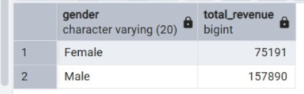

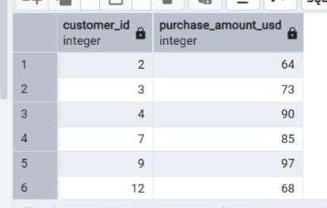
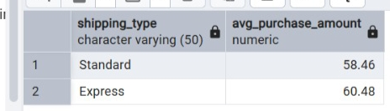
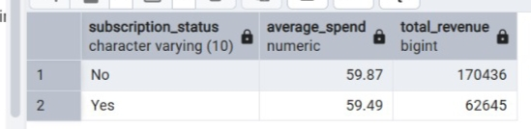
SQL Analysis — Revenue & Spending
Q1: Revenue by Gender
Male: $157,890 | Female: $75,191 — Male customers generated significantly higher revenue, indicating a larger contribution to total sales.
Q2: Discount + Above-Average Spend
Several customers purchased above the average amount despite receiving discounts, suggesting discounts successfully encouraged higher spending.
Q4: Shipping Type
Express: $60.48 | Standard: $58.46 — Express Shipping customers spend slightly more on average.
Q5: Subscribers vs Non-Subscribers
Similar average purchase amounts, but non-subscribers contribute a larger share of total revenue due to their higher customer count.

Slide 7
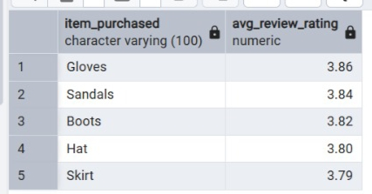
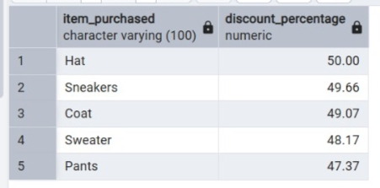
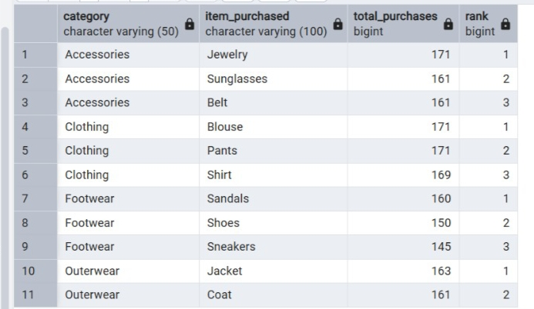
SQL Analysis — Products, Ratings & Segments
Q3: Top-Rated Products
Gloves, Sandals, Boots, Hat, Skirt — Gloves received the highest average customer rating, followed by Sandals and Boots, demonstrating high satisfaction.
Q6: Highest Discount Usage
Hat, Sneakers, Coat, Sweater, Pants — Hat purchases received discounts most frequently.
Q8: Top Products by Category

Slide 8
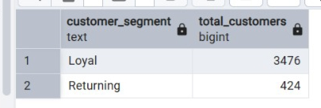
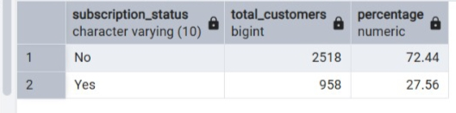
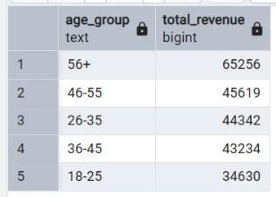
Customer Segmentation & Age Group Revenue
Q7: Customer Segmentation
Loyal customers: 3,476 | Returning: 424 The majority are loyal, indicating strong retention.
Q9: Repeat Buyers & Subscription
72.44% non-subscribers | 27.56% subscribers — Most repeat buyers are still non-subscribers, suggesting an opportunity to convert loyal customers into subscription members.
Q10: Revenue by Age Group
Customers aged 56+ contribute the highest revenue, followed by the 46–55 age group.

Slide 9
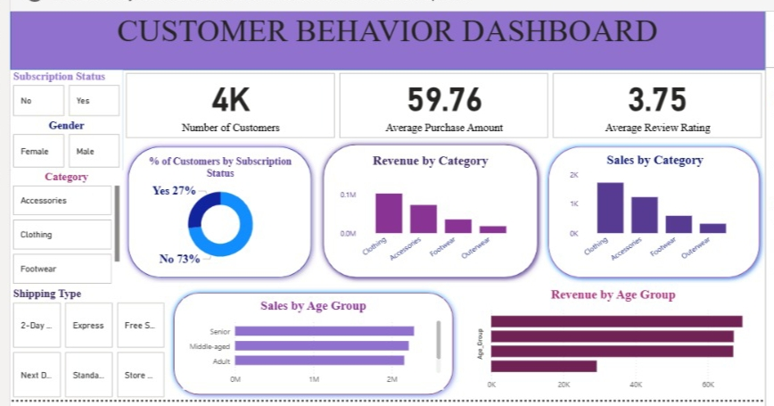
Power BI Dashboard
KPIs
4K customers · $59.76 avg purchase · 3.75 avg rating
Visuals
Revenue & Sales by Category and Age Group, Subscription Distribution
Filters
Gender, Subscription Status, Category, Shipping Type
Insights
Clothing leads revenue; seniors drive largest share; only 27% subscribers

Slide 10

Key Insights, Recommendations & Future Scope
Key Insights
Recommendations
Clothing contributes the highest sales and revenue
Adults and middle-aged customers generate the largest revenue share
Subscribers generally contribute higher revenue than non-subscribers
Products with higher ratings tend to perform better
Discount campaigns improve customer purchases
Repeat buyers show stronger subscription adoption
Strengthen loyalty and membership programs
Target marketing campaigns toward high-value customer segments
Promote highly-rated products more aggressively
Offer personalized recommendations using previous purchase history
Optimize discount campaigns based on product performance
Improve inventory planning for top-selling categories
Future Scope: Build predictive models for customer lifetime value, develop churn prediction using machine learning, create recommendation systems, and automate dashboard refresh using Power BI Service.

