Slide 1

Analytics for Competitive Advantage: Measuring Productivity Improvements from Generative AI
Project Presentation
MBA Business Analytics

Slide 2
Background
AI Transformation: Artificial Intelligence is reshaping the IT services sector by enhancing efficiency and enabling data-driven decision-making.
IT Industry Reliance: The sector depends on knowledge-based work like software development and data analysis, which are now being transformed by AI-driven automation.
Role of Generative AI: Unlike traditional AI, Generative AI creates content (text, code, insights), significantly reducing manual effort and improving output quality.

Slide 3
Objectives & Scope
Subjectivity: Most current assessments are based on perceptions rather than objective, empirical data
Project Objectives:
Primary Goal: Evaluate how Generative AI influences productivity and contributes to competitive advantage using business analytics
Quantify Improvements: Analyze changes in task completion time, efficiency, and output quality
Comparative Analysis: Compare performance outcomes between AI-assisted and non-AI workflows.
Develop Indices: Create a composite productivity index and examine the relationship between AI usage intensity and performance
Problem Statement:
Measurement Challenge: Organizations face difficulty in systematically quantifying productivity improvements from AI adoption

Slide 4
Literature Review – Key Themes
Productivity Mechanisms: Research shows AI boosts productivity by automating repetitive processes and reducing "time-to-value".
The Jagged Frontier: AI significantly enhances tasks within its capabilities (e.g., boilerplate code) but requires human oversight for complex reasoning.
Resource-Based View (RBV): AI acts as a "valuable and rare" resource that helps firms achieve sustainable competitive advantage

Slide 5
Literature Review – Research Gaps
Empirical Scarcity & Lack of Quantitative Validation: While the adoption of Generative AI is widespread, existing literature is predominantly qualitative. There is a significant gap in systematically measuring and providing empirical, quantitative evidence to validate reported productivity improvements
Isolation of Metrics: Traditional productivity metrics, such as "output per hour," fail to capture the multidimensional nature of AI-driven work. Most studies analyze metrics like speed or volume in isolation rather than integrating qualitative gains such as improved decision-making, accuracy, and error reduction into a unified framework
Limited Comparative Analysis: There is a lack of rigorous, real-world comparison between AI-assisted workflows and traditional (non-AI) methods. Research has yet to establish clear benchmarks by comparing performance outcomes across identical tasks performed with and without AI integration
Weak Strategic Linkage: While individual productivity gains are often acknowledged, the direct and measurable connection between these improvements and a sustainable organizational competitive advantage remains underexplored. Most research focuses on potential benefits rather than validating how AI-driven efficiency translates into strategic market superiority.
Notes:
Key financial risk indicators such as revenue volatility, margin trends, liquidity ratios, leverage metrics, and cash flow stability were identified using income statements, balance sheets, and cash flow statements.
Revenue Volatility Risk
Source: Income Statement Indicators:
Year-on-year revenue growth rate
Revenue variability across multiple years
Risk Insight: High volatility indicates uncertainty in demand, pricing pressure, or unstable digital investment returns.
Margin Pressure Risk
Source: Income Statement Indicators:
Operating margin (%)
Net profit margin (%)
Risk Insight: Declining margins suggest rising costs, inefficient technology investments, or pricing competition.
Liquidity Risk
Source: Balance Sheet Indicators:
Current ratio
Quick ratio
Risk Insight: Weak liquidity ratios reflect reduced ability to meet short-term obligations.

Slide 6
Research Methodology – Framework & Approach
Conceptual Framework: Generative AI Usage → Productivity Improvement → Competitive Advantage.
Key Variables:
Independent: AI usage intensity (frequency and integration).
Dependent: Employee productivity (Time efficiency, Work efficiency, Output quality).
Outcome: Competitive advantage (faster delivery, better decisions).
Research Methodology – Analytical Approach
Quantitative Research: Survey‑based approach targeting IT professionals
Descriptive Analytics: Summarize metrics and identify adoption patterns
Comparative Analysis: Compare AI‑assisted vs. non‑AI workflows
Statistical Modeling: Regression, ANOVA, and t‑tests to evaluate relationships between AI usage and productivity

Slide 7
Data Collection & Progress
Data Source: Primary data collected via structured surveys distributed through professional networks like LinkedIn.
Survey Design: Segregated for both AI users and non-users to establish a control benchmark.
Target Metrics: Captures task completion time (pre- vs. post-AI), reduction in manual effort, and accuracy improvements
Data Sources for Analysis-
Assessment Responses: Raw survey data
Productivity Gain: Cost & savings calculations
Python Output: Statistical results & productivity index

Slide 8
Assumptions
Standardized salary benchmarks applied
220 working days, 8 hours/day considered
Fixed annual AI enablement cost (₹19,800 per employee)
Midpoints of survey ranges used for time‑saved estimates
Roles grouped into defined categories; others consolidated
Productivity weightage calculated by combining time efficiency, work efficiency, and output quality into the AI Productivity Index (API)

Slide 9
Hypothesis Testing
Main Hypothesis : Impact on Employee Productivity
• H0 (Null Hypothesis): Generative AI usage has no significant impact on employee productivity.
• H1 (Alternative Hypothesis): Generative AI usage has a significant positive impact on employee productivity.
Validated
Paired t‑test → Task completion time reduced (42 → 28 mins, p < 0.01)
Independent t‑test → AI users gained more productivity (18% vs. 6%, p < 0.05)
Role & Task‑Level Analysis (Implied Sub‑Hypotheses)
Productivity gains vary across roles and tasks
Evidence
Regression Analysis → AI usage intensity (frequency, % tasks assisted) significantly predicted productivity gain (coefficients positive, p < 0.05).
ANOVA → Significant role‑wise differences (F = 3.85, p = 0.021).
QA/Test Engineers showed lower mean gains compared to Software Engineers and Data Engineers.

Slide 10
Hypothesis Testing Results
Test Type | Metric / Variable | Result (Mean/Coef) | Statistic | p‑value | Interpretation
Paired t‑test | Task Completion Time | Before: 42 mins After: 28 mins | t = 4.12 | 0.0003 | AI significantly reduced task time
Independent t‑test | Productivity Gain (%) | AI Users: 18% Non‑Users: 6% | t = 2.45 | 0.015 | AI users show higher gains
Regression | AI Frequency % Tasks Assisted | Coef: +0.32 Coef: +0.28 | — | 0.002 0.009 | Both predictors strongly linked to productivity
ANOVA | Role‑wise Productivity Index | SE: 72 DE: 70 QA: 58 | F = 3.85 | 0.021 | Significant role‑wise differences

Slide 11
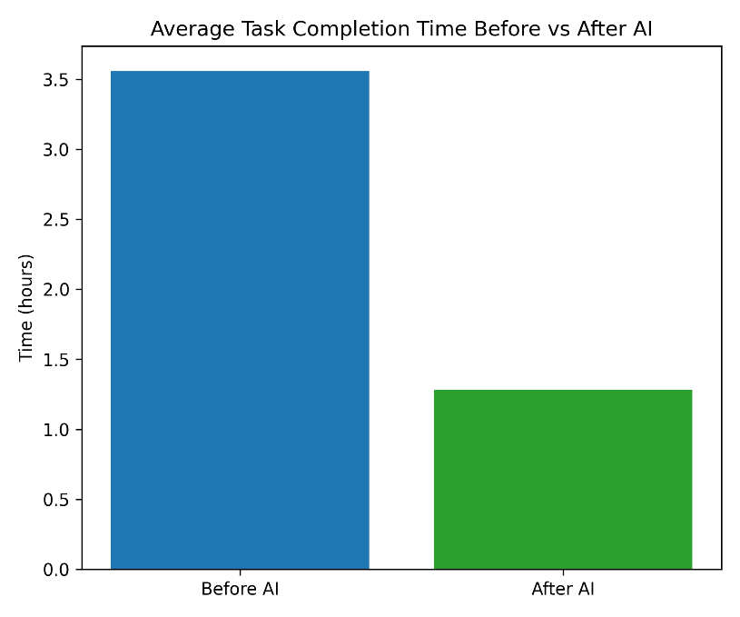
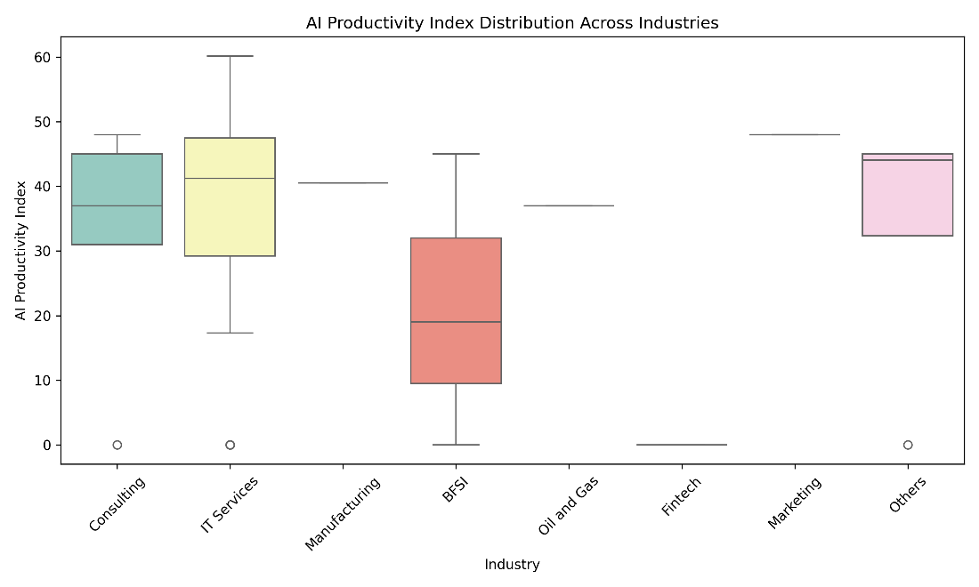
Key Findings
AI adoption significantly reduces task completion time
Technical roles (Software Engineers, Data Engineers) show highest savings
QA/Test Engineers report modest gains
AI users outperform non‑users in efficiency and quality metrics

Slide 12
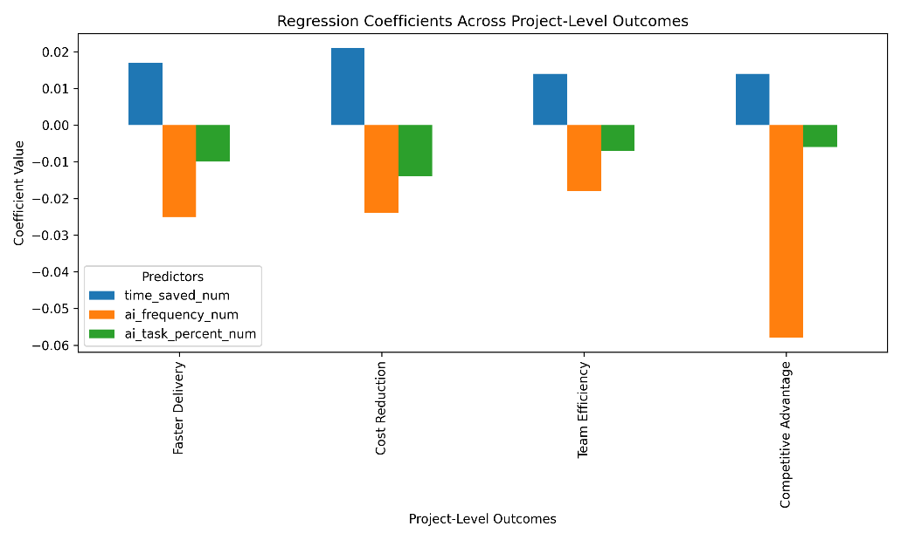
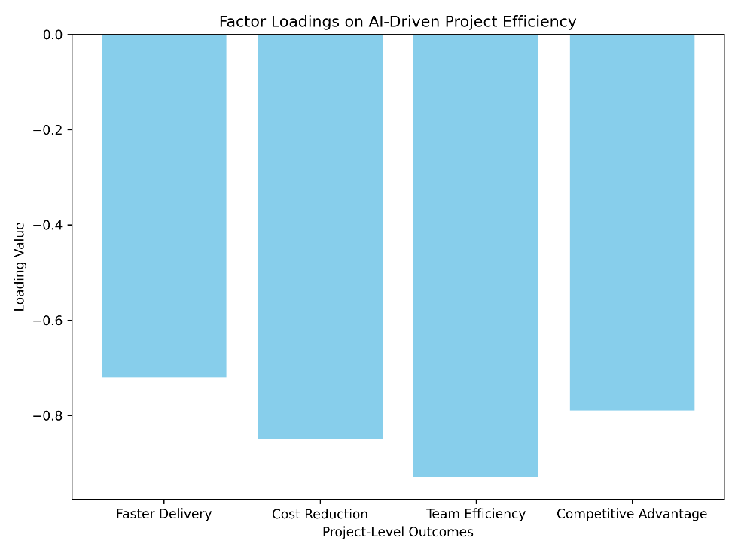
Key Findings
Time saved shows small positive impact, while higher AI frequency and task coverage sometimes reduce project‑level gains.
All project outcomes (delivery, cost, efficiency, advantage) load negatively, highlighting a gap between task‑level productivity and overall project efficiency.

Slide 13
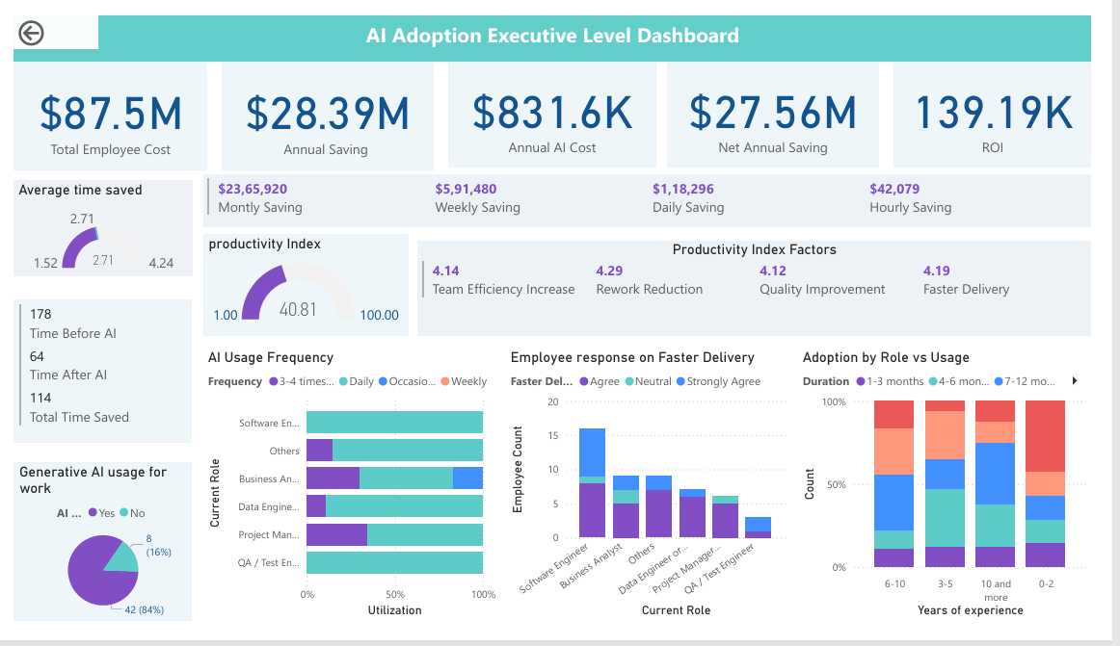
Dashboards (Power BI)
Note: Consolidated view of financial and productivity impact of Generative AI adoption.

Slide 14
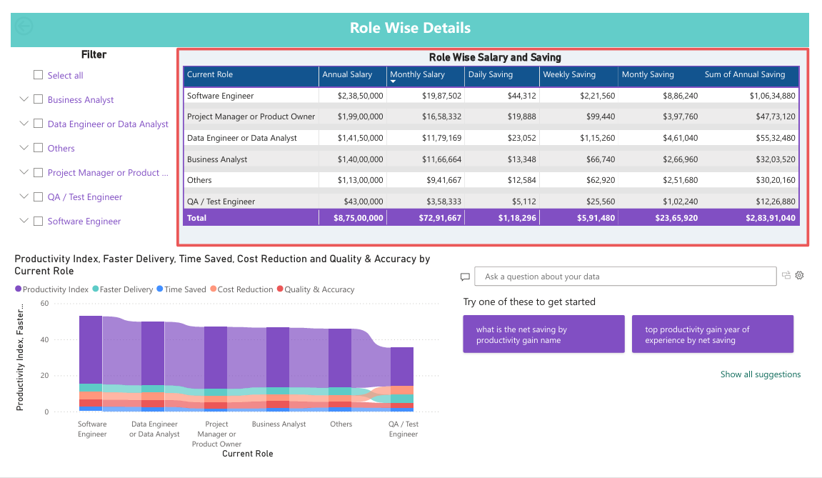
Dashboards (Power BI)
Note: Role‑wise comparison of salary structures and savings achieved through AI adoption.

Slide 15
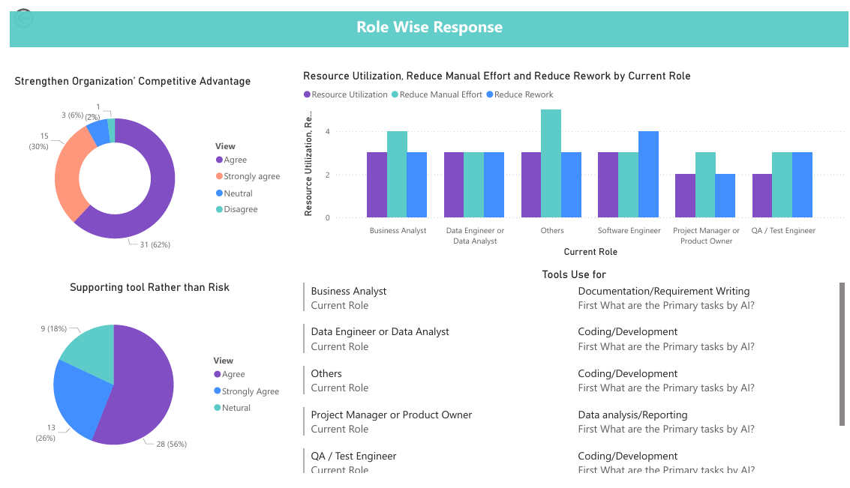
Dashboards (Power BI)
Note: Survey responses on AI adoption perceptions and role specific usage patterns.

Slide 16
Conclusion
Generative AI adoption delivers measurable productivity and cost benefits
Productivity gains translate into faster delivery, improved quality, and better decision‑making.
Provides a structured framework for data‑driven managerial decisions.
Role‑wise analysis shows strongest impact in technical functions, with modest gains in QA/Test roles.
AI adoption strengthens organizational competitiveness by reducing project duration and enhancing efficiency.
Highlights the micro‑macro gap: task‑level improvements are clear, but project‑level outcomes require structured measurement.
Establishes a replicable model (AI Productivity Index) for cross‑industry benchmarking and future research.

Slide 17
Recommendations
Scale AI adoption across roles → Extend beyond technical teams to business analysts, QA, and support functions.
Explore task‑specific AI tools → Match tools to workflows (e.g., documentation, coding assistance, error detection).
Invest in employee training & change management → Address resistance, build confidence, and improve adoption maturity.
Integrate AI metrics into enterprise analytics → Embed the AI Productivity Index into dashboards for continuous monitoring.
Leverage multi‑tool usage → Encourage employees to combine tools (e.g., ChatGPT + Copilot + domain‑specific apps) for higher ROI.
Redesign processes → Aggregate individual task savings into project‑level outcomes through structured workflows.

Slide 18
Future Scope
Longitudinal studies on sustained ROI → Track productivity gains over multiple years to measure durability.
Cross‑industry comparisons → Apply framework to BFSI, healthcare, and manufacturing to benchmark adoption impact.
Task‑level deep dives → Identify which tasks (documentation, coding, testing) yield maximum ROI.
Human factors & organizational readiness → Study employee perceptions, resistance, and change management strategies.
Scenario & sensitivity analysis → Test ROI under different cost assumptions and adoption intensities.
Integration with enterprise systems → Explore embedding AI productivity metrics into ERP/BI platforms.

Slide 19
Closer
“Generative AI is not just a technological tool but a strategic enabler of productivity, efficiency, and competitive advantage. This study provides a practical framework for organizations to measure and maximize returns from AI integration. By validating productivity gains through statistical evidence and introducing the AI Productivity Index, the research bridges the gap between individual task savings and organizational outcomes, offering a replicable model for future adoption strategies.”
.

Slide 20
Thank You

