Slide 1
NLP stands for Natural Language Processing, which is a part of Computer Science, Human language, and Artificial Intelligence. It is the technology that is used by machines to understand, analyse, manipulate, and interpret human's languages. It helps developers to organize knowledge for performing tasks such as translation, automatic summarization, Named Entity Recognition (NER), speech recognition, relationship extraction, and topic segmentation.

Slide 2
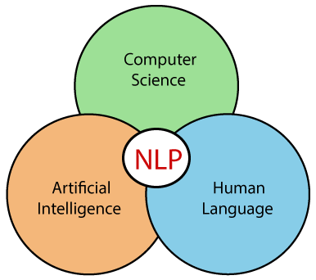

Slide 3

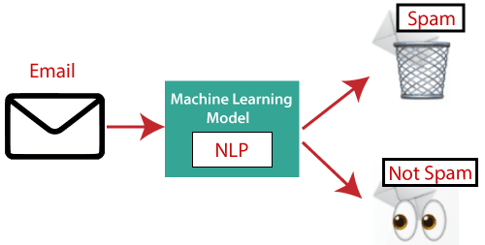

Applications of NLP
There are the following applications of NLP -
Question Answering
Question Answering focuses on building systems that automatically answer the questions asked by humans in a natural language.
2. Spam Detection
Spam detection is used to detect unwanted e-mails getting to a user's inbox.
3. Sentiment Analysis
Sentiment Analysis is also known as opinion mining. It is used on the web to analyse the attitude, behaviour, and emotional state of the sender. This application is implemented through a combination of NLP (Natural Language Processing) and statistics by assigning the values to the text (positive, negative, or natural), identify the mood of the context (happy, sad, angry, etc.)

Slide 4
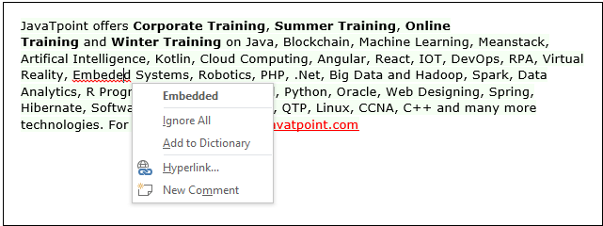
4. Machine Translation
Machine translation is used to translate text or speech from one natural language to another natural language
. Example: Google Translator
5. Spelling correction
Microsoft Corporation provides word processor software like MS-word, PowerPoint for the spelling correction.
6. Speech Recognition
Speech recognition is used for converting spoken words into text. It is used in applications, such as mobile, home automation, video recovery, dictating to Microsoft Word, voice biometrics, voice user interface, and so on.
7. Chatbot
Implementing the Chatbot is one of the important applications of NLP. It is used by many companies to provide the customer's chat services.

Slide 5
8. Information extraction
Information extraction is one of the most important applications of NLP. It is used for extracting structured information from unstructured or semi-structured machine-readable documents.
9. Natural Language Understanding (NLU)
It converts a large set of text into more formal representations such as first-order logic structures that are easier for the computer programs to manipulate notations of the natural language processing

Slide 6
NLP Libraries
Scikit-learn: It provides a wide range of algorithms for building machine learning models in Python.
Natural language Toolkit (NLTK): NLTK is a complete toolkit for all NLP techniques.
Pattern: It is a web mining module for NLP and machine learning.
TextBlob: It provides an easy interface to learn basic NLP tasks like sentiment analysis, noun phrase extraction, or pos-tagging.
Quepy: Quepy is used to transform natural language questions into queries in a database query language.
SpaCy: SpaCy is an open-source NLP library which is used for Data Extraction, Data Analysis, Sentiment Analysis, and Text Summarization.
Gensim: Gensim works with large datasets and processes data streams.

Slide 7
NLP Pipeline
In comparison to general machine learning pipelines, In NLP we need to perform some extra processing steps. The region is very simple that machines don’t understand the text. Here our biggest problem is How to make the text understandable for machines. Some of the most common problems we face while performing NLP tasks are mentioned below.
Data Acquisition
Text Cleaning
Text Preprocessing
Feature Engineering
Model Building
Evaluation
Deployment

Slide 8
NLP Techniques
NLP encompasses a wide array of techniques that aimed at enabling computers to process and understand human language. These tasks can be categorized into several broad areas, each addressing different aspects of language processing. Here are some of the key NLP techniques:
1. Text Processing and Preprocessing In NLP
Tokenization: Dividing text into smaller units, such as words or sentences.
Stemming and Lemmatization: Reducing words to their base or root forms.
Stopword Removal: Removing common words (like “and”, “the”, “is”) that may not carry significant meaning.
Text Normalization: Standardizing text, including case normalization, removing punctuation, and correcting spelling errors.

Slide 9
2. Syntax and Parsing In NLP
Part-of-Speech (POS) Tagging: Assigning parts of speech to each word in a sentence (e.g., noun, verb, adjective).
Dependency Parsing: Analyzing the grammatical structure of a sentence to identify relationships between words.
Constituency Parsing: Breaking down a sentence into its constituent parts or phrases (e.g., noun phrases, verb phrases).

Slide 10
3. Semantic Analysis
Named Entity Recognition (NER): Identifying and classifying entities in text, such as names of people, organizations, locations, dates, etc.
Word Sense Disambiguation (WSD): Determining which meaning of a word is used in a given context.
Coreference Resolution: Identifying when different words refer to the same entity in a text (e.g., “he” refers to “John”).
4. Information Extraction
Entity Extraction: Identifying specific entities and their relationships within the text.
Relation Extraction: Identifying and categorizing the relationships between entities in a text.

Slide 11
5. Text Classification in NLP
Sentiment Analysis: Determining the sentiment or emotional tone expressed in a text (e.g., positive, negative, neutral).
Topic Modeling: Identifying topics or themes within a large collection of documents.
Spam Detection: Classifying text as spam or not spam.
6. Language Generation
Machine Translation: Translating text from one language to another.
Text Summarization: Producing a concise summary of a larger text.
Text Generation: Automatically generating coherent and contextually relevant text.
7. Speech Processing
Speech Recognition: Converting spoken language into text.
Text-to-Speech (TTS) Synthesis: Converting written text into spoken language.

Slide 12
8. Question Answering
Retrieval-Based QA: Finding and returning the most relevant text passage in response to a query.
Generative QA: Generating an answer based on the information available in a text corpus.
9. Dialogue Systems
Chatbots and Virtual Assistants: Enabling systems to engage in conversations with users, providing responses and performing tasks based on user input.
10. Sentiment and Emotion Analysis in NLP
Emotion Detection: Identifying and categorizing emotions expressed in text.
Opinion Mining: Analyzing opinions or reviews to understand public sentiment toward products, services, or topics.

Slide 13
Technologies related to Natural Language Processing
There are a variety of technologies related to natural language processing (NLP) that are used to analyze and understand human language. Some of the most common include:
Machine learning: NLP relies heavily on machine learning techniques such as supervised and unsupervised learning, deep learning, and reinforcement learning to train models to understand and generate human language.
Natural Language Toolkits (NLTK) and other libraries: NLTK is a popular open-source library in Python that provides tools for NLP tasks such as tokenization, stemming, and part-of-speech tagging. Other popular libraries include spaCy, OpenNLP, and CoreNLP.

Slide 14
Parsers: Parsers are used to analyze the syntactic structure of sentences, such as dependency parsing and constituency parsing.
Text-to-Speech (TTS) and Speech-to-Text (STT) systems: TTS systems convert written text into spoken words, while STT systems convert spoken words into written text.
Named Entity Recognition (NER) systems: NER systems identify and extract named entities such as people, places, and organizations from the text.

Slide 15
Sentiment Analysis: A technique to understand the emotions or opinions expressed in a piece of text, by using various techniques like Lexicon-Based, Machine Learning-Based, and Deep Learning-based methods
Machine Translation: NLP is used for language translation from one language to another through a computer.
Chatbots: NLP is used for chatbots that communicate with other chatbots or humans through auditory or textual methods.
AI Software: NLP is used in question-answering software for knowledge representation, analytical reasoning as well as information retrieval.

