Slide 1

Walchand College Of Engineering, Sangli
1
Department of Information technology
(Second Year Information Technology
Academic Year: 2018-2019 )

Slide 2
Walchand META
2
A project UNDER the guidance of Mr U.b.chavan
Presented by:-
Ankita Agarwal (2016BTEIT00006)
Sanjivani Shinde (2016BTEIT00051)
Abhisha Vernekar (2016BTEIT00052)
Anagha Shitole (2014BIT009)

Slide 3
Domain of Project
To create a website in order to help
the Teachers Association of Walchand College of Engineering, Sangli

Slide 4




Overview
Objectives
Features
Technologies
Methodology
References

Slide 5
Objectives
To create a platform for teachers to solve their problems.
Integrate the currently known technology (Django) with the new ones.
To enhance the blended interaction between teachers.
To reduce the hectic task of the admin.
Get acquainted with Real time Database Management.
Principally sponsored.

Slide 6




Features
To add a discussion forum
Members be able to keep a track of all the activities of the organization
Members be able to upload on website
Notify the members about the meeting

Slide 7
Features
Chat with different members
Articles about the organization
Log in for the members
Table talks

Slide 8
Technologies
Client Side
Database
Server Side

Slide 9
Technologies
HTML
CSS
Bootstrap
JavaScript
Django
PHP
SQLite

Slide 10

Why Django?
Django framework is best, because it is simple, reliable, and transparent .
Django web framework is written on the quick and powerful Python language. Python works on any platform and is also open source.
Django is a high-level web framework which was created for quick web project development. It delivers transparent and high-quality code writing, making it important for developers, and equally important for customers.
Django offers one of the best security levels of the currently available frameworks, ensuring that your project is kept safe.
Django suits high-load projects perfectly, given that the approach to implementation is done properly

Slide 11
Methdology

Slide 12
Platform to access for different users
Admin
01
Members
02
Public
03

Slide 13
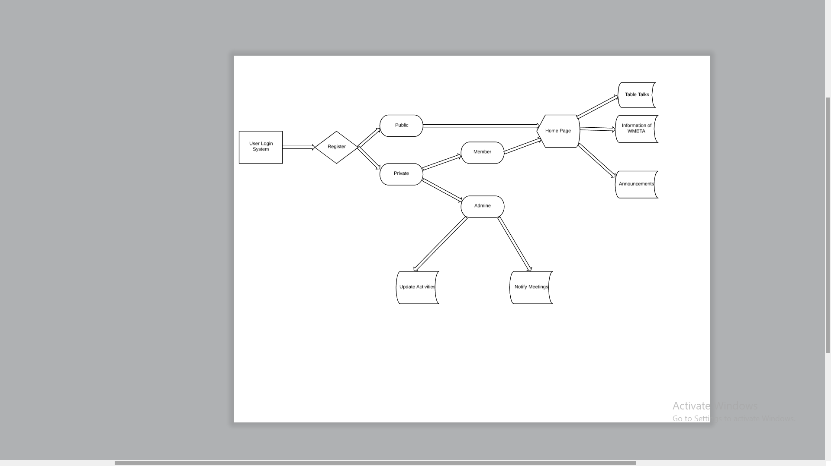
Flow Diagram

Slide 14
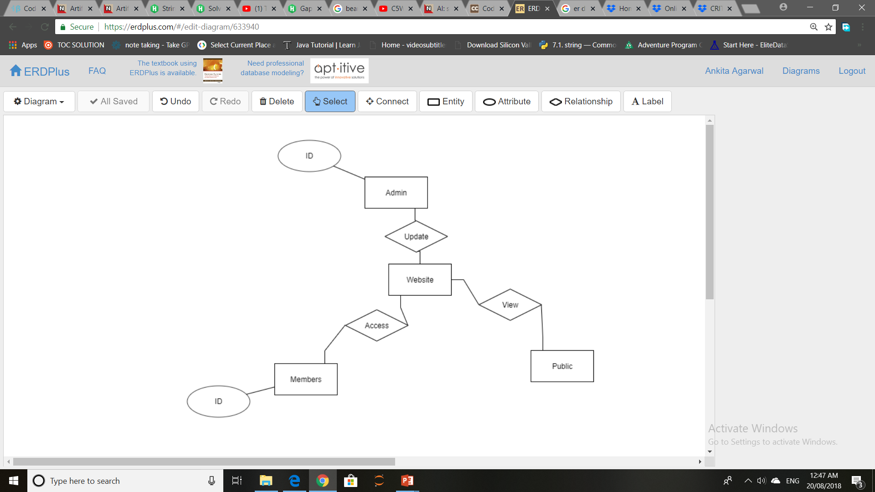
ER Diagram

Slide 15
References
https://www.cta.org/en/About-CTA/Who-We-Are/Teachers.aspx
http://www.mecta.in/html/en/index.html

Slide 16
ThankYou….!!

