Slide 1

Analysis of Malicious Urls using Machine Learning
GUIDE NAME: Prof. Sudeepa Roy Dey
TEAM NUMBER: 2
TEAM MEMBERS: Ankita Aditya (1PE17CS023)
Atul K Uchil (1PE17CS029)
Mitali Singh (1PE17CS182)
Prescilla Angel (1PE18CS419)

Slide 2
PROBLEM STATEMENT
Malicious URL is a common and serious threat to cybersecurity. Malicious URLs host unsolicited content ( spam, phishing, drive-by downloads, etc.) and lure unsuspecting users to become victims of scams (monetary loss, theft of private
information, and malware installation), and cause losses of billions of dollars every year. It is
imperative to detect and act on such threats in a
timely manner.

Slide 3
MOTIVATION
Malicious Web Sites is a cornerstone of Internet
criminal Activities. The detection of malicious
URL's is one of the highest priority issues for
cybersecurity practitioners. There are plenty of
machine learning techniques to address this issue,
the most used approach remains blacklisting. The
main obstacle to using machine learning is the
difficulties in data collection. We are building a
model that can overcome the obstacles and create
a proactive system for the effective and efficient
detection of malicious URLs.

Slide 4
LITERATURE SURVEY
Detection of Malicious URLs using Machine Learning Techniques – Immadisetti Naga Venkata Durga Naveen, Manamohana K, Rohit Verma – IJITEE – March 2019
Methodology: Use of syntactical, semantic and lexical nature of URL.
Models: Convolutional Neural Networks
Empirical Study on Malicious URL Detection using Machine Learning – Ripon Patgiri(B), Hemnath Katari(B), Ronit Kumar(B), Dheeraj Sharma – ICDCIT – January 2019
Methodology: Detection is treated as binary classification.
Models: Random Forest, Support Vector Machine, Naïve Bayes

Slide 5
LITERATURE SURVEY
Chrome Extension For Malicious URLs detection in Social Media Applications Using Artificial Neural Networks And Long Short Term Memory Networks – Shivangi S, Pratyush Debnath, Sajeevan K, D. Annapurna – IEEE – September 2018
Methodology: Propose a tool deployed as chrome extension to overcome malicious URLs.
Models: Artificial Neural Network, Long Short Term Memory Networks
Detecting Malicious URLs Using Lexical Analysis – Justin Ma, Lawrence K. Saul, Stefan Savage, Geoffrey M. Voelkar – NSS – September 2016
Methodology: Automated URL classification using statistical methods.
Models: Feature Selection Algorithm, KNN

Slide 6
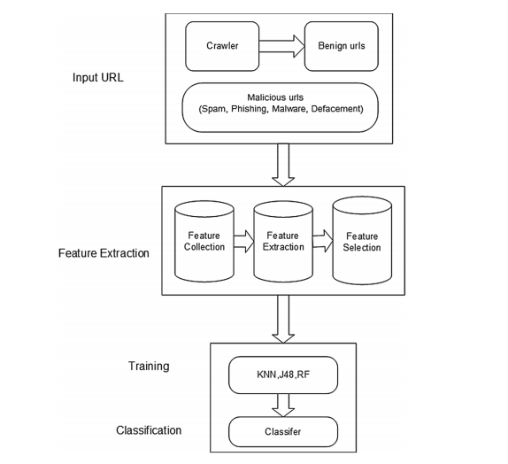
PROPOSED METHODOLOGY
RF

Slide 7
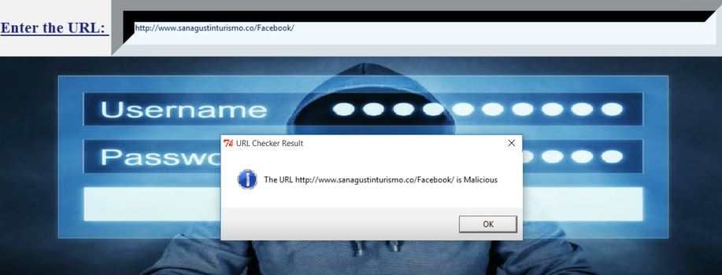
EXPECTED OUTCOME
The static model is embedded to the GUI and user can check whether the entered URL is malicious or benign. Moreover, we will be adding a chrome extension for real time detection.

Slide 8
TIME LINE
Task 1 Project Title Decision
Sep 21 - Sep 30
Task 2 Synopsis
Oct 1 - Oct 15
Task 3 PPT
Oct 16 - Oct 30
Task 4 Working On Project
Nov 10 - Dec 25
Task 5 Finalizing Project
Feb 5 - Mar 30
Project Kickoff
Milestone 1
Review 1
Milestone 2
Review 2
Project Close
Sep 21
Nov 4
Dec 20
Apr 1
2020
Sep
Oct
Nov
Dec
Jan
Feb
Mar
Apr
2021
Today

Slide 9
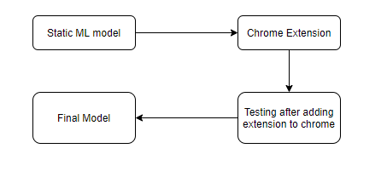
CONCLUSION
We have described how a machine would be able to judge the URLs based upon the given feature set.
Based on the features selected, our approach will classify different attack types of URL automatically as benign, defacement, spam, phishing and malware through supervised learning.
As future work we are planning to develop a real time tool for detecting malicious URLs by converting our static model to chrome extension.

Slide 10
REFERENCES
Using Lexical Features for Malicious URL Detection - A Machine Learning Approach
Design and Evaluation of a Real-Time URL Spam Filtering Service
Beyond Blacklists: Learning to Detect Malicious Web Sites from Suspicious URLs
Chrome Extension For Malicious URLs detection in Social Media Applications Using ANN
Malicious URL Detection by Dynamically Mining Patterns without Pre-defined Elements?
Detection of Malicious URLs using Machine Learning Techniques

