Slide 1

Note: The data and information in this document is reflective of a hypothetical situation and client. This document is to be used for KPMG Virtual Internship purposes only.
Sprocket Central Pty Ltd
Data analytics approach
Ankita Das

Slide 2
Note: The data and information in this document is reflective of a hypothetical situation and client. This document is to be used for KPMG Virtual Internship purposes only.
Agenda
Introduction
Data Exploration
Model Development
Interpretation

Slide 3
Note: The data and information in this document is reflective of a hypothetical situation and client. This document is to be used for KPMG Virtual Internship purposes only.
Introduction
Identity & Recommending High Value Customers
Outline Of Problem
Sprocket Central is a company that specializes in high quality bike and accessories
The marketing team is looking to boost sales
To target 1000 new customer that will bring the highest value to the business
Approach For Data Analysis
Bike Related Purchases for the last 3 years based on Gender
Top industries contributing the maximum profit and bike related sales
Wealth Segment by Age Category
Number of cars owned in each state
Customer classification

Slide 4
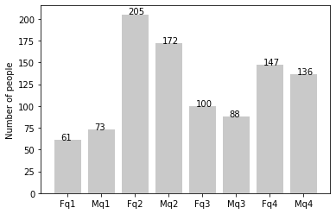
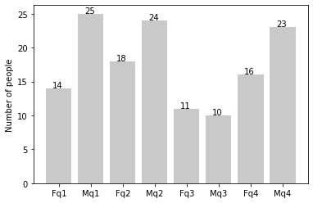
Note: The data and information in this document is reflective of a hypothetical situation and client. This document is to be used for KPMG Virtual Internship purposes only.
Data Exploration
‘New’ and ‘Old’ Customer Age Distribution
NEW
As we can see, mostly our new customers are between 25 to 48 years old.
Number of customers from 48 to 59 years old has big drops on percentages.
There is a slightly increase in number of customers over 59 years old in terms of percentages.
It looks like the percentages of under 25 years old not really change.
OLD

Slide 5
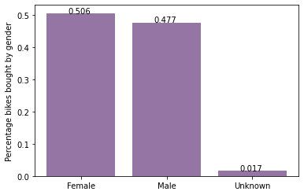
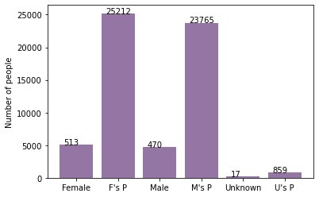
Note: The data and information in this document is reflective of a hypothetical situation and client. This document is to be used for KPMG Virtual Internship purposes only.
Model Development
Bike purchases last 3 years
As we can see, our new customers mostly Female with 50.6% purchases with total of 25,212 bikes.
Male contributed to 47.7% purchases with 23,765 bikes.
So we should focus on advertises on Female customers than Male customers.

Slide 6
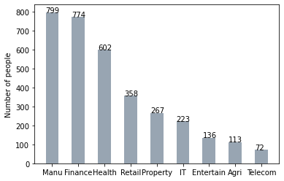
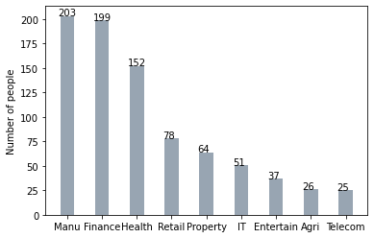
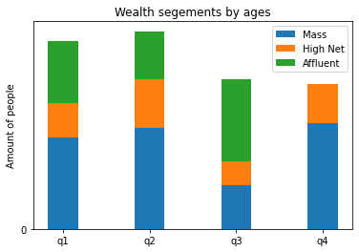
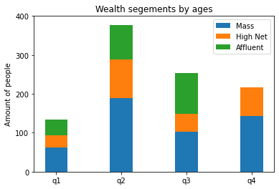
Note: The data and information in this document is reflective of a hypothetical situation and client. This document is to be used for KPMG Virtual Internship purposes only.
Interpretation
Job industry category
Mostly our new customers are from Finance industry and our Manufacturing customers are still on top 2.
The rest industries are still same.
Wealth segments
In all ages, the number of Mass Customers is the highest so we should focus on this social class.
After that, we should focus on High Net Customer.
Then Affluent Customers but mostly second and third quadrant.

Slide 7
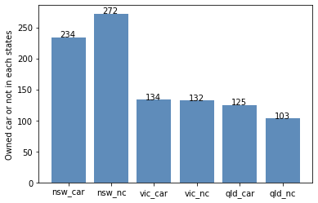
Note: The data and information in this document is reflective of a hypothetical situation and client. This document is to be used for KPMG Virtual Internship purposes only.
Interpretation
Numbers of cars owned
NSW should be considered the most since numbers of customers don’t own cars is significantly larger than that own.
VIC and QLD has more customers that own car that who don’t but we can try to have something so that those owns car will buy bikes.

Slide 8
Note: The data and information in this document is reflective of a hypothetical situation and client. This document is to be used for KPMG Virtual Internship purposes only.
Thank You

