Slide 1

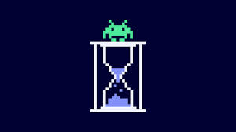
TITLE: BUG TRACKING SYSTEM
Bug Busters
Submitted by:
DIKSHA TRIVEDI
ANKITA JAISWAL
SAYAN BAKSHI
SHATAKSHI SINGH
PRATHIJANA SHETTY
TUSHAR SACHDEVA
RISHI
KARAN

Slide 2

CONTENT:
ABSTRACT
INTRODUCTION
IMPLEMENTATION
OBJECTIVE
MODULES AND DESCRIPTION
FLOWCHART
SNAPSHOTS
CONCLUTION
FUTURE SCOPE

Slide 3




ABSTRACT
This project aims to develop a tracking system useful for application deployed in an organization. The bug tracking system Is a application that can be accesses throughout the organization. THIS system can be used for logging defects against an application/module, assigning defects to individuals and tracking the defects to resolution.
BUG TRACKING IS THE PROCESS OF FINDING DEFECTS IN A PRODDUCT (TESTING),AND MAKING NEW VERSIONS OF THE PRODUCT THAT FIX THE DEFECTS.
DEFECTS ARE MANAGING, EVALUATING AND PRIORTIZING THESE DEFECTS IS A DIFFCIULT TASK: bUG TRACKING SYSTEMS ARE COMPUTER DATABASE SYSTEMS THAT STORE DEFECTS AND HELP PEOPLE TO MANAGE THEM.

Slide 4
INTRODUCTION
In the fast-paced world of software development, managing and resolving bugs efficiently is a critical aspect of delivering high-quality software products. Today, we are excited to introduce our Bug Tracking System, a powerful solution designed to streamline the issue management process.
In software development, bugs and issues are inevitable. They can impact product quality, customer satisfaction, and project timelines.
Our Bug Tracking System is a comprehensive tool that facilitates the reporting, tracking, and resolution of software bugs within project teams.
By centralizing bug-related information and providing role-based access, our system empowers project managers, developers, and testers to collaborate effectively in identifying, addressing, and closing issues.

Slide 5

IMPLEMENTATION
Frontend : HTML, CSS, JAVASCRIPT, and Bootstrap
DATABASE : JDBC, SQL
PROGRAMMING LANGUAGE : JAVA

Slide 6

OBJECTIVE
The objective of our Bug Tracking System project is to develop a robust and user-friendly web-based application that simplifies the process of identifying, reporting, tracking, and resolving software bugs within our software development projects.
This system aims to streamline issue management, improve collaboration , enhance product quality, and provide valuable data-driven insights for informed decision-making.
Ultimately, our goal is to create a reliable and efficient tool that empowers project managers, developers, and testers to work cohesively in delivering high-quality software products on time and within budget.

Slide 7
Modules & Description of Bug Tracking System
.

Slide 8




Users Module
Purpose: The Users module manages user-related functionalities and data. It deals with user authentication, profiles, and permissions.
Key Functionalities: User Registration and Authentication: Allows users to create accounts and log in securely. User Profiles: Manages user profiles, including personal information, roles, and permissions.
Use Case: When a user logs in, the Users module ensures they have the appropriate permissions and displays content accordingly.

Slide 9
Projects Module
Purpose: The Projects module is responsible for organizing software development projects and their associated information.
Key Functionalities: Project Creation and Management: Allows users to create, update, and delete projects. Project Details: Stores information about each project, such as name, description, start date, and end date. Project Members: Manages the list of team members associated with a project.
Use Case: When a user logs in, they can view a list of projects they are involved in and access project-specific information.

Slide 10
Use Case: Developers, testers, and managers use this module to report, track, and resolve bugs during the software development process.
Bugs Module
Purpose: The Bugs module is at the core of the Bug Tracking System and deals with the identification, reporting, and resolution of software bugs.
Key Functionalities: Bug Reporting: Allows users to report new bugs, specifying details like title, description, and steps to reproduce. Bug Assignment: Managers can assign bugs to development teams or individual developers. Bug Tracking: Tracks the status of each bug (e.g., open, in progress, resolved) and provides a history of changes. Bug Comments: Enables communication and collaboration among team members by allowing comments on each bug.

Slide 11
Use Case: Managers use this module to assign development teams to specific projects and allocate bug-fixing responsibilities.
Teams Module
Purpose: The Teams module focuses on organizing development teams and their roles within different projects.
Key Functionalities: Team Creation and Management: Allows the creation and administration of development teams. Team Members: Manages team members, assigns roles, and tracks team activity.

Slide 12
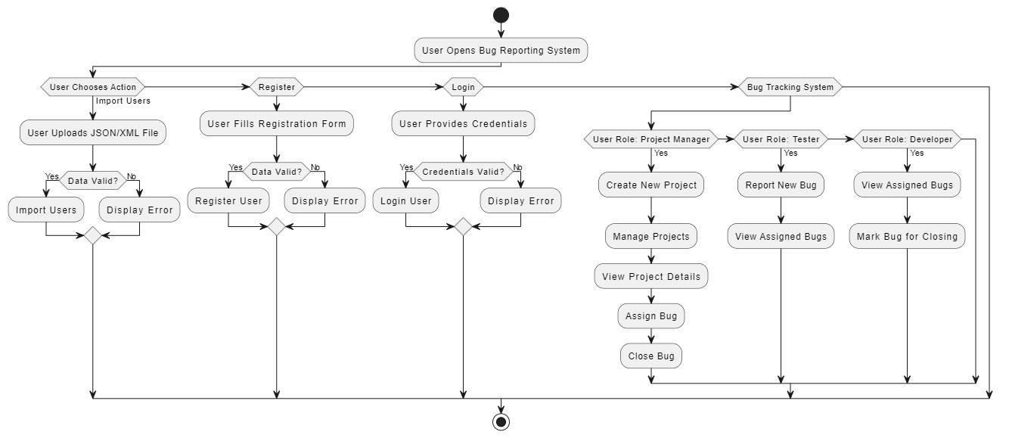
FLOWCHART

Slide 13
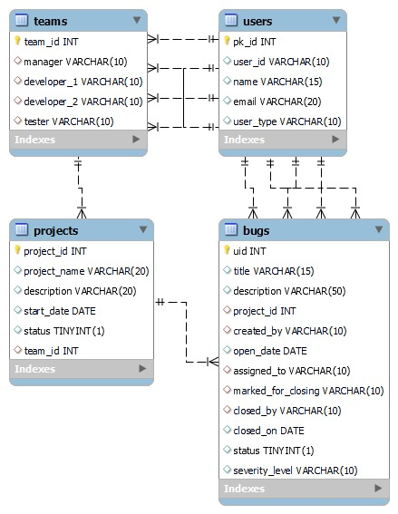
ER DIAGRAM

Slide 14

SNAPSHOTS

Slide 15
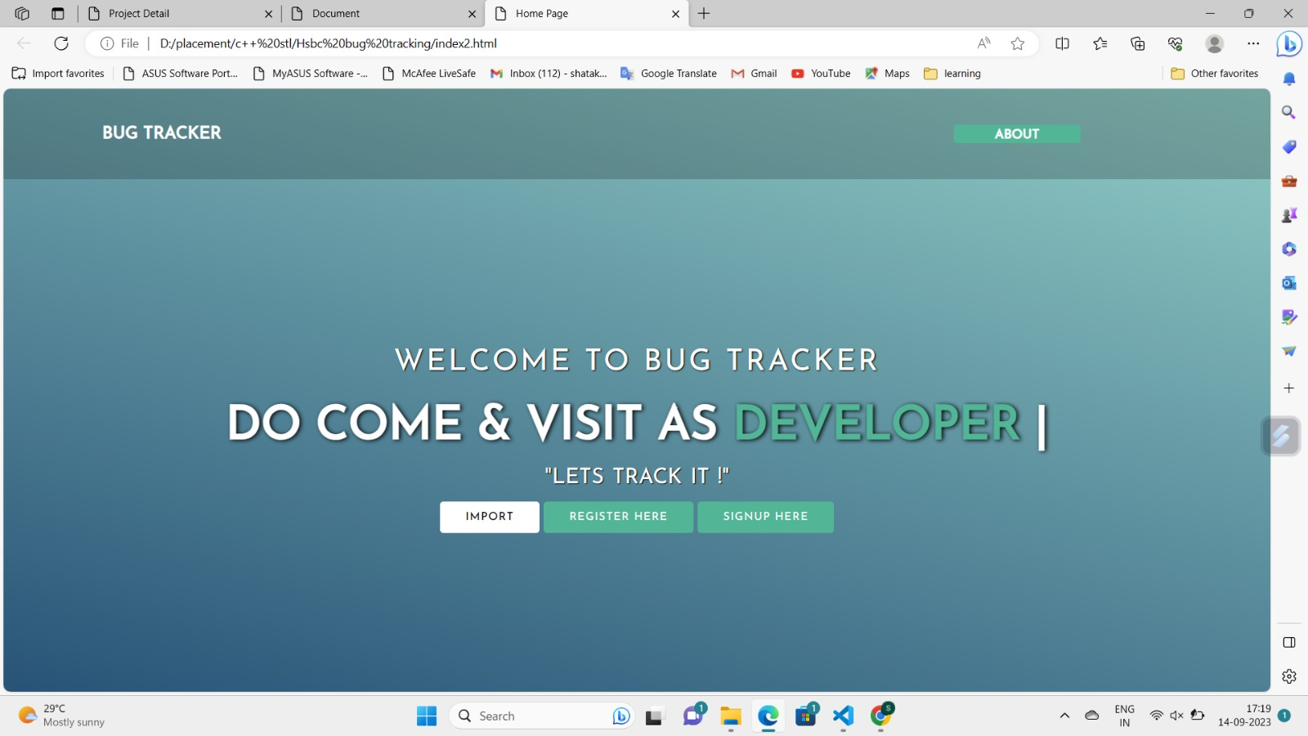
(HomePage)

Slide 16
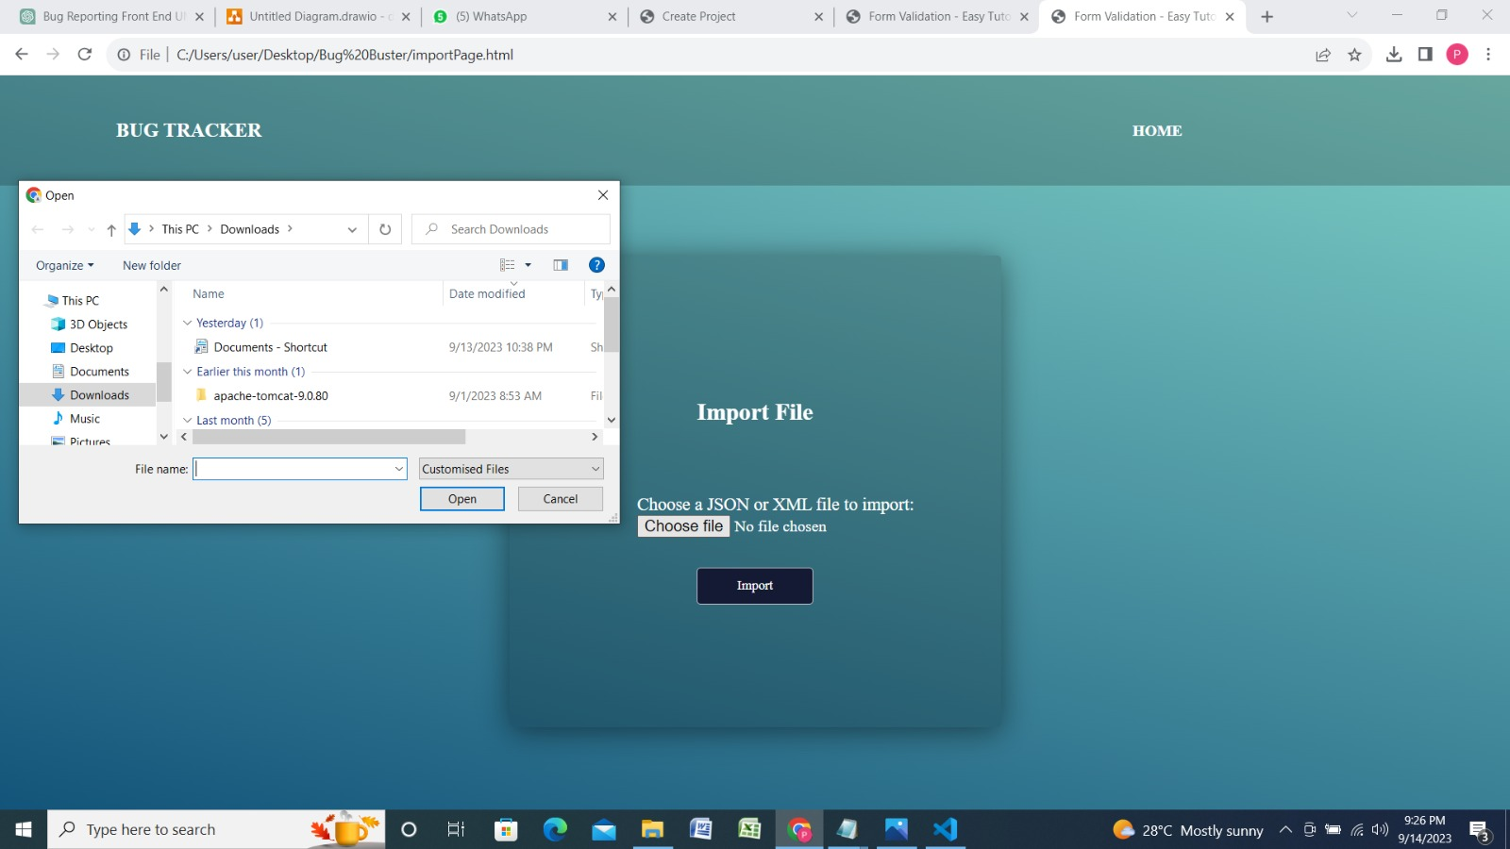
(importPage)

Slide 17
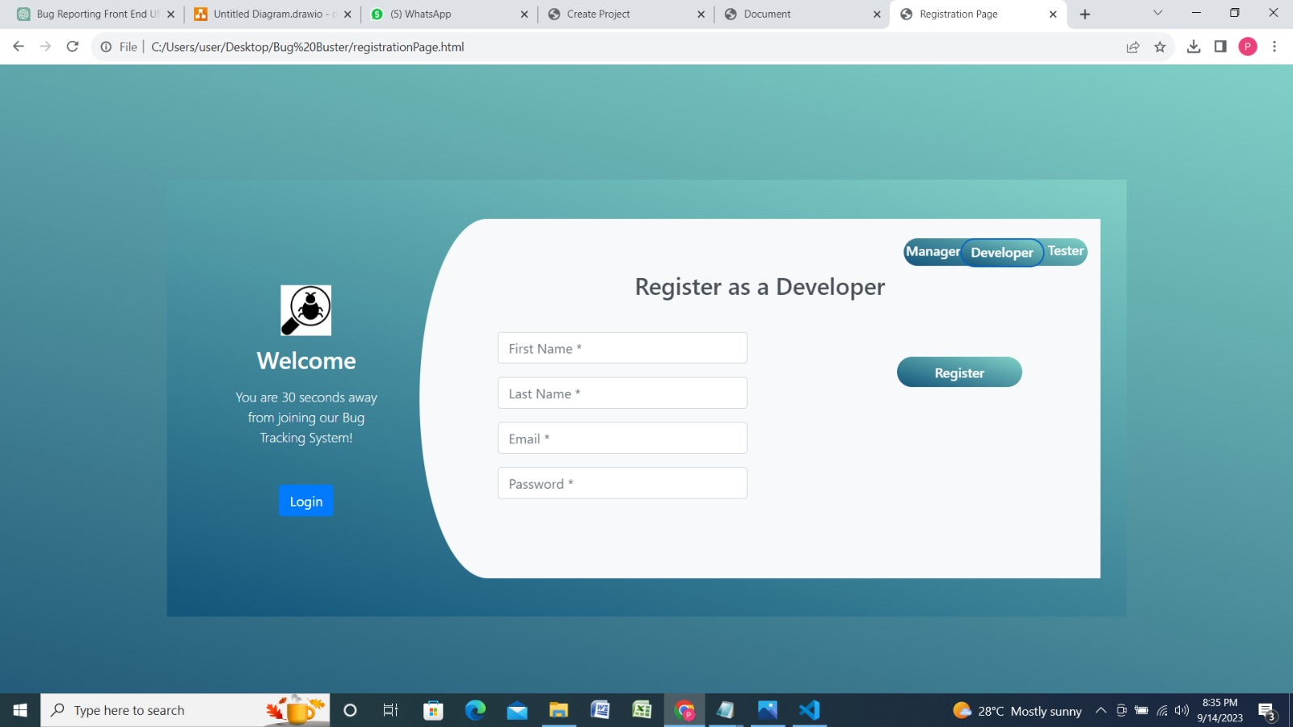
(RegisterPage)

Slide 18
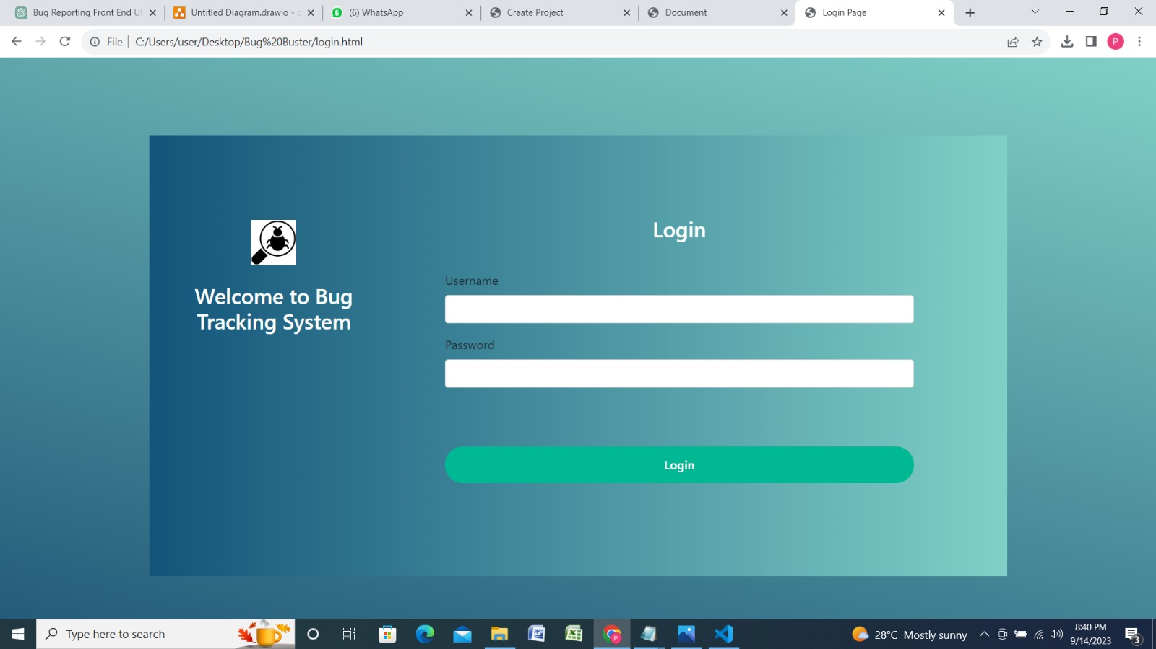

Slide 19
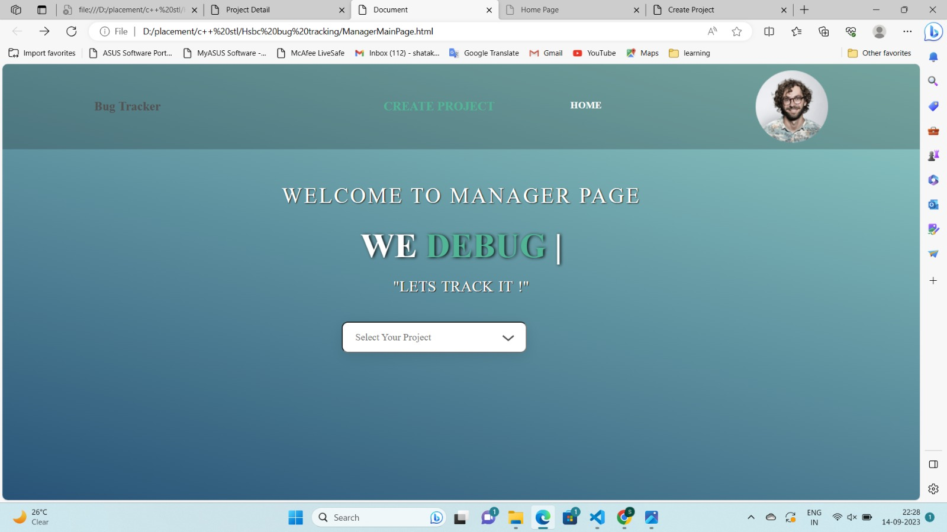
(ManagerPage)

Slide 20
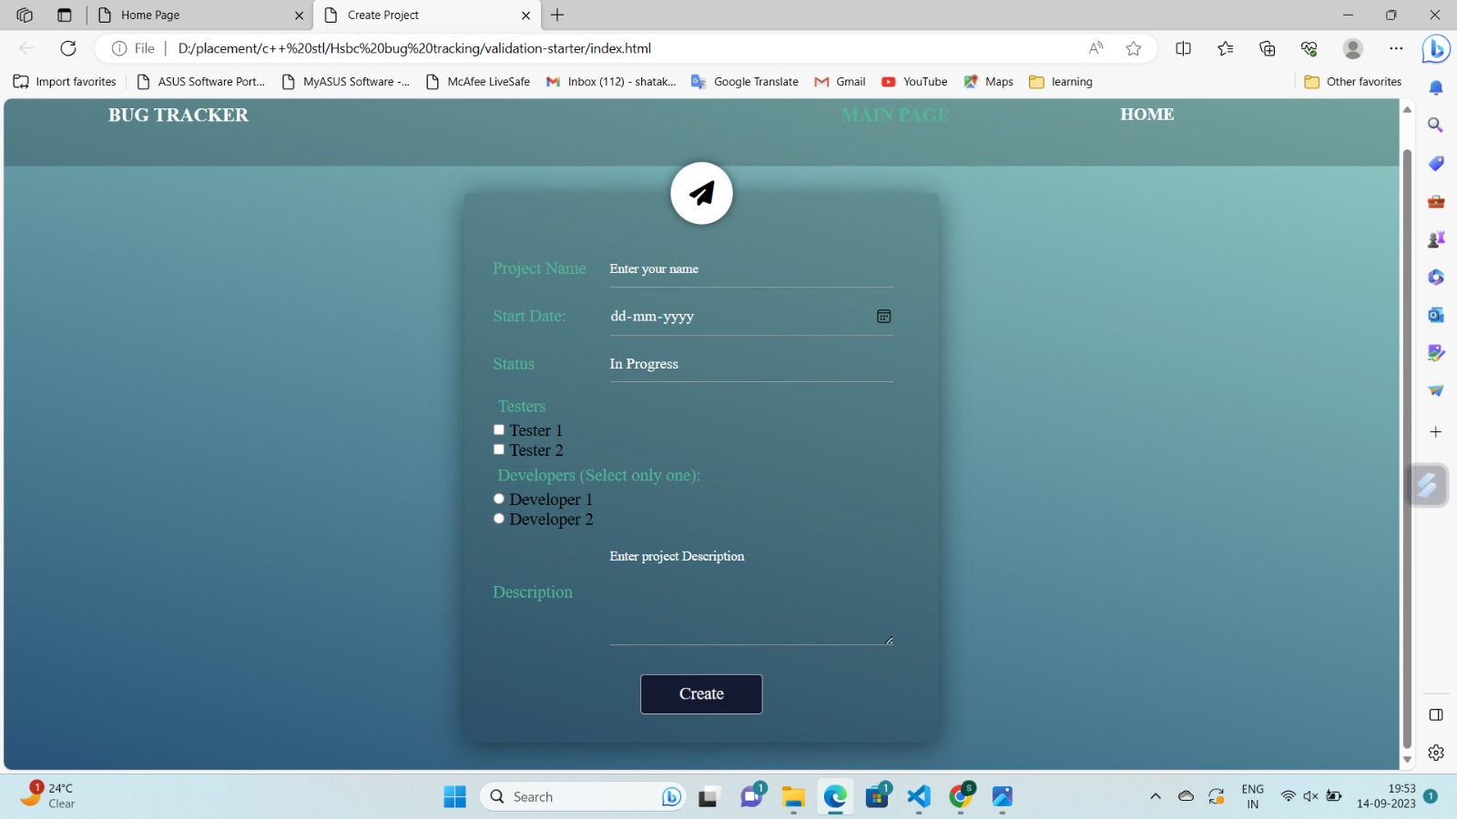
(newProjectCreationProjectPage)

Slide 21
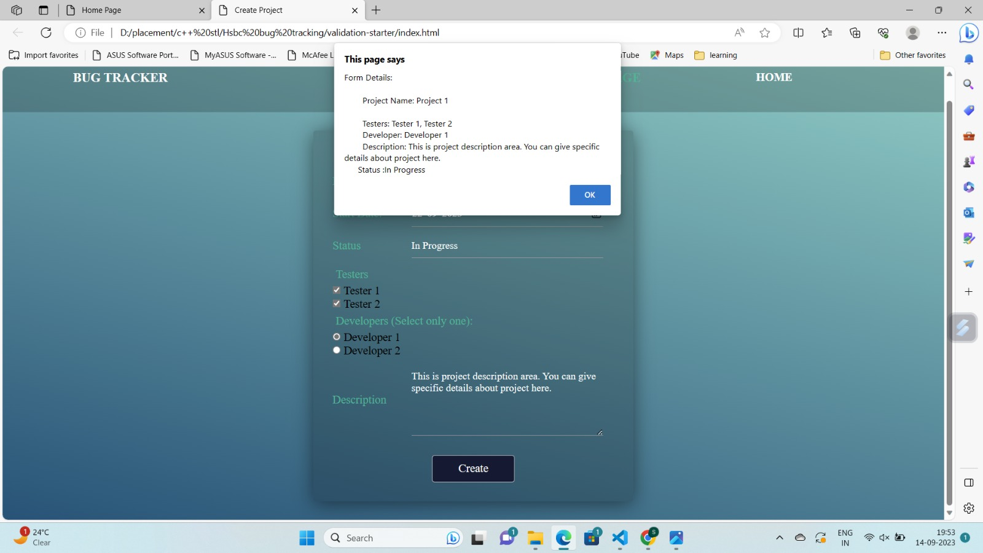
(afterClickingProjectCreationPage)

Slide 22
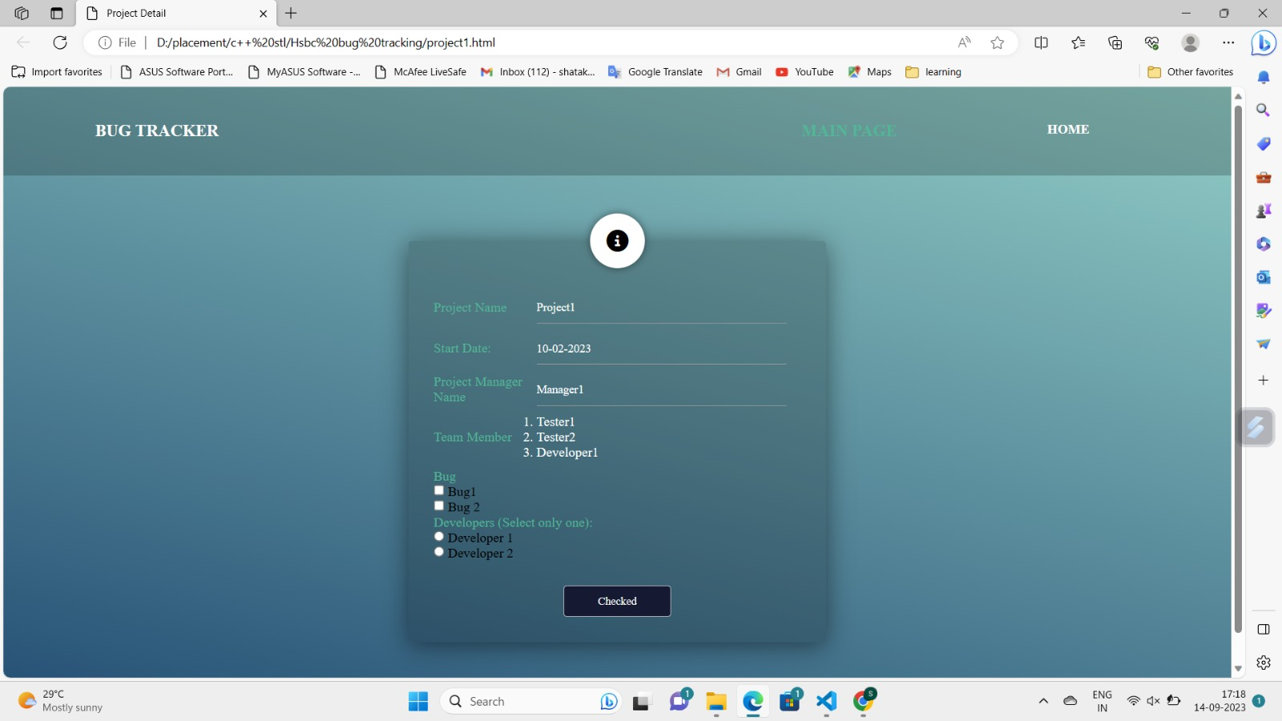
(projectDetailsPage)

Slide 23
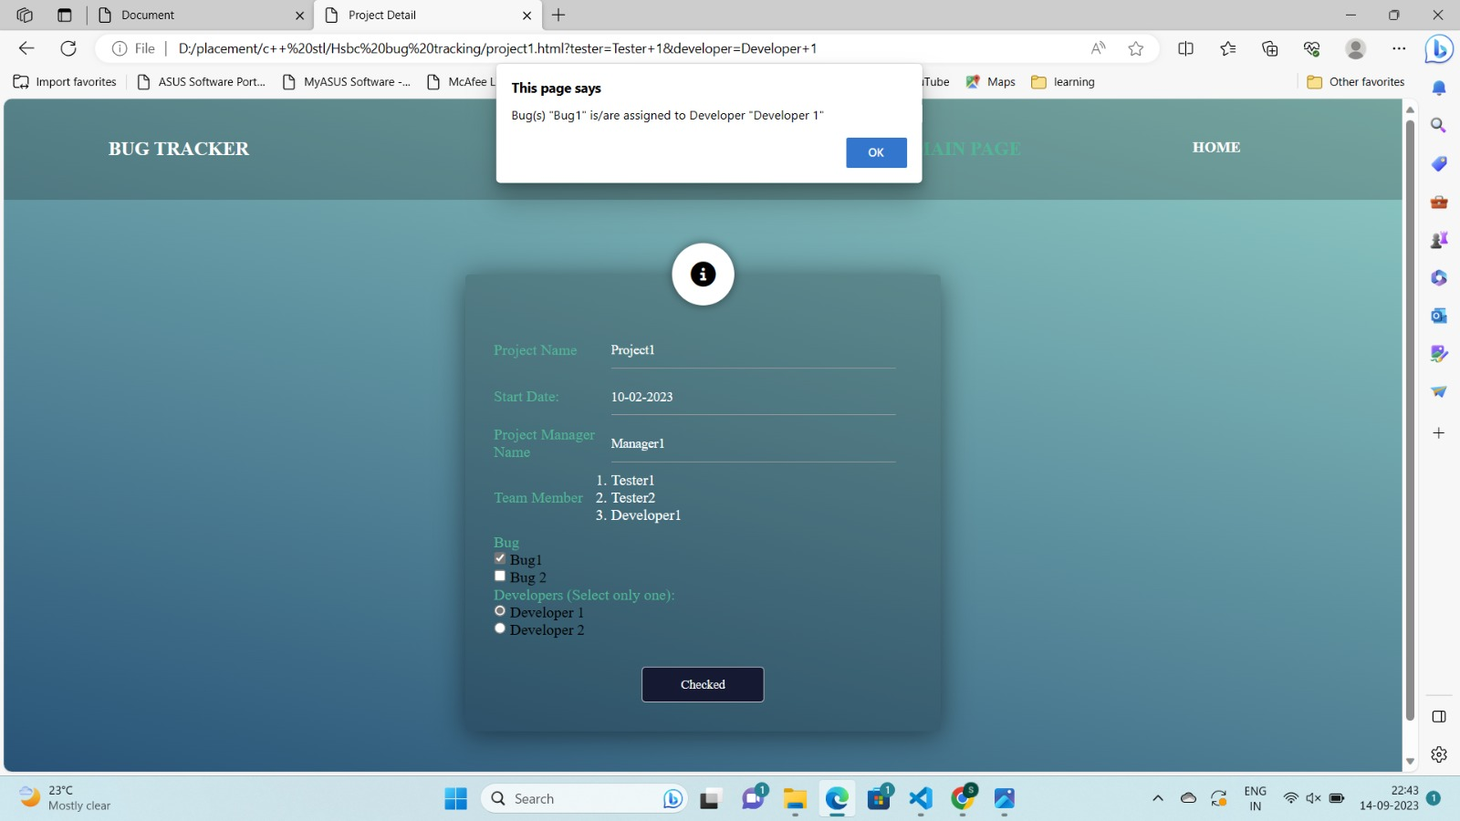
(afterClickingprojectDetailsPage)

Slide 24
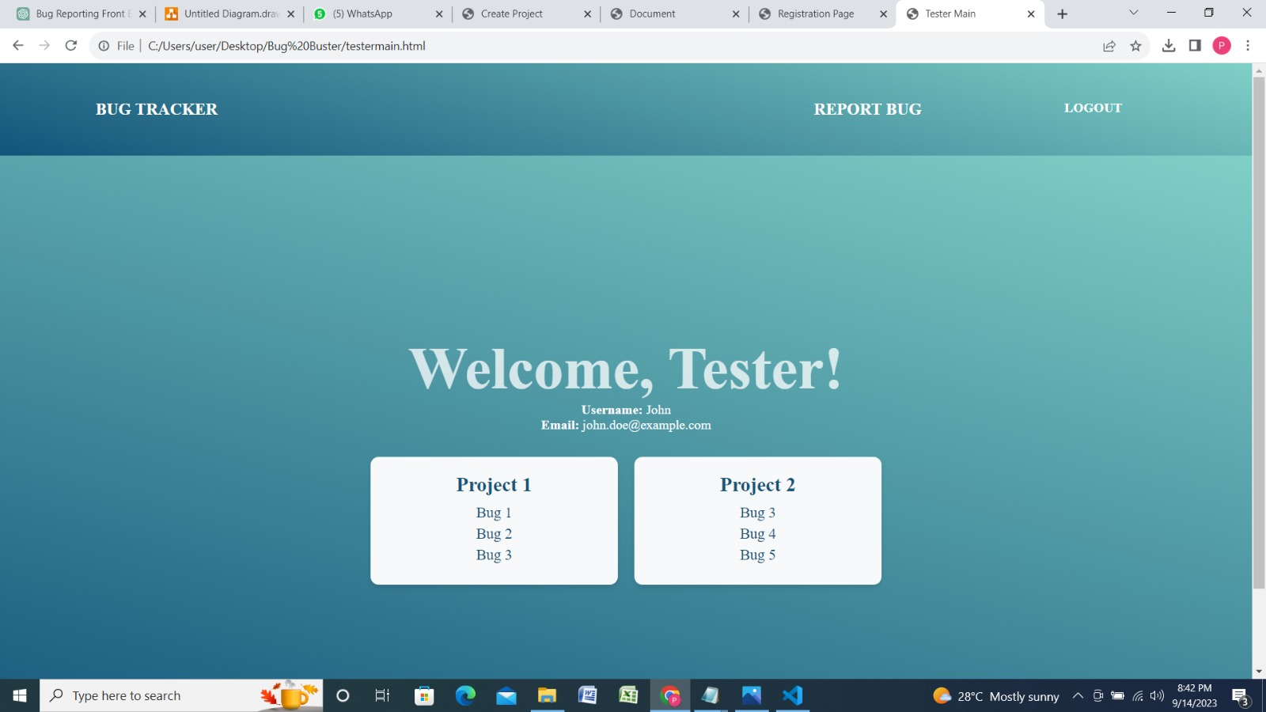
(testerMainPage)

Slide 25
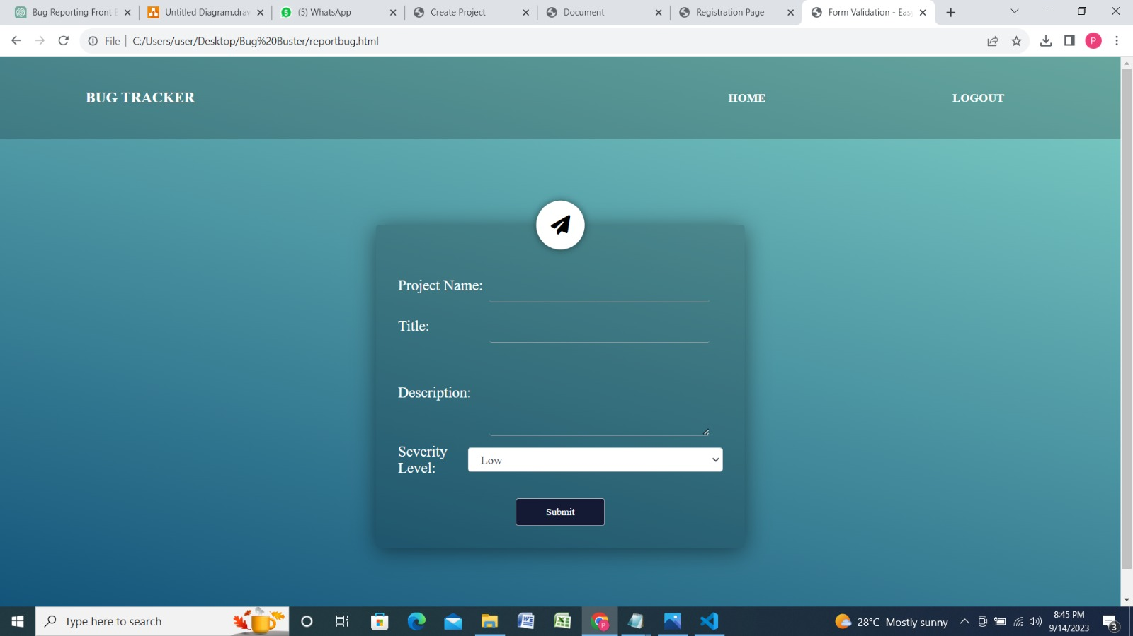
(reportNewBugPage)

Slide 26
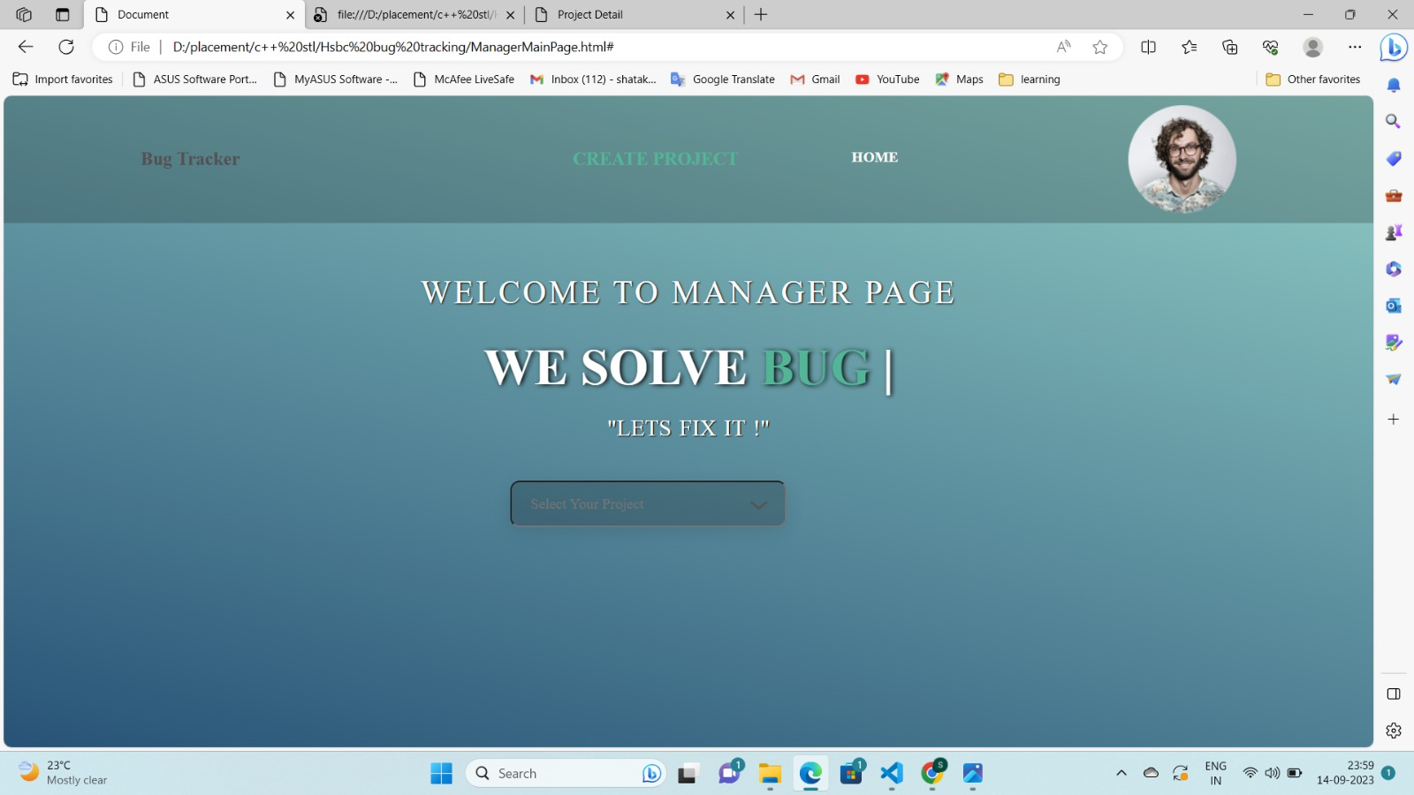
(developerMainPage)

Slide 27
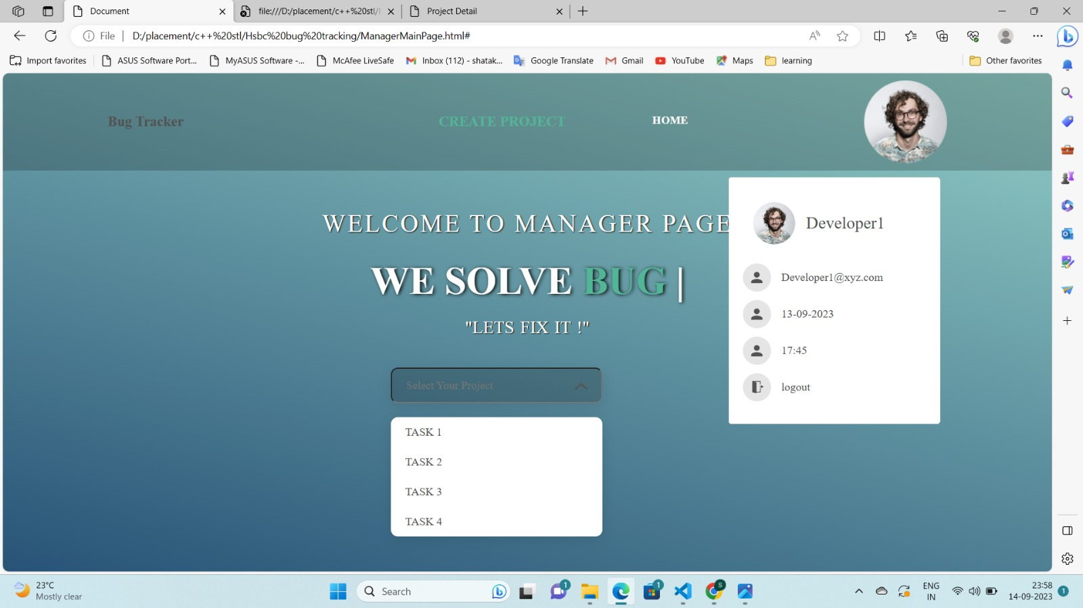
(developerDetailsPage)

Slide 28
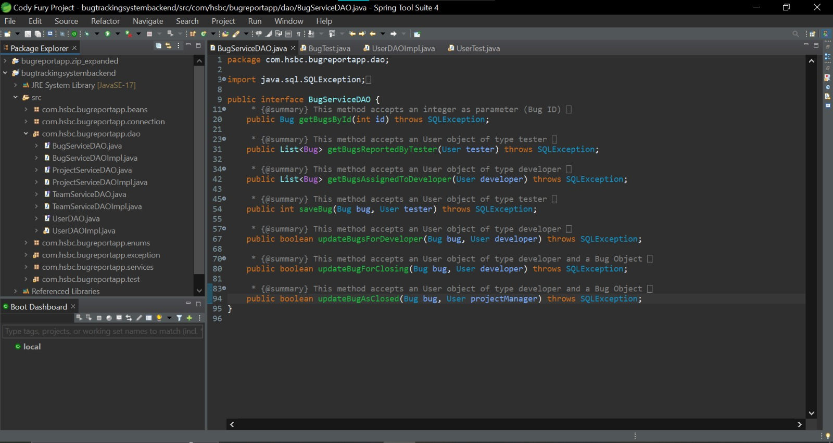

Slide 29
CONCLUSION
In conclusion, our Bug Tracking System represents a significant leap forward in how we manage software issues and deliver high-quality products.
We've designed a user-friendly interface that empowers our teams to work efficiently and effectively.
The system's robust database architecture ensures that we have a solid foundation for issue tracking.
Security measures and role-based access control safeguard our data and operations.
Our bug tracking functionality simplifies the entire process from reporting to resolution.
We've adhered to strict business rules, validations, and testing to ensure reliability and data integrity.

Slide 30
FUTURE SCOPE
Implement more advanced reporting and visualization tools to provide deeper insights into bug trends and project performance.
Establish a feedback mechanism within the system to collect suggestions and feedback from users, driving continuous improvement.
Keep the system up-to-date with the latest security standards and best practices to safeguard sensitive data.
Explore the use of machine learning algorithms to automatically detect and categorize bugs based on historical data and patterns.
Implementing User Session Management feature
Adding SQL Injection Validator and Notification and Alert Feature

Slide 31

THANK YOU!

