Slide 1
Optimization of Sparse Deep Neural Networks using GPU
Amruta Gokhale
12040140
Ankita Kumari
12040220
Nidhi Sinchana SR
12040970

Slide 2
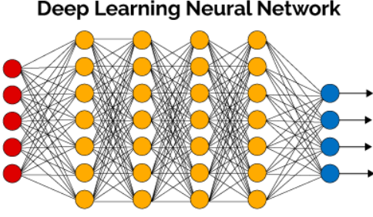
Introduction
Deep neural networks (DNNs) are very important for Machine Learning
Applications : image recognition, NLP
Size of DNNs is continuously increasing, need to find a way to control memory usage and time usage

Slide 3
Sparse DNNs
Sparse DNNs were introduced to lower memory usage, but keep the performance equivalent to DNNs
The Graph Challenge focuses on optimizing calculations for sparse DNNs

Slide 4
Algorithm
Main function:
make two arrays for Y matrix : emptyRows and nonZeroCount
for the first iteration: pin the first two layers’ W matrices
from next iterations : remove initial W matrix and pin the next W matrix
Kernel function:
use shared memory for loading Y and W matrices
use tiling approach to multiply, skipping over all the rows that are empty in the emptyRows array
copy result from device to device

Slide 5

Applied Optimizations
The first optimization was to use pinned memory instead of paged memory for the layer matrix W so that loading it to the GPU would be quicker.
‘cudaMallocHost’ is the command for specifying usage of pinned memory.

Slide 6

The second optimization was for the input matrix Y. Two arrays were made – one for storing which rows had no values in them and one for storing the number of non-zero values in each row.
All the rows which are empty will have their value in the emptyRows array as 1. For matrix multiplication, we can directly skip these rows.

Slide 7
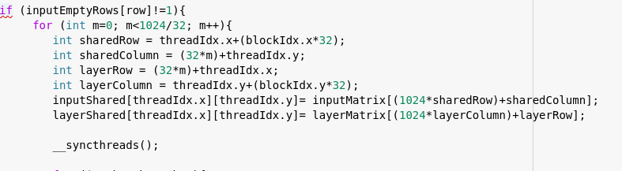
The next optimization was using shared memory and tiling in the kernel function. Both W and Y matrices are divided into tiles of size 32x32. Since the dimensions of Y are 60000x1024, the number of tiles are 1875x32. Similarly for W matrix, dimensions are 1024x1024 therefore number of tiles are 32x32.

Slide 8
Experimental Setup
GPU Hardware Parameters
GPU Device Name: NVIDIA Tesla T4
Shared Memory available in each SM:64KB
Maximum size of thread block:1024
Setup: Google Collab

Slide 9
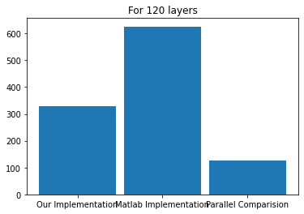
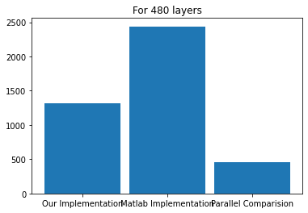
Results
We compared our implementation with matlab and parallel computation(A GPU Implementation of the Sparse Deep Neural Network Graph Challenge).

Slide 10
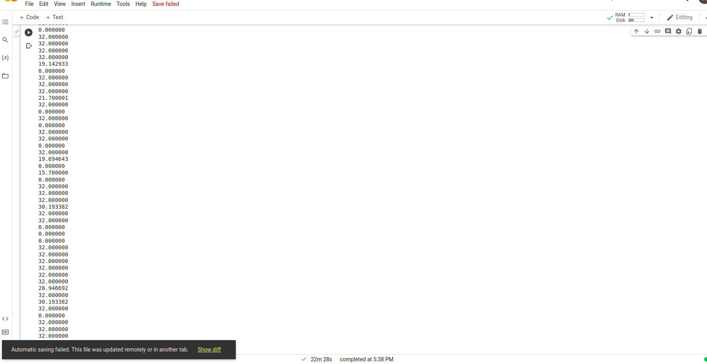
DEMO CODE
Below is the screenshot for 480 layers:

