Slide 1
Cross-Lingual Legal Summarization
English → Hindi Legal Judgment Summarization using MILDSum
The stakes: in a legal judgment, one wrong number or name doesn't just read oddly — it can flip the outcome.
So the question we ask today is:
"How do Zero-shot, Few-shot, and Structured CoT prompting strategies differ in English-to-Hindi legal summarization?"
• This is a controlled 10-case exploratory study ; the goal is to find what the evidence shows, not to crown a winner in advance.
Presentation by : Ankita Mishra
To answer this fairly, we first control the experiment so only the prompt changes...
MILDSum • English→Hindi • Qwen 3.5 4B • 10-case exploratory study 1/12

Slide 2
Dataset: MILDSum
Setup
Automatic
Manual
Cases
Verdict
10 Indian legal judgments where these stakes are real
• MILDSum (Law-AI) — English-Hindi Indian court judgment/summary pairs.
• Used all 10 available samples for this exploratory pilot.
• Each sample: EN_Judgment.txt (input) + HI_Summary.txt (reference for scoring).
• EN_Summary.txt exists but is NOT used ; task is strictly English → Hindi.
• Domain mix spans the kind of high-stakes facts described above: bail terms, drug quantities, reimbursement amounts, government identity.
Sample | Legal domain
S1 | COVID hospital reimbursement
S5 | Bail (Few-shot generation failed)
S7 | Anticipatory bail, repeat filing
S8 | NDPS Act — drug quantity, bail
S9 | Family court judge conduct/bias
With only 10 cases, every result ahead should be read as exploratory evidence not a statistically powered benchmark.
With the same 10 judgments fixed, next we fix the model and setup too...
MILDSum • English→Hindi • Qwen 3.5 4B • 10-case exploratory study 2/12

Slide 3
Model & Experimental Setup
Setup
Automatic
Manual
Cases
Verdict
Holding everything constant except the one variable we care about
Qwen 3.5 4B
Model (fixed)
Seed = 42
Deterministic generation
4-bit NF4
Quantization (fixed)
10 cases
Same set, all methods
Independent variable: Prompting strategy (Zero-shot / Few-shot / Structured CoT) , everything else held constant.
• Holding the model, seed, and quantization constant isolates prompting strategy as the sole source of output difference.
• Evaluation combines automatic metrics (ROUGE-1/2/L, BERTScore-F1) with manual scoring on 5 criteria (1-5 scale).
• One generation failure occurred (Sample 5, Few-shot) therefore it is treated as N/A, excluded from Few-shot averages; error rates for Few-shot are computed over 9 valid outputs (n=9), not 10.
Context handling
Target judgment: max 1,500 tokens
Few-shot examples: 450 EN + 300 HI tokens
Few-shot total input: max 3,000 tokens
Original judgments: 1,398–9,009 tokens
Setup fixed. Now the one thing that varies: the prompt itself...
MILDSum • English→Hindi • Qwen 3.5 4B • 10-case exploratory study 3/12

Slide 4
Three Prompting Strategies
Setup
Automatic
Manual
Cases
Verdict
The single variable we're testing so same model, same cases
Zero-shot
Judgment → Hindi Summary
Instruction only. No demonstrations. Model decides which facts/reasoning to preserve.
Few-shot
Examples + Judgment → Hindi Summary
A few English->Hindi example pairs shown before the target judgment.
Structured CoT
Judgment -> Facts -> Issue -> Reasoning -> Decision -> Hindi Summary
Explicitly decomposes the judgment before summarizing.
No strategy was assumed superior in advance ; this is precisely what the next slides test.
First test: do the numbers agree on a winner? Starting with automatic metrics...
MILDSum • English→Hindi • Qwen 3.5 4B • 10-case exploratory study 4/12

Slide 5
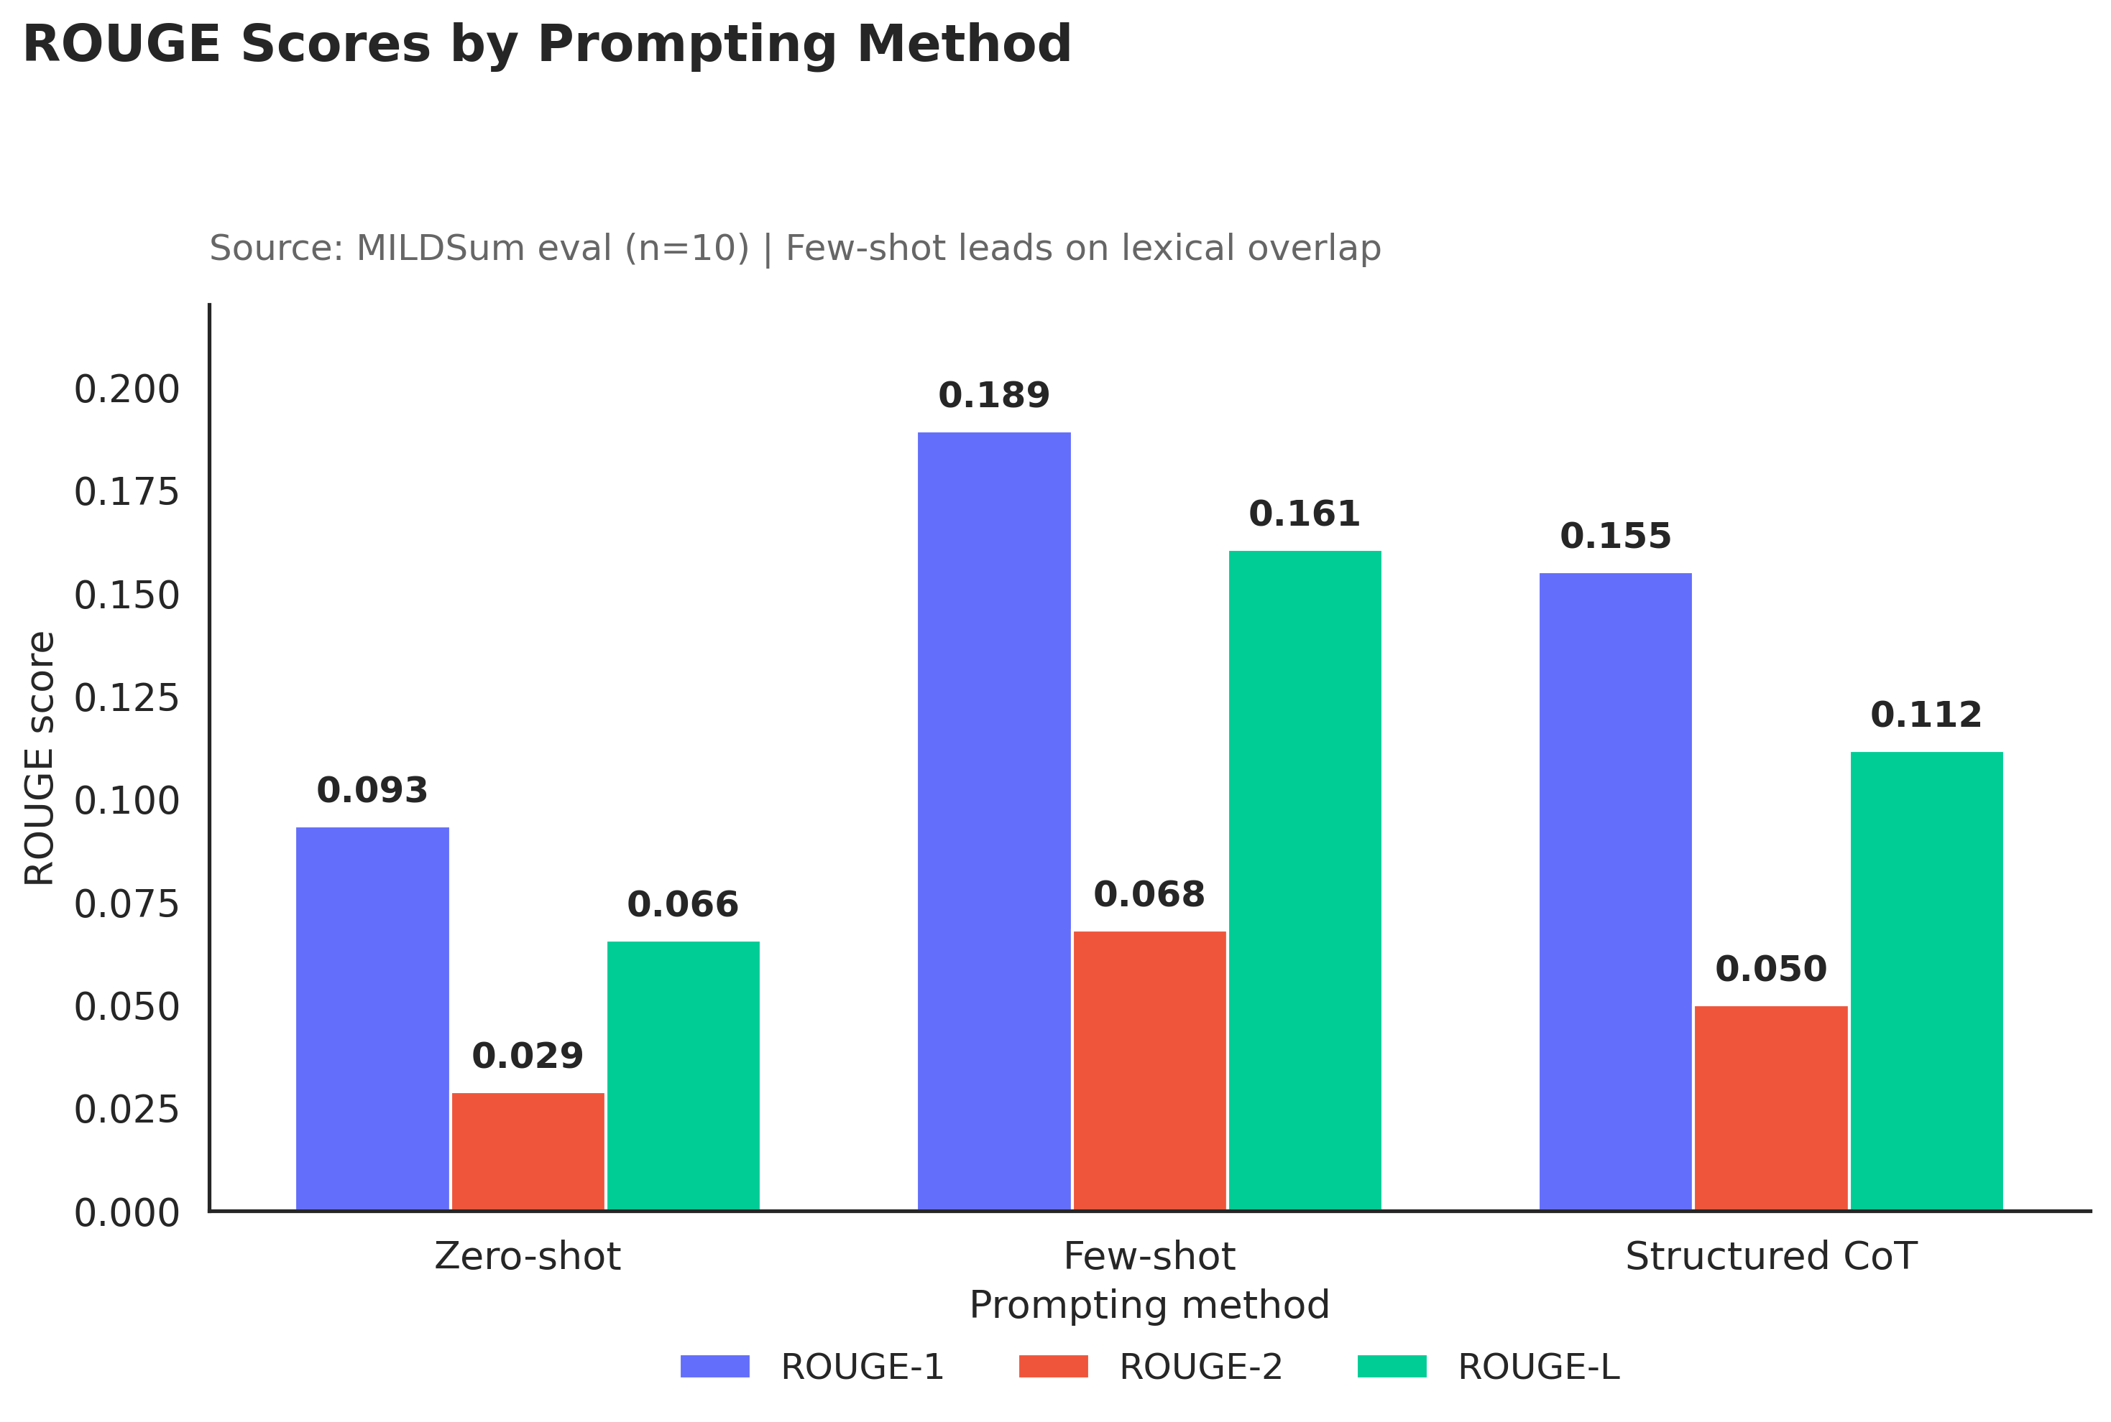
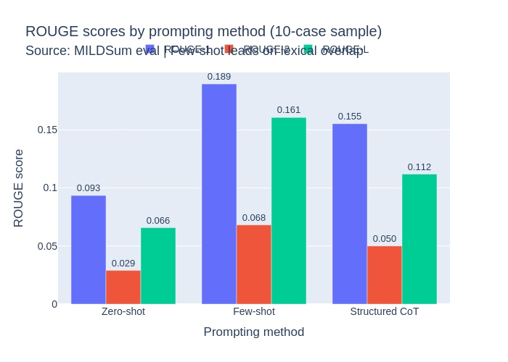
Automatic Evaluation Results
Setup
Automatic
Manual
Cases
Verdict
First piece of evidence and it already contradicts itself
Method | ROUGE-1 | ROUGE-2 | ROUGE-L | BERT-F1
Zero-shot | 0.0934 | 0.0289 | 0.0657 | 0.7242
Few-shot | 0.1894 | 0.0681 | 0.1606 | 0.6458
Structured CoT | 0.1552 | 0.0500 | 0.1118 | 0.7042
• Few-shot achieves the highest ROUGE-1, ROUGE-2, and ROUGE-L (lexical overlap with reference).
• Zero-shot achieves the highest BERTScore-F1 (semantic similarity); CoT is close behind and more stable.
• Few-shot also shows very high variance on BERTScore so its lexical wins are less consistent.
Two automatic metrics, two different winners.
If the metrics disagree, does human evaluation tell a different story?
MILDSum • English→Hindi • Qwen 3.5 4B • 10-case exploratory study 5/12

Slide 6
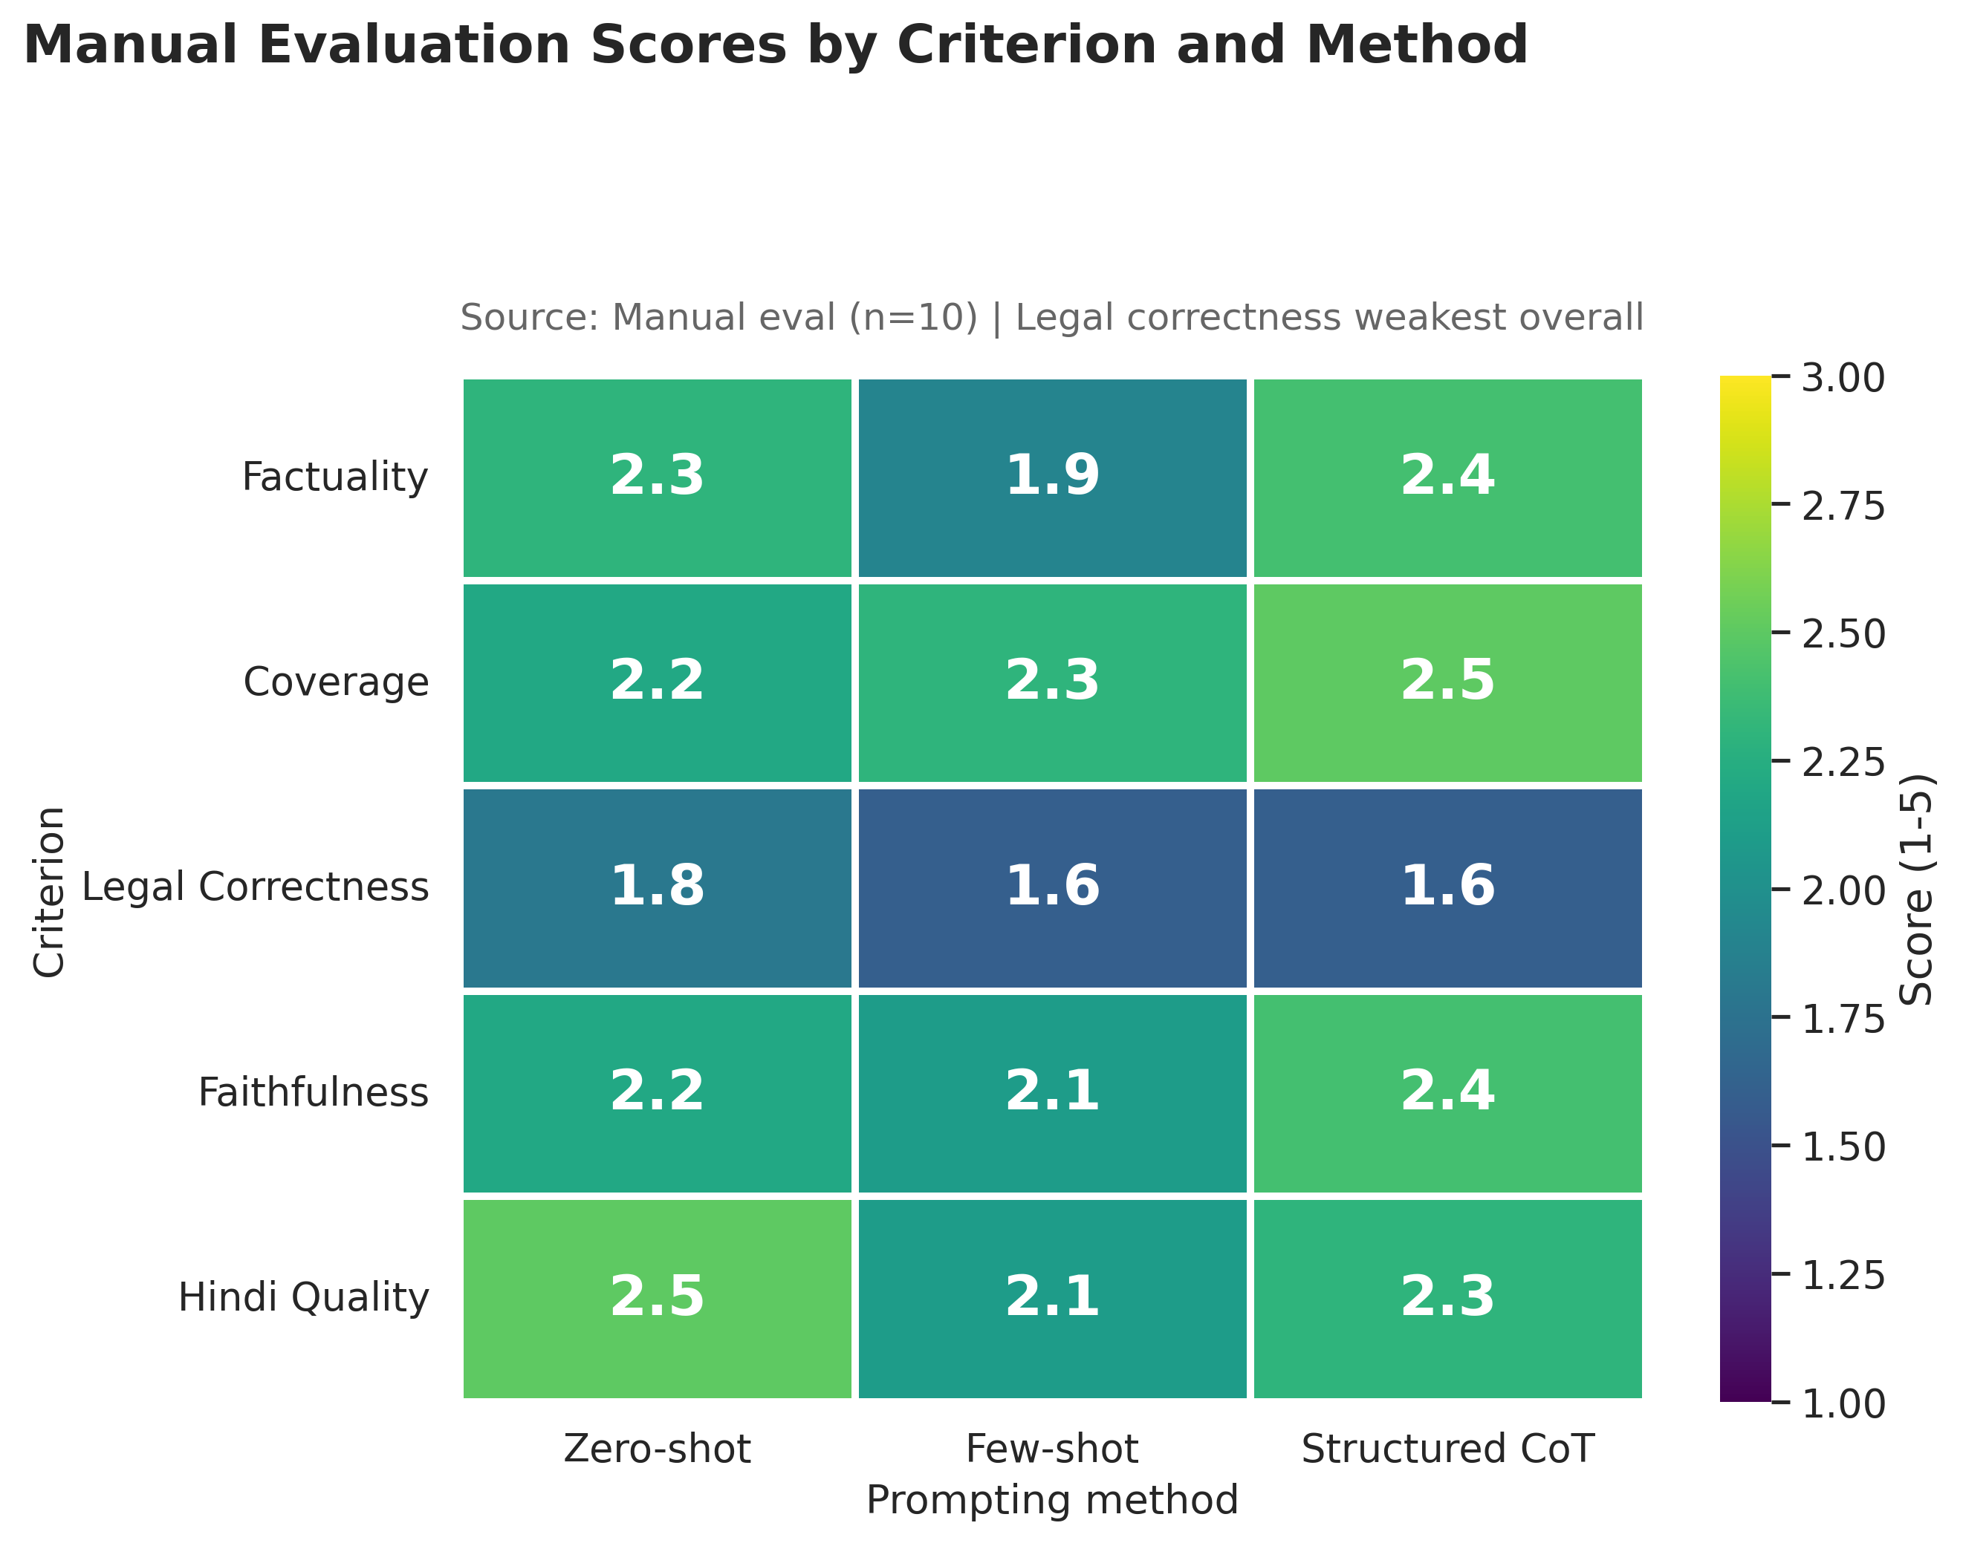
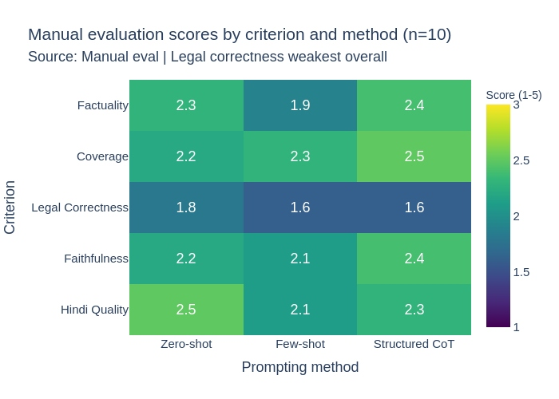
Manual Evaluation Results
Setup
Automatic
Manual
Cases
Verdict
A third opinion emerges but it's a narrow one
Criterion | Zero | Few | CoT
Factuality | 2.3 | 1.9 | 2.4
Coverage | 2.2 | 2.3 | 2.5
Legal Correctness | 1.8 | 1.6 | 1.6
Faithfulness | 2.2 | 2.1 | 2.4
Hindi Quality | 2.5 | 2.1 | 2.3
Overall | 2.18 | 1.98 | 2.24
CoT = 2.24 vs Zero-shot = 2.18
A 0.06-point gap on n=10 it is a signal worth noting, not a verdict.
Now we have THREE rankings. To see why, we look inside the actual errors...
MILDSum • English→Hindi • Qwen 3.5 4B • 10-case exploratory study 6/12

Slide 7
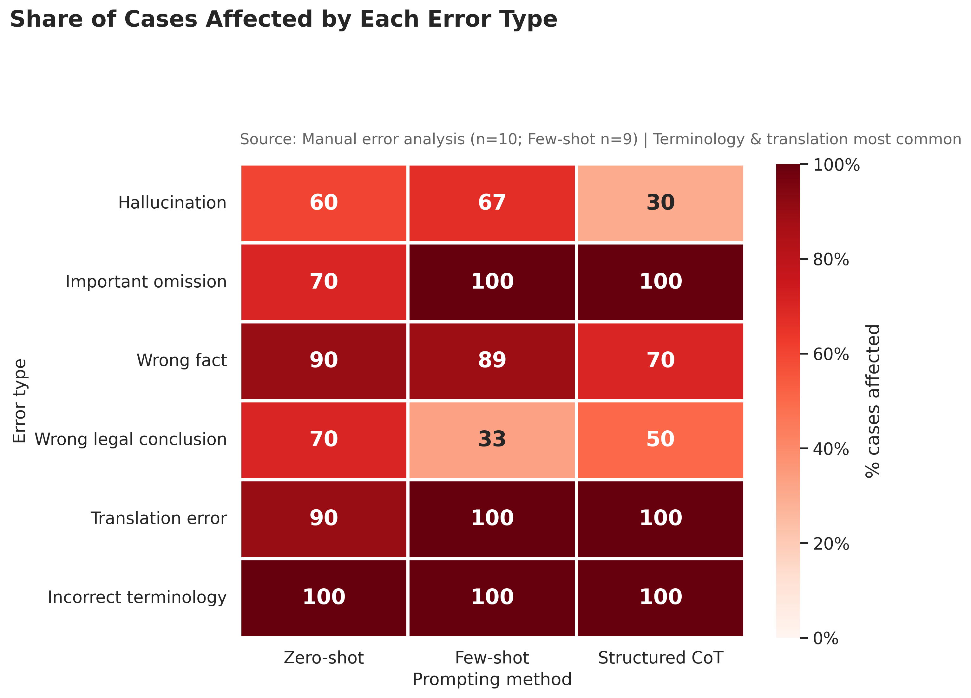
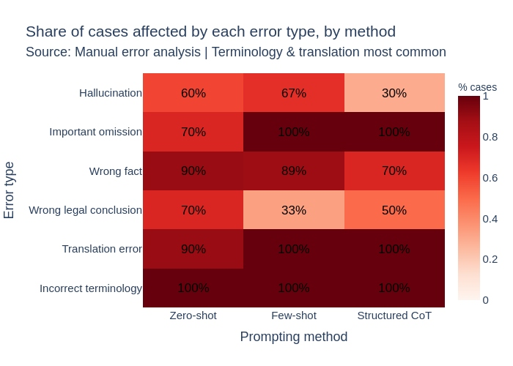
Error Analysis
Setup
Automatic
Manual
Cases
Verdict
Zooming in: what kinds of mistakes actually happen?
• Hallucination: 60% Zero-shot, 67% (6/9) Few-shot, 30% Structured CoT.
• Wrong facts: 90% Zero-shot, 89% (8/9) Few-shot, 70% CoT , near-universal.
• Incorrect terminology & translation errors: ~90-100% across ALL methods.
• Few-shot had one generation failure (Sample 5); its error rates are computed over 9 valid outputs, not 10.
• CoT's 100% important-omission rate reflects a strict binary rule (flag if ANY key point is missing) not zero retention.
Critical legal errors remain common across all three strategies, even where automatic similarity looks reasonable.
These percentages aren't abstract — here's exactly what they look like in three real cases...
MILDSum • English→Hindi • Qwen 3.5 4B • 10-case exploratory study 7/12

Slide 8
Case Study: Sample 7 — A Clear Winner
CLEAR WINNER
One prompting method clearly performs better on this case
REFERENCE (Judgment)
पंजाब और हरियाणा हाईकोर्ट ने बिना पर्याप्त आधार के लगातार जमानत आवेदन दाखिल करने की प्रैक्टिस का विरोध किया — यह दूसरा अग्रिम जमानत आवेदन है, कोई नई परिस्थिति नहीं दी गई। कोर्ट ने कहा कि इससे अदालत का समय बर्बाद होता है और प्रक्रिया का दुरुपयोग होता है।
ZERO-SHOT
CrPC धारा 438 के तहत अग्रिम जमानत का दूसरा आवेदन (FIR 134, दि. 08.03.2021), जिसमें IPC धारा 420, 467, 468, 471 और 120-B का उल्लेख है। पहले, अतिरिक्त सेशन जज पानीपत ने 06.01.2022 को आवेदन खारिज किया; बाद में याचिका वापस ली गई और 10 दिनों में पुलिस के सामने पेश होने का वादा किया गया था।
FEW-SHOT
पीटीशनर ने CrPC धारा 438 के तहत जमानत का दूसरा आवेदन दायर किया। पहला आवेदन वापस लिया गया था क्योंकि 10 दिनों में पुलिस के सामने पेश होने का वादा किया था; वादे का पालन नहीं हुआ, फिर भी कोई नया कारण न होने पर दूसरा आवेदन दायर हुआ।
STRUCTURED CoT
FACTS: पेटिशनर ने धारा 438 के तहत फिर से अग्रिम जमानत मांगी। पहले अतिरिक्त सेशन जज पानीपत ने 06.01.2022 को इसी मामले (FIR 134) में जमानत का विरोध किया। LEGAL ISSUE: क्या बिना नई परिस्थिति के दूसरा अग्रिम जमानत आवेदन स्थापित (maintainable) है?
Why this matters: All three broadly capture the FIR and procedural sequence, but Zero-shot most cleanly preserves the exact statutory sections (IPC 420/467/468/471/120-B) and dates. This matches the manual scores directly: Zero-shot (3.8/5) clearly outscored CoT (3.6/5) and Few-shot (2.8/5) on this case one prompting method genuinely performed better here.
MILDSum • English→Hindi • Qwen 3.5 4B • 10-case exploratory study 8/12

Slide 9
Case Study: Sample 8 — An Important Mistake
CRITICAL ERROR
A critical numerical error reverses the legal conclusion
REFERENCE (Judgment)
जब्ती ज्ञापन के अनुसार अजीत कुमार से 6 पैकेट (12 किलो गांजा) और ठाकुर से 5 पैकेट (10 किलो गांजा) बरामद — कुल 22 किलो। दोनों को मिलाकर सील किया गया, जो स्टैंडिंग ऑर्डर 1/88 का उल्लंघन था; अदालत ने जमानत दी क्योंकि नमूना संग्रह ही दोषपूर्ण था।
ZERO-SHOT
12 किलो गांजा और अभियुक्त द्वारा पकड़े गए 10 किलो गांजा एक साथ मिक्स करके सील किए गए — कुल 22 किलो, जो व्यापारिक मात्रा से अधिक है। कोर्ट ने अभियुक्त के दावे को स्वीकार नहीं किया और नियमित जमानत की अनुमति दी।
FEW-SHOT
एक व्यक्ति से 6 पैकेट (12 किलोग्राम) और दूसरे से 5 पैकेट (10 किलोग्राम) — यहाँ 69.50 किलोग्राम। बैगों को मिक्स करना या दो नमूने लेना अभियुक्त के हित को प्रभावित नहीं करता। अतः, उठाई गई दलील का कोई आधार नहीं है।
STRUCTURED CoT
6 पैकेट, जिनमें कुल 12 किलो गांजा मिला; 5 अन्य पैकेट — कुल 69.50 किलो गांजा मिला जो व्यापारिक मात्रा से अधिक है। कोर्ट ने स्वीकार किया कि सामान मिलाने की प्रक्रिया में कोई नुकसान नहीं हुआ।
Why this matters: Few-shot AND CoT both state a total of 69.50 kg which is nearly triple the correct 22 kg and both conclude there was NO procedural irregularity, the exact opposite of the reference's actual holding that improper mixing warranted bail. This is an important mistake: a single wrong number flips the entire legal conclusion in two of three methods.
MILDSum • English→Hindi • Qwen 3.5 4B • 10-case exploratory study 9/12

Slide 10
Case Study: Sample 1 — Metrics vs Manual Disagree
METRIC DISAGREEMENT
High lexical overlap coexists with a legally critical entity error
REFERENCE (Judgment)
एडीजे दिनेश कुमार को दिल्ली सरकार के दायित्व के अधीन 22 अप्रैल से 7 जून 2021 तक PSRI अस्पताल में भर्ती किया गया — बिल रु.24,02,380; प्रतिपूर्ति रु.7,08,500; शेष रु.16,93,880 दिल्ली सरकार को देने का निर्देश।
ZERO-SHOT
उत्तराधिकारी नं. 1 से 3 ने तकनीकी समिति की सिफारिश पर केवल ₹7,08,500 रिफंड दिए हैं और बाकी राशि (लगभग ₹16 लाख) वापस करने से इनकार किया।
FEW-SHOT
पेटिशनिस्ट ने कहा कि वह 22.04.2021 से 07.06.2021 तक उत्तर प्रदेश सरकार द्वारा नियंत्रित हॉस्पिटल में उपचार के लिए प्रवेश किया था, जिसमें 24 लाख 2 हजार 380 रुपये चुकाए। उत्तर प्रदेश सरकार ने केवल 7 लाख 8 हजार 500 रुपये रिफंड किए।
STRUCTURED CoT
रеспॉन्डेंट नं. 1 से 3 ने केवल ₹7,08,500 की रकम वापस की है और बाकी राशि ₹16,93,880 को वापस करने से इनकार किया, क्योंकि रेस्पॉन्डेंट नं. 5 ने दिल्ली सरकार द्वारा जारी सर्कुलर के नियमानुसार अधिक दरें लगाई थीं।
Why this matters: Few-shot correctly reproduces the exact rupee figures (₹24,02,380 / ₹7,08,500) , giving it strong lexical/ROUGE overlap with the reference , yet it substitutes 'Uttar Pradesh Government' for 'Delhi Government', a critical entity error. Automatic metrics reward the numeric overlap; manual evaluation would penalize this factual substitution heavily. This is exactly why ROUGE/BERTScore and manual scores disagree.
MILDSum • English→Hindi • Qwen 3.5 4B • 10-case exploratory study 10/12

Slide 11
Key Findings
Setup
Automatic
Manual
Cases
Verdict
Separating what we observed from what we conclude
WHAT THE EXPERIMENT SHOWS (Observed)
• Few-shot has the highest ROUGE scores (R-1/R-2/R-L).
• Zero-shot has the highest BERTScore-F1 (0.7242).
• Structured CoT has the highest mean manual score: 2.24/5.
• CoT and Zero-shot differ by only 0.06 in manual score.
• Terminology/translation errors occur in ~90-100% of outputs across all methods.
• Important omissions remain frequent across all methods.
WHAT THIS SUGGESTS (Interpretation)
Automatic similarity metrics alone are insufficient for evaluating legal summaries, because they do not directly assess legal correctness, factual validity, or critical omissions.
The case studies (S1, S8) illustrate this gap concretely: high textual overlap coexisted with a wrong government entity (S1) and an incorrect drug quantity that flipped the legal conclusion (S8).
The CoT-Zero-shot manual gap (0.06) is too small, on n=10, to claim CoT is a superior strategy.
"High similarity is not necessarily high legal quality."
That distinction shapes exactly what to be does next...
MILDSum • English→Hindi • Qwen 3.5 4B • 10-case exploratory study 11/12

Slide 12
Limitations & Next Steps
Setup
Automatic
Manual
Cases
Verdict
Closing the loop: what this study can't claim, and what comes next
Limitations
• Only 10 cases are there so no statistical significance testing performed
• One model (Qwen 3.5 4B) is used so it may not be generalized to other model families
• One language pair (English->Hindi)
• Manual evaluation done by a single annotator so partly subjective
• Reference-based metrics have inherent limitations for factual verification
• One generation failure occurred (S5, Few-shot); Few-shot error rates use n=9
Context limitation: Results reflect summarization under a fixed context budget, not unrestricted full-judgment summarization.
Next Steps
• Larger-scale MILDSum evaluation across more samples
• Test multiple legal domains and multiple multilingual models
• More robust factuality/faithfulness evaluation frameworks
• Legal-domain LLM-as-judge with human validation
• Automated entity/number/legal-holding consistency checks
• Formal statistical significance analysis with larger n
The story ends where it began: similarity is measurable, but legal correctness still needs a human in the loop.
MILDSum • English→Hindi • Qwen 3.5 4B • 10-case exploratory study 12/12

