Slide 1
Business Insights Dashboard
Sales, Profit and Operational Overview
Presented by: Ankita Patel
Email ID - personalmail.ankita@gmail.com

Slide 2
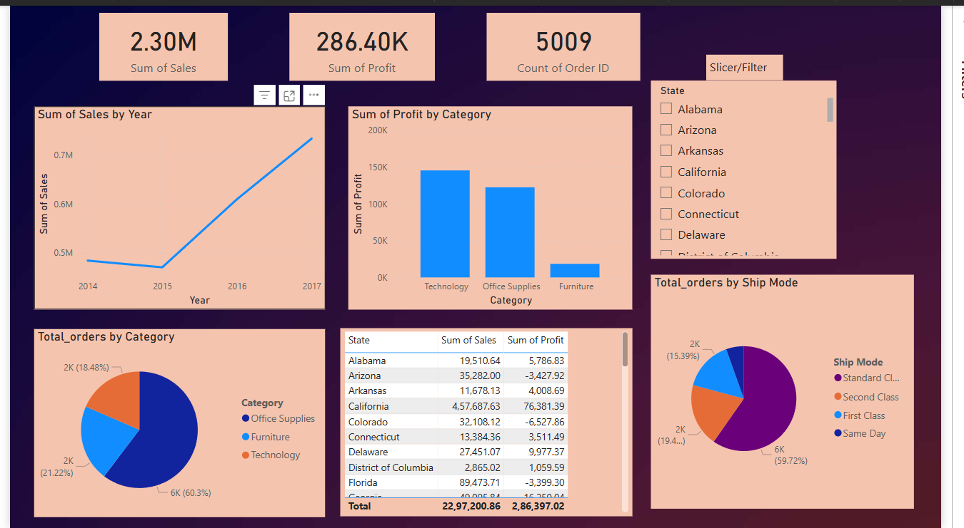
Overall Business Performance
Total Sales: $2.30M
Total Profit: $286.40k
Total Orders: 5,009

Slide 3
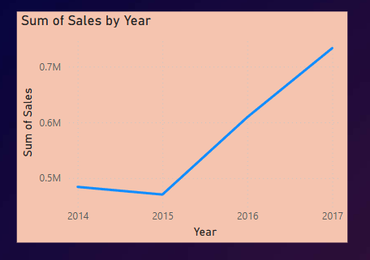
Sales Performance by Year
Sales declined slightly from 2014 to 2015
Sales increased consistently from 2015 to 2017

Slide 4
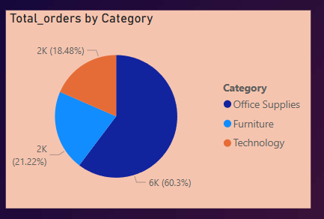
Distribution of Orders by Category
Office Supplies: 60.3% (Most Ordered)
Furniture: 21.22%
Technology: 18.48% (Least ordered)

Slide 5
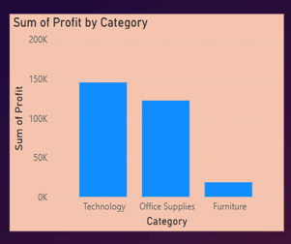
Profit Contribution by Category
Highest Profit: Technology ( $145.45k )
Lowest Profit: Furniture ( $18.45k )

Slide 6
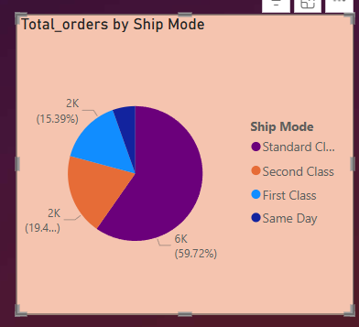
Orders by Shipping Mode
Most Orders: Standard Class (6,000 orders i.e. 59.27%)
Fewest Orders: Same Day (543 orders i.e. 5.43%)

Slide 7
Key Takeaways
Strong sales growth post-2015 indicates healthy business trend.
Office Supplies dominate in volume, but Technology drives profit.
Standard shipping is most common; consider analyzing cost-efficiency.
Further investigation suggested on improving furniture category margins.

Slide 8

Thank you

