Slide 1
Project Summary
Ankita Roychoudhury
Murray Lab

Slide 2
Summaries
8.21.2020

Slide 3
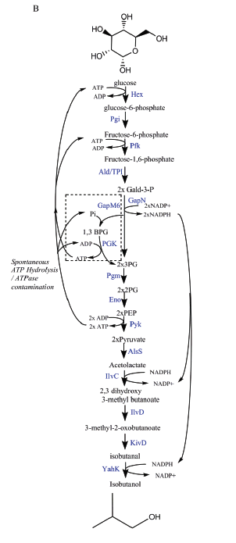
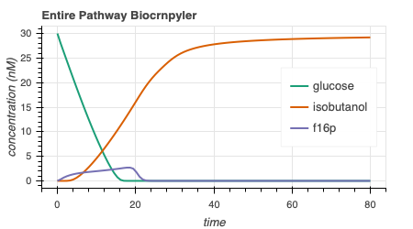
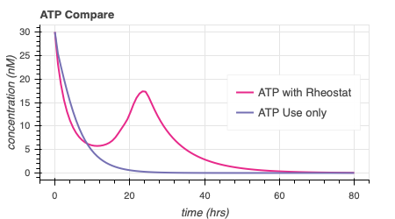
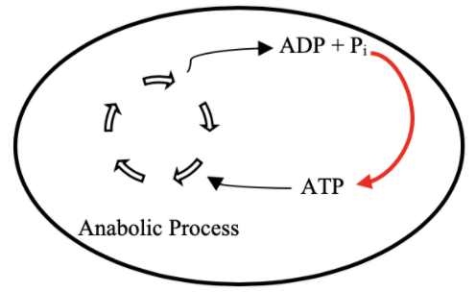
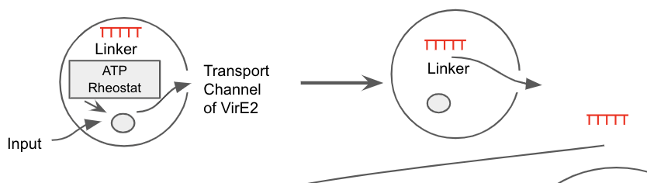
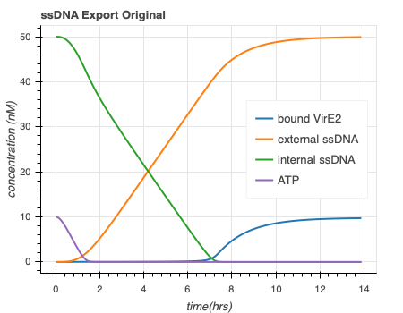
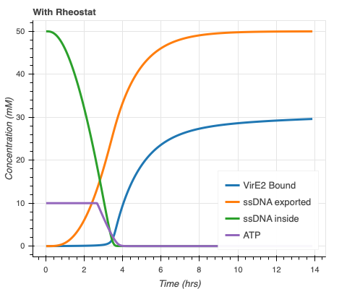

Goal: ATP Life Extension in Synthetic Cells
Proposal 1: Regeneration by Rheostat Machinery
Combine with ssDNA Export Model
TX/TL
ssDNA export original
ssDNA export with ATP Rheostat
Ankita Roychoudhury 8.13.2020
Opgenorth et al., Nature Chemical Biology, 2017
Notes:
Hi I’m Ankita! Undergraduate at Caltech. I’ve been working on modelling of mechanisms for ATP life extension in synthetic cells this summer with Richard Murray Lab. I’m here to learn and contribute in any way I can

Slide 4
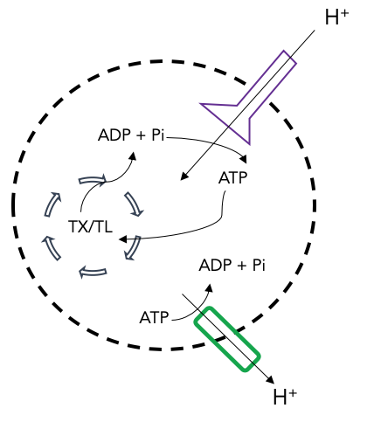
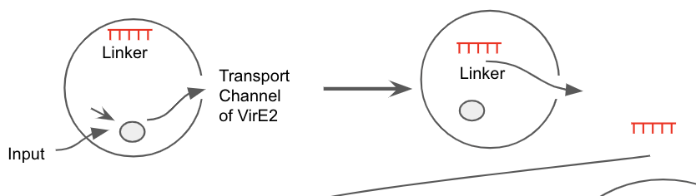
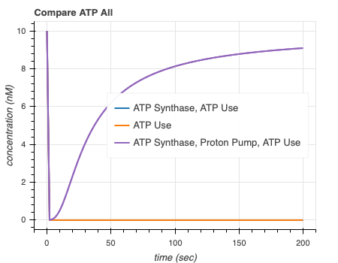
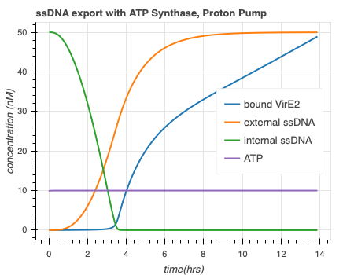
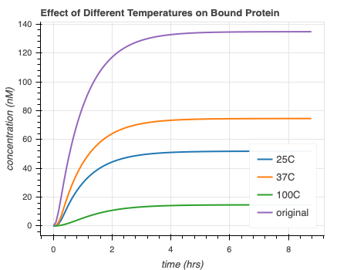
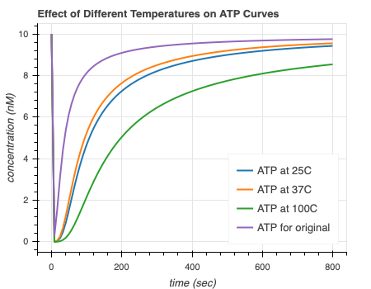
Proposal 2: Regeneration by ATP Synthase
Goal: ATP Life Extension in Synthetic Cells
Combine with ssDNA Export Model
ATP
TX/TL
Add Temperature Sensitivity
Temperature Sensitive
DNA
RNA
Membrane Integration
Protein Folding

Slide 5
Supplementary

Slide 6
Software Tools

Slide 7


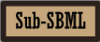

Software Tools
Communicate & Combine!
Simulate!
Create Model!
Bioscrape
Notes:
Speaker: Ankita
Due to COVID-19, most of the summer projects schedule to be completed in Richard Murray Lab moved to simulation-based experiments rather than wet-lab. For this reason, we looked for particular software tools that would help us not only simulate our own models but also help communicate between models to encourage collaboration and interlinking.
We decided to use BioCRNpyler, SBML,sub-sbml, and bioscrape.
Broadly stated, Biocrnpyler is a chemical reaction network based software. This software is used to write out CRN models given simple descriptions.
SBML was used for communication and model combination purposes. SBML is essentially a model representation format used mostly in systems and synthetic biology. It is mainly used to represent biochemical pathways, such as metabolic pathways, cell-signaling pathway, gene regulation, and the like.
Sub-sbml is useful to model shared resources, compartment combination, and more.
And then we needed to choose a simulator to analyze our CRNs so we chose bioscrape! Which can take an SBML file and will output a dataframe with results for each timepoint, which can easily be visualized.
Both biocrnpyler and sub-sbml were released by various members of Richard Murray Lab at Caltech including Ayush Pandey, William Poole, Zoltan Tuza in 2018.
SBML was released in 2002 by John Doyle lab at Caltech and Hiroaki Kitano, a professor at Okinawa institute of science and technology.
Bioscrape was developed by members of Murray Lab, including Anand Swaminathan, Ayush Pandey, and William Poole in 2017.

Slide 8
Simple Workflow
Input
Output
Design Model
Simulate
Output!
Bioscrape
Notes:
Speaker: Ankita
A simple overview of a workflow with this system.

Slide 9
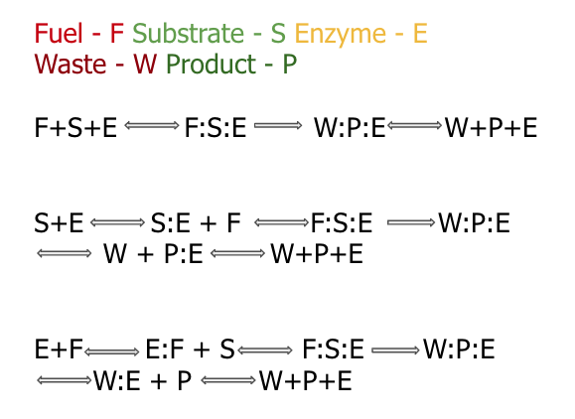
Mechanism
Biocrnpyler Development
Component
Called MichalisMentenReversible
Type ‘catalysis’
Takes in enzyme, substrate_list, product_list (fuel and waste included)
Binding, catalysis, and unbinding reaction
Called MultiEnzyme
Uses mechanism ‘catalysis’
Takes in rate parameters

Slide 10
ATP Rheostat

Slide 11
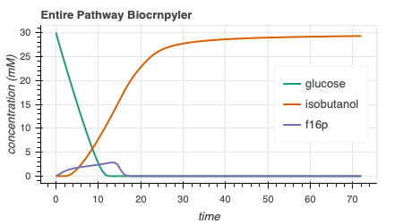
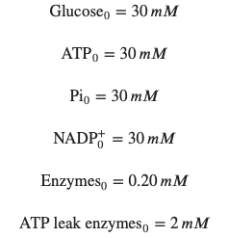
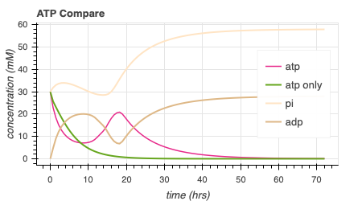
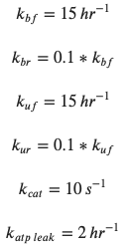
Rheostat Model Output
414.6
Notes:
Isobutanol toxicity - once around 180 mM, cells stopped growing
https://www.ncbi.nlm.nih.gov/pmc/articles/PMC3242789/
Concentrations of 1-2 % v/v isobutanol can induce toxic effects in microbial production host, reducing growth rates and precursor synthesis – low product yields
E coli = volume = 1 umeter^3 , length – 1-2 umeter = 1000 nanometer
GUV = 300 nanometer , volume = 0.3 umeter^3
Conc of isobutanol – 30 mM
Isobutanol toxicity: n-butanol can interact with the cell by altering the lipid composition and fluidity of the membrane, decreasing intracellular pH and ATP concentration, inhibiting the uptake of glucose. Isobutanol stress response in E.coli is quantitively similar to that of n-butanol with respect to transcriptional levels, except for increased repression of amino acid biosynthesis by n-butanolhttps://www.embopress.org/doi/full/10.1038/msb.2010.98

Slide 12
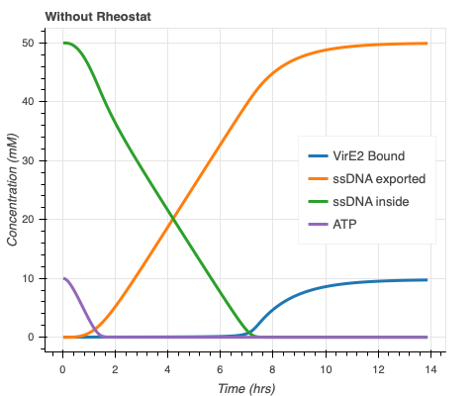
Entire ATP Rheostat Model speeds up ssDNA export and causes more bound VirE2
Concentration (nM)
Concentration (nM)
Export model courtesy of Agrima Deedwania (IIT Delhi)

Slide 13
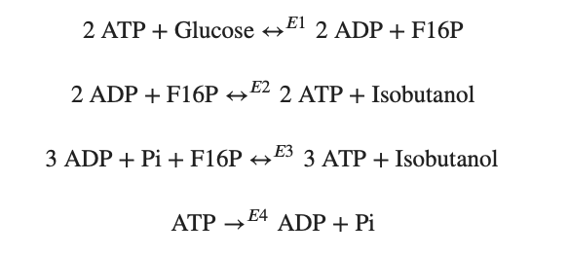
Modelling Approach
1) Simple pathway - bioscrape
Choose an enzymatic mechanism
2) Simple pathway – biocrnpyler
3) Entire pathway - biocrnpyler
Notes:
We have shown the simplified pathway on the right that we will use for the simplified modeling for convenience

Slide 14
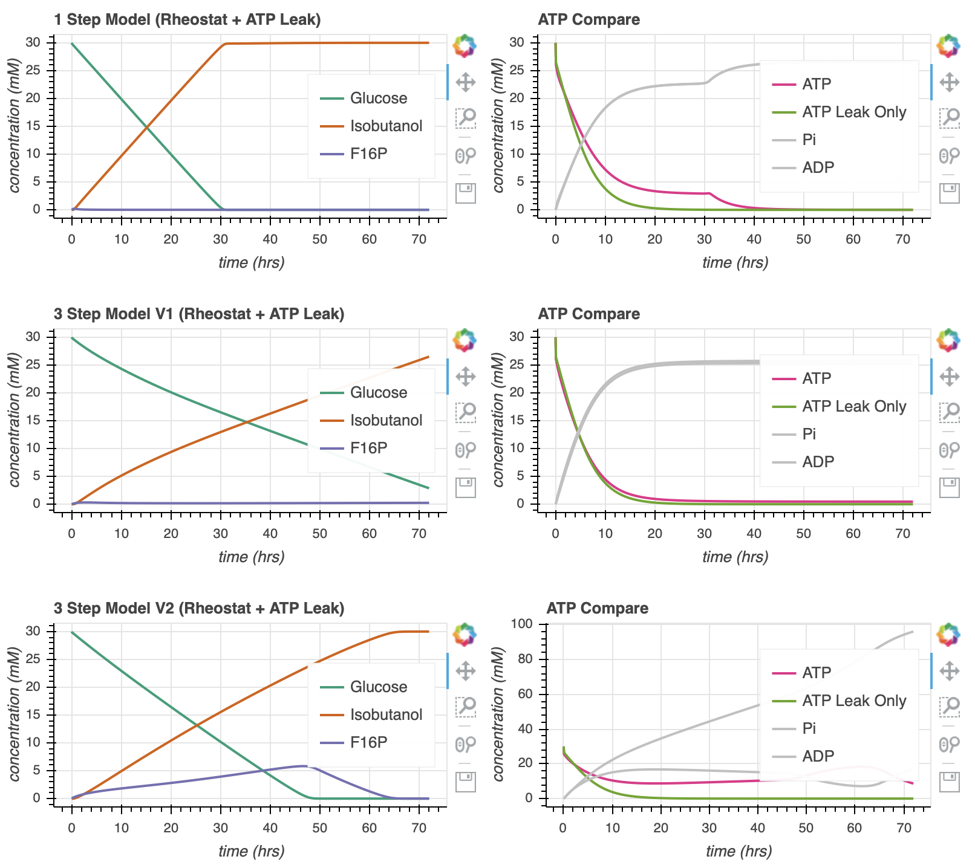

Enzymatic Models
Notes:
Here, we show the different enzymatic models we’ve tried to study
<click>
At this point, I chose slightly arbitrary parameters. They are generally on the correct order of magnitude but they may not entirely accurate.
Go through the graphs
ATP leak curve is a large oversimplification to try to account for the atp hydrolysis by atpase activity and the atp used in tx/tl
we make sure that these parameters ensure use of atp by time 20 in the simulations that only consider atp (experimental evidence)

Slide 15

Parameter Estimates
$$k_{bf}$$
$$k_{cat}$$
$$k_{uf}$$
$$k_{br}$$
$$k_{ur}$$
Notes:
In attempt to explore the dynamics of the pathway, I made some parameter generalizations to begin with.
All the k for all the enzymes in the pathway are the same
We assume that we put the same amount of each enzyme in the mixture.
ATP leak enzymes is a large oversimplification to try to account for the atp hydrolysis by atpase activity and the atp used in tx/tl
we make sure that these parameters ensure use of atp by time 20 in the simulations that only consider atp (experimental evidence)

Slide 16
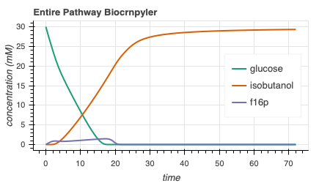
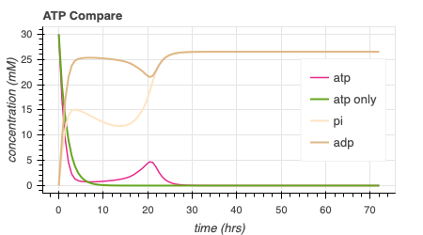
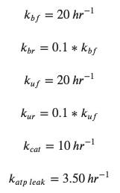
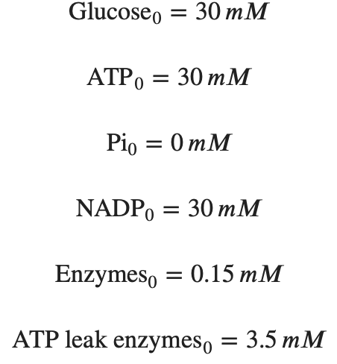
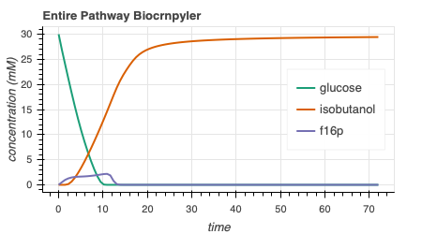
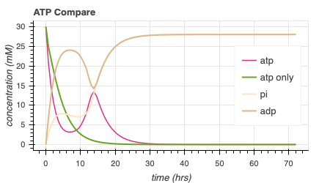
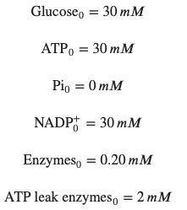
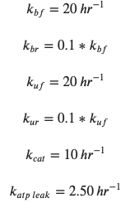
Simulate Entire Pathway - Biocrnpyler
74.5
s⁻¹
170.5
s⁻¹
Adjusting the rate of ATP leak and the initial concentrations of enzymes can lead to more optimal dynamics.
Notes:
Now, we incorporate this entire pathway in biocrnpyler.
On the top here, we have used very similar parameters from before. Now, I will begin to do a bit of parameter search to try to find cases where there may be more optimal dynamics and to try an gain a better intuition of the pathway .
<click>
On the bottom, I’ve changed the initial amount of enzymes (CLICKS!) and the rate of atp leak a bit in attempt to move the ‘hump’ of atp production. Note that the green line represents the simulation with only atp leak, no rheostat machinery. We would ideally like the pink ‘atp’ line to be right-shifted in comparison to the green atp only line.
<click>
Moving forward, I will perform a parameter search to try to optimize the area underneath the curve of the pink atp line and also try to gain a better intuition of why we see what we see. While doing the optimizations, we must keep in mind that the green atp_only line should continue to reach 0 around time 20. For reference, here are the integral values of the atp line.

Slide 17

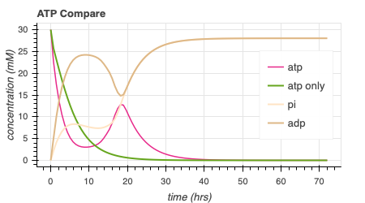
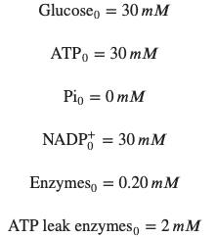
Optimizing $k_{bf}$and $k_{uf}$ and increasing [Pi]₀ extends ATP lifetime
216.0
s⁻¹
414.6
Notes:
I also see that increasing the initial free phosphate concentration can increase the amount of atp produced without affecting the atp_only curve.
In the context of simulations, this is relatively positive since we do indeed see that we can get extended atp lifetime, up to about 40 hours. However, the parameter estimates and assumptions we have made may be a bit concerning. NEXT
Going forward, we will be using the parameters shown on the bottom plot, unless otherwise stated

Slide 18
Reconsidered Modelling Approach
Full Model
CRN Mass action
(k_{bf1}, k_{br1}, k_{uf1}, k_{ur1},k_{cat1},k_{bf2},…)
Minimal Model
Coarse-grained
(k₁, k₂ = k)
Lumped parameters
Extracted from experimental data
Effective relations to help argue values of reduced model
Include assumptions
Conservation laws
QSSA
Generalize binding/unbinding
Reduced Model
(k₁, k₂,…)
More relevant to experimental data
Notes:
Full model has all reaction rate parameters
This makes sense – I’ve optimized the full model, but how can I come up with some biological relevance

Slide 19
Attempted Reduced Models
1: Remove all complexes
2: Remove 1/2 complexes
3: Remove 1 complex
4: Remove all except atp, nadph, isobutanol, glucose, enzymes
Complexes

Slide 20
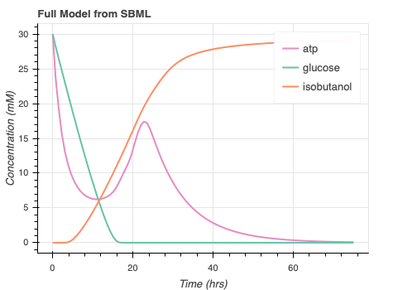
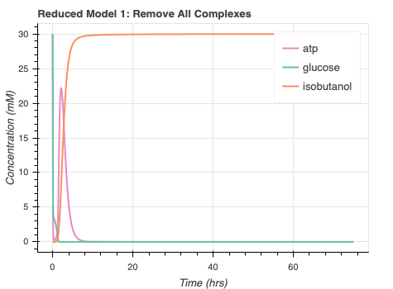
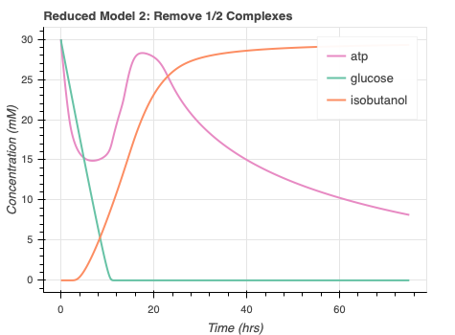
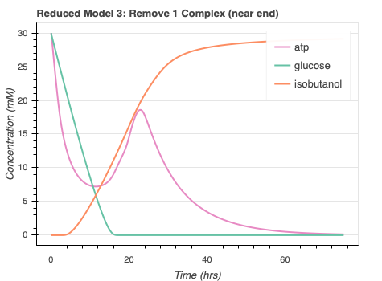
autoReduce progress/issues
Automate SBML to ODE
High error for some proposed reduced models
Errors for Reduced Model 4
Notes:
Seems like all the models reach the appropriate steady state value
Concerns include the sacrificed dynamics. Not sure why remov ing all complexes quickens all the dynamics and why removing ½ complexes seems to only delay atp dynamics.
Have to find a compromise between having curves close to the full model but also reducing the amount of species and corresponding parameters required
Maybe look at redmod1, has a lot less parameters, adjust parameters to see desired dynamics, kind of like having different mechanism in biocrnpyler
Benefits: lumped parameters in reduced models, lower num of params to analyze system with. Helps with parameter identification. Without data, a reduced model may be closer to phenomenological model so you can conclude things about model in easier manner because you only have the species that you care about
Param sweeps and simulations with a red model would be more about how outputs are affected by inputs bc you get rid of other states so could guide design choices
Get a better understanding of what really matters from a physical point of view – is it that a particular metabolite affects dynamics or some other species etc – can be helpful information
Am hoping that if more experiments are done with this system, parameters can be extracted and inserted into one of these reduced models compared to the full massaction model .
Easier to work with more generalized dynamics.

Slide 21
ATP Synthase

Slide 22
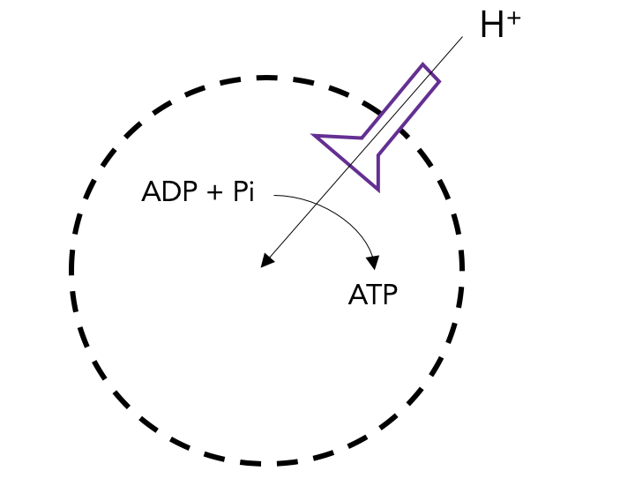
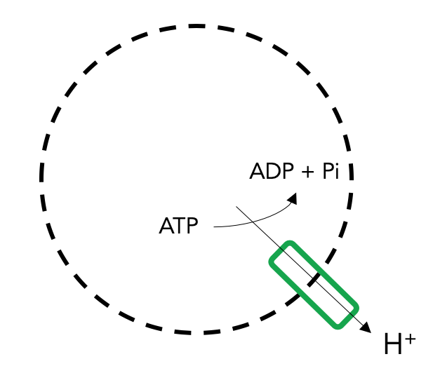
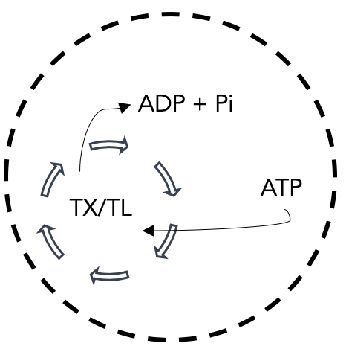
ATP Synthase Components
ATP Synthase Transcription & Translation
ATP Synthase Membrane Integration
ATP Synthesis through ATP Synthase
ATP Synthesis
Proton Pump Transcription & Translation
Proton Pump Membrane Integration
Proton movement through Proton Pump
Maintain Proton Gradient
ATP Use
ATP Hydrolysis
Notes:
Proton pump = Plasma membrane H+-ATPase
P-type proton ATPase
found in the plasma membrane of plants, fungi, protists and many prokaryotes.

Slide 23
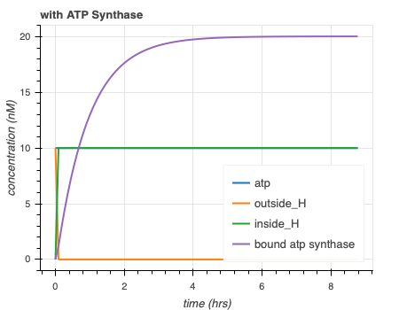
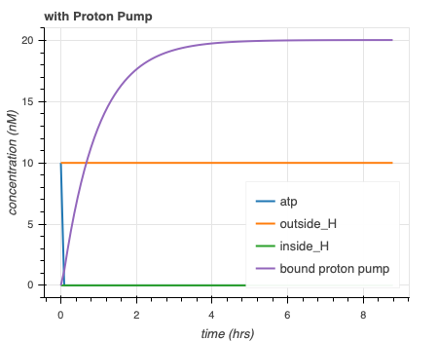
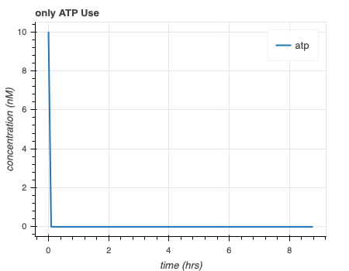
Separate simulations for ATP synthase model are as expected
H⁺
ADP + Pi
ADP + Pi
ADP + Pi
TX/TL
ATP
ATP
ATP
H⁺
Notes:
WHAT kIND OF Proton PUMP MORE DETAILS

Slide 24
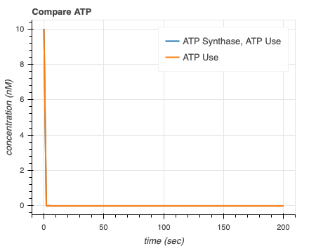
ATP synthase simulations show that proton pump is necessary to extend ATP lifetime

Slide 25
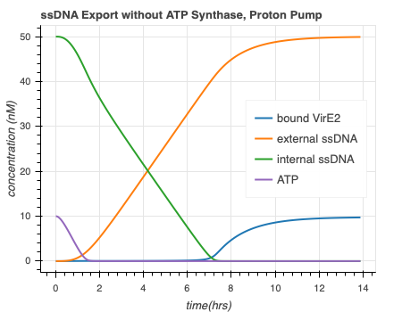
Entire ATP Synthase Model speeds up ssDNA export and causes more bound VirE2
ATP
Faster ssDNA export and more bound VirE2!
Export model courtesy of Agrima Deedwania (IIT Delhi)

Slide 26
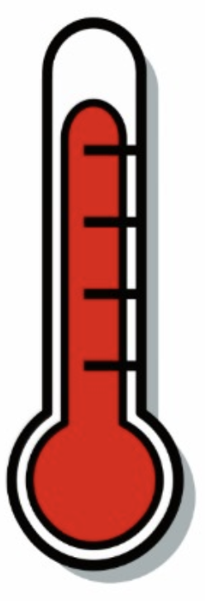
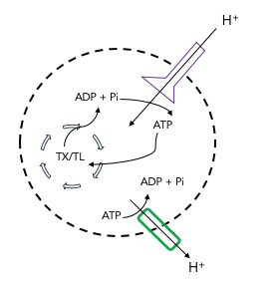

Entire ATP Synthase Model in Different Temperatures
Temperature Sensitive
Protein Folding
Membrane Integration
DNA
RNA
Temperature rate equation courtesy of Ayush Venkatesh Bindlish (IIT Delhi)

