Slide 1
William Meeting
Ankita Roychoudhury
12.23.2020
Murray Lab

Slide 2
TODO
Write all the assays you know how to do/have calibrated
What kind of projects interest me
My original goal
Ways this could still work
Other possible projects

Slide 3
Assays Techniques
ATP
ADP
Inorganic Phosphate
Bulk TXTL
Fluorescence/Luminescence Measurements
Encapsulation in vesicles
Microscopy
Time course and single point
PCR
Have isolated and amplified ATP syn subunits
Gel Electrophoresis
(Vesicle lysis and quantification)

Slide 4
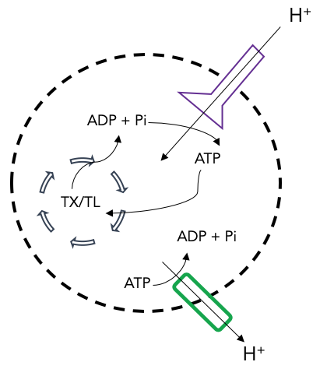
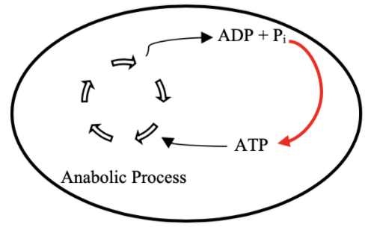
Original Goal
ATP Life Extension
Increase lifetime of processes within synthetic cells by replenishing energy supply
Proposal: ATP Regeneration by ATP Synthase
TX/TL

Slide 5
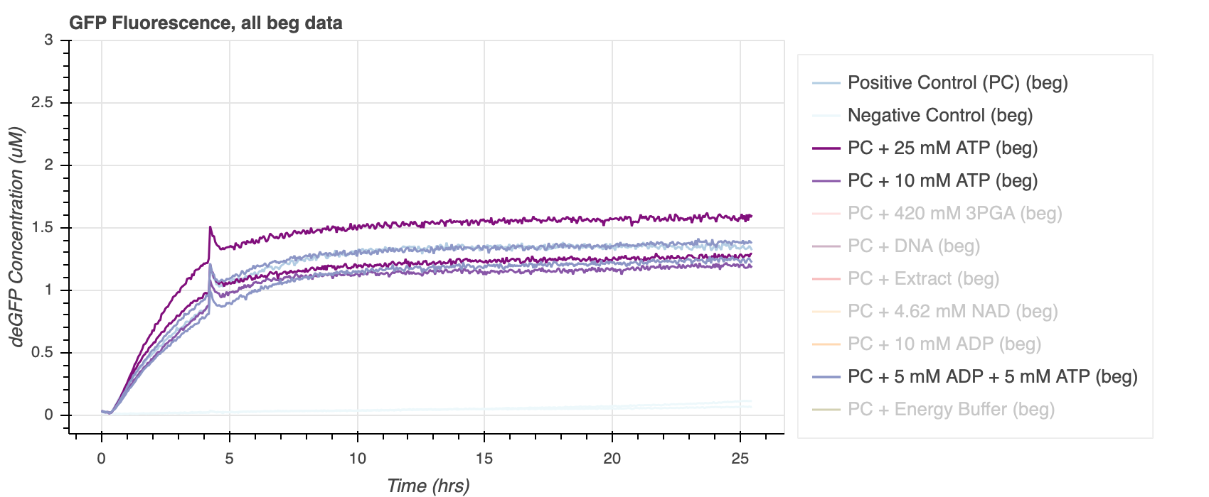
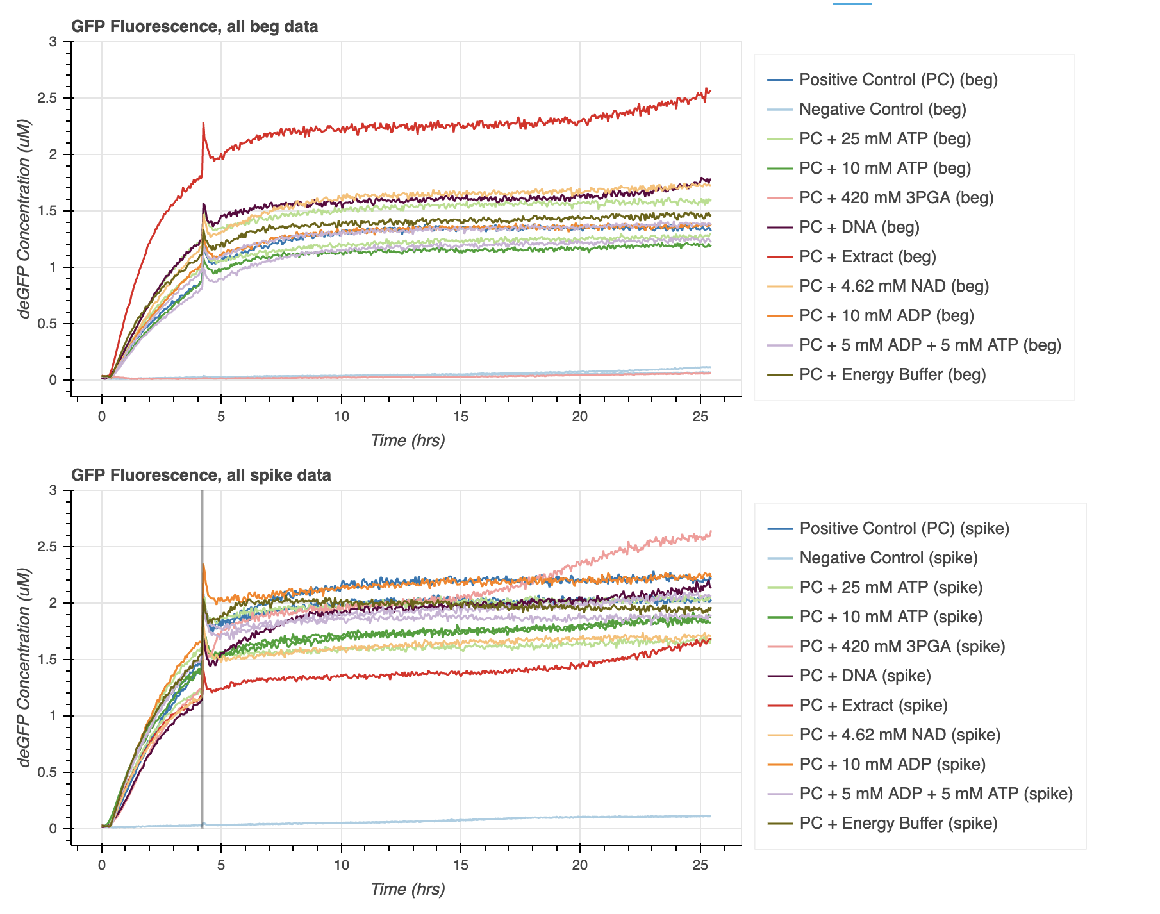
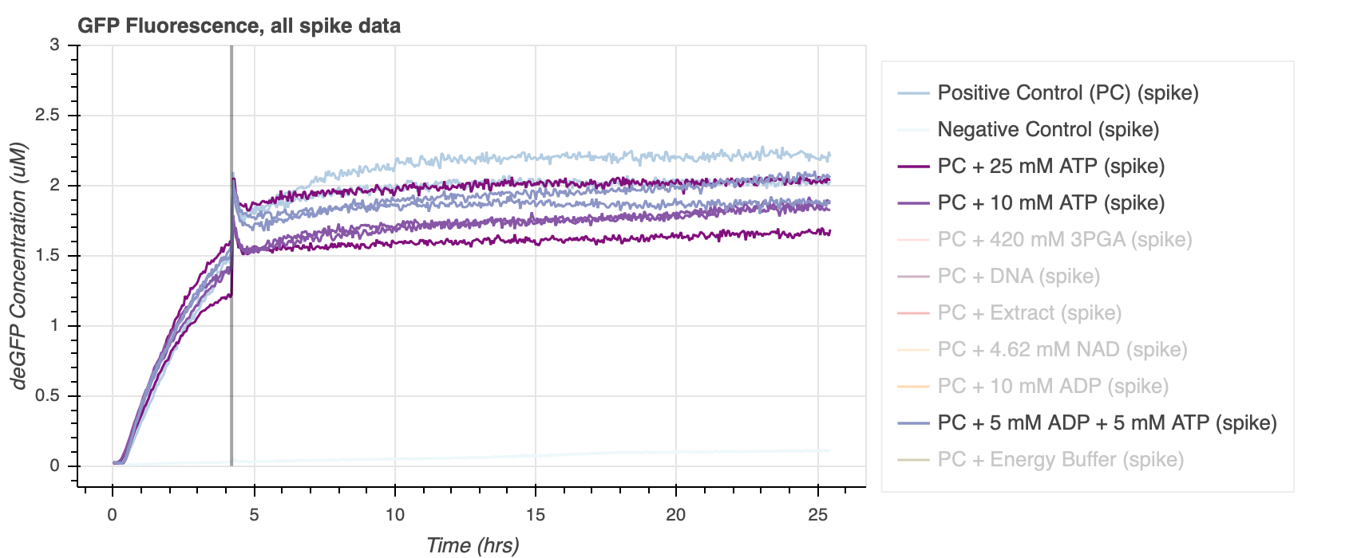
Project Status: Spike and Beg Experiments
Notes:
Exp 18

Slide 6
Interests
Wet lab experiments (with supplemental modeling)
Vesicles

Slide 7
Possible Projects
Is spontaneous vesicle membrane integration of multi-component membrane proteins possible?
Might have to integrate membrane channel (alpha hemolysin) to replenish TXTL within vesicle

