Slide 1

ATP Life Extension in Synthetic Cells
Synthetic Cell Meeting 7.15.2020
Ankita Roychoudhury
Murray Lab

Slide 2

Things to include in this
Autoreduce progress (reduced model)
Comparison between outputs of reduced and unreduced model not good
Model reduced model with appropriate parameters?
Should you try this in biocrnpyler/bioscrape for the time being?
Maybe show some minimal model things
IMPORTANT
Other people you can colab with
How other’s can use this model (subSBML)
Do ATP Synthase Model
Gro?chemostat?
Gro simulation for fun
Includes dilution/division, doesn’t happen in liposomes
Include phases like peter (roadmap)
Notes:
Bigger context of synthetic cell
How link to other peoples
Other things for syn cell that could integrate, subsystem of component within a syn cell that has other stuff going on (from DOD PROPOSAL)
Have to try to get someone else’s model and get it to work
peter + Ankita? Reach out to see energy regeneration
One slide with whatever your project is about

Slide 3
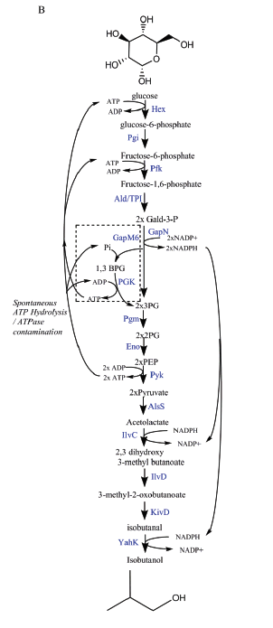
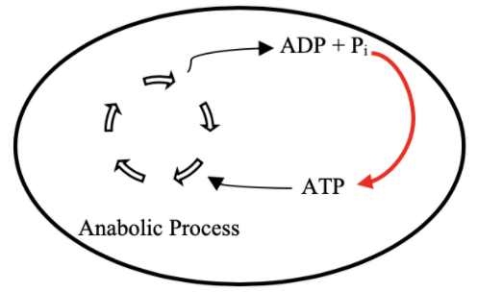
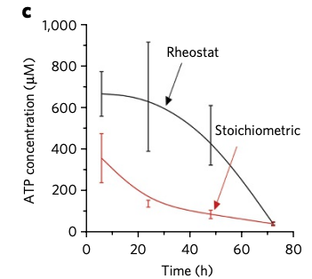
Goal: ATP Life Extension in Synthetic Cells
Proposal 1: Regeneration by Rheostat Machinery
TX/TL
Opgenorth et al., 2017, Nature Chemical Biology

Slide 4
Roadmap
Model entire rheostat in BioCRNPyler
Investigate reduced (autoReduce) and minimal models
Study an ATP Synthase Model
Parameter experimentation to understand pathway and optimize
Collaborate with other projects
Experimental Planning (?)

Slide 5
Model Overview
Full Model
CRN Mass action
(k_{bf1}, k_{br1}, k_{uf1}, k_{ur1},k_{cat1},k_{bf2},…)
Minimal Model
Coarse-grained
(k₁, k₂ = k)
Lumped parameters
Extracted from experimental data
Effective relations to help argue values of reduced model
Include assumptions
Conservation laws
QSSA
Generalize binding/unbinding
Reduced Model
(k₁, k₂,…)
More relevant to experimental data
Notes:
Full model has all reaction rate parameters
This makes sense – I’ve optimized the full model, but how can I come up with some biological relevance

Slide 6
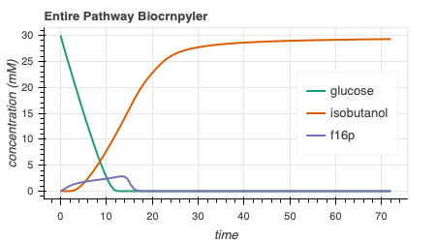
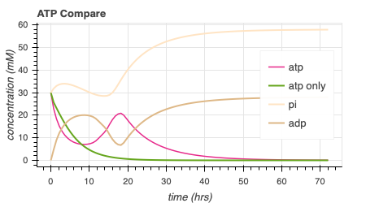
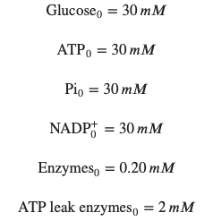
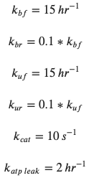
Rheostat Model Output
414.6

Slide 7
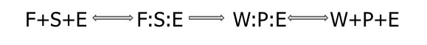
Attempted Reduced Models
1: Remove all complexes
2: Remove 1/2 complexes
3: Remove 1 complex
4: Remove all except atp, isobutanol, glucose
Complexes

Slide 8
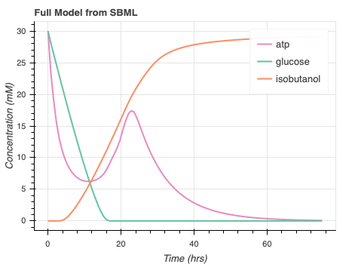
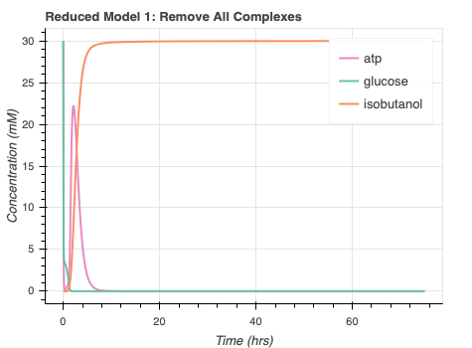
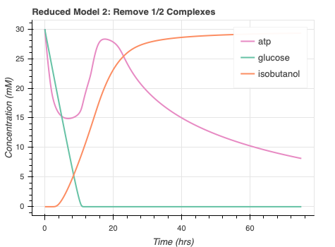
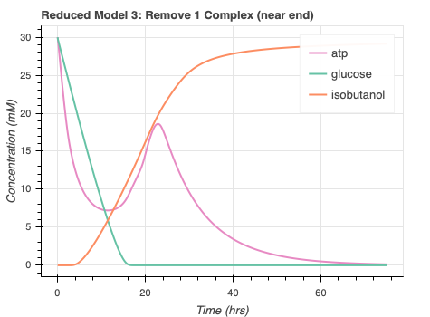
autoReduce progress/issues
Automate SBML to ODE
High error for proposed reduced models
Long runtime for Reduced Model 4
Notes:
Double check red mod 3

Slide 9
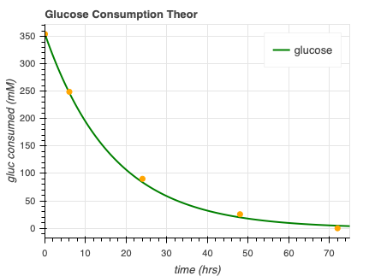
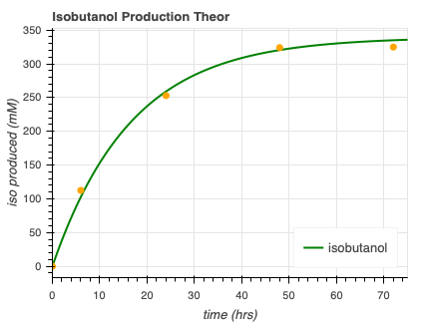



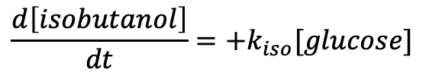
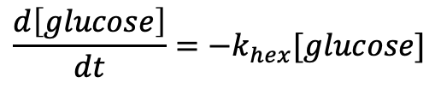

Minimal model progress data from other papers?
$$k_{hex}=0.06$$
$$k_{iso}=0.057$$
$$\frac{d\left[glucose\right]}{dt}=−k_{hex}[glucose]$$
$$\frac{d\left[isobutanol\right]}{dt}=+k_{iso}[glucose]$$
$glucose →^{k_{hex}}$ ⌀
$$glucose →^{k_{iso}}isobutanol$$

Slide 10
Putting rheostat it all together
Model with current minimal parameters in reduced?? Not sure if you are here yet
Either say you are looking for more values/research/ and skip or try to see if you get more wholistic model

Slide 11
Rheostat concerns
Experimental Planning
Accurate enzyme kinetics
nOt enough information
Lot of enzymes in experiment
Could affect transcription, translation
Look into this

Slide 12
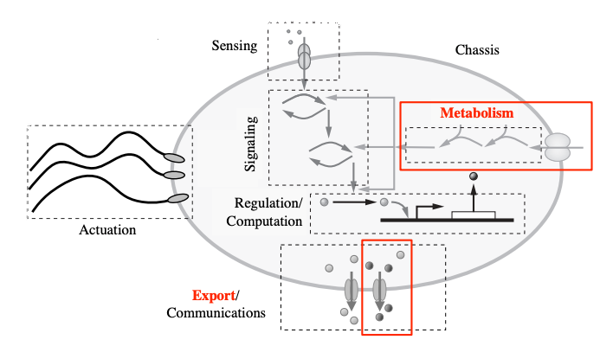
Collaboration
Subsbml model
”rheostat_sbml_model.xml”
Input [enzymes]₀, [glucose]₀, [atp]₀, [pi]₀, [nadp]₀
Murray, Richard, Towards Genetically-Programmed Synthetic Cells and Multi-Cellular Machines, July 2017. PowerPoint Presentation.

Slide 13
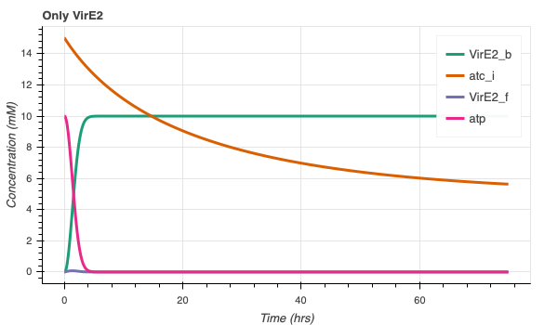
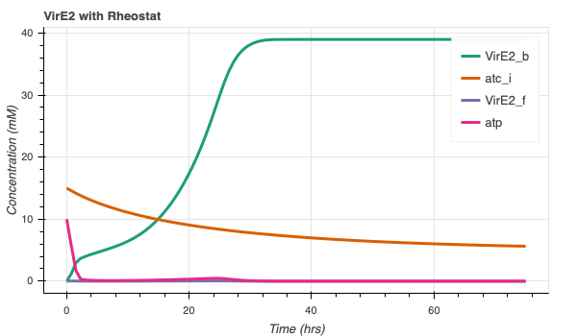
Collaboration with Agrima (VirE2) CHECK UNITS OF THESE
More bound VirE2!
VirE2 model/code courtesy of Agrima Deedwania

Slide 14
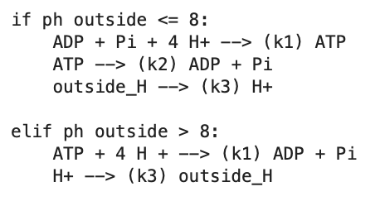
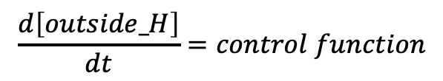
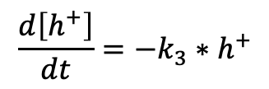

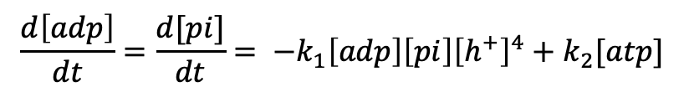
ATP synthase model progress – ATP synthesis
H⁺
ADP + Pi
ATP
TX/TL
$$\frac{d\left[atp\right]}{dt}=k_{1}\left[adp\right]\left[pi\right]{\left[h^{+}\right]}^{4}−k_{2}[atp]$$
$$\frac{d\left[adp\right]}{dt}={\frac{d[pi]}{dt}= −k}_{1}\left[adp\right]\left[pi\right]{\left[h^{+}\right]}^{4}+k_{2}[atp]$$
$$\frac{d\left[h^{+}\right]}{dt}=−k_{3}∗h^{+}$$
$$\frac{d\left[outside_H\right]}{dt}=control function$$

Slide 15
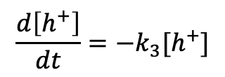
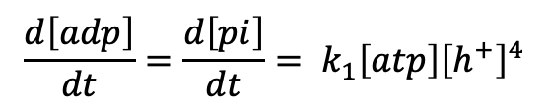
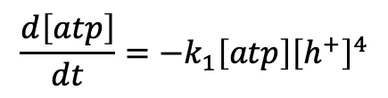
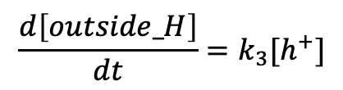
ATP synthase model progress – ATP hydrolysis
H⁺
ADP + Pi
ATP
TX/TL
$$\frac{d\left[atp\right]}{dt}=−k_{1}\left[atp\right]{\left[h^{+}\right]}^{4}$$
$$\frac{d\left[adp\right]}{dt}=\frac{d\left[pi\right]}{dt}= k_{1}\left[atp\right]{\left[h^{+}\right]}^{4}$$
$$\frac{d\left[h^{+}\right]}{dt}=−k_{3}[h^{+}]$$
$$\frac{d\left[outside_H\right]}{dt}=k_{3}[h^{+}]$$

Slide 16
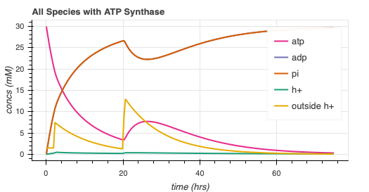
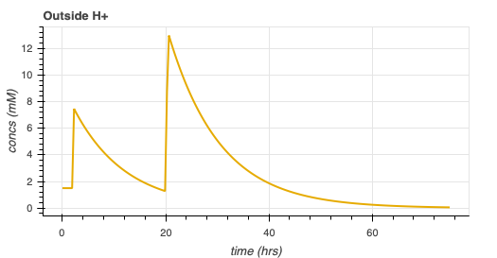
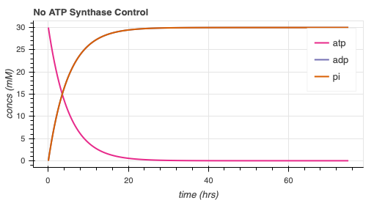
ATP synthase simulation
Arbitrary parameters

Slide 17
Future directions
Rheostat Model
More collaboration!
Develop autoReduce
More work with minimal/reduced models
ATP synthase model develop

Slide 18
Thank You!
William Poole
David Garcia
Ayush Pandey
Richard Murray

