Slide 1

Project Updates
Ankita Roychoudhury
7.20.2020
Murray Lab

Slide 2
Things I want to talk about
My research updates/next steps
Atp synthase steps
Add protein maturation (zoila’s stuff)
Export SBML for ATP?
What mechanism to use for proton gradient
Conclusion for rheostat model?
Recommendation for grad schools, fellowships that have different deadlines for students
Return to RESEARCH!!
Surf presentation

Slide 3
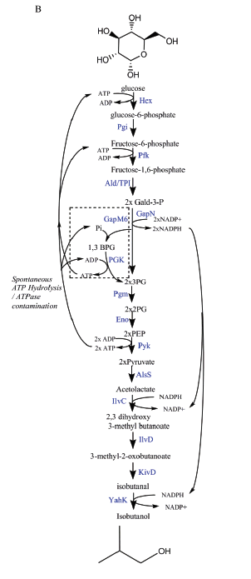
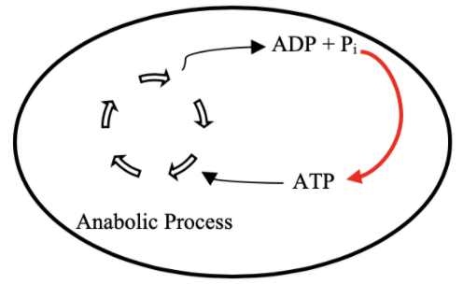
Goal: ATP Life Extension in Synthetic Cells
Proposal 1: Regeneration by Rheostat Machinery
Proposal 2: Regeneration by ATP Synthase
H⁺
ADP + Pi
TX/TL
ATP + H₂0
TX/TL
Ankita Roychoudhury
Opgenorth et al., Nature Chemical Biology, 2017

Slide 4
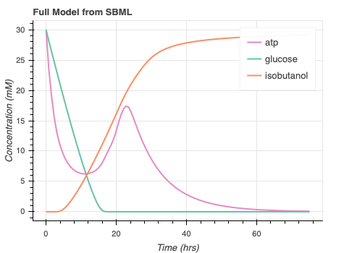
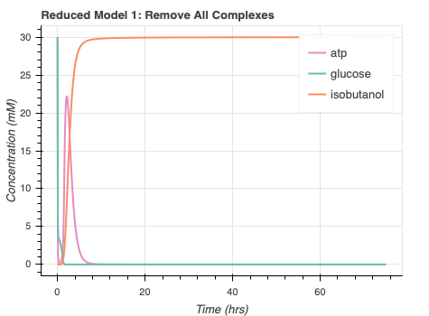

ATP Rheostat
Reduced Model:
Continue to collaborate
Ayush Pandey, R. M. Murray, biorxiv, 2020

Slide 5
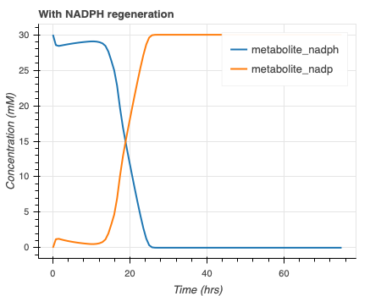
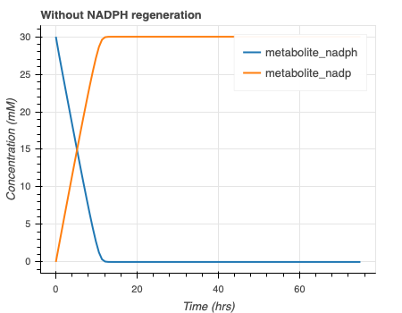
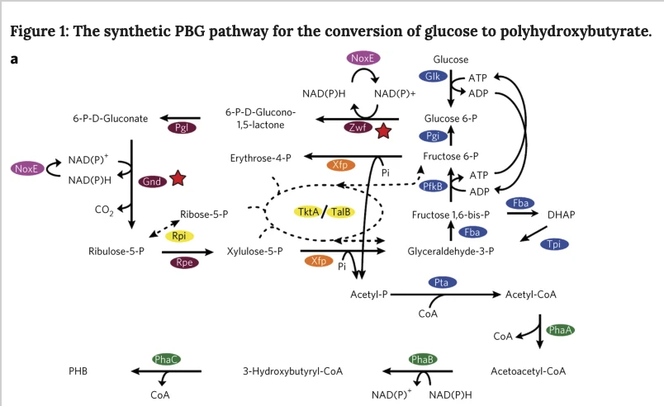
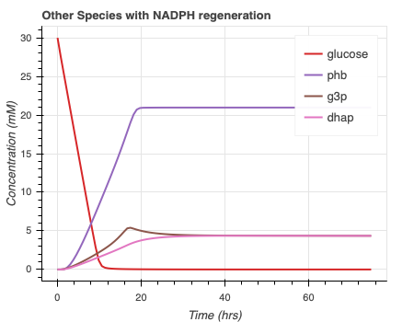
NADPH Regeneration
Opgenorth et al., Nature Chemical Biology, 2016

Slide 6
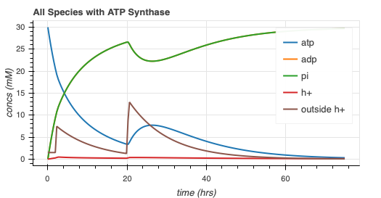
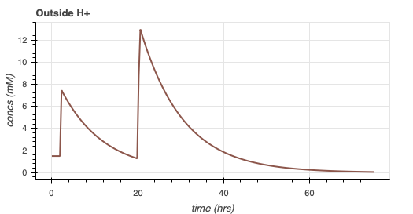
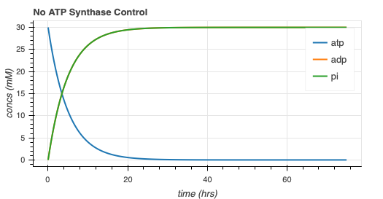
ATP synthase simulation (NO MEMBRANE INTEGRATION)

Slide 7
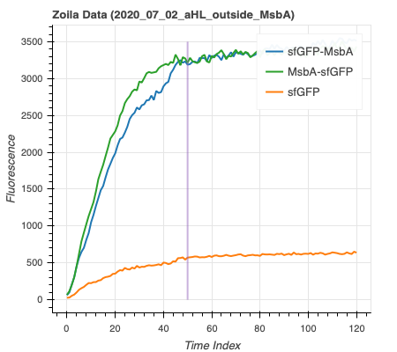
ATP Synthase Model with Gene Expression ZOILA’ DATA
Protein | Size | Dimensions
MsbA | 65 kDa, E.Coli
ATP Synthase | 27 kDa, mitochondrial | Height: 20 nm, Diameter: 10 nm
sfGFP | 26.8 kDa
Membrane integration steady state for MsbA with sfGFP around 6.5 hours
sfGFP size, FPbase superfolder gfp page
ATP Synthase Dimensions, Bionum ID: 111322
Notes:
sfgfp size - https://www.fpbase.org/protein/superfolder-gfp/

Slide 8
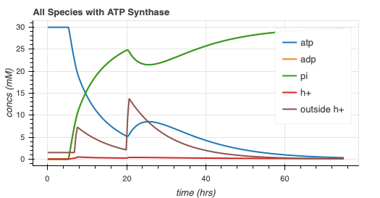
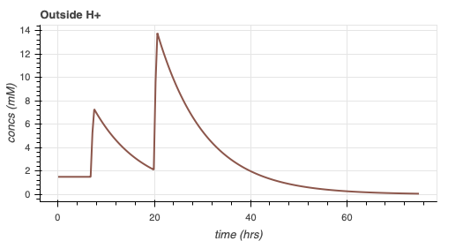
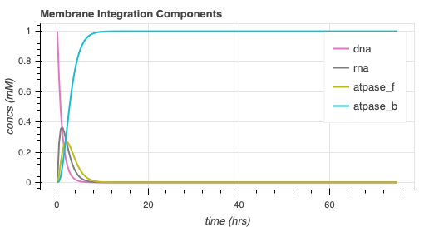
ATP Synthase Model with Gene Expression
Same dynamics, with protein membrane integration delay

Slide 9
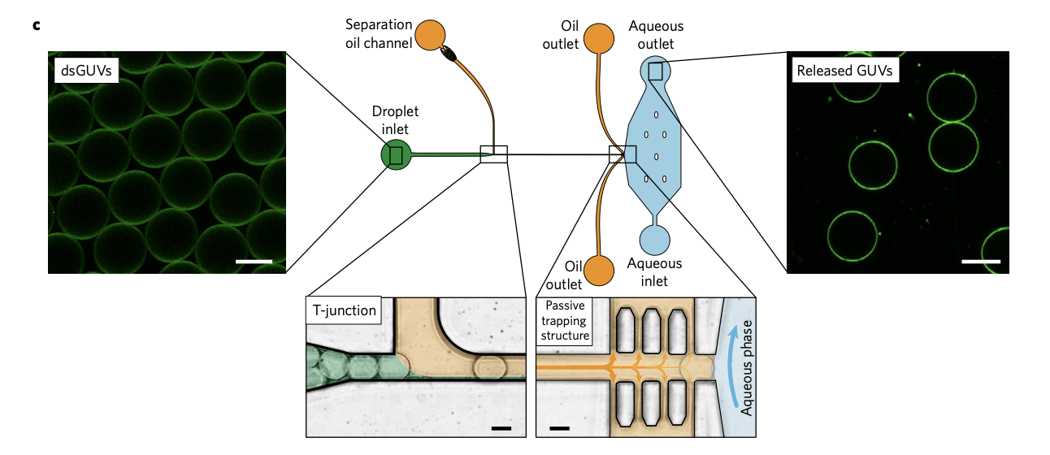
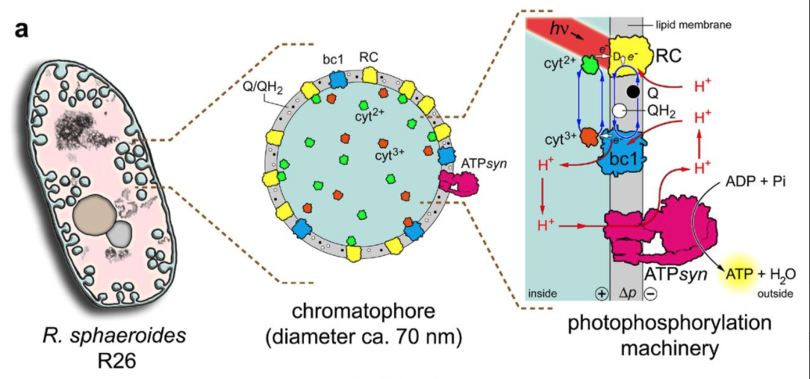
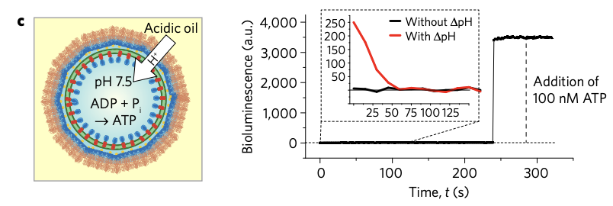
Proton Gradient Mechanisms
Mechanism | Experimental Complexity | Timescale | Comments
Buffer Medium | Low | ~45 mins | (Zgurskaya et al., 1999)
Efflux Pumps | High | ~2.3 hrs (Altamura et al., 2017) ~ 15 hrs (Dunlop et al.) | Photosynthetic reaction center – limited by DNA (Altamura et al.)
Adding acidic oil (ex: FC40) | Medium | ~45 mins | Added to oil phase of dsGUV in microfluidic device (M. Weiss et al., 2018)
Buffer Medium
Efflux Pumps
Adding Acidic Oil
pH 6.0
pH 7.0
Notes:
Weiss (oil) - https://www.nature.com/articles/nmat5005#MOESM1
Zgurskaya (buffer) - https://pubmed.ncbi.nlm.nih.gov/10377390/
Dunlop (efflux) - https://www.ncbi.nlm.nih.gov/pmc/articles/PMC3130554/
Altamura - https://www.pnas.org/content/114/15/3837.short

Slide 10
Future directions - ATP synthase
Implement proton gradient mechanism
scipy.odeint() custom function to collaborate with BioCRNPyler (through SBML?)

Slide 11
Misc.
SURF presentation
Grad school update

Slide 12
Fellowship/School | Due Date for Recommendation
Hertz Fellowship

Slide 13
Thank You!
William Poole
David Garcia
Ayush Pandey
Zoila Jurado
Manisha Kapasiawala
Melissa Takahashi
Richard Murray
Samuel P. and Frances Krown SURF Fellow

