Slide 1
ATP Life Extension in Synthetic Cells
Ankita Roychoudhury
Murray Lab
6.2.2020

Slide 2
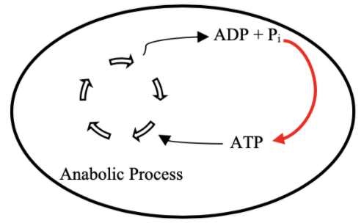
Goal: ATP Life Extension in Synthetic Cells by Regeneration
TX/TL

Slide 3
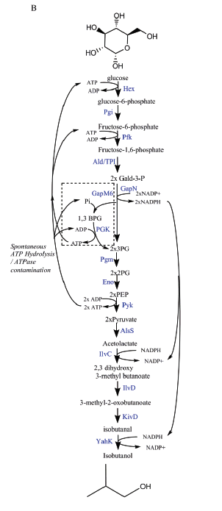
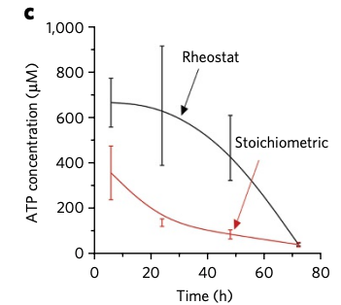
Proposed Model: Rheostat Machinery
Notes:
Shown in buffer
We want to show with txtl
Bowie lab

Slide 4
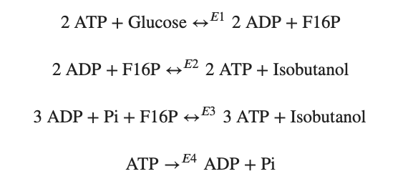
Modelling Approach
1) Simple pathway - bioscrape
Choose an enzymatic mechanism
2) Simple pathway – biocrnpyler
3) Entire pathway - biocrnpyler
Notes:
We have shown the simplified pathway on the right that we will use for the simplified modeling for convenience

Slide 5
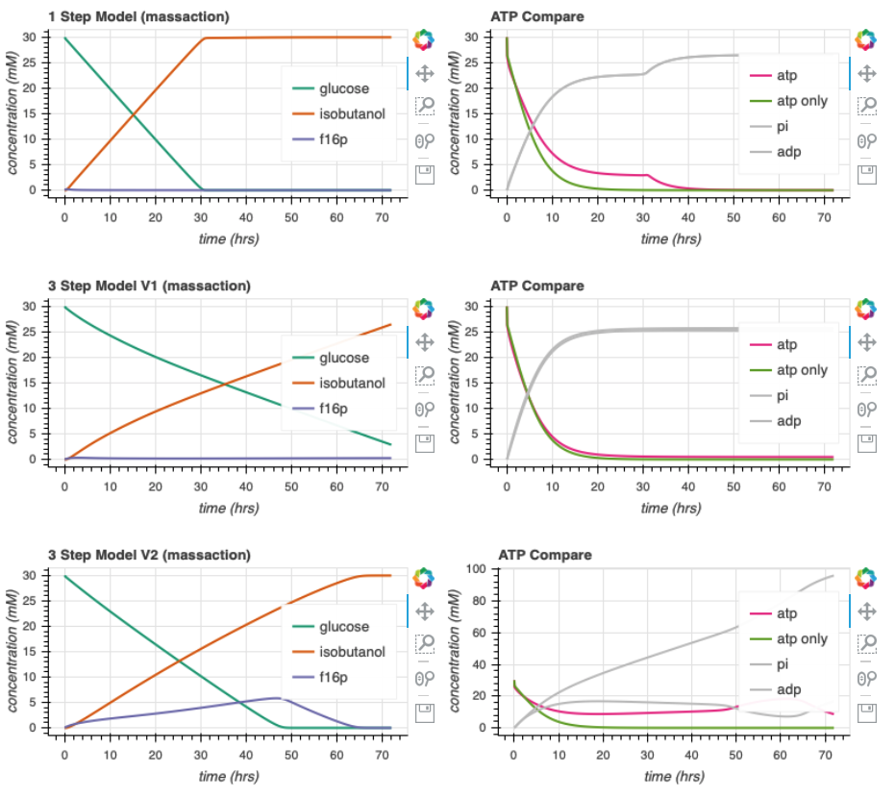
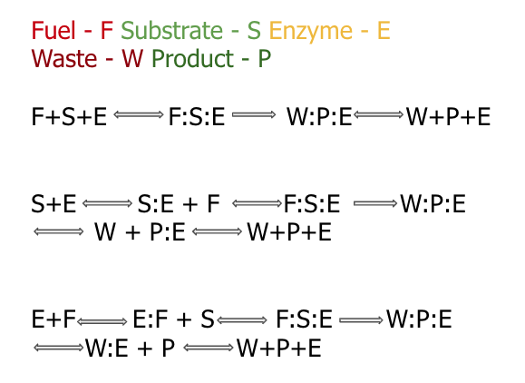

Enzymatic Models
Notes:
Here, we show the different enzymatic models we’ve tried to study
<click>
At this point, I chose slightly arbitrary parameters. They are generally on the correct order of magnitude but they may not entirely accurate.
Go through the graphs
ATP leak curve is a large oversimplification to try to account for the atp hydrolysis by atpase activity and the atp used in tx/tl
we make sure that these parameters ensure use of atp by time 20 in the simulations that only consider atp (experimental evidence)

Slide 6
Model 1:
Model 2:
Model 3:

Slide 7

Mechanism
Biocrnpyler
Component
Mixture
Called FuelMichaelisMenten
Type ‘catalysis’
Takes in enzyme, fuel_list, substrate_list, product_list, waste_list
Binding, catalysis, and unbinding reaction
Called Enzyme
Uses mechanism ‘catalysis’
Also takes in $k_{uf}, k_{bf}, k_{cat}$
Called EnergyTxTl
Uses mechanism ‘catalysis’

Slide 8
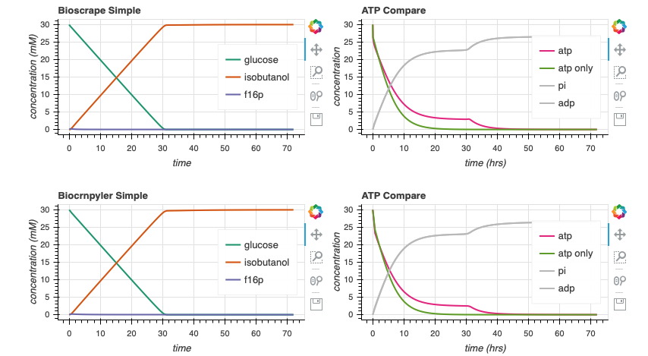

Bioscrape Biocrnpyler Comparison

Slide 9
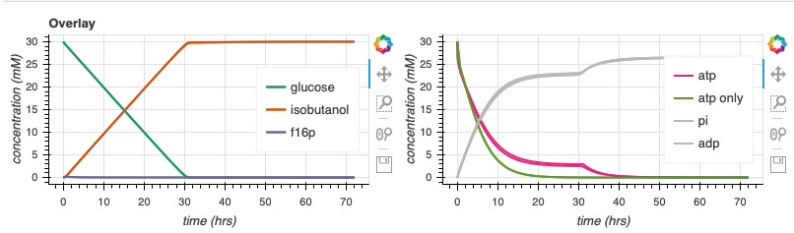
Bioscrape Biocrnpyler Comparison
Notes:
Why is it thicker?

Slide 10






Parameter Estimates
$$k_{bf}$$
$$k_{cat}$$
$$k_{uf}$$
$$k_{br}$$
$$k_{ur}$$
Notes:
In attempt to explore the dynamics of the pathway, I made some parameter generalizations to begin with.
All the k for all the enzymes in the pathway are the same
We assume that we put the same amount of each enzyme in the mixture.
ATP leak enzymes is a large oversimplification to try to account for the atp hydrolysis by atpase activity and the atp used in tx/tl
we make sure that these parameters ensure use of atp by time 20 in the simulations that only consider atp (experimental evidence)

Slide 11
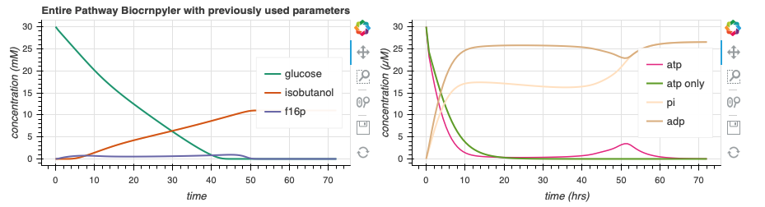
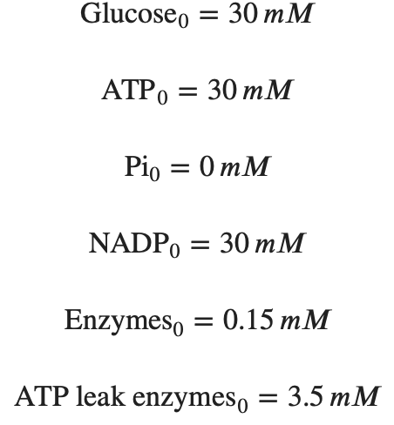
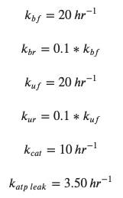
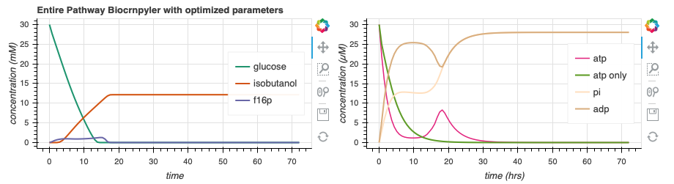
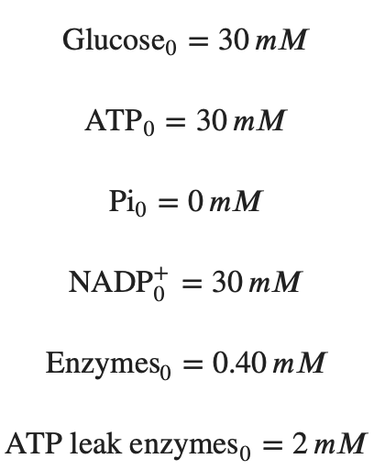
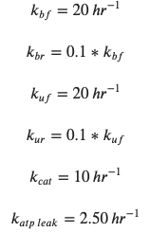
Simulate Entire Pathway - Biocrnpyler
44.4
s⁻¹
130.7
s⁻¹
Adjusting the rate of atp leak and the initial concentrations of enzymes can lead to more optimal dynamics.
Notes:
Now, we incorporate this entire pathway in biocrnpyler.
On the top here, we have used very similar parameters from before. Now, I will begin to do a bit of parameter search to try to find cases where there may be more optimal dynamics and to try an gain a better intuition of the pathway .
<click>
On the bottom, I’ve changed the initial amount of enzymes (CLICKS!) and the rate of atp leak a bit in attempt to move the ‘hump’ of atp production. Note that the green line represents the simulation with only atp leak, no rheostat machinery. We would ideally like the pink ‘atp’ line to be right-shifted in comparison to the green atp only line.
<click>
Moving forward, I will perform a parameter search to try to optimize the area underneath the curve of the pink atp line and also try to gain a better intuition of why we see what we see. While doing the optimizations, we must keep in mind that the green atp_only line should continue to reach 0 around time 20. For reference, here are the integral values of the atp line.

Slide 12
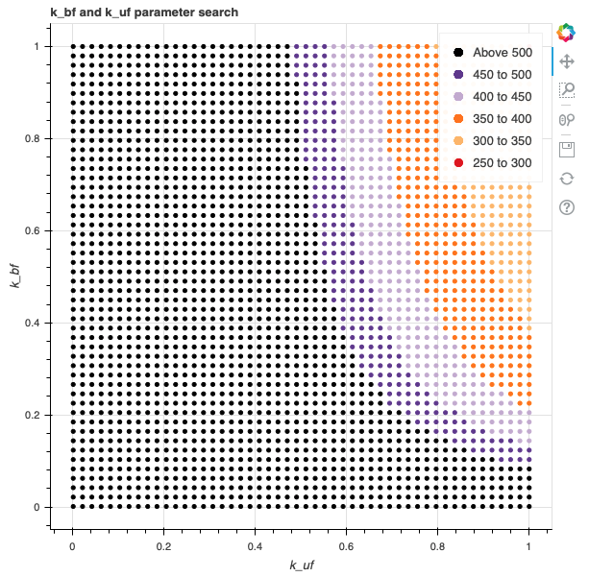
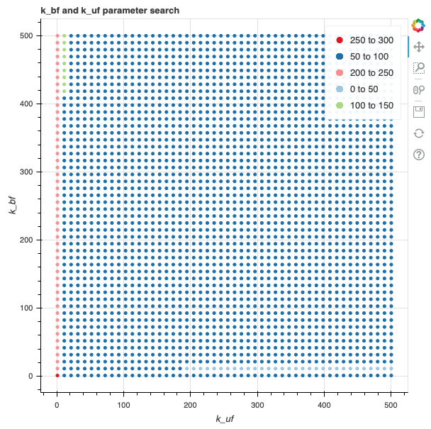
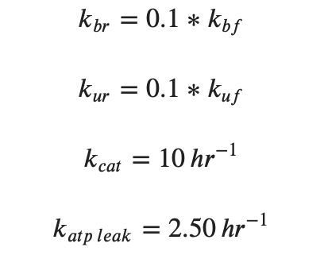
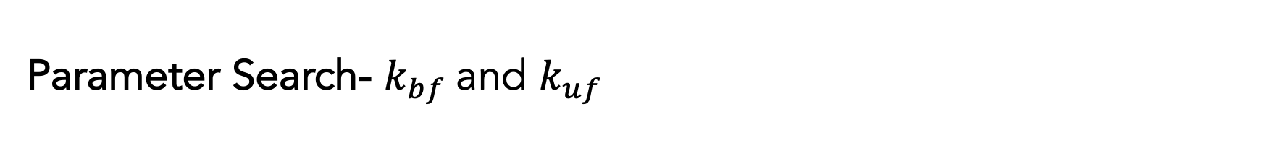
Parameter Search- $k_{bf}$and $k_{uf}$
s⁻¹
Slower rates tend to cause prolonged ATP life extension, as expected.
Notes:
This is a quick parameter search of the binding and unbinding rates – the first plot I range kbf and kuf from 0 to 1. The color code corresponds to a region of areas. On the second graph, I range the binding rates from 0 to 500. <CLICK>
For the most part, we see that lower binding rates are indeed better. But we should visualize them to make sure that it does not affect the atp_only dynamics too much.

Slide 13
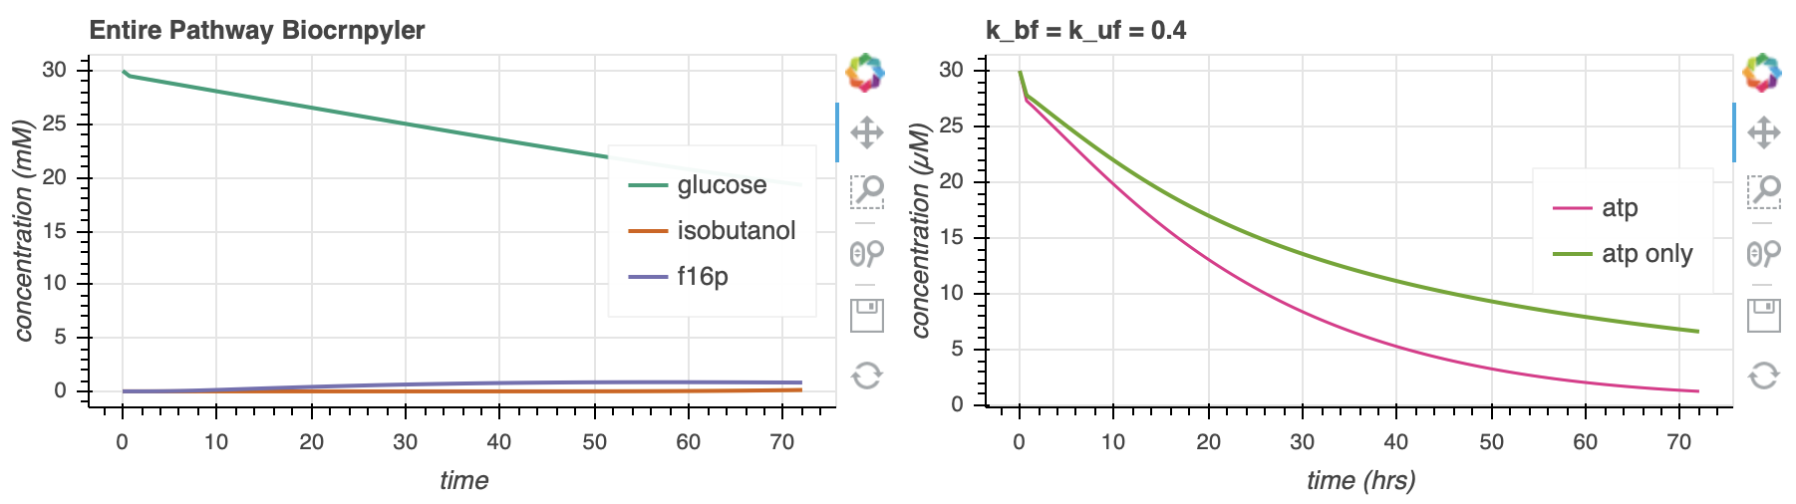
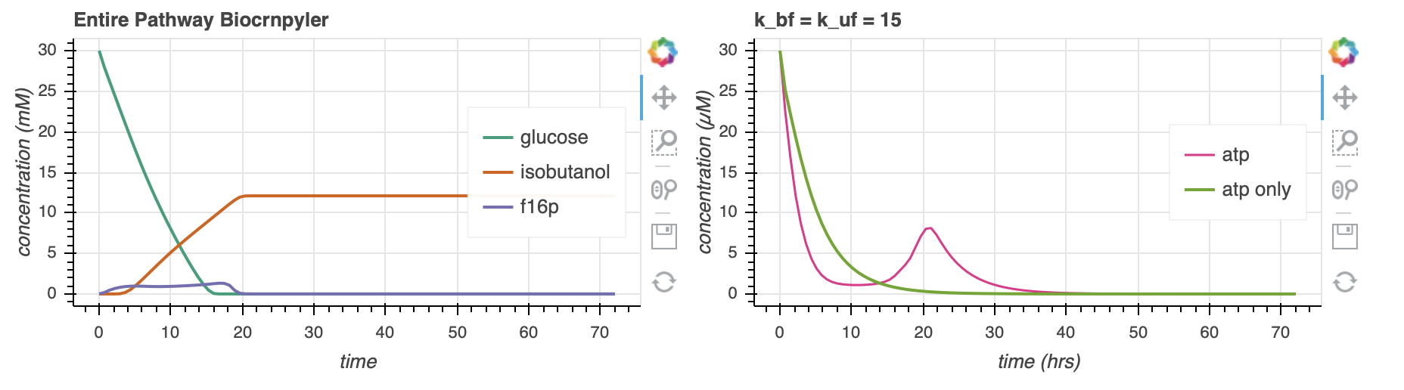
Parameter Search- $k_{bf}$and $k_{uf}$
662.9
144.2
Notes:
Ok here I’ve plotted one of the more optimal settings – as we can see, for values of k_bf and k_uf that are too low, the atp_only dynamics are sacrificed.
<CLICK>
However, by doing some minimization and playing around with the parameters, I find that values around 15 seem to be most optimal and can show prolonged atp lifetime with the rheostat machinery while making sure that the atp leak value goes to 0 around 20.
<VLICK>
Here are their relative areas for reference

Slide 14
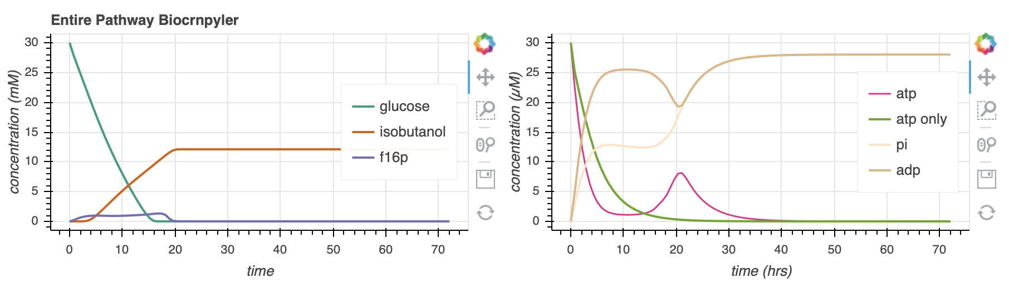
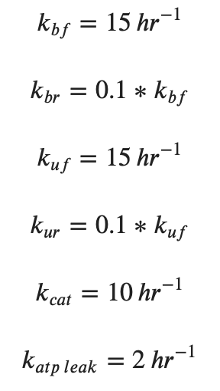
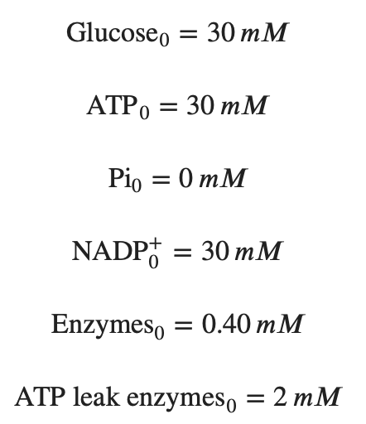
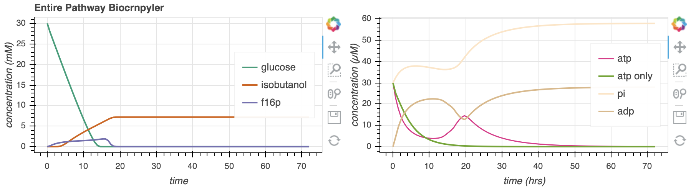
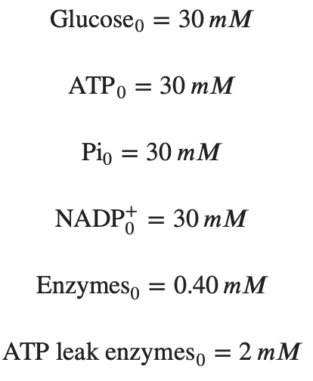
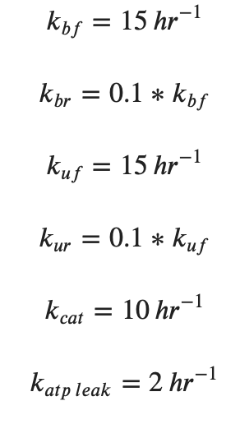
Increasing [Pi]₀ extends ATP lifetime
144.2
s⁻¹
291.3
s⁻¹
Notes:
I also see that increasing the initial free phosphate concentration can increase the amount of atp produced without affecting the atp_only curve.
In the context of simulations, this is relatively positive since we do indeed see that we can get extended atp lifetime, up to about 40 hours. However, the parameter estimates and assumptions we have made may be a bit concerning. NEXT

Slide 15
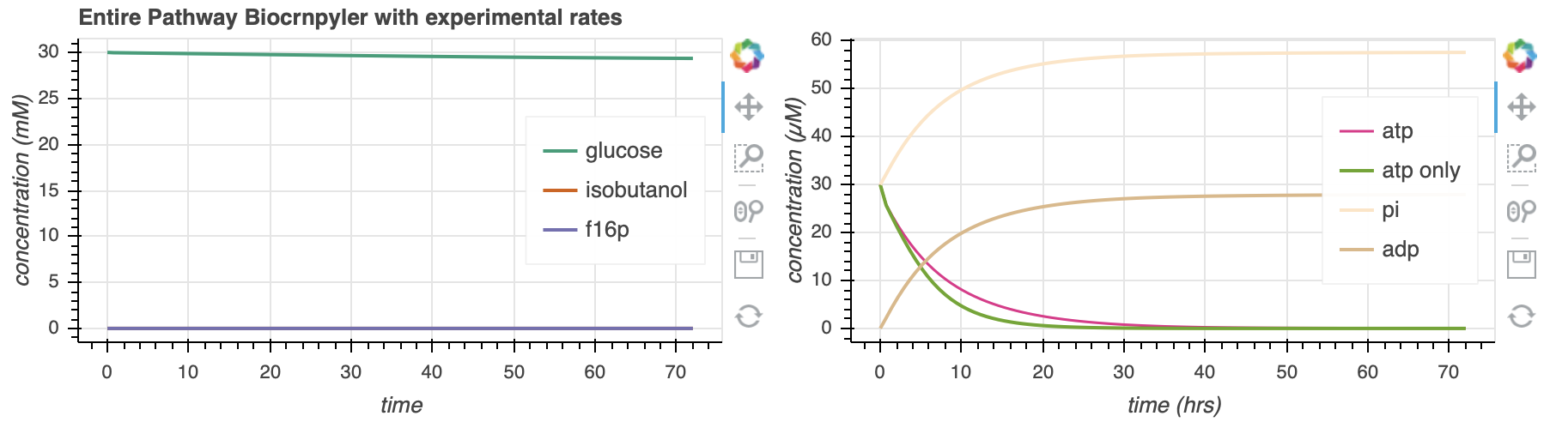
Compare with experimental enzyme rates and initial concentrations
Notes:
Here, I’ve shown what the plot looks like when I input some parameters from the paper that discuss the relative enzyme activities
(instead of generalizing for a particular k_bf and k_uf for all the enzymes)
As we can see, the effect of the rheostat seems to be diminished greatly. Moving forward, it may be useful to perform a type of parameter optimization on this scenario.

Slide 16
Future Directions
Extended parameter search with experimental enzyme rates
Attempt to model with TXTL conditions
Plan an experiment
Begin simulating other lifetime extension models

Slide 17
Supplementary

Slide 18
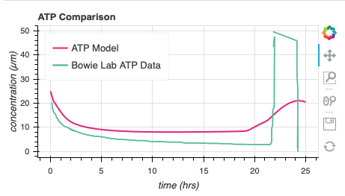
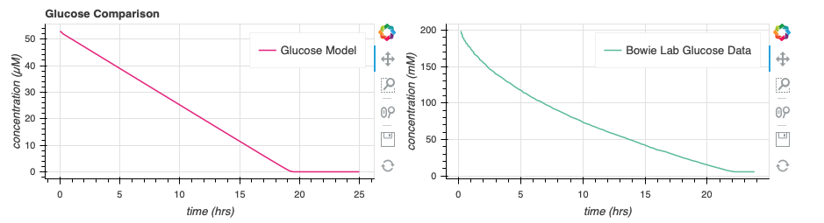
Weak Data Comparison

