Slide 1
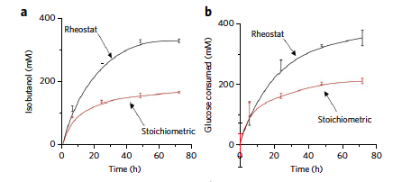
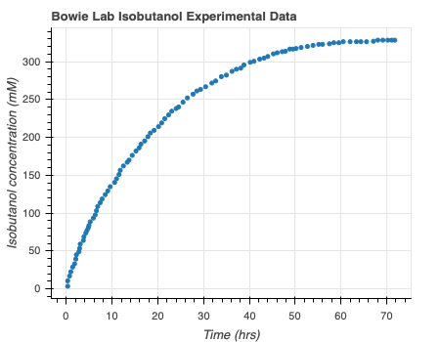
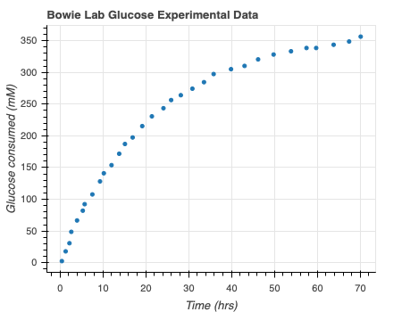

Model Bowie Lab Experimental Data
Digitizeit
Rheostat pathway data: Opgenorth et al., 2017, Nature Chemical Biology
Notes:
Use digitize it to get the consumption over time – subtract times and rates to get rates (mM/hr) – perform MLE on this data
Bootstrapping from all the confidence intervals
Need help – not sure that negative binomial approach is correct? Should I take Bayesian approach? Is this necessary? Should I use binomial model? Is Glucose production rate that right thing to be looking at? How to extrapolate to my data?

Slide 2
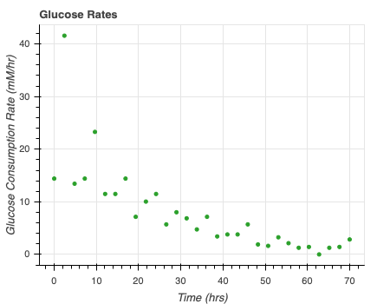
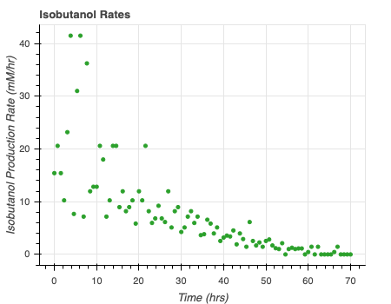

Model Bowie Lab Experimental Data
Rate = $\frac{d[x]}{dt}$
Rheostat pathway data: Opgenorth et al., 2017, Nature Chemical Biology
Notes:
Use digitize it to get the consumption over time – subtract times and rates to get rates (mM/hr) – perform MLE on this data
Bootstrapping from all the confidence intervals
Need help – not sure that negative binomial approach is correct? Should I take Bayesian approach? Is this necessary? Should I use binomial model? Is Glucose production rate that right thing to be looking at? How to extrapolate to my data?

Slide 3
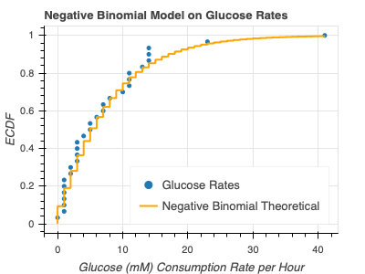
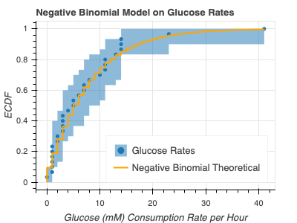
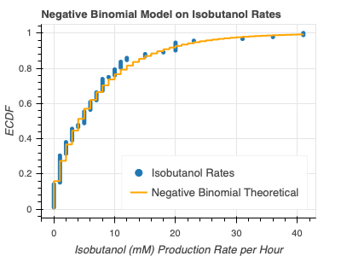
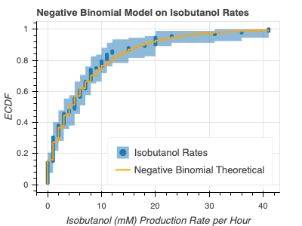
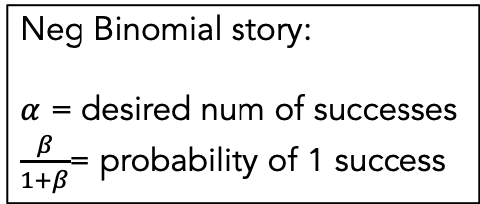
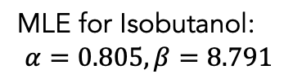
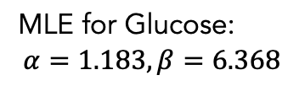
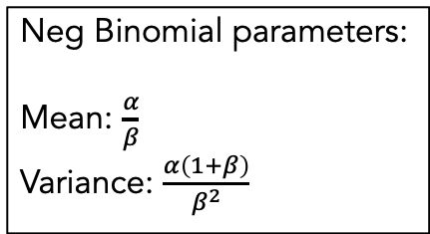
Model Bowie Lab Experimental Data
Neg Binomial parameters:
Mean: $\frac{α}{β}$
Variance: $\frac{α\left(1+β\right)}{β^{2}}$
MLE for Glucose:
$$α=1.183, β=6.368$$
Neg Binomial story:
$α$ = desired num of successes
$\frac{β}{1+β}$= probability of 1 success
MLE for Isobutanol:
$$α=0.805, β=8.791$$
Notes:
Use digitize it to get the consumption over time – subtract times and rates to get rates (mM/hr) – perform MLE on this data
Bootstrapping from all the confidence intervals
Need help – not sure that negative binomial approach is correct? Should I take Bayesian approach? Is this necessary? Should I use binomial model? Is Glucose production rate that right thing to be looking at? How to extrapolate to my data?

