Slide 1

ATP Life Extension in Synthetic Cells
Synthetic Cell Meeting 7.15.2020
Ankita Roychoudhury
Murray Lab

Slide 2
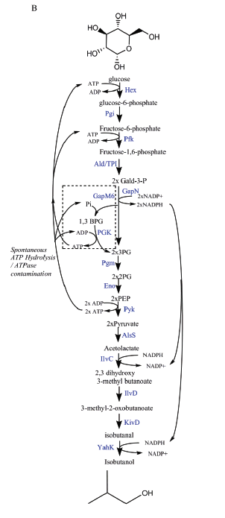
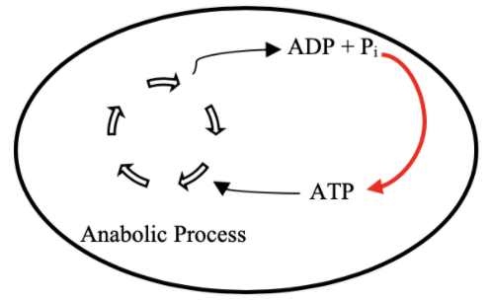
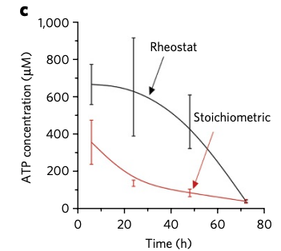

Goal: ATP Life Extension in Synthetic Cells
Proposal 1: Regeneration by Rheostat Machinery
TX/TL
Opgenorth et al., 2017, Nature Chemical Biology

Slide 3
Roadmap
Model entire rheostat in BioCRNPyler
Investigate reduced (autoReduce) and minimal models
Study an ATP Synthase Model
Parameter experimentation to understand pathway and optimize
Collaborate with other projects
Experimental Planning (?)

Slide 4
Model Overview
Full Model
CRN Mass action
(k_{bf1}, k_{br1}, k_{uf1}, k_{ur1},k_{cat1},k_{bf2},…)
Minimal Model
Coarse-grained
(k₁, k₂ = k)
Lumped parameters
Extracted from experimental data
Effective relations to help argue values of reduced model
Include assumptions
Conservation laws
QSSA
Generalize binding/unbinding
Reduced Model
(k₁, k₂,…)
More relevant to experimental data
Notes:
Full model has all reaction rate parameters
This makes sense – I’ve optimized the full model, but how can I come up with some biological relevance

Slide 5
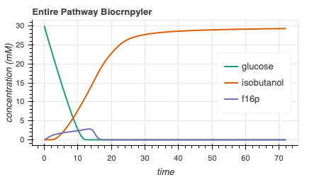
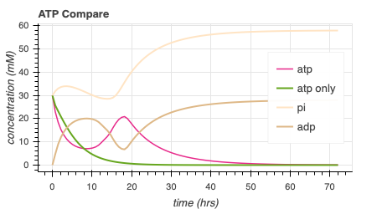
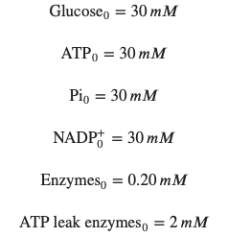
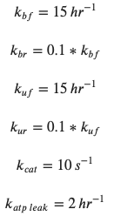
Rheostat Model Output
414.6
Notes:
Isobutanol toxicity - once around 180 mM, cells stopped growing
https://www.ncbi.nlm.nih.gov/pmc/articles/PMC3242789/
Concentrations of 1-2 % v/v isobutanol can induce toxic effects in microbial production host, reducing growth rates and precursor synthesis – low product yields
E coli = volume = 1 umeter^3 , length – 1-2 umeter = 1000 nanometer
GUV = 300 nanometer , volume = 0.3 umeter^3
Conc of isobutanol – 30 mM
Isobutanol toxicity: n-butanol can interact with the cell by altering the lipid composition and fluidity of the membrane, decreasing intracellular pH and ATP concentration, inhibiting the uptake of glucose. Isobutanol stress response in E.coli is quantitively similar to that of n-butanol with respect to transcriptional levels, except for increased repression of amino acid biosynthesis by n-butanolhttps://www.embopress.org/doi/full/10.1038/msb.2010.98

Slide 6
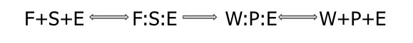
Attempted Reduced Models
1: Remove all complexes
2: Remove 1/2 complexes
3: Remove 1 complex
4: Remove all except atp, nadph, isobutanol, glucose, enzymes
Complexes

Slide 7
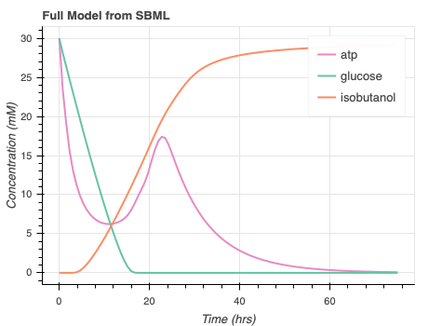
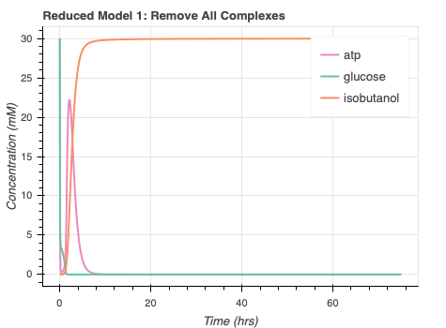
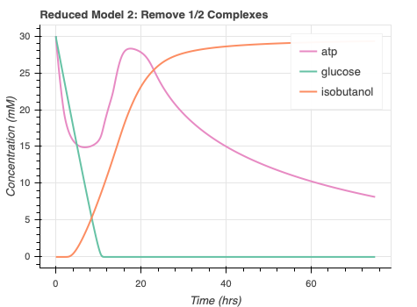
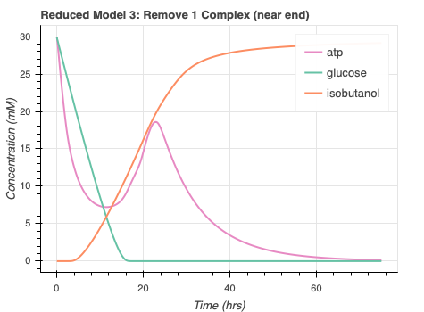
autoReduce progress/issues
Automate SBML to ODE
High error for some proposed reduced models
Errors for Reduced Model 4
Notes:
Seems like all the models reach the appropriate steady state value
Concerns include the sacrificed dynamics. Not sure why remov ing all complexes quickens all the dynamics and why removing ½ complexes seems to only delay atp dynamics.
Have to find a compromise between having curves close to the full model but also reducing the amount of species and corresponding parameters required
Maybe look at redmod1, has a lot less parameters, adjust parameters to see desired dynamics, kind of like having different mechanism in biocrnpyler
Benefits: lumped parameters in reduced models, lower num of params to analyze system with. Helps with parameter identification. Without data, a reduced model may be closer to phenomenological model so you can conclude things about model in easier manner because you only have the species that you care about
Param sweeps and simulations with a red model would be more about how outputs are affected by inputs bc you get rid of other states so could guide design choices
Get a better understanding of what really matters from a physical point of view – is it that a particular metabolite affects dynamics or some other species etc – can be helpful information
Am hoping that if more experiments are done with this system, parameters can be extracted and inserted into one of these reduced models compared to the full massaction model .
Easier to work with more generalized dynamics.

Slide 8
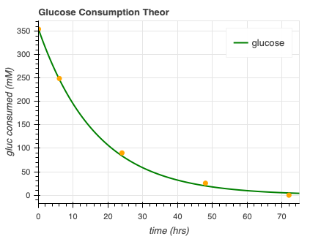
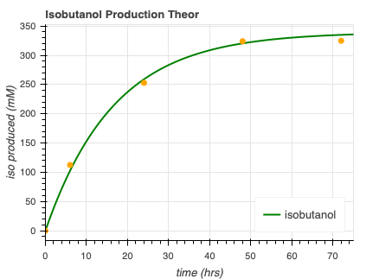


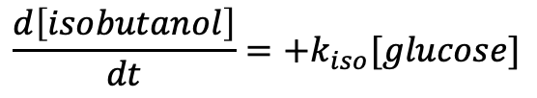
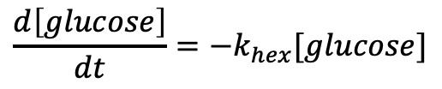


Minimal model progress
$$\frac{d\left[isobutanol\right]}{dt}=+k_{iso}[glucose]$$
$$\frac{d\left[glucose\right]}{dt}=−k_{hex}[glucose]$$
$glucose →^{k_{hex}}$ ⌀
$$glucose →^{k_{iso}}isobutanol$$
$$k_{hex}=0.06$$
$$k_{iso}=0.057$$
Opgenorth et al., 2017, Nature Chemical Biology
Notes:
Kind of gives us a guide on the timescale of glucose/isobutanol consumption but this minimal model seems quite disconnected from underlying dynamics since there is only one state.
An attempt at using experimental data. Gives us a frame of reference of what parameters should look like. Tells us what the overarching rate is but doesn’t necesarilly help with the reduced model unless I can get a model to work that only has glucose and isobutanol, and prpbably atp, in it
I am limited by experimental data.

Slide 9
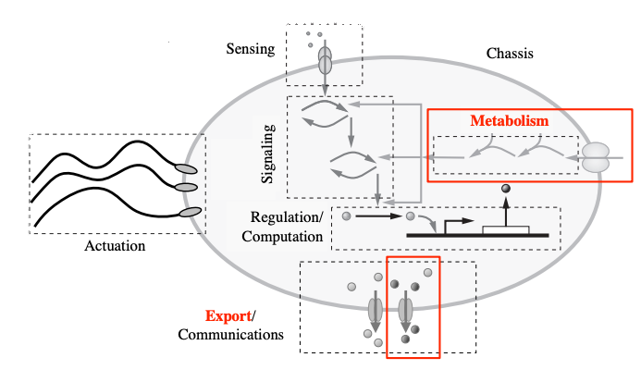
Collaboration
Subsbml model
”rheostat_sbml_model.xml”
Input [enzymes]₀, [glucose]₀, [atp]₀, [pi]₀, [nadp]₀
Murray, Richard, Towards Genetically-Programmed Synthetic Cells and Multi-Cellular Machines, July 2017. PowerPoint Presentation.
Notes:
Working on metabolism! Can work with any of these other processes, like export, signaling, regulation, etc as long as atp consumption is modelled! Have to input some initial concentrations once the sbml model is downloaded and then you’re good to go!
I’m happy to work with anyone’s models and look into this.

Slide 10
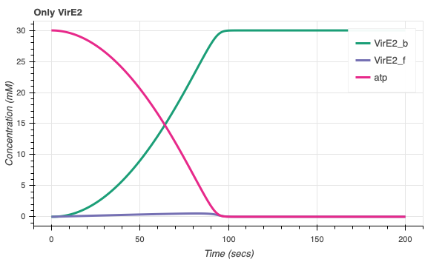
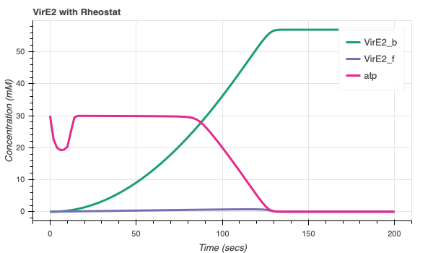
Collaboration with Agrima (VirE2)
More bound VirE2!
VirE2 model/code courtesy of Agrima Deedwania
Notes:
One that we’ve tried, that you’ve already kind of heard about, is my collab with Agrima. One issue is that my regeneration was on timescale of 50 hrs and Agrima’s process is on order of 1 minute. For this reason, when the models were initially combined, there was no effect to the amt/rate of vire2 bound. Once I lowered the timescale of my system so atp regeneration could happen quicker, I was able to see effects. Something to consider moving forward. Find what’s accurate.
Timescale of membrane insertion may be too quick, so that's also something to adjust in the future

Slide 11
Rheostat concerns
Accurate enzyme kinetics
Limited information
Many enzymes
How may these enzymes affect transcription translation
Timescale separation
Parameter estimation

Slide 12
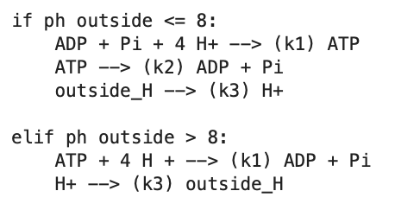
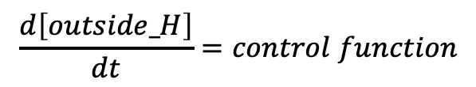
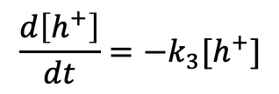

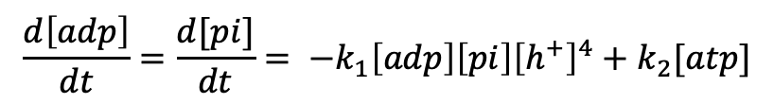
ATP synthase model progress – ATP synthesis
If pH outside <= 8:
H⁺
ADP + Pi
ATP
TX/TL
$$\frac{d\left[atp\right]}{dt}=k_{1}\left[adp\right]\left[pi\right]{\left[h^{+}\right]}^{4}−k_{2}[atp]$$
$$\frac{d\left[adp\right]}{dt}={\frac{d[pi]}{dt}= −k}_{1}\left[adp\right]\left[pi\right]{\left[h^{+}\right]}^{4}+k_{2}[atp]$$
$$\frac{d\left[h^{+}\right]}{dt}=−k_{3}[h^{+}]$$
$$\frac{d\left[outside_H\right]}{dt}=control function$$

Slide 13
ATP synthase model progress – ATP synthesis
H⁺
ADP + Pi
ATP
TX/TL
$$\frac{d\left[atp\right]}{dt}=k_{1}\left[adp\right]\left[pi\right]{\left[h^{+}\right]}^{4}−k_{2}[atp]$$
$$\frac{d\left[adp\right]}{dt}={\frac{d[pi]}{dt}= −k}_{1}\left[adp\right]\left[pi\right]{\left[h^{+}\right]}^{4}+k_{2}[atp]$$
H⁺
$$\frac{d\left[h^{+}\right]}{dt}=−k_{3}[h^{+}]$$
$$\frac{d\left[outside_H\right]}{dt}=control function$$

Slide 14
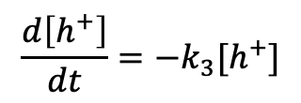
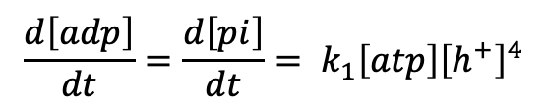
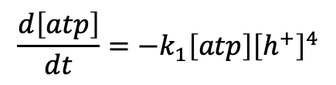
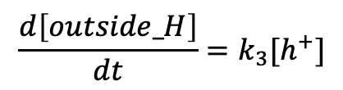
ATP synthase model progress – ATP hydrolysis
If pH outside > 8:
H⁺
ADP + Pi
ATP
TX/TL
$$\frac{d\left[atp\right]}{dt}=−k_{1}\left[atp\right]{\left[h^{+}\right]}^{4}$$
$$\frac{d\left[adp\right]}{dt}=\frac{d\left[pi\right]}{dt}= k_{1}\left[atp\right]{\left[h^{+}\right]}^{4}$$
$$\frac{d\left[h^{+}\right]}{dt}=−k_{3}[h^{+}]$$
$$\frac{d\left[outside_H\right]}{dt}=k_{3}[h^{+}]$$

Slide 15
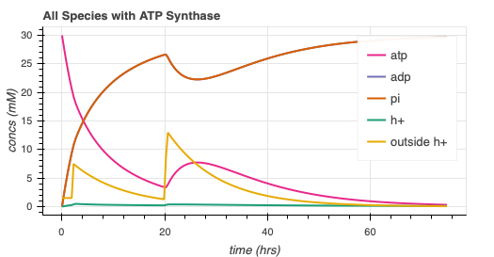
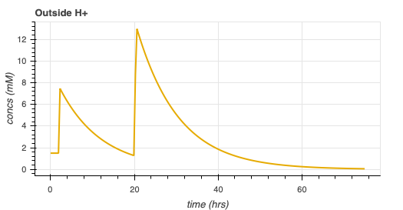
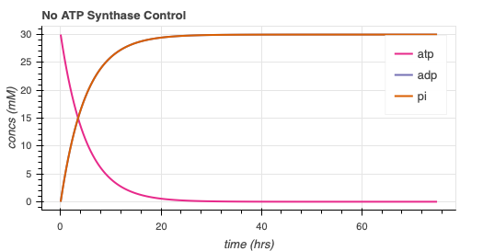
ATP synthase simulation
Arbitrary parameters
Add complexity
Protein folding
Membrane integration

Slide 16
Future directions
Rheostat Model
More collaboration!
Develop autoReduce
More work with reduced models
ATP synthase model develop

Slide 17
Thank You!
William Poole
David Garcia
Ayush Pandey
Zoila Jurado
Manisha Kapasiawala
Melissa Takahashi
Richard Murray
Samuel P. and Frances Krown SURF Fellow

