Slide 1
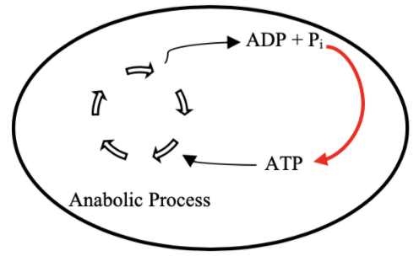
ATP Life Extension in Synthetic Cells
TX/TL
Ankita Roychoudhury
Lab Meeting
8.25.2020

Slide 2
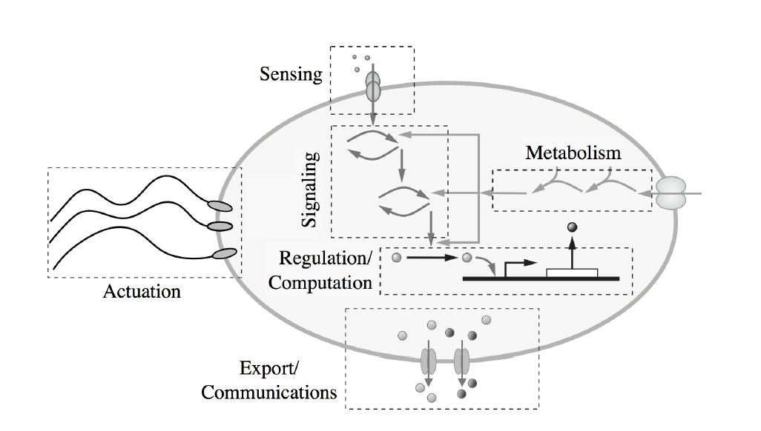

What are synthetic cells?
Escherichia Coli
Synthetic Cell
Tx
Tx
Tl
Tl

Slide 3
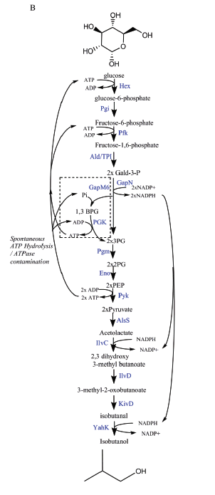
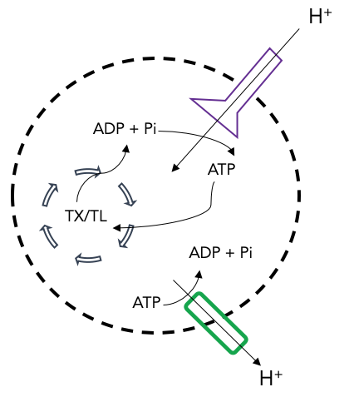
Proposal 1: Regeneration by Rheostat Machinery
Proposal 2: Regeneration by ATP Synthase
Goal: ATP Life Extension in Synthetic Cells
TX/TL
Opgenorth et al., Nature Chemical Biology, 2017

Slide 4


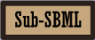
Software Tools
Create Model!
Communicate & Combine!
Bioscrape
Simulate!

Slide 5
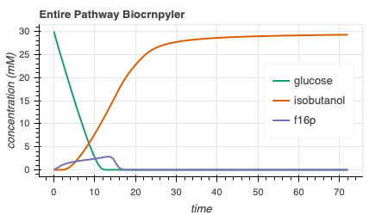
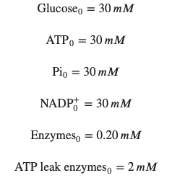

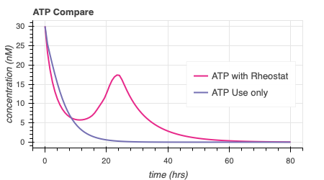
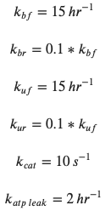
Rheostat Model Output
414.6

Slide 6
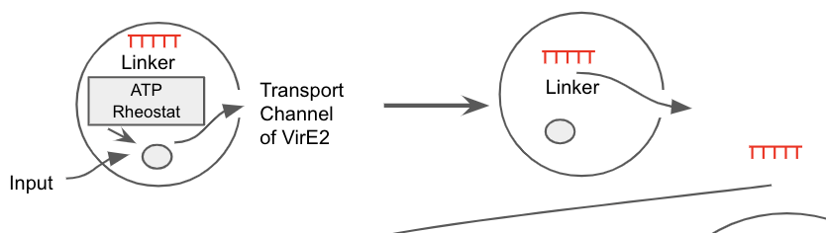
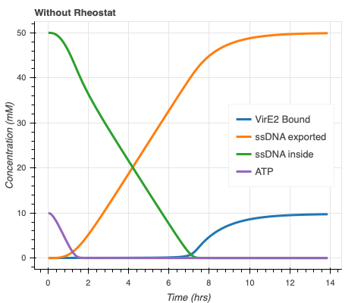
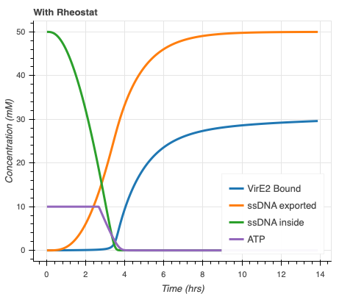
Rheostat Model + ssDNA Export Model
Concentration (nM)
Concentration (nM)
Faster ssDNA export and more bound VirE2!
Export model courtesy of Agrima Deedwania (IIT Delhi)

Slide 7
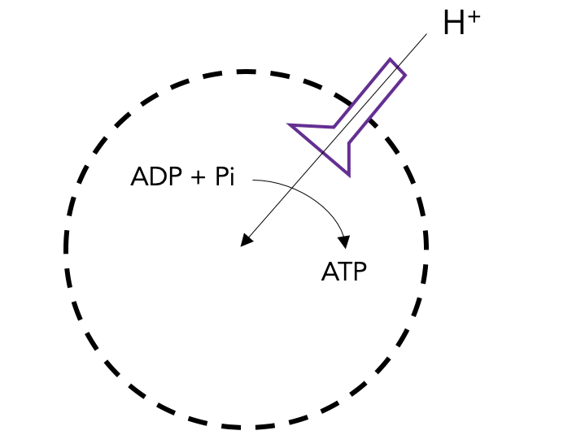
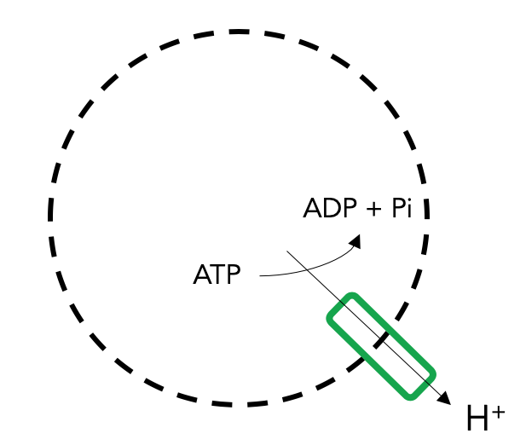
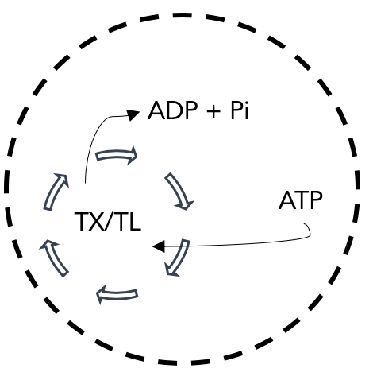
ATP Synthase Components
ATP Synthase Transcription & Translation
ATP Synthase Membrane Integration
ATP Synthesis through ATP Synthase
ATP Synthesis
Proton Pump Transcription & Translation
Proton Pump Membrane Integration
Proton movement through Proton Pump
Maintain Proton Gradient
ATP Use
ATP Hydrolysis

Slide 8
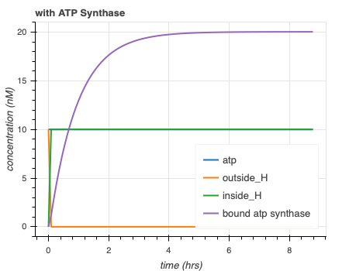
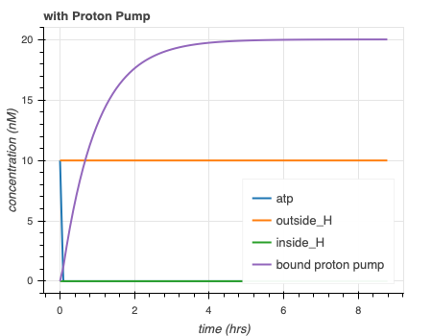
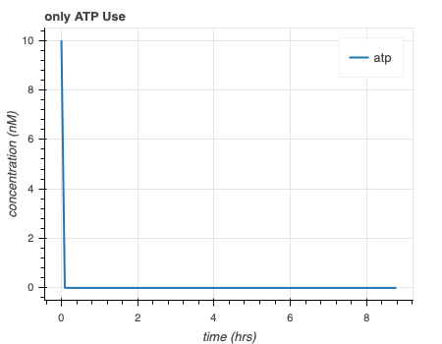
Separate simulations for ATP synthase model are as expected
Initial Conditions - Tx/Tl Machinery, outside_H, dna for protein, ATP: 10 nM
H⁺
ADP + Pi
ADP + Pi
ADP + Pi
TX/TL
ATP
ATP
ATP
H⁺

Slide 9
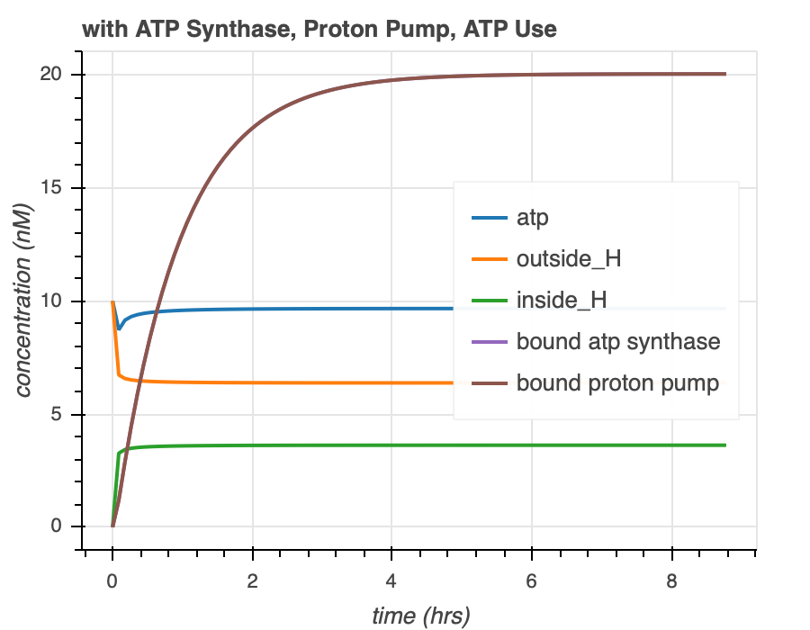
Combined simulations for ATP Synthase Model
H⁺
ADP + Pi
ATP
TX/TL
ADP + Pi
ATP
H⁺

Slide 10
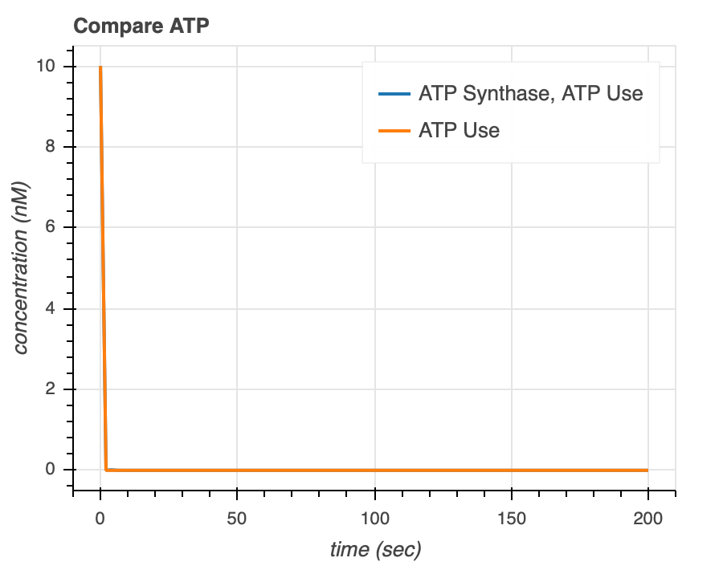
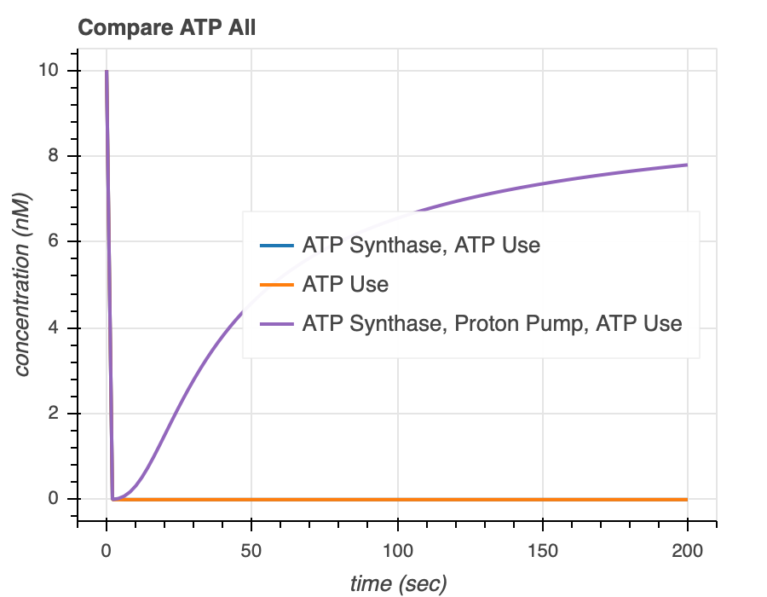
ATP synthase simulations show that proton pump is necessary to extend ATP lifetime
Notes:
Recheck plots

Slide 11
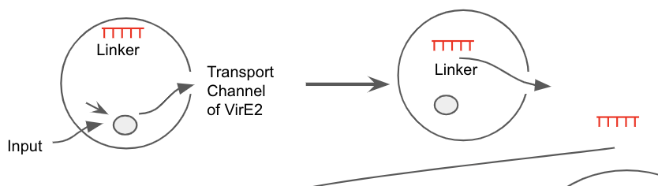
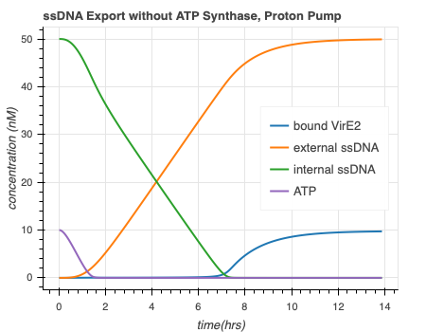
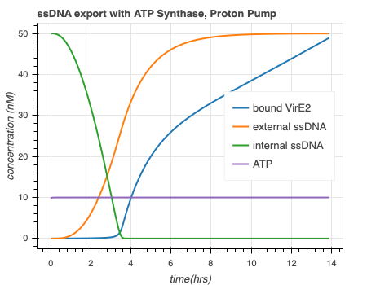
ATP Synthase Model + ssDNA Export Model
ATP
Faster ssDNA export and more bound VirE2!
Export model courtesy of Agrima Deedwania (IIT Delhi)

Slide 12
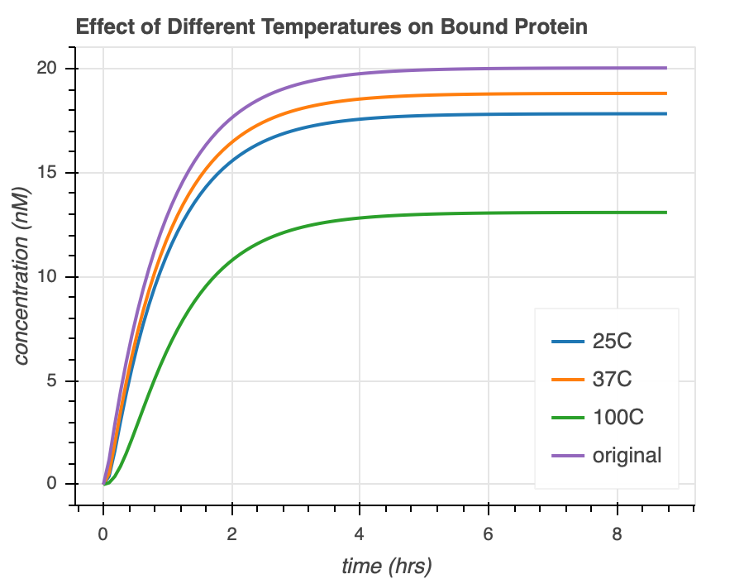
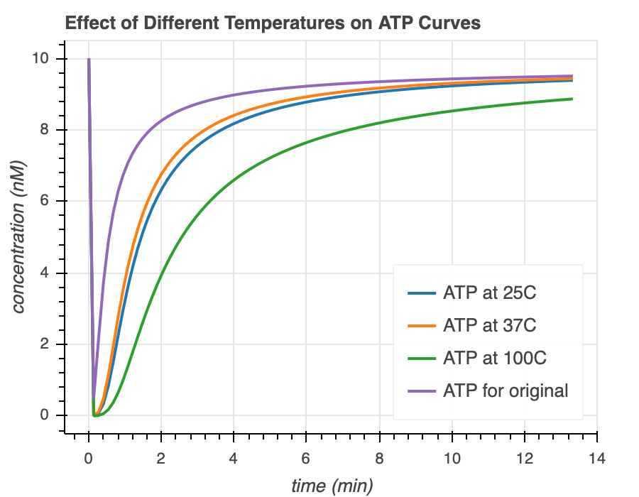
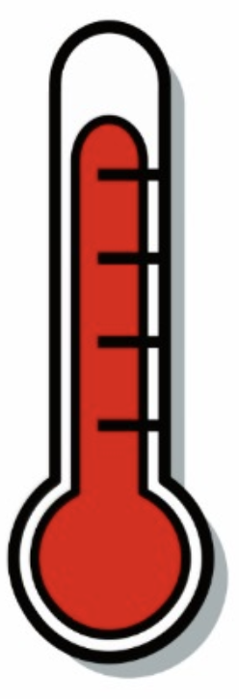
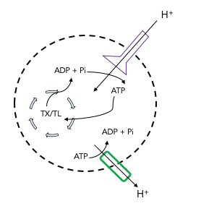

ATP Synthase Model + Temperature Dependence
Temperature Sensitive
Protein Folding
Membrane Integration
DNA
RNA
Temperature rate equation courtesy of Ayush Venkatesh Bindlish (IIT Delhi)

Slide 13
Thank you!
Ayush Pandey
William Poole
David Garcia
Manisha Kapasiawala
Zoila Jurado
Agrima Deedwania
Ayush Bindlish
Richard Murray
Samuel P. and Frances Krown SURF Fellow
TX/TL

Slide 14
Summary
Goal
TX/TL
ATP Synthase
ATP Rheostat
Mechanisms
ssDNA export
Temperature Sensitive
ssDNA export
Tests

