Slide 1
Senior Thesis: ATP Life Extension in Synthetic Cells
Ankita Roychoudhury
Murray Lab Meeting
12.09.2020

Slide 2
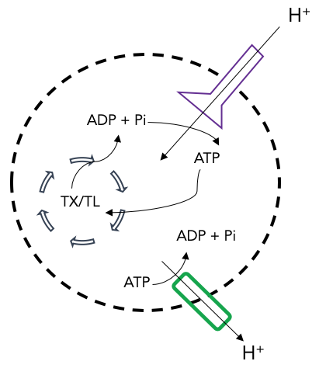
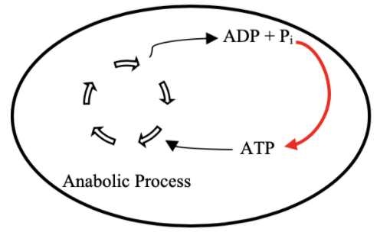
Goal: Cell-free Mitochondrial Mimics
Proposal: ATP Regeneration by ATP Synthase
TX/TL

Slide 3

Coarse Roadmap
Test ATP in Bulk
Implement Proton Pump into vesicle
Implement ATP Synthase into vesicle
Make User-Friendly
Ankita Roychoudhury 8.13.2020
Notes:
Happy to do more bulk atp

Slide 4
Bulk Experiments

Slide 5
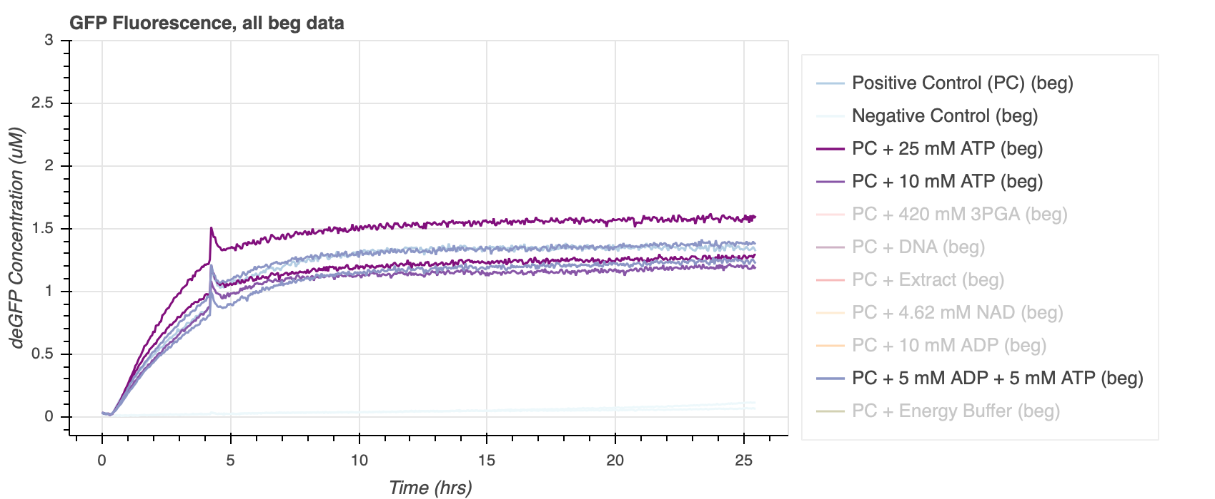
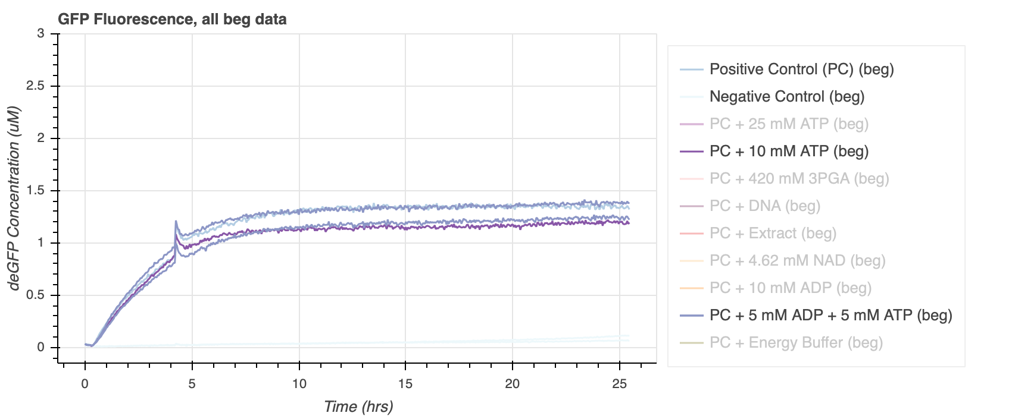
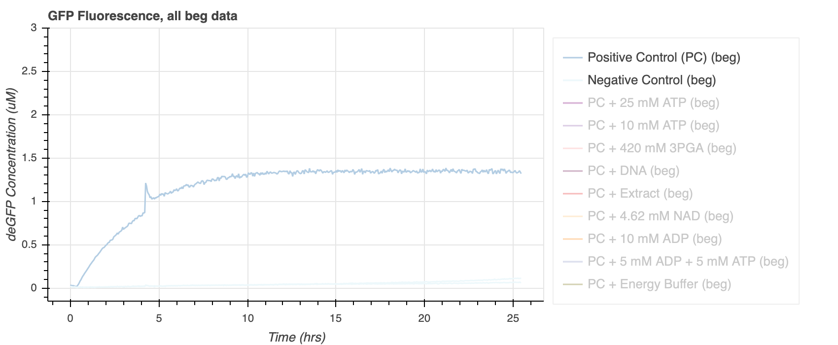
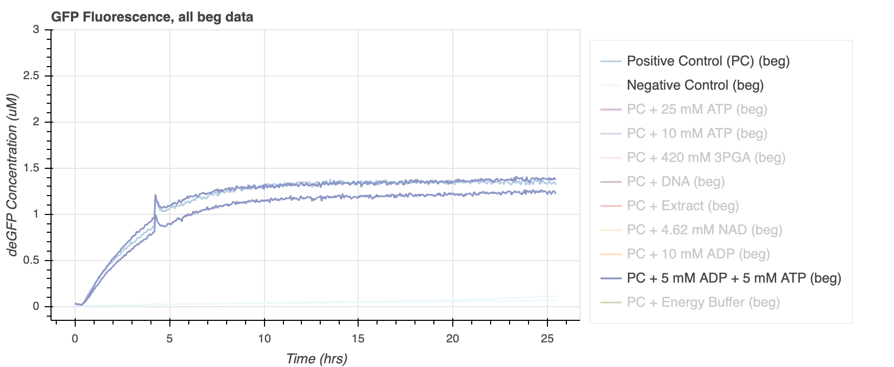
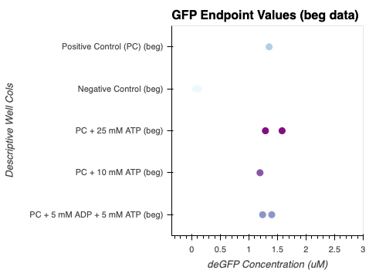
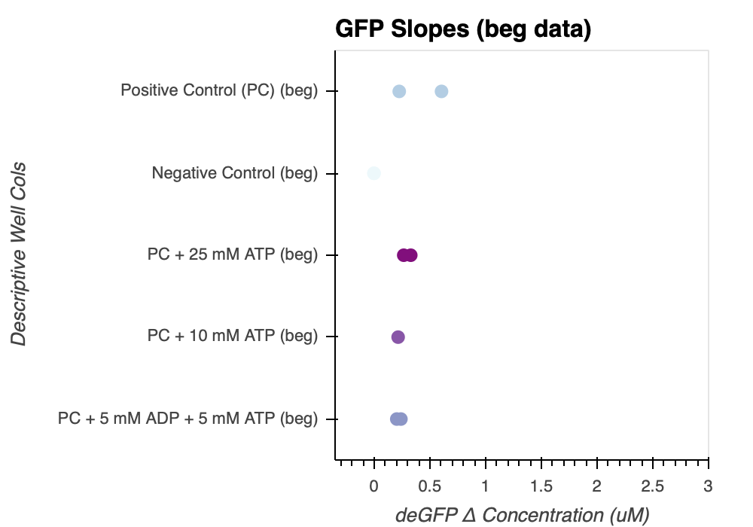
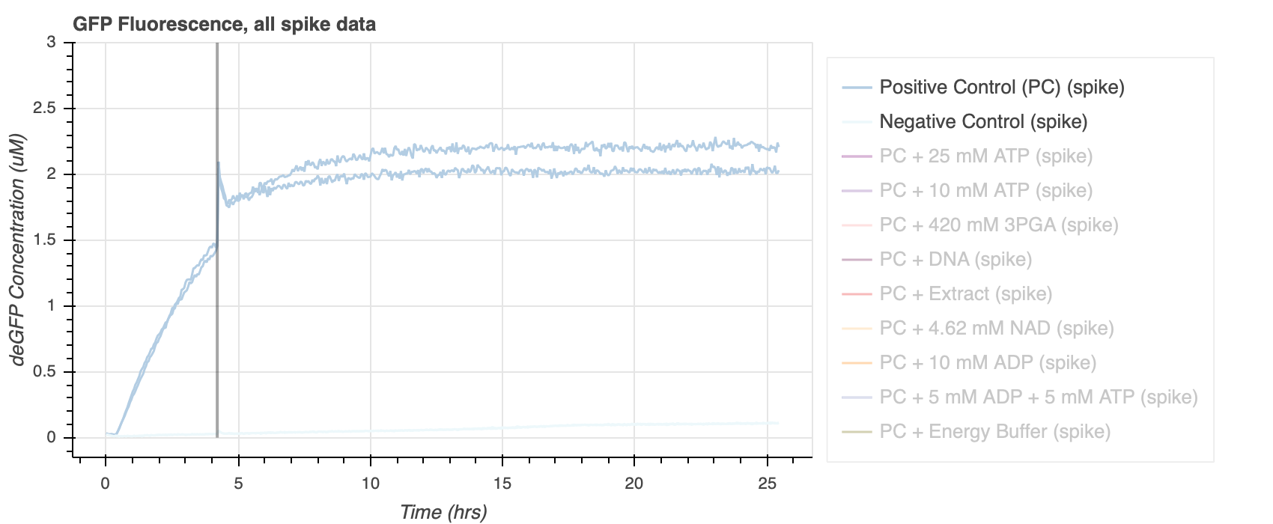
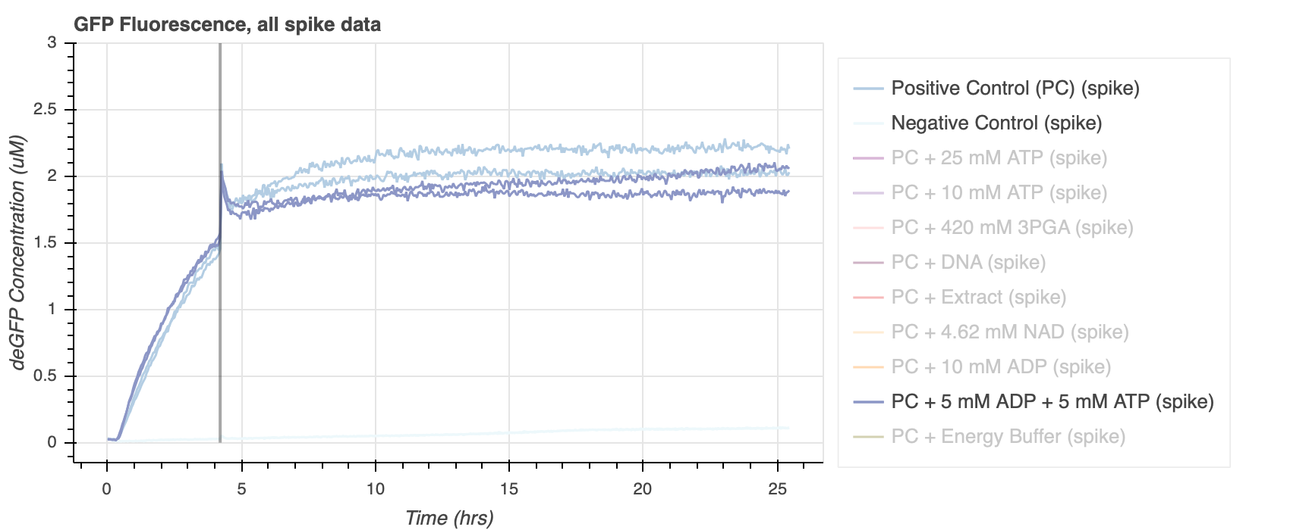
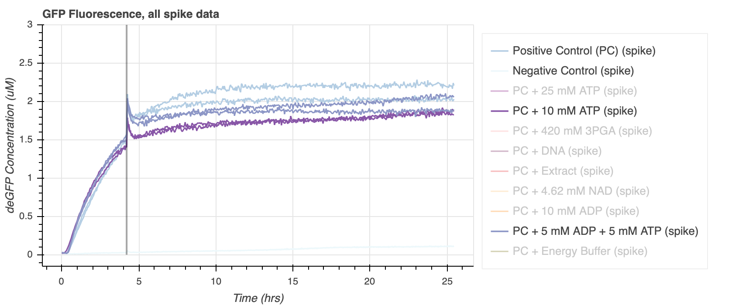

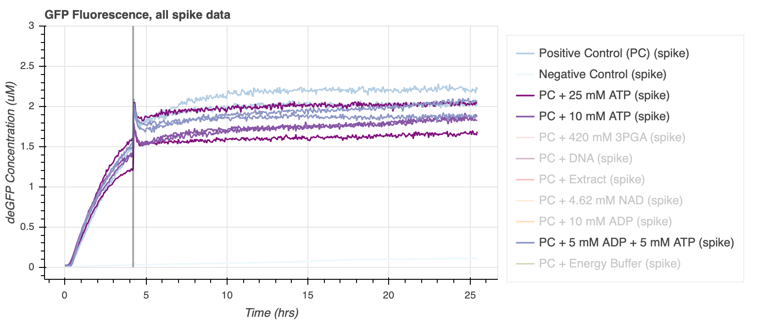
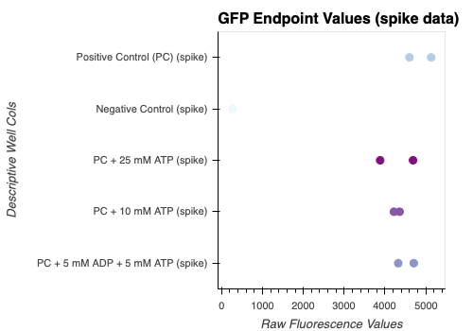
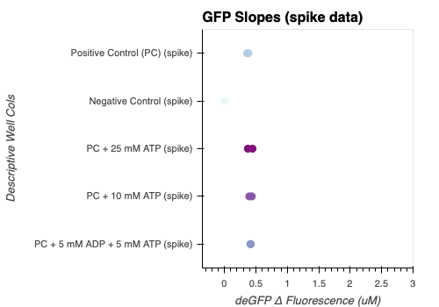
Does adding varying [ATP] result in more protein production?
Extra ATP added in beginning and spiked
Not really
PC = extract + buffer + DNA
All data from exp 18
Notes:
Exp 18
The first question I wanted to ask is if adding varying concentrations of ATP actually results in more protein production. This is just for bulk experiments and added on TOP of the positive control setup, which includes extract, buffer, and dna. So on this slide I will show data from experiments where I added ATP in the beginning and also spiked in some more around hour 4.
Here’s the positive and negative control, the 5 mM ATP, 10 mM ATP, and 25 mM ATP. For reference, Energy buffer has final conc of ATP around 21 mM.
I also have some summary plots of these data, so here are ethe steady state value of all the samples and also the GFP slopes. This is the slope from time 0 to about 2.5. It’s an attempt to see if adding more ATP will increase the rate of production at the beginning.
So from this we see that adding ATP doesn’t really have thaaat much of an effect. The endpoint values seem to be pretty mush around the pos control with one of the 25 mM samples going a bit higher. The slopes also don’t seem to be that different.
Now I’ll show the data for the spike version of this experiment. But the conclusions that come from it are pretty similar. Again the end point values and gfp slopes are kind of inconclusive.
This could mean that ATP isn’t the limiting factor in these reactions, which I think is very possible. Based off the other reagents I didn't show here, it seems like extract or DNA are more likely to restart the reaction.
So the answer to this question is (CLICK) not really, or not in this setup at least

Slide 6
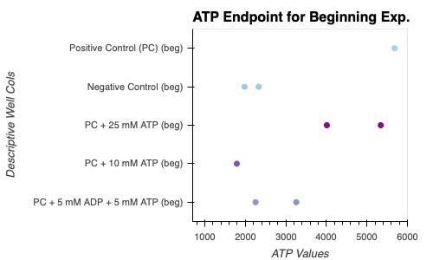
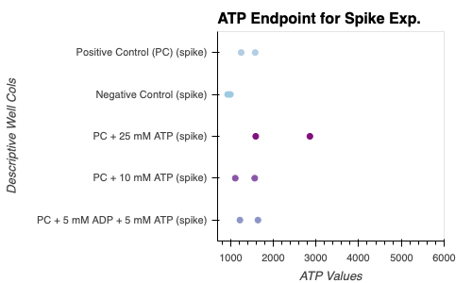
Is there more ATP use when ATP is added?
Inconclusive
Beginning
Spike
All data from exp 18
Notes:
Here, we are looking at the same summary plots from the last slides. I added the ATP endpoint calculations, just raw fluorescence values my bad- I have calibration data. But we can still compare relative ATP conc’s.
For the beg exp’s, it seems like pos control and 25 mM ATP added have the higher values of atp at the end. But somehow more ATP is used for the 10 mM and 5 mM ATP values. Maybe if we add a little bit of ATP, it’s able to use more for some process (that may not directly be relaated to protein production but some sequestration or degradation of something) but if we add too much there’s too much degradation or free phosphate toxicity. I’m not sure, it’s a theory.
Now we can take a look at the data for the spike experiment. Again 25 mM seems to have highest endpoint ATP valuefor this one. But here the PC, 10 mM and 5 mM are pretty similar. Note that we can’t really technically compare across beg and spike experiments because the total vol for beg exp is 10.5 uL but 12 uL for spike exp.
Important to note that it’s possible the actual scale of difference for these atp values could be miniscule..will see when I convert it.
So the answer to this question is (CLICK) inconclusive because even if more is used we don't necesarilly know what it is used for.

Slide 7
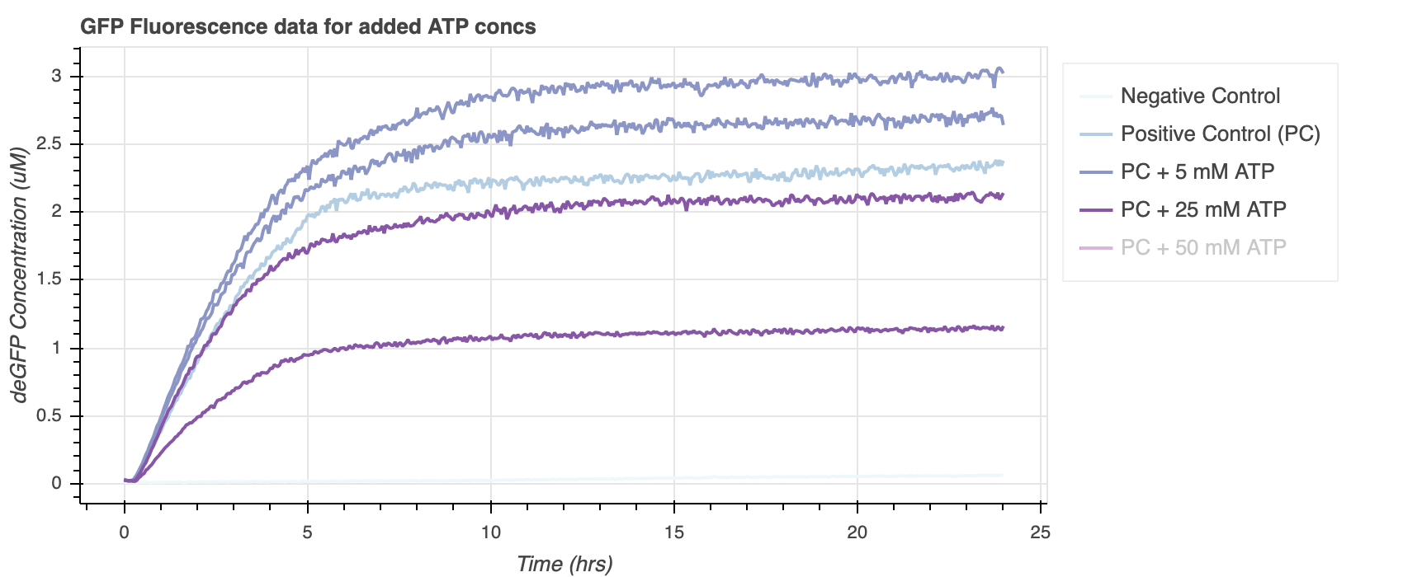
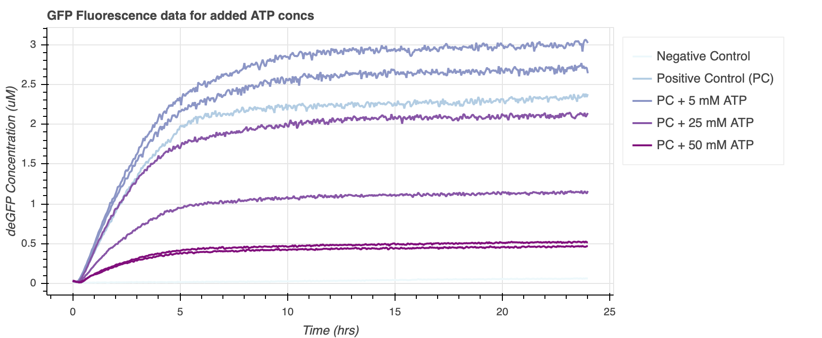
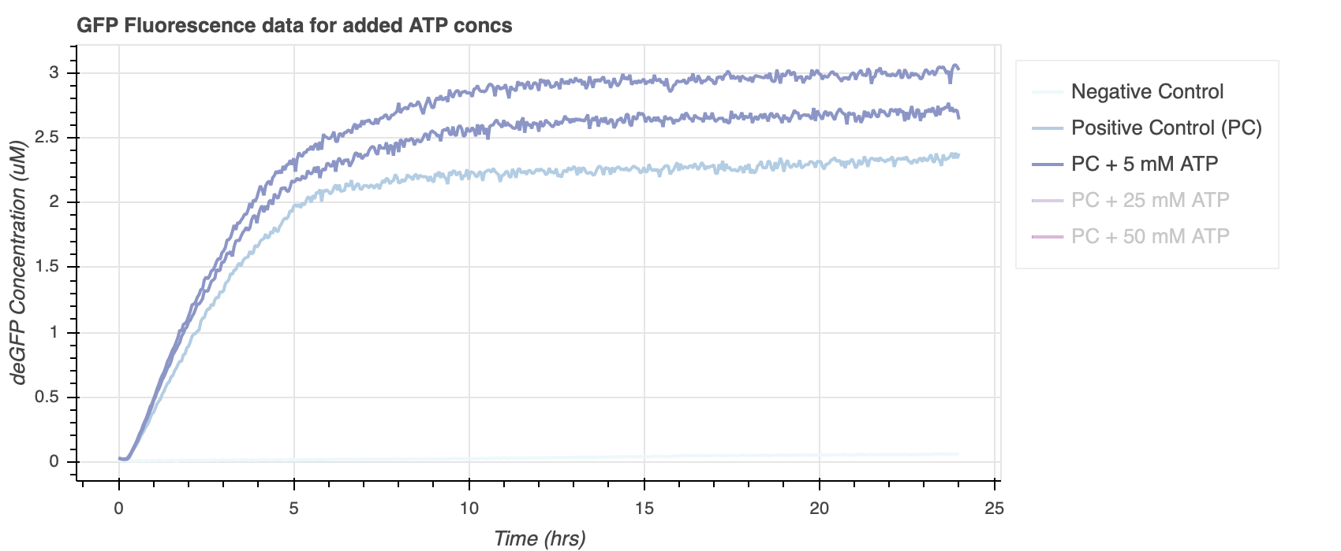
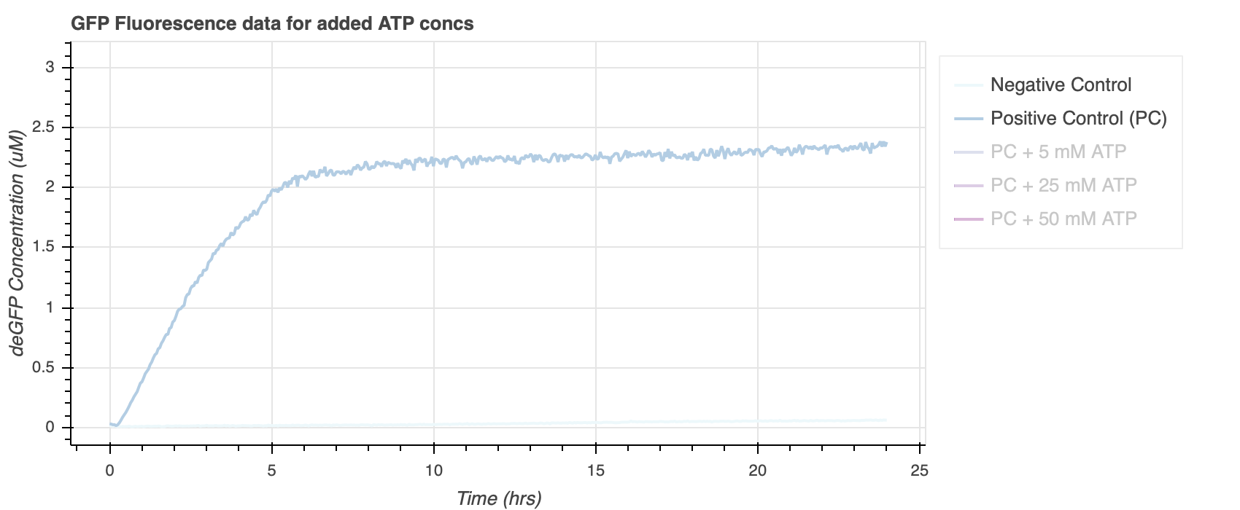
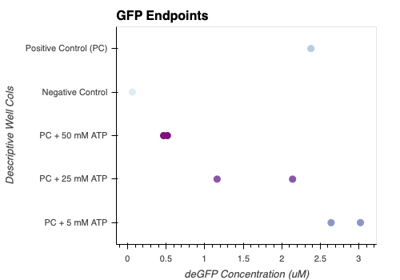
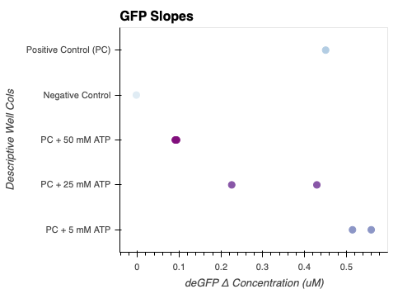
Adding ATP to Positive Control means more Pi toxicity?
Extra ATP added in beginning
There is a limit to how much added ATP will help.
All data from exp 19
Notes:
From exp 19
Next question I wanted to address is whether adding ATP to positive control might result in more Pi toxicity. Which could explain why giving more atp doesn’t necesarilly increase rates or steady state values of protein production.
So I ran another experiment where I added 5, 25, and 50 mM ATP in the beginning. The 50 mM was kind of meant to act as an overkill. Seems like (CLICK) there is a limit to how much added ATP will help. Here are the summary plots with GFP endpoints and slopes. It’s kind of neat how well the endpoints and slopes line up actually, but it’s also expected. The 5 mM ATP had the highest end point value and slope here.
So we can see that there seems to be a limit to how much added atp will help, since something else is probably going on after because the 50 mM had lower slope and endpoint values.

Slide 8
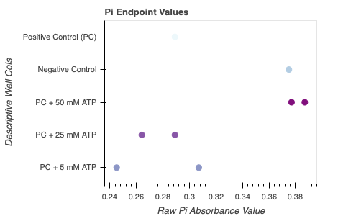
Adding ATP to Positive Control means more Pi toxicity? (cont.)
It’s possible!
PC + 50 mM ATP had more Pi at end point than PC.
All data from exp 19
Notes:
Here I brought the summary plots from the last slide and then there’s also the pi end point values. We can see that adding ATP does result in more free phosphate at the end, at least in the case of 50 mM.,a lot more than the PC. And adding 5 + 25 mM both could give less Pi than PC, but not conclusively.
CLICK - it's possible. adding too much ATP could have Pi toxicity.

Slide 9
What did we learn from bulk experiments?
Only adding ATP is not sufficient for revival
Free phosphate toxicity could be a concern
Notes:
What did we learn from the bulk experiments
Only adding ATP is not sufficient for revival
and free phosphate toxicity could be a concern, which is technically solved because ATP synthase uses free phosphate to make the ATP.
But I also think these brought up a lot of unanswered questions, like is more ATP really being used if you add it? And also what is it being used for? Cuz we want to make sure the ATP being produced is being used for the 'right' thing or what we want, if that's even possible.

Slide 10
Vesicles
Notes:
I got impatient to move onto vesicles so here we go

Slide 11
Vesicle Plan
End Goal:
Step 1:
H⁺
ADP + Pi
ATP
TX/TL
Notes:
First step is to just try to integrate ATP synthase.

Slide 12
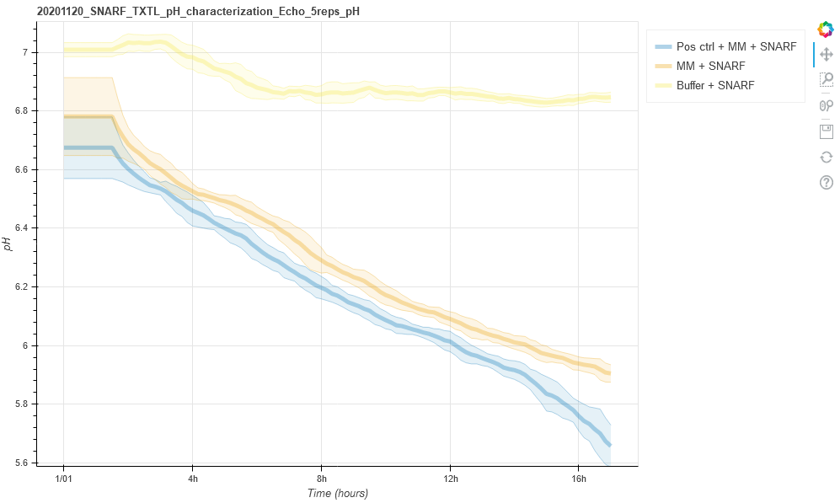
Can we visualize pH gradient in vesicles?
ACMA
TX/TL
Courtesy of Manisha Kapasiawala
Notes:
One of the first things we wanted to try is to see if we can visualize pH gradient in vesicles. Been working with Manisha a bunch for this stuff.
Manisha did the pH experiments and saw that pH is decreased with just txtl extract and buffer, even independent of DNA. So I tried to put tx/tl in a vesicle with this pH gradient indicator, ACMA.
ACMA binds to membranes and then becomes quenched and emits blue light when a pH gradient forms. So this is what we tried, we got nice vesicles but didn’t get great expression, so maybe a pH gradient wasn't established or I might have to play with the concentration of ACMA among other things. We want to be able to do time course imaging of the samples so we can see how the pH gradient may develop over time.

Slide 13
Future Plans
Quantify pH gradient in vesicles
Test spontaneous ATP Synthase integration
Get proton pump plasmids

Slide 14
Thank You!
Zoila
Manisha
David
Miki
Cohort 1
Richard
Biocircuits Group!

Slide 15
Supp. Plots

Slide 16
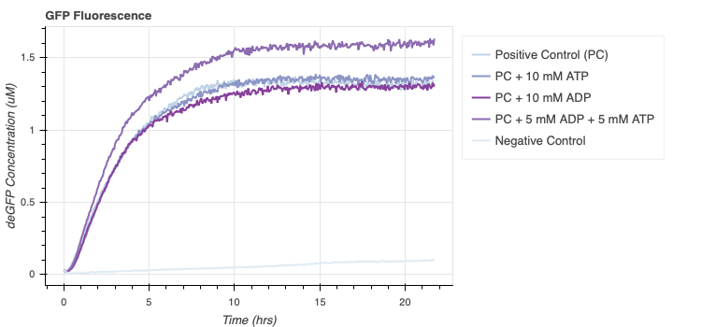
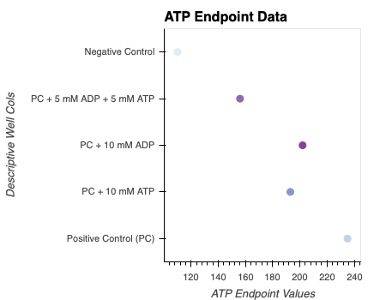
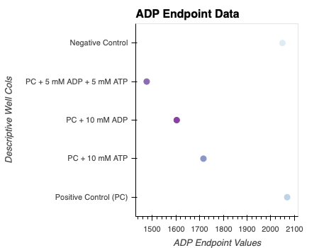
ATP and ADP endpoints
All data from exp 16
Notes:
From exp 16

Slide 17
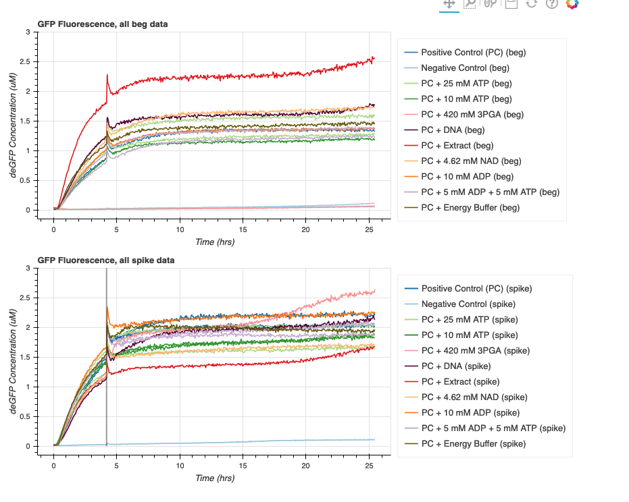
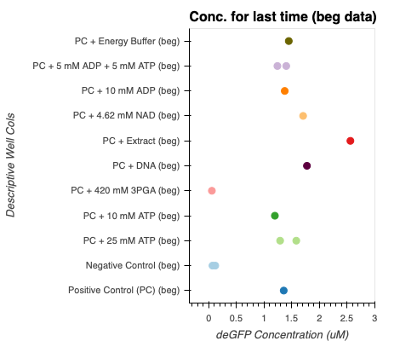
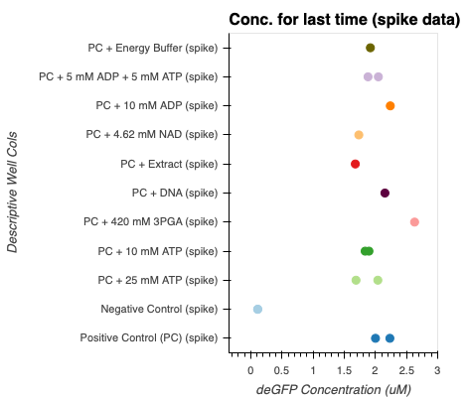
From exp 18, all reagents

