Slide 1
Summary PowerPoint
Ankita Roychoudhury
Murray Lab

Slide 2
From Murray Meeting
10.12.2020
File: 20201012_murray_mtg_2

Slide 3
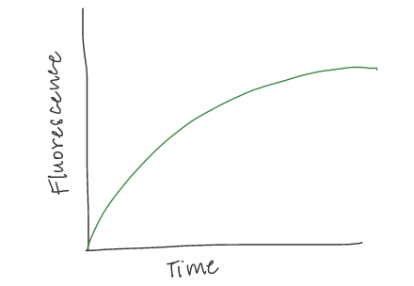
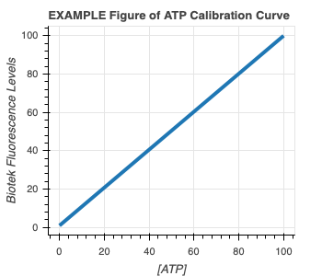
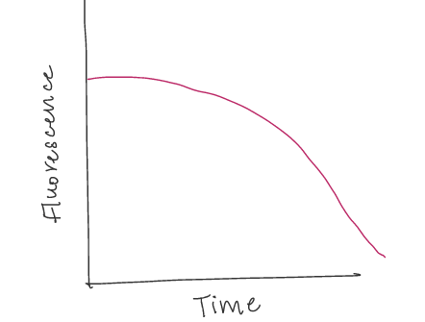
Experimental Plans
1) ATP Calibration Curve 2) Quantify GFP and ATP in bulk TX-TL with DNA
EXAMPLE GFP Curve
EXAMPLE ATP Curve

Slide 4
#2 cont.) Proposed Controls
In all cases, GFP and ATP will be measured
Exp # | deGFP DNA | Energy Buffer | TXTL Extract | Salt | Why?
1 | ✔️ | ✔️ | ✔️ |  | Positive Control
2 |  |  | ✔️ | ✔️ | Negative Control for background fluorescence
3 |  | ✔️ | ✔️ |  | Quantify ATP depletion due to metabolic leak
4 | ✔️ |  | ✔️ | ✔️ | How does the system perform without energy? How quickly does energy run out?
5 | ✔️ | ✔️ |  | ✔️ | How does the system perform with only energy?

Slide 5
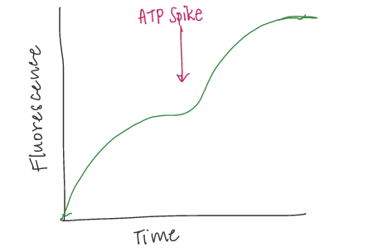
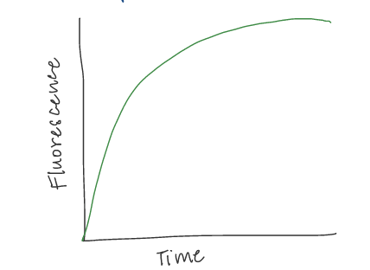
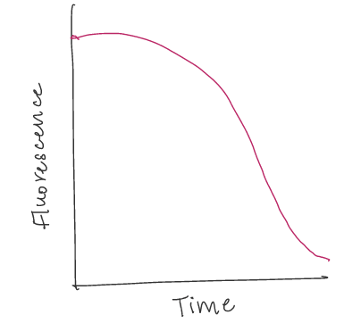
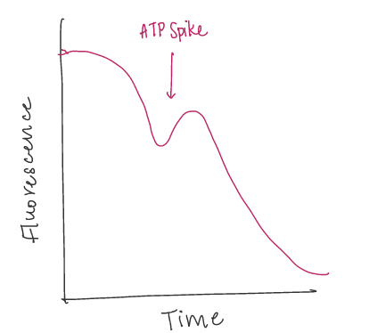
3) Add more ATP at start 4) Add more ATP in middle
PREDICTED GFP Curve
EXAMPLE GFP Curve
PREDICTED GFP Curve
EXAMPLE ATP Curve
PREDICTED ATP Curve
PREDICTED ATP Curve
Hypothesis: Proportionally more protein production with more initial ATP
Hypothesis: Can revive protein production with ATP spike

Slide 6
After that…
5) Greater Initial Concentration and Spike Experiments with 3PGA, Energy Mix, and/or DNA to see if any are the limiting factor
6) Characterize GFP and ATP with TXTL Extract, Buffer, & DNA in vesicles
7) Add ATP Synthase, Proton Pump, and Test!

Slide 7
Exp 5: ATP Assay Calibration
20201019_exp5_atpassaycalibration

Slide 8
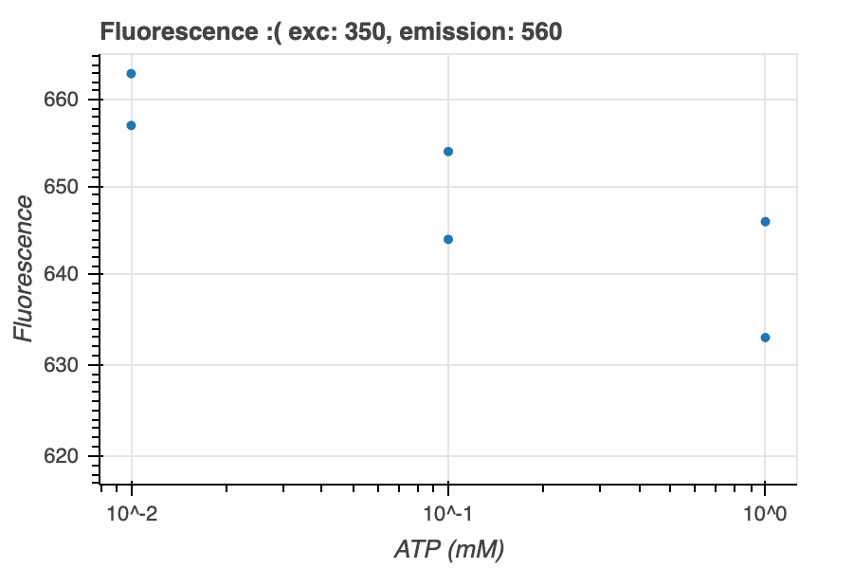
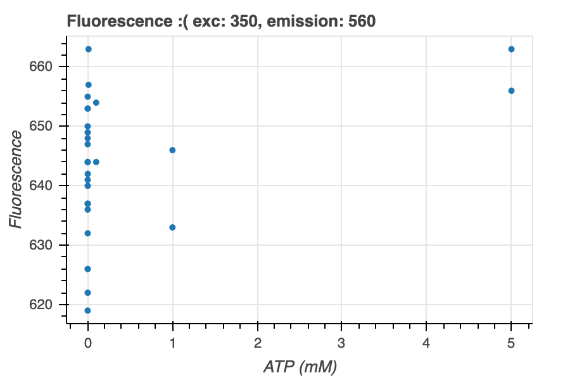
This was wrong because did fluorescence not luminescence

Slide 9
Exp 7: GFP Controls Time Series
20201022_exp7_controls_gfp_timeseries

Slide 10
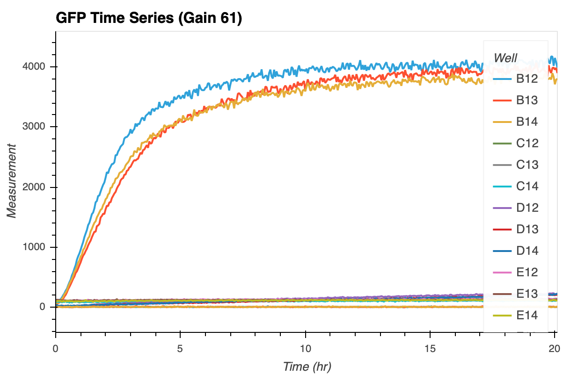
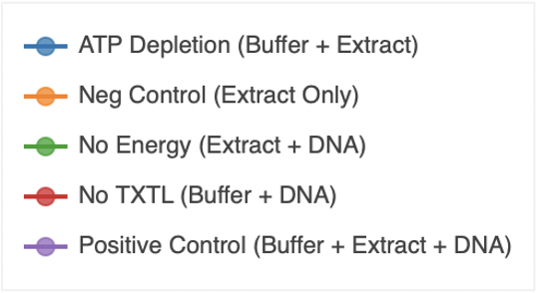

Slide 11
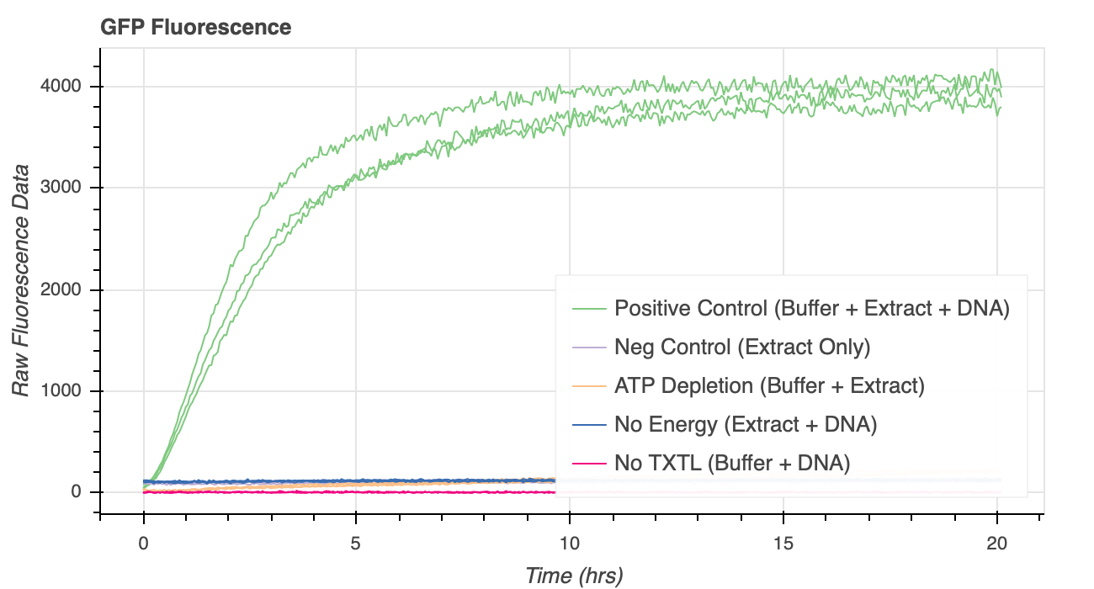
Better plotting

Slide 12
Exp 8: GFP and ATP Long Controls
20201023_exp8_controls_gfp_atp

Slide 13
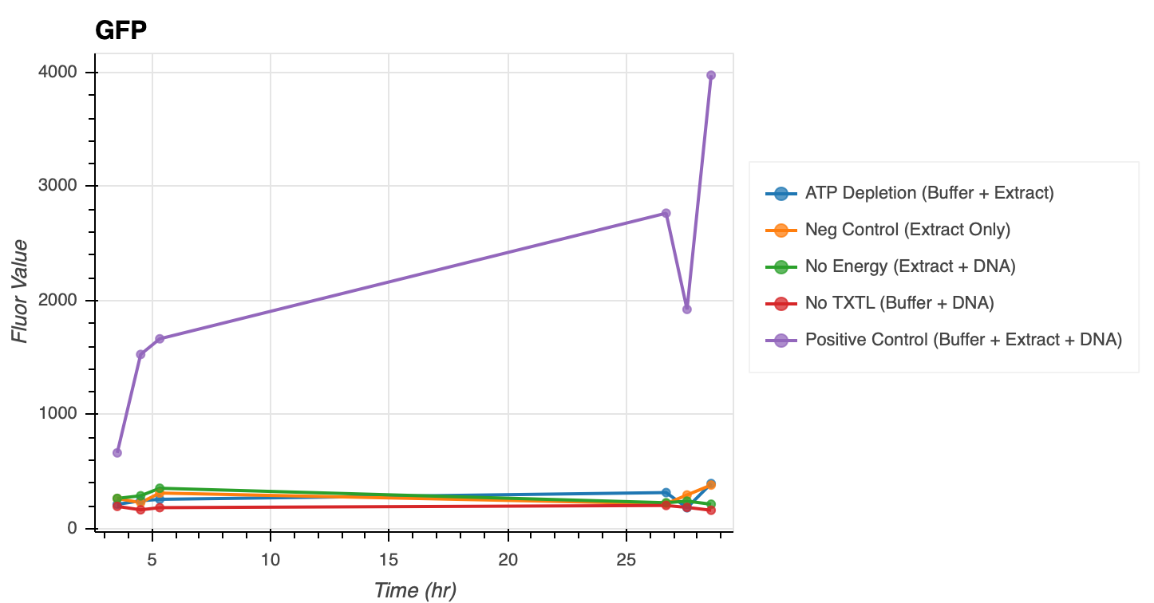
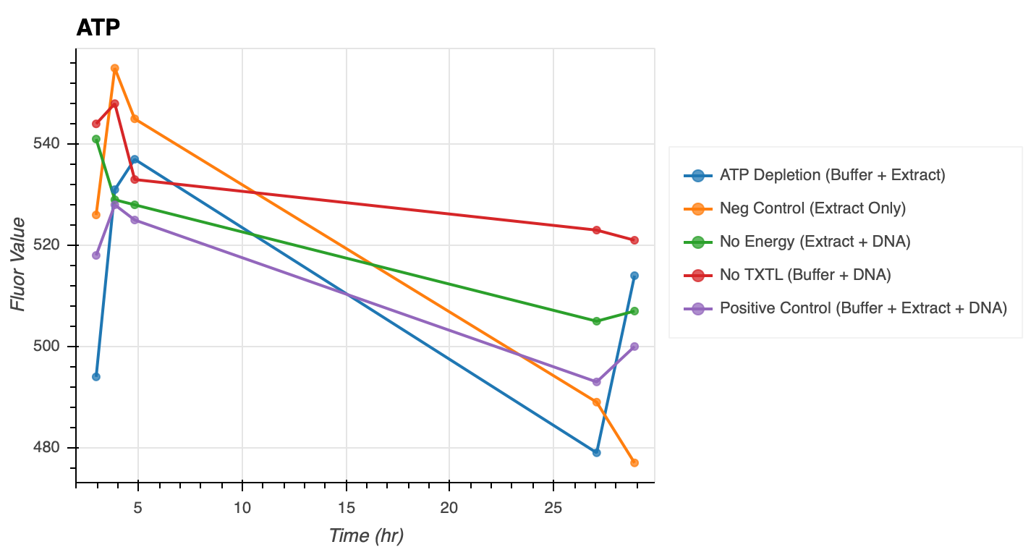
The last data point had bubbles (removed from graphs)
Also used fluorescence, which is wrong☹

Slide 14
Exp 9: ATP Assay Calibration Round 2
Done with luminescence
11/2/2020
20201102_exp9_atpassaycalibration_2

Slide 15
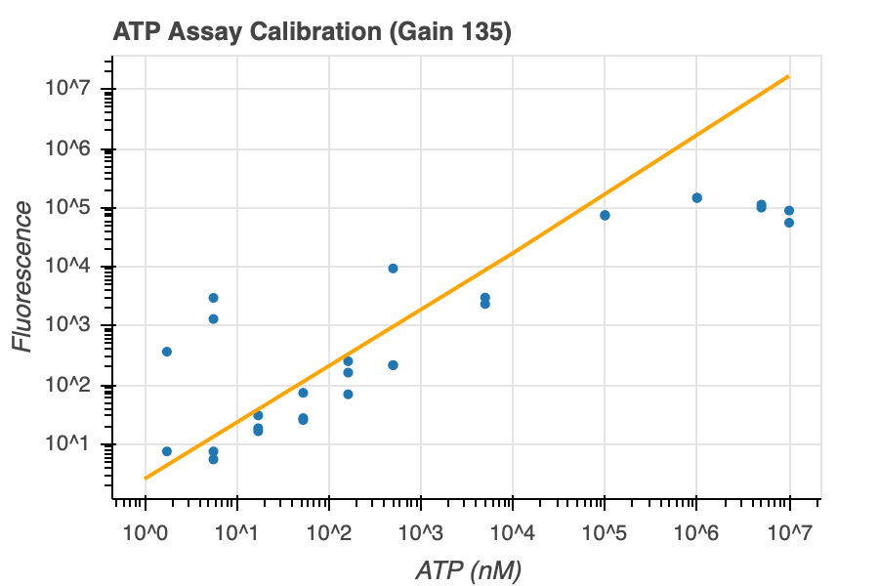
slope=1.2732601723574946,
intercept=-1.6966496369015145

Slide 16
Exp 10: ATP Control Round 2
Done with luminescence this time!
20201103_exp10_controls_atp

Slide 17
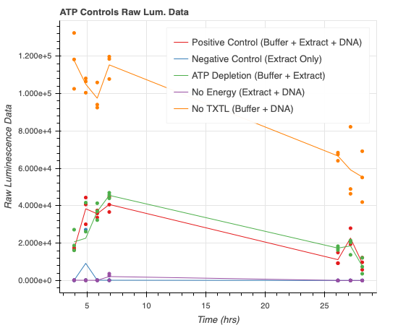
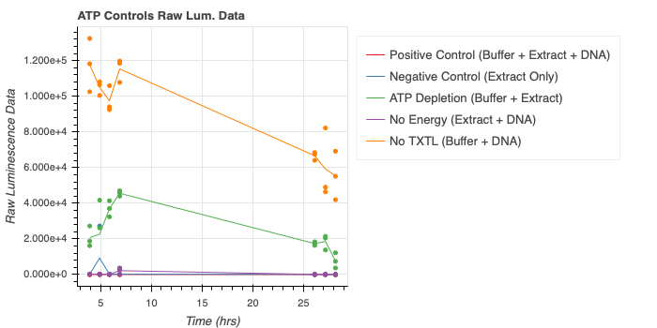

Slide 18
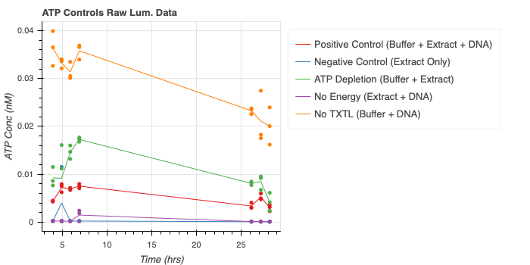
With ATP Conc

Slide 19
Exp 11: ATP in Beginning
20201103_exp11_gfp_atpinbeg_timeseries

Slide 20
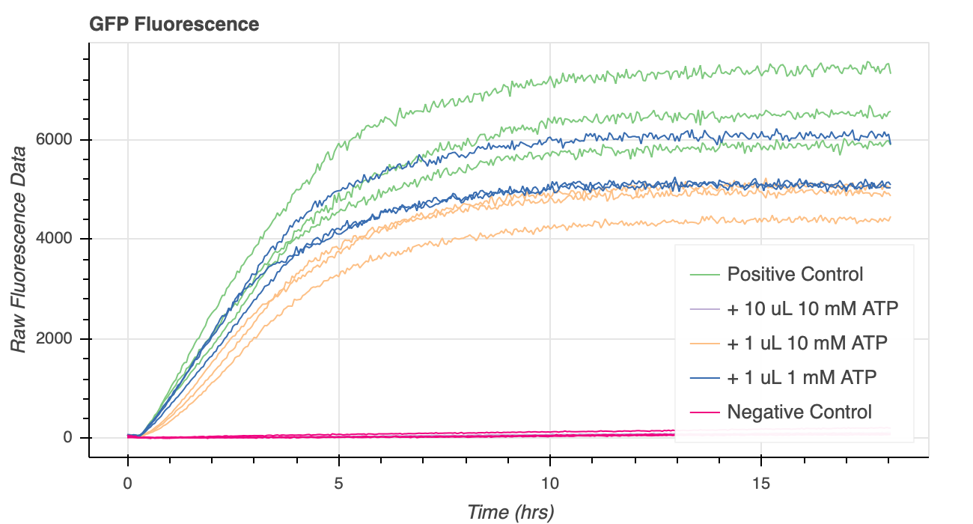
This is bad data because volume was not consistent

Slide 21
Exp 12: Reagents in Beginning
20201104_exp12_gfp_moreinbeg_timeseries

Slide 22
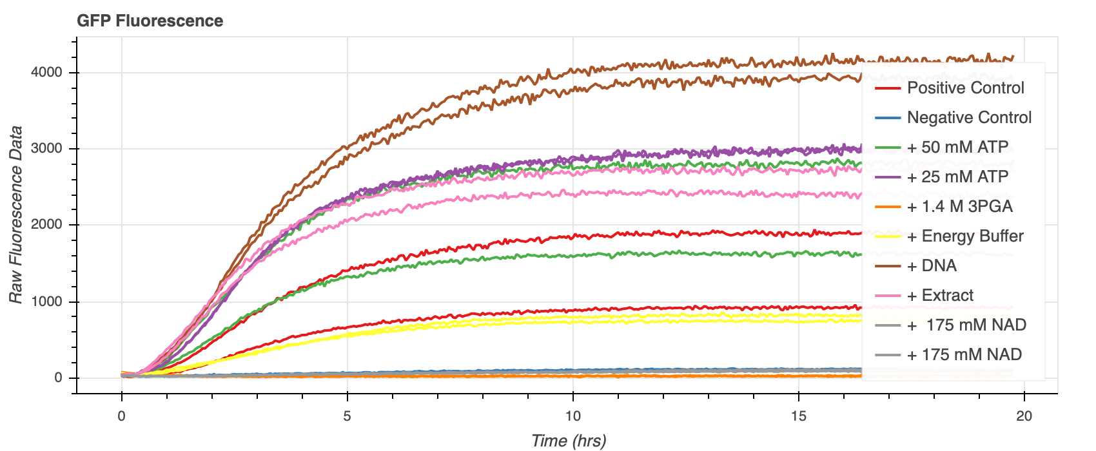
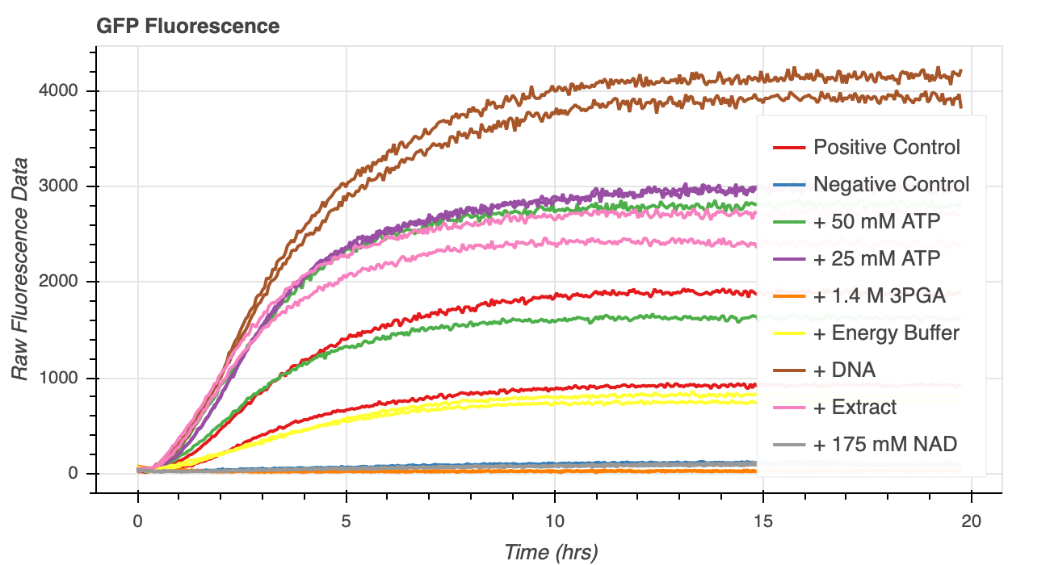
Seems weird since positive control doesn’t go to 4000, which I think it normally does

Slide 23
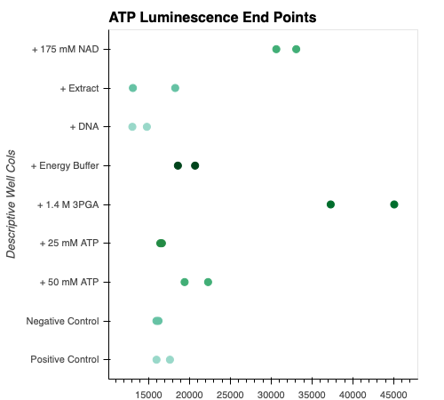
Data in raw lum values but doesn’t matter because not that accurate

Slide 24
Exp 13: Spike Experiments
20201106_exp13_gfp_spike
20201107_exp13_gfp_post_spike

Slide 25
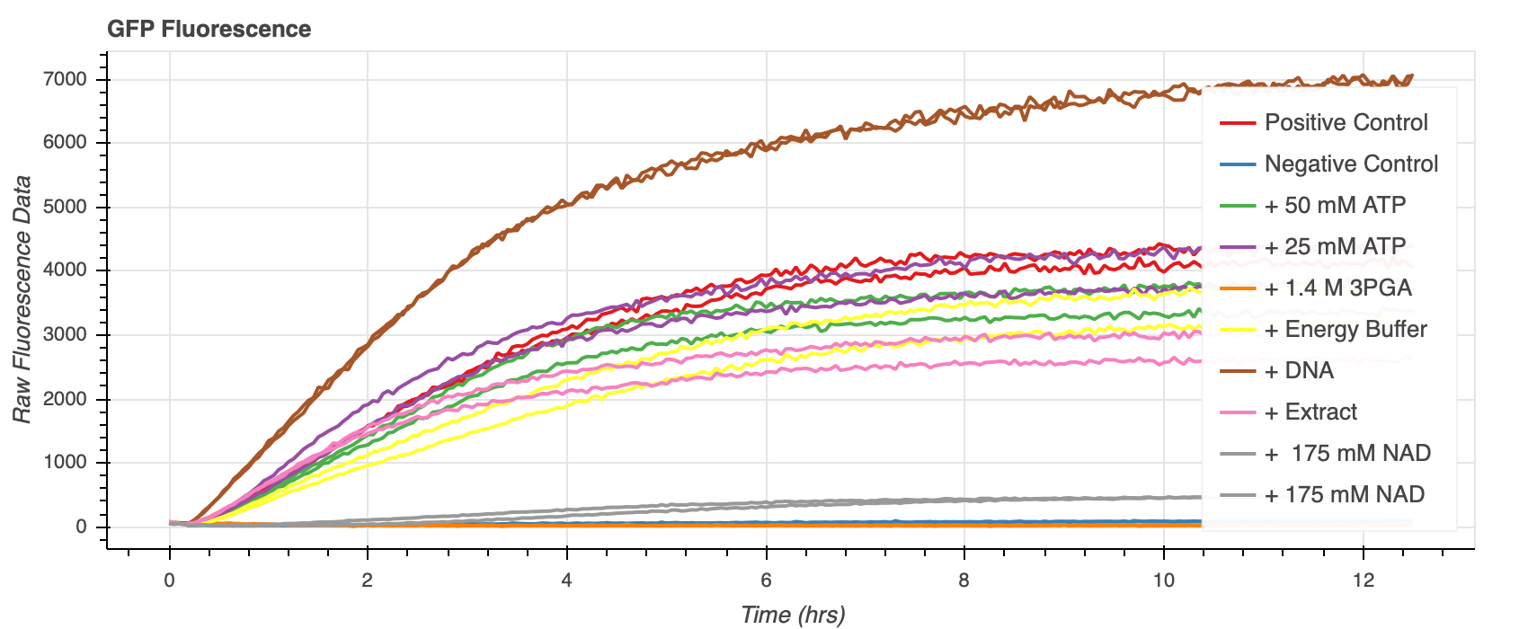
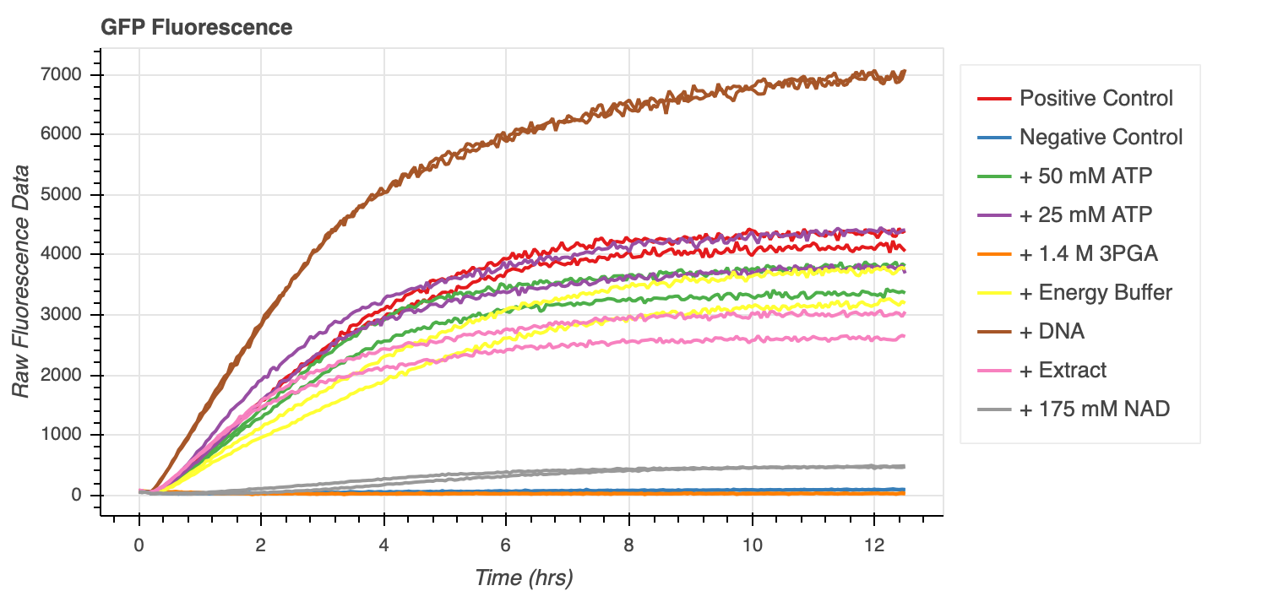
Pre Spike

Slide 26
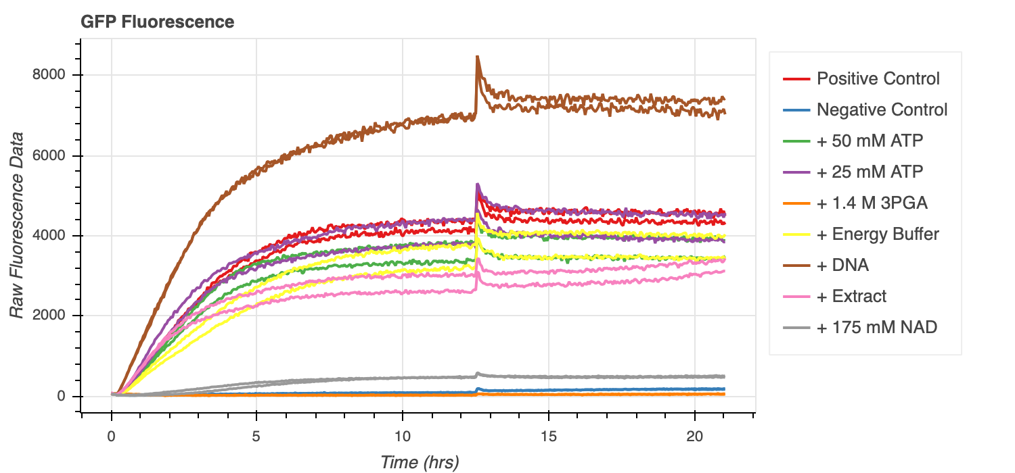
Post Spike

Slide 27
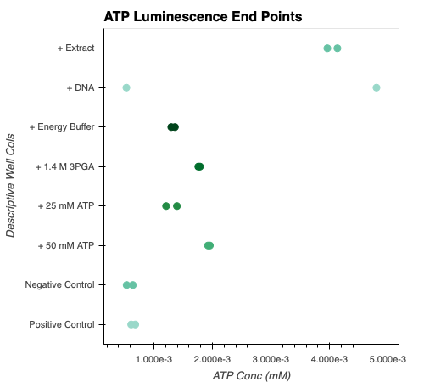
ATP End Point Values

Slide 28
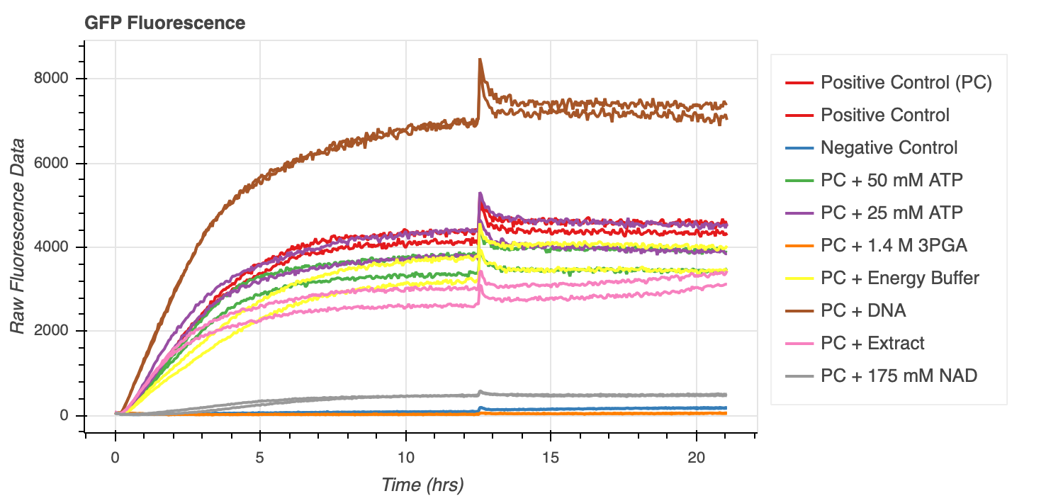
With Better Labels

Slide 29
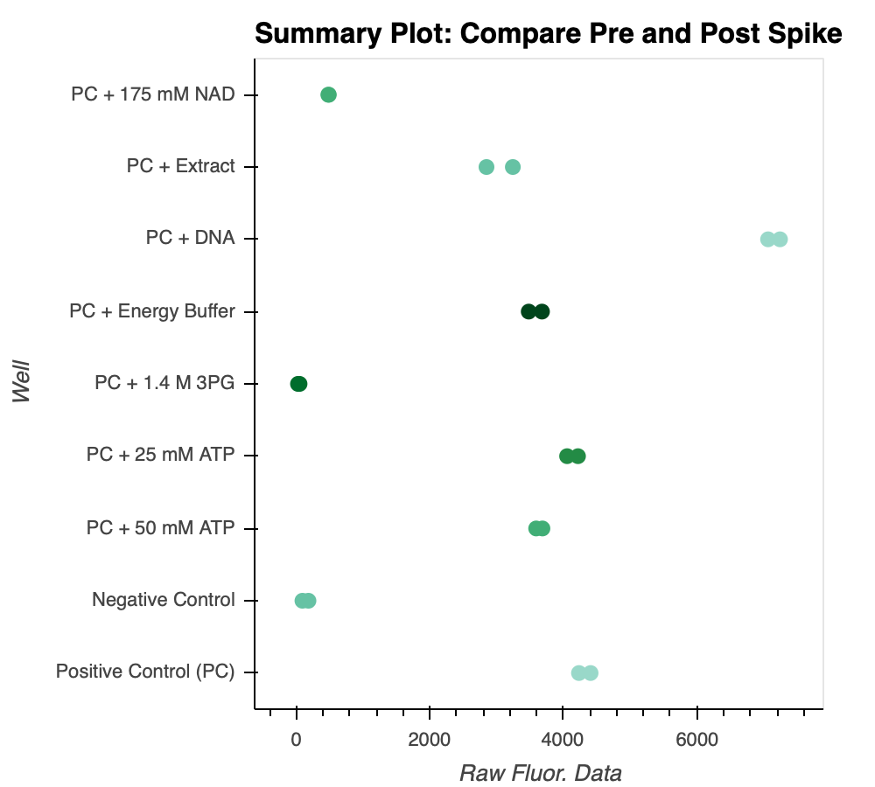
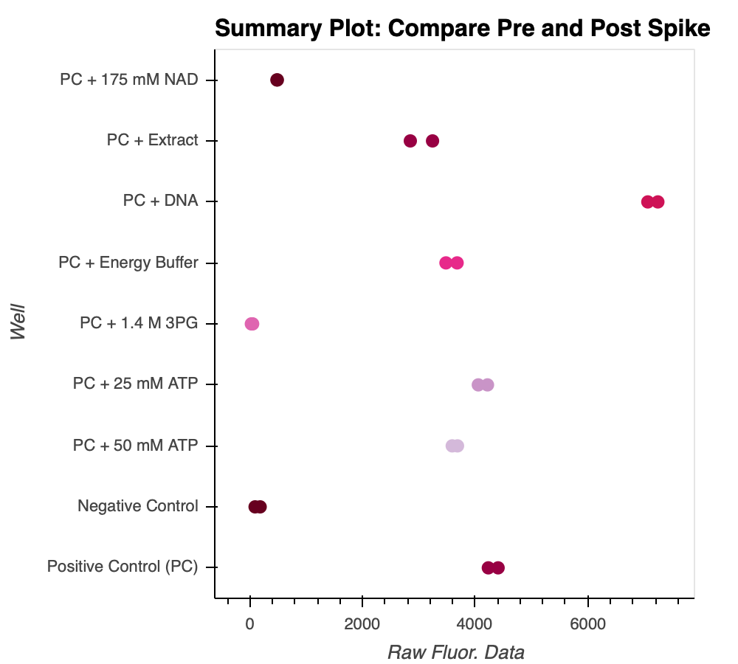
Summary Plot, compare pre and post spike

