Slide 1
As aforementioned, I was faulted for referencing another student’s written solution on a homework (problem set 4 of ACM 95a, Introductory Methods of Applied Mathematics for the Physical Sciences) in a class I took winter term of my sophomore year at Caltech. This was deemed an unfair advantage for which I took complete responsibility. Although we are encouraged to collaborate, the proper route would have been to discuss the problem with the student and write our thoughts on a white board or scratch paper instead of looking at their work directly. As a punishment, my credit gained for the entire homework was deducted and my letter grade changed from a B+ to a B.
This occurred during an emotional time and was compounded by pressures arising from balancing increased athletic, academic, and research commitments. I took steps to rethink my commitments and work ethic. I started prioritizing, being judicious, avoided procrastinating, and rigorously followed a routine. As an example, I began homework sets the day they came out and went to the first office hours. This process helped me focus on deep learning and genuine understanding of subject material.
Thereafter, my term GPA started to increase significantly. I went from averaging a 3.0 my sophomore year to 3.7 my junior year while taking upper-level bioengineering classes. I am on course for a higher GPA during my senior year while also adding a minor in control & dynamical systems. This dedication to improvement was also visible on the tennis court and I was awarded the ‘Most Improved Award’ in 2019.
Sophomore year was a reflective and emotional time for me. With the death of my most beloved grandparent and a very young cousin in my family, I lost myself and fell astray from my morals. Since this occurred in the middle of the school year, I was not able to visit my family. The academic disciplinary action along with the support and guidance from my family has served as a learning experience. It has restored my self-confidence and led me back on my path to success. I am ready to take on the challenges that graduate school requires.
On the following page, I have attached the poster presentation from my work in Murray Lab during the summer of 2020.

Slide 2

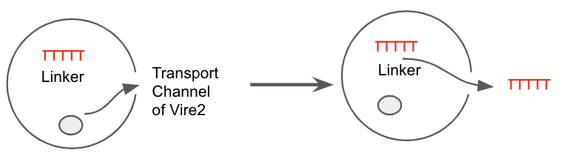
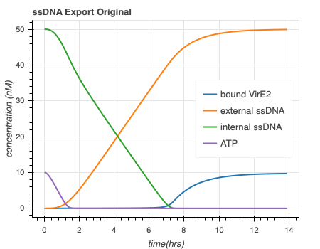
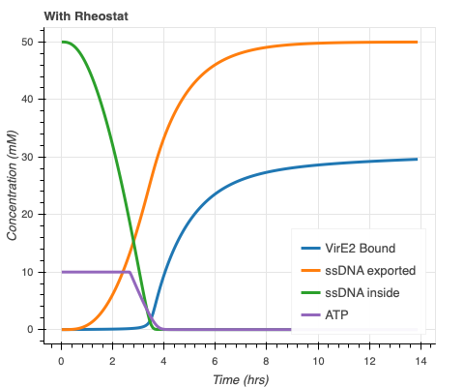
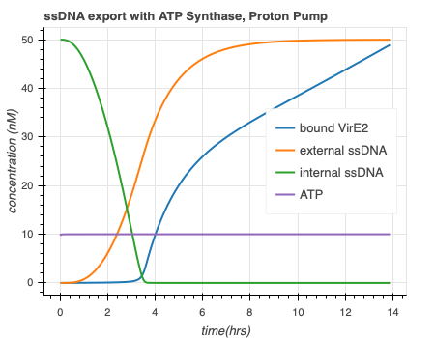
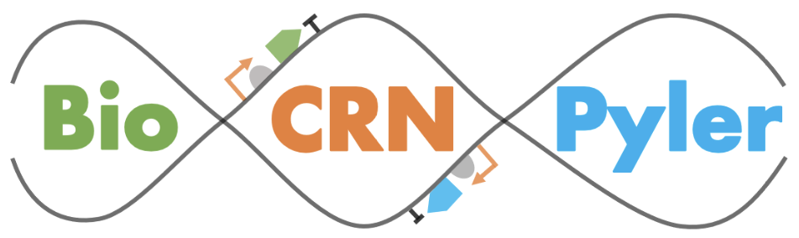

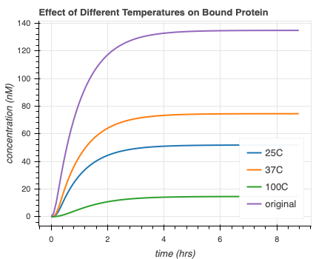
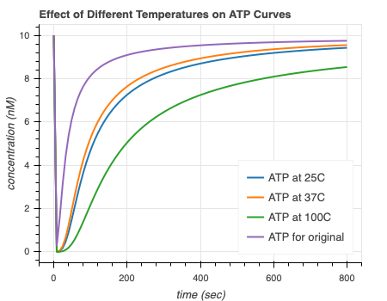
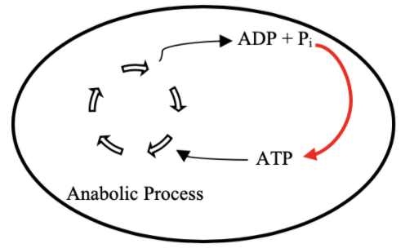

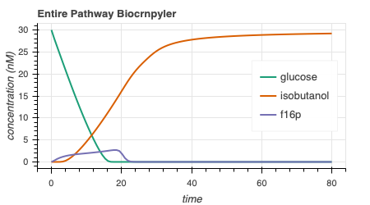
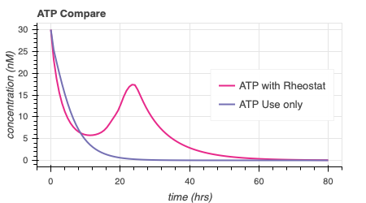
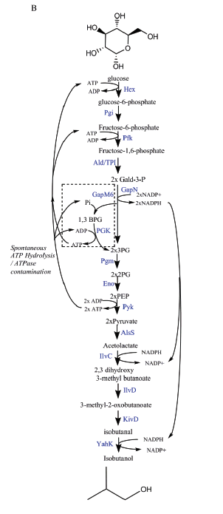
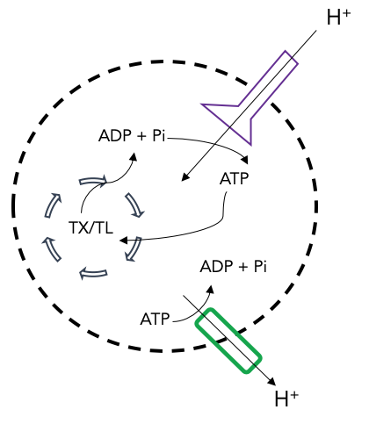
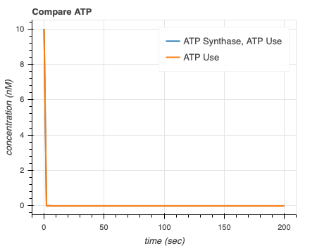
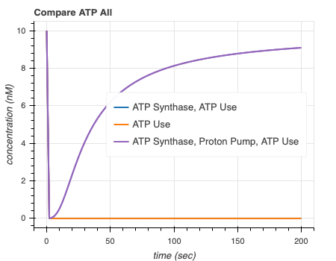
Modeling a Glucose Pathway and an ATP Synthase Mechanism shows ATP Life Extension in Synthetic Cells
Ankita Roychoudhury¹; Richard Murray, PhD¹;
¹California Institute of Technology
Abstract
Methods and Materials
In synthetic cell protein synthesis, a potential limiting factor is the energy supply for transcription and translation. By computationally studying mathematical models of various ATP regeneration mechanisms in synthetic cells, we aim to propose experimental methods for ATP life extension. We use available software tools to study two models. These allow us to develop and study mass-action models by implementing simple chemical reaction networks. Our simulations show that a glucose metabolic pathway can extend lifetime of ATP up to about 60 hours. Integrating ATP synthase can also lengthen the lifetime of ATP to various times depending on the implemented proton gradient mechanism. These simulations will help us understand if ATP is truly the limiting factor. To ensure prolonged synthetic cell protein synthesis, either the glucose pathway or ATP synthase mechanism can be used. In the future, it will be useful to perform wet-lab experiments in order to compare our model to data.
Different software packages were used for model simulation
We used multiple software packages in order to test the hypothesis in silico. In particular, we used BioCRNpyler, bioscrape, SBML, and sub-sbml [7,8,9]. Biocrnpyler is an object-oriented framework (written in Python). Given simple descriptions, the software can generate chemical reaction networks (CRNs). These are outputted as SBML files. SBML is a model representation format, which uses the language XML and is commonly used in systems and synthetic biology. We then used bioscrape as a CRN simulator. Given an SBML file, bioscrape can solve the system and return an output of results that can be visualized. Sub-sbml was also used because it allows for the creation of subsystems, the ability to combine multiple subsystems, and the ability to model interactions such as molecule transport and membrane diffusion. A typical workflow is shown in Figure 5.
Figure 8. VirE2 membrane integration and ssDNA export model schematic
9a
9b
9c
ssDNA export original
ssDNA export with ATP Rheostat
ssDNA export with ATP Synthase and Proton Pump
Figure 9. Combination of ssDNA export and ATP life extension models. 9a) Original ssDNA export model. 9bc) ssDNA export model with ATP Rheostat and ATP synthase model shows quicker ssDNA export and more bound VirE2.
Design Model
Discussion
Output!
Bioscrape
Our models can be integrated with others
It is important to combine these models with others to understand and confirm their effects. This was done with Agrima Deedwania’s (IIT Delhi) single-stranded DNA (ssDNA) export model [10], schematic shown in Figure 8. We notice that when both ATP regeneration models are separately combined with the export model, there is more bound VirE2 and faster ssDNA export (Fig 9 bc). We also studied the effects of temperature on our model as a potential method to control the rates of ATP regeneration – Ayush Venkatesh Bindlish’s (IIT Delhi) model (Figure 10). Results are shown in Figure 11.
Going forward, it will be useful to validate and test these claims with experiments.
Figure 5. A typical simulation workflow used in this project.
Introduction
Results
An ATP Rheostat and ATP Synthase Model were chosen as regeneration mechanisms for synthetic cells
There is a growing interest in the development and application of genetically-programmed synthetic cells, cells which do not replicate or divide. We want to explore whether ATP life extension mechanisms, as depicted in Figure 1, can extend ATP levels in synthetic cells with TX/TL, a transcription/translation system that creates protein from linear DNA templates [3,4,5]. See Figure 2 for a representation.
An efficient, longer-lasting method to provide energy required for internal reactions will allow us to carry out more complex, sustainable experiments.
The two mechanisms we studied are a glucose metabolic pathway, also known as the ATP rheostat (from Bowie Lab at UCLA), and an ATP synthase mechanism [5]. See Figure 3 below for the reaction pathway of the ATP rheostat. A schematic for the ATP synthase model is shown in Figure 4.
ATP Life Extension can be modeled with BioCRNpyler and Bioscrape
For both models, we were able to show that ATP life extension can be achieved. After choosing parameters based on literature for the ATP rheostat, we simulated the pathway, shown in Figure 6 below. We note that there is isobutanol production and glucose consumption, as expected (Fig 6a). The lifetime of ATP is extended when the rheostat is implemented compared to when we only model ATP use (Fig 6b). The ATP use case is included in all simulations to represent ATP consumed by TX/TL.
The three main components of this ATP synthase are ATP synthesis via ATP synthase, proton gradient maintenance via a proton pump, and ATP use. When we include the proton pump, ATP is completely regenerated and can reach a higher steady state (Fig 7 ab), confirming that a proton gradient is necessary for the success of the ATP synthase model.
The ability to combine different models is one of the challenges of synthetic biology. Thus, we attempted to integrate our ATP life extension models with others, such as the one shown in Figure 8.
DNA
Temperature Sensitive
RNA
11a
11b
Membrane Integration
Protein Folding
Escherichia Coli
Synthetic Cell
Figure 10. The DNA to RNA step of the modelling is temperature sensitive.
Figure 11. Different temperatures affects the amount of bound protein (11a) and ATP regeneration rates (11b) of the ATP synthase model.
Tx
Tl
Tx
Tl
Figure 2. A depiction of a synthetic cell. The transcriptional (orange) and translational (blue) machinery from E. Coli is extracted and placed into a liposome with the desired DNA template.
6a
6b
Conclusions
Figure 1. A diagram representing our overall goal. By implementing some mechanism (red arrow), we would like to regenerate ATP to longer support an anabolic process.
Entire ATP Rheostat Pathway
Compare ATP Curves for Rheostat Pathway
Experimental data will be necessary to validate our claims
In conclusion, we have been able to model two mechanisms for ATP regeneration in synthetic cells; the ATP rheostat and ATP synthase model. These in silico results have allowed us to understand what parameter sets ensure desired ATP levels. A designer may choose a model based on the desired timescale and complexity of their experiment.
Validation of this project with experimental data will offer new information. The parameters implemented in this model are all presumed to be on the correct order of magnitude however there is minimal available data to confirm further accuracy. To continue, maintenance of a proton gradient mechanism for the ATP synthase model may be more challenging than depicted. Others have been able to use light-activated bacteriorhodopsin to develop a lasting gradient. Further, there are 15 additional enzymes that need to be expressed for the ATP rheostat pathway. This could lead to harmful side effects and rapid resource depletion in vitro. Experimental data will offer answers to these questions and more.
Figure 6. Simulations of the ATP rheostat pathway. We see stoichiometric production of isobutanol (6a) and extended ATP production with the rheostat (6b).
7a
7b
Comparison of ATP Curves with and without ATP Synthase
Compare All ATP Curves for ATP Synthase Model
Figure 3. Entire Rheostat pathway as shown in the Opgenorth et al paper [5].
Figure 4. ATP Synthase (purple) model schematic. We include a proton pump (green) to maintain the proton gradient necessary for ATP synthesis.
Figure 7. Simulations of the ATP synthase model. Without the proton pump, there is not enough regeneration (7a). When the proton gradient is maintained, we note a higher steady state of ATP (7b).
Contact
References
Samuel P. and Frances Krown SURF Fellow
8.19.2020
Note: All source code can be found at [11]
Ankita Roychoudhury
Caltech
aroychou@caltech.edu
203-584-4466
1) R. M. Murray. SURF 2020: Genetically Programmed Synthetic Cells and Multi-Cellular Machines.
https://www.cds.caltech.edu/~murray/wiki/SURF_2020:_Synthetic_Cell
2) Murray, Richard, Towards Genetically-Programmed Synthetic Cells and Multi-Cellular Machines, July 2017. http://www.cds.caltech.edu/~murray/talks/murray_buildacell-pasadena_24Jul17.pdf. PowerPoint Presentation.
3) Arbor Biosciences. The myTXTL system is a comprehensive solution for protein engineering and synthetic biology applications. myTXTL – Cell-Free Expression, 2014.
4) Ortega. Biocircuits TX TL Life Extension Project Presentation. June 2018.
5) P. H. Opgenworth, T. P. Korman, L. Iancu, and J. U. Bowie. A molecular rheostat maintains ATP levels to drive a synthetic biochemistry system. Nature Chemical Biology, 2017.
6) Ayush Pandey, R. Murray, AutoReduce, https://github.com/ayush9pandey/autoReduce
7) William Poole, A. Pandey, A. Shur, Z. Tuza, R. Murray. BioCRNpyler: Compiling Chemical Reaction Networks from Biomolecular Parts in Diverse Contexts. Biorxiv. 2020.
8) Anand Swaminathan, W. Poole, V. Hsiao, R. Murray. Fast and flexible simulation and parameter estimation for synthetic biology using bioscrape. Biorxiv. 2019.
9) Ayush Pandey, W. Poole, Z. Tuza, sub-sbml, https://github.com/BuildACell/subsbml
10) Agrima Deedwania, https://github.com/agrimadeedwania
11) Ankita Roychoudhury, https://github.com/AnkitaRoychoudhury/ug_murray

