Slide 1

ATP Life Extension in Synthetic Cells
Ankita Roychoudhury
Murray Lab
6.25.2020

Slide 2
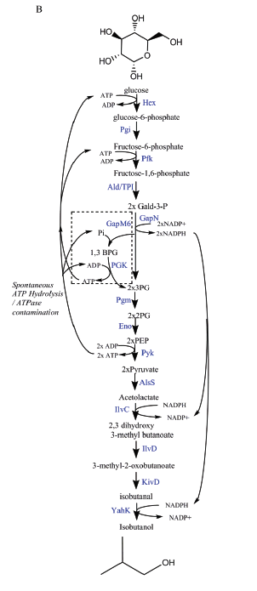
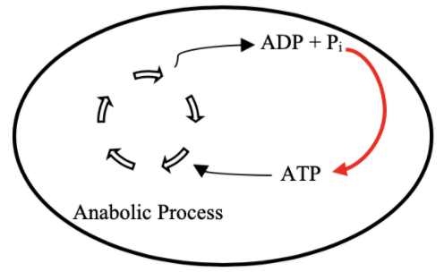
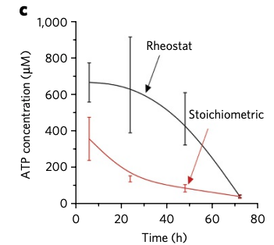

Goal: ATP Life Extension in Synthetic Cells
Proposal 1: Regeneration by Rheostat Machinery
TX/TL
Opgenorth et al., 2017, Nature Chemical Biology

Slide 3
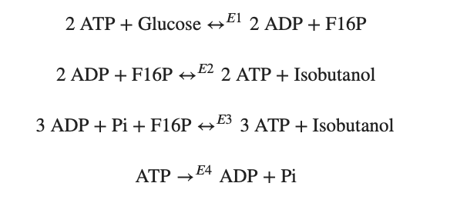
Modelling Approach
1) Simple pathway - bioscrape
Choose an enzymatic mechanism
2) Simple pathway – biocrnpyler
3) Entire pathway - biocrnpyler
Notes:
We have shown the simplified pathway on the right that we will use for the simplified modeling for convenience

Slide 4
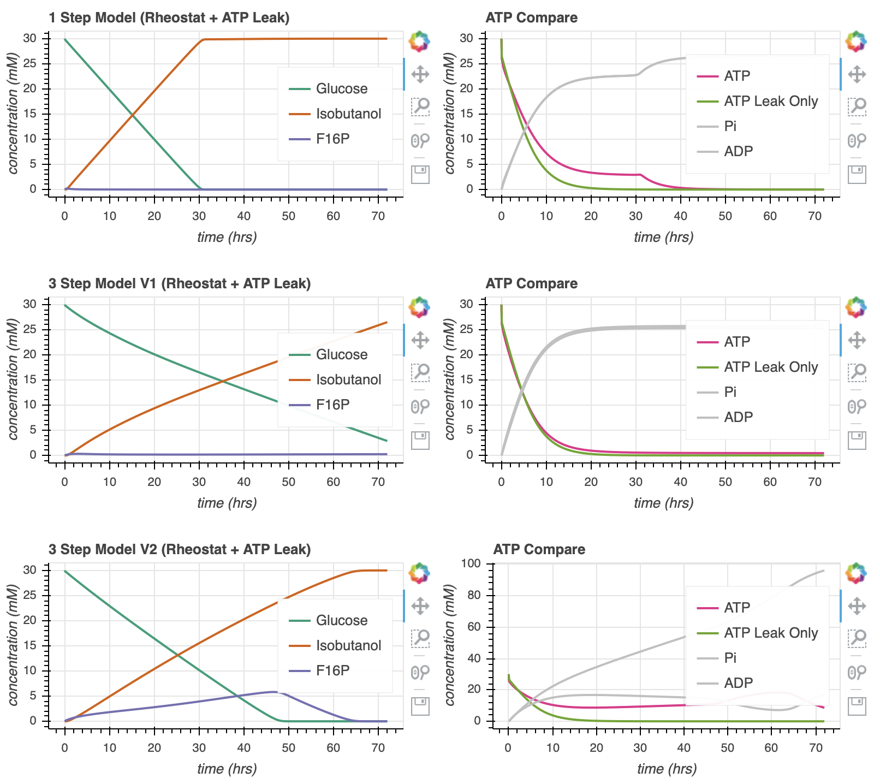
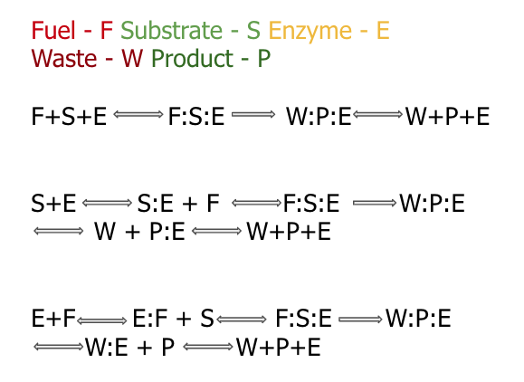

Enzymatic Models
Notes:
Here, we show the different enzymatic models we’ve tried to study
<click>
At this point, I chose slightly arbitrary parameters. They are generally on the correct order of magnitude but they may not entirely accurate.
Go through the graphs
ATP leak curve is a large oversimplification to try to account for the atp hydrolysis by atpase activity and the atp used in tx/tl
we make sure that these parameters ensure use of atp by time 20 in the simulations that only consider atp (experimental evidence)

Slide 5
Mechanism
Biocrnpyler Development
Component
Called MichalisMentenReversible
Type ‘catalysis’
Takes in enzyme, substrate_list, product_list (fuel and waste included)
Binding, catalysis, and unbinding reaction
Called MultiEnzyme
Uses mechanism ‘catalysis’
Takes in rate parameters

Slide 6
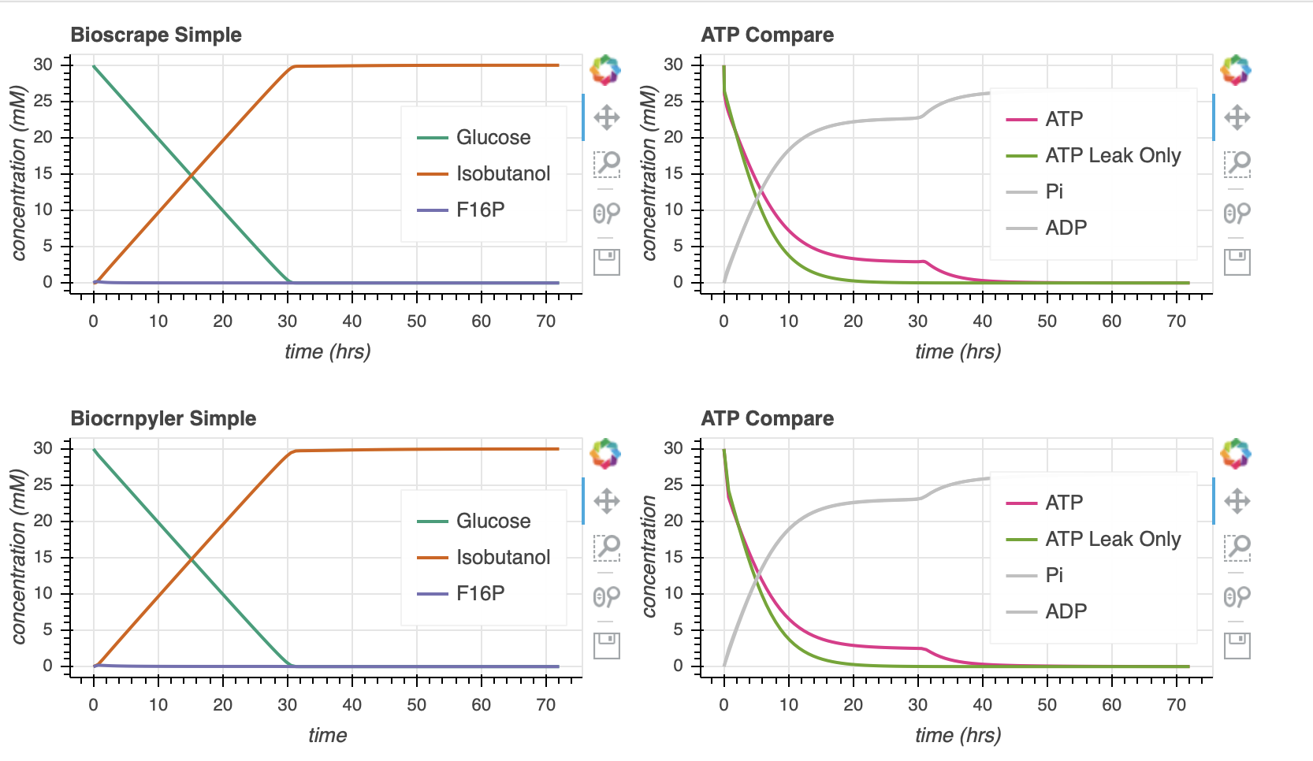

Bioscrape Biocrnpyler Comparison

Slide 7
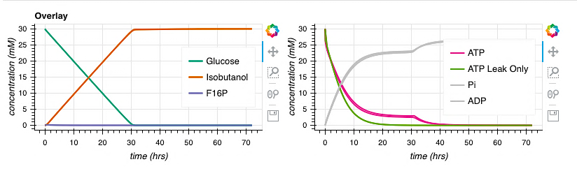
Bioscrape Biocrnpyler Comparison

Slide 8






Parameter Estimates
$$k_{bf}$$
$$k_{cat}$$
$$k_{uf}$$
$$k_{br}$$
$$k_{ur}$$
Notes:
In attempt to explore the dynamics of the pathway, I made some parameter generalizations to begin with.
All the k for all the enzymes in the pathway are the same
We assume that we put the same amount of each enzyme in the mixture.
ATP leak enzymes is a large oversimplification to try to account for the atp hydrolysis by atpase activity and the atp used in tx/tl
we make sure that these parameters ensure use of atp by time 20 in the simulations that only consider atp (experimental evidence)

Slide 9
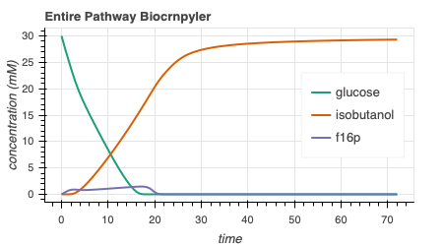
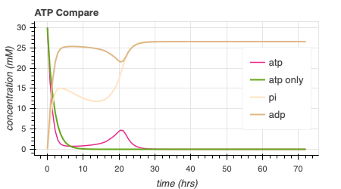
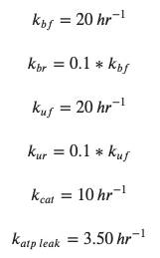
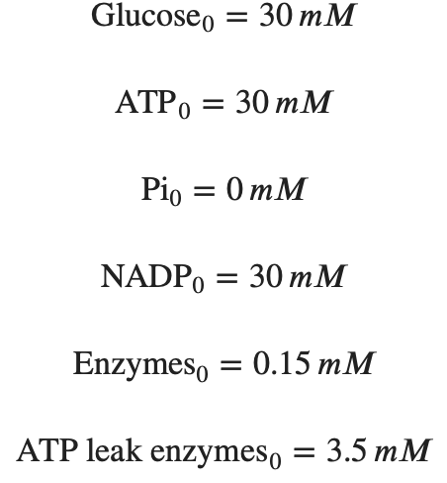
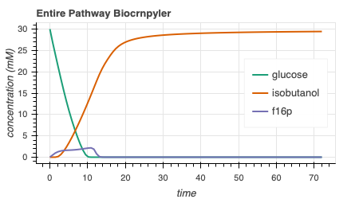
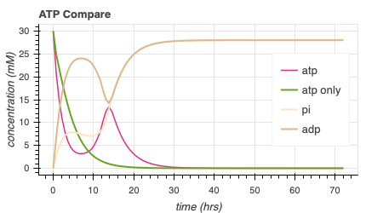
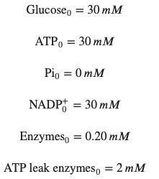
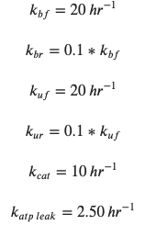
Simulate Entire Pathway - Biocrnpyler
74.5
s⁻¹
170.5
s⁻¹
Adjusting the rate of ATP leak and the initial concentrations of enzymes can lead to more optimal dynamics.
Notes:
Now, we incorporate this entire pathway in biocrnpyler.
On the top here, we have used very similar parameters from before. Now, I will begin to do a bit of parameter search to try to find cases where there may be more optimal dynamics and to try an gain a better intuition of the pathway .
<click>
On the bottom, I’ve changed the initial amount of enzymes (CLICKS!) and the rate of atp leak a bit in attempt to move the ‘hump’ of atp production. Note that the green line represents the simulation with only atp leak, no rheostat machinery. We would ideally like the pink ‘atp’ line to be right-shifted in comparison to the green atp only line.
<click>
Moving forward, I will perform a parameter search to try to optimize the area underneath the curve of the pink atp line and also try to gain a better intuition of why we see what we see. While doing the optimizations, we must keep in mind that the green atp_only line should continue to reach 0 around time 20. For reference, here are the integral values of the atp line.

Slide 10
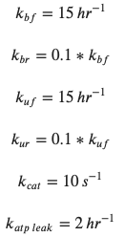
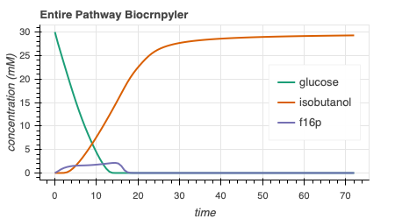
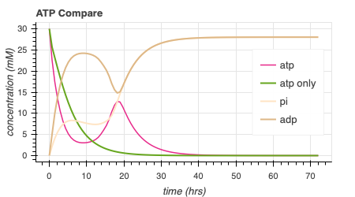
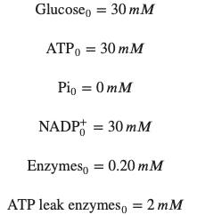

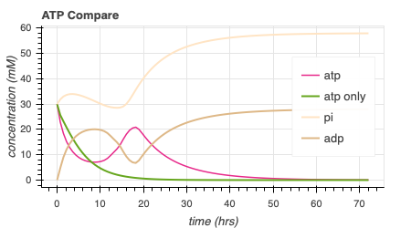
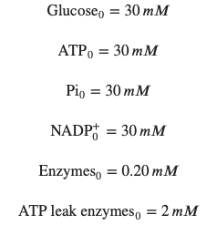
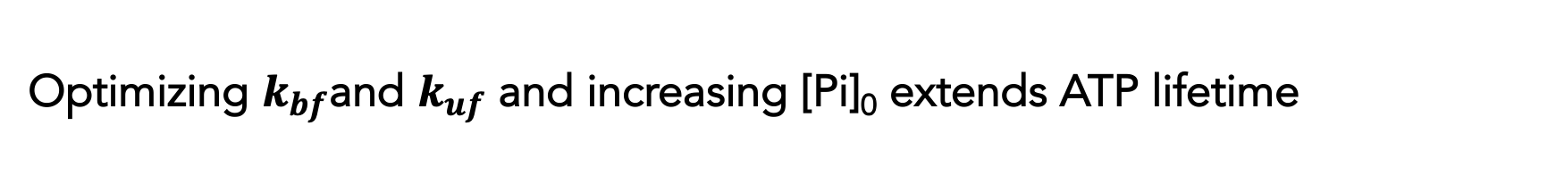
Optimizing $k_{bf}$and $k_{uf}$ and increasing [Pi]₀ extends ATP lifetime
216.0
s⁻¹
414.6
Notes:
I also see that increasing the initial free phosphate concentration can increase the amount of atp produced without affecting the atp_only curve.
In the context of simulations, this is relatively positive since we do indeed see that we can get extended atp lifetime, up to about 40 hours. However, the parameter estimates and assumptions we have made may be a bit concerning. NEXT
Going forward, we will be using the parameters shown on the bottom plot, unless otherwise stated

Slide 11
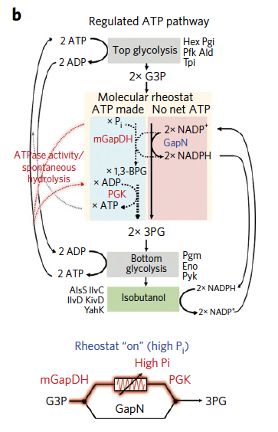
Hypothesis: Hump due to flux through mGapDH and Pgk enzymes with increased [Pi]
Top glycolysis
Molecular rheostat
ATP made
No net ATP
2x NADP⁺ + P_{i}
2x NADP⁺
mGapDH
GapN
2x NADPH
2x NADPH
1,3-BPG
ADP
PGK
ATP
2x 3PG
Bottom glycolysis
Isobutanol
Rheostat pathway images: Opgenorth et al., 2017, Nature Chemical Biology

Slide 12
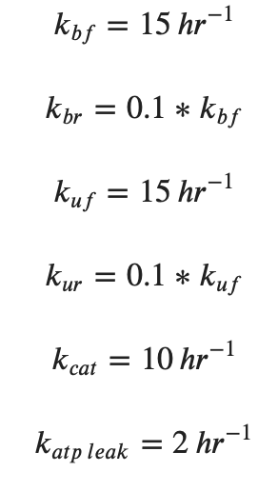
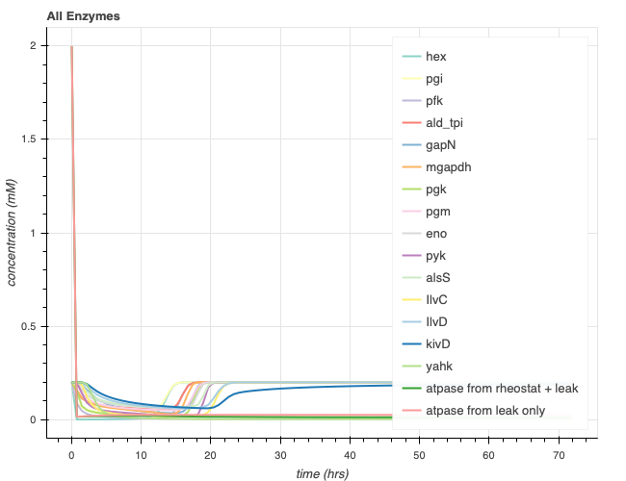
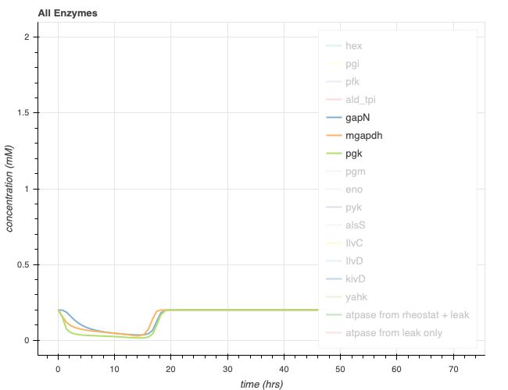
Entire pathway simulation
414.6
Top glycolysis
Presence of ATP hump
Complete isobutanol production
Molecular rheostat
ATP made
No net ATP
2x NADP⁺ + P_{i}
2x NADP⁺
mGapDH
GapN
2x NADPH
2x NADPH
1,3-BPG
ADP
ATP
PGK
2x 3PG
Bottom glycolysis
Isobutanol
Notes:
Hump is not entirely gone – because of ATP regeneration pathway, second half of pathway
Glucose stored in acetolactate and isobutanol because the gapN pathway is not as favored and it makes NADPH and NADPH is needed to make those reactions go forward

Slide 13
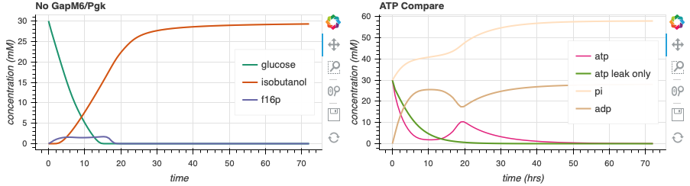
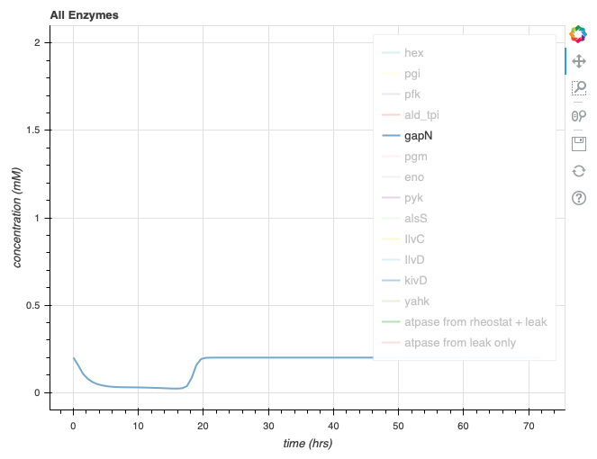
Removing mGapDH and Pgk from simulation (GapN pathway is used)
225.2
Top glycolysis
Molecular rheostat
Slightly more GapN activity
Lower magnitude ATP hump
Complete isobutanol production
ATP made
No net ATP
2x NADP⁺ + P_{i}
2x NADP⁺
mGapDH
GapN
2x NADPH
2x NADPH
1,3-BPG
ADP
ATP
PGK
2x 3PG
Bottom glycolysis
Isobutanol
Notes:
Hump is not entirely gone – because of ATP regeneration pathway, second half of pathway

Slide 14
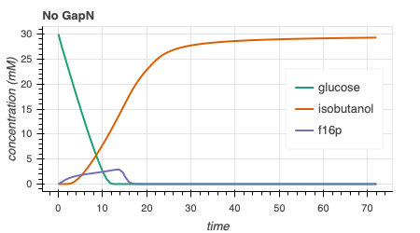
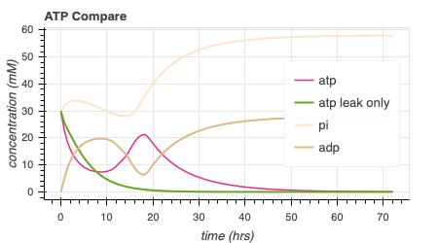
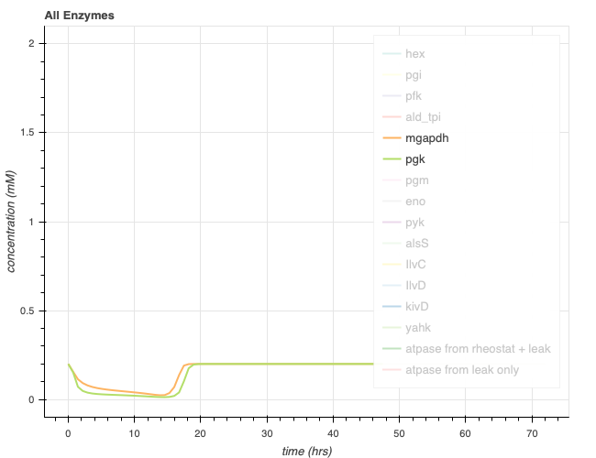
Remove GapN from simulation (mGapDH and Pgk pathway is used)
421.8
Top glycolysis
Slightly higher magnitude ATP hump than entire pathway
Complete isobutanol production
Molecular rheostat
ATP made
No net ATP
2x NADP⁺ + P_{i}
2x NADP⁺
mGapDH
GapN
2x NADPH
2x NADPH
1,3-BPG
ADP
ATP
PGK
2x 3PG
Bottom glycolysis
Isobutanol
Notes:
Hump is not entirely gone – because of ATP regeneration pathway, second half of pathway
Entirely stuck at acetolactate – not enough nadph to get past because that enzyme is gone - expected
Entier pathway had 414.6

Slide 15
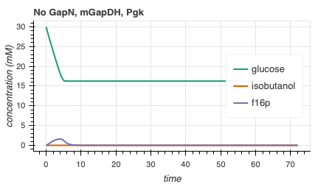
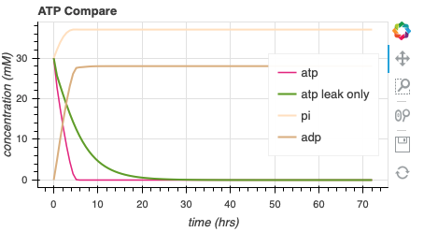
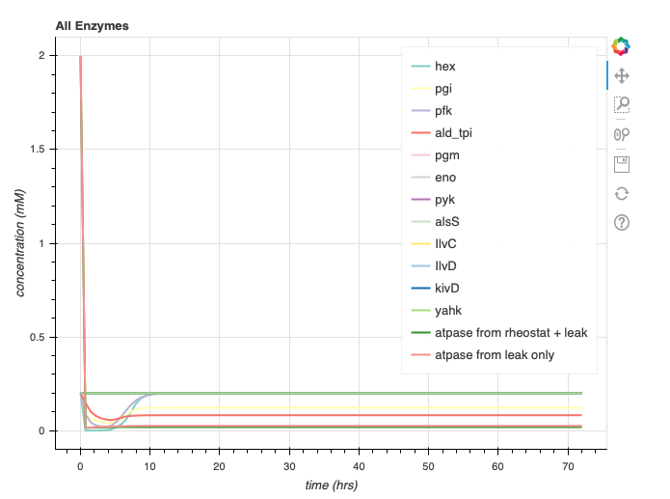
Remove GapN, GapM6, and Pgk from simulation (Incomplete pathway)
60.1
Top glycolysis
Molecular rheostat
No hump
No isobutanol
ATP made
No net ATP
2x NADP⁺ + P_{i}
2x NADP⁺
mGapDH
GapN
2x NADPH
2x NADPH
1,3-BPG
ADP
ATP
PGK
2x 3PG
Bottom glycolysis
Isobutanol
Notes:
Hump is not entirely gone – because of ATP regeneration pathway, second half of pathway
Entirely stuck at acetolactate – not enough nadph to get past because that enzyme is gone - expected

Slide 16
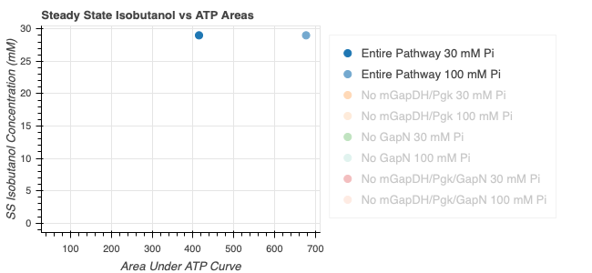
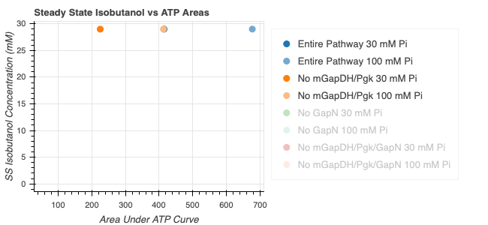
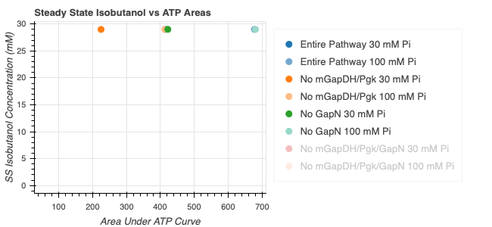
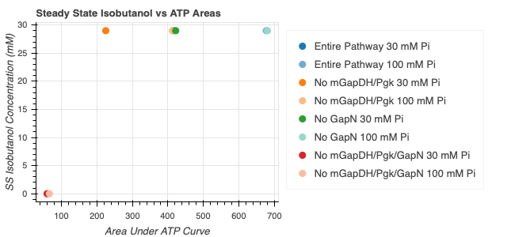
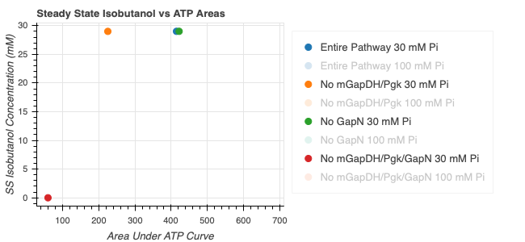
Entire pathway is not necessary for optimal isobutanol steady state value and ATP area
Top glycolysis
Molecular rheostat
ATP made
No net ATP
2x NADP⁺ + P_{i}
2x NADP⁺
mGapDH
GapN
2x NADPH
2x NADPH
1,3-BPG
ADP
ATP
PGK
2x 3PG
Bottom glycolysis
Isobutanol
Notes:
3.97 8.6
Comment about phosphate – Papers have shown that using non-phosphorylated energy substrates can result in phosphate limitation of energy regeneration – adding 10 mM provided 3 fold increase in CFPS yield in glucose driven e coli cfps (Calhoun and Schwartz 2005a)
More inorganic phosphate can inhibit protein production – should I be modelling more protein stuffe (related to magnesium)

Slide 17
Reconsidered Modelling Approach
Full Model
CRN Mass action
(k_{bf1}, k_{br1}, k_{uf1}, k_{ur1},k_{cat1},k_{bf2},…)
Minimal Model
Coarse-grained
(k₁, k₂ = k)
Lumped parameters
Extracted from experimental data
Effective relations to help argue values of reduced model
Include assumptions
Conservation laws
QSSA
Generalize binding/unbinding
Reduced Model
(k₁, k₂,…)
More relevant to experimental data
Notes:
Full model has all reaction rate parameters
This makes sense – I’ve optimized the full model, but how can I come up with some biological relevance

Slide 18
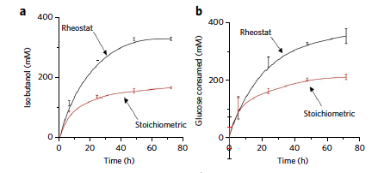
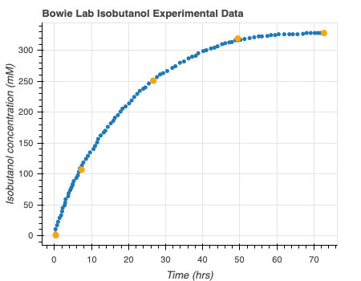
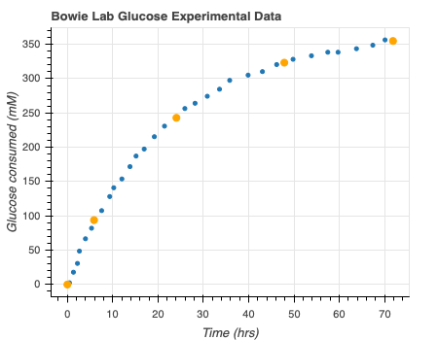
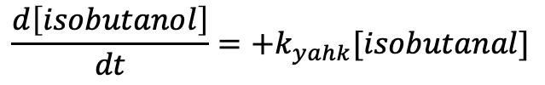
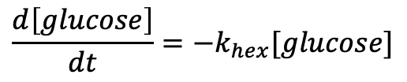
Get Minimal Model from Bowie Lab Experimental Data
Digitizeit
$$\frac{d\left[glucose\right]}{dt}=−k_{hex}[glucose]$$
$$\frac{d\left[isobutanol\right]}{dt}=+k_{yahk}[isobutanal]$$
Rheostat pathway data: Opgenorth et al., 2017, Nature Chemical Biology
Notes:
Use digitize it to get the consumption over time – subtract times and rates to get rates (mM/hr) – perform MLE on this data
Bootstrapping from all the confidence intervals
Need help – not sure that negative binomial approach is correct? Should I take Bayesian approach? Is this necessary? Should I use binomial model? Is Glucose production rate that right thing to be looking at? How to extrapolate to my data?

Slide 19
Future directions for rheostat model
Use multiple models to approximate parameters (ex. enzyme kinetics)
Model 20 min lag
P_{i} toxic accumulation
Use model reduction to analyze circuit stability
Using autoreduce and/or function-topology maps
Autoreduce: Ayush Pandey github
Function-Topology: Ma et al., 2009, Cell
Notes:
10 species/parameters – reduce to 2/3 to study
Ma look at sensitivity versus precision
This is not considering binding forward and binding reserve- only overall forward and reverse parameters

Slide 20
Other Proposed Models
TX/TL

Slide 21
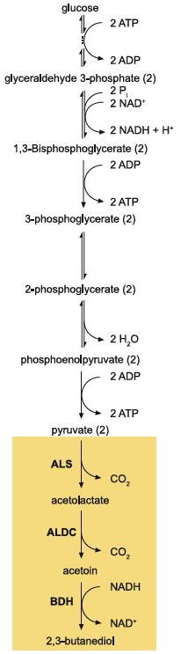
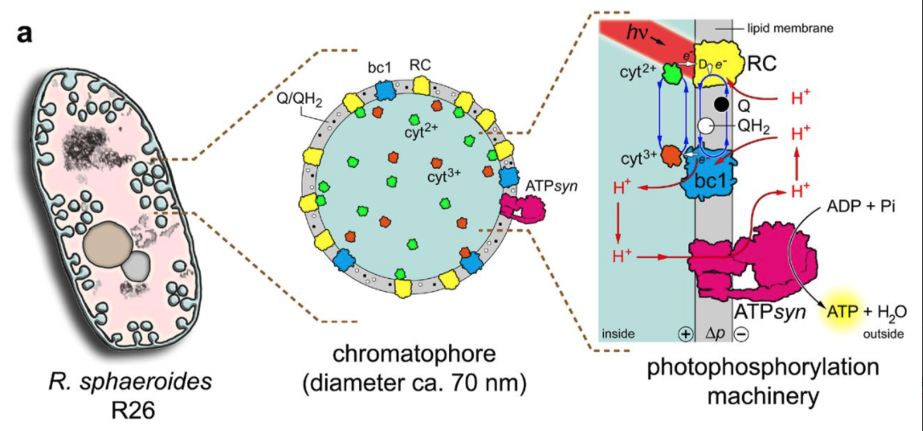
Other pathways with glucose
Light-activated systems
Jennifer E. Kay, Michael C Jewett, Metabolic Engineering, 2015
Altamura et al., biorxiv, 2020
Notes:
Using glucose as starting point can be a problem – in e coli extract, it is rapidly co nsumed (Jewett 2015
preferred to more expensive phosphorylated proteins
Light activated systems – used in Artifical Simplified-Autotroph Protocells – sphere of lipids (100 atp/s per atp synthase). Were able to show mrna biosynthesis inside individual vesicles

Slide 22
Transporter Model
ATP Synthase Model
ADP + Pi
H⁺
ADP + Pi
ADP + Pi
TX/TL
ATP + H₂0
ATP
ATP
TX/TL

Slide 23
Vesicle Fusion Model
ADP + Pi
TX/TL
Excess ATP
ATP

Slide 24
Vesicle Fusion Model
Fusion by ssDNA
Concentrations are ½
ADP, Pi toxic accumulation?
Include transporter
Other considerations
ADP + Pi
TX/TL
Excess ATP
ATP
Lipid Vesicle fusion by linker DNA:Yee-Hung M. Chan, Bettina van Lengerich, and Steven G. Boxer, PNAS, 2009
Notes:
Linker sequences = https://www.pnas.org/content/106/4/979
Other considerations – such as diffusion

Slide 25
Future Directions
Complete Exhaustive Rheostat Modelling
Utilize subsbml and compartments to look at other models
Add fusion functionality to biocrnpyler

Slide 26
Thank You!
William Poole
David Garcia
Ayush Pandey
John Marken
Chelsea Hu
Richard Murray

