Slide 1
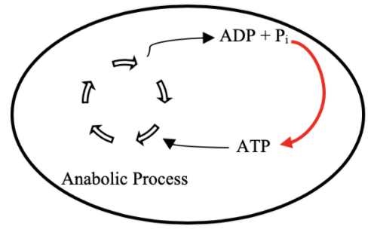
Project Updates & SURF Plans
Ankita Roychoudhury
4.27.2020

Slide 2
BE 98 Term 3 Plan
Replicate Opgenorth et al. model in Bioscrape
Model energy usage in liposomes / characterize reaction time
Understand limiting factors
Parameter search for optimal extension of TX/TL lifetime

Slide 3
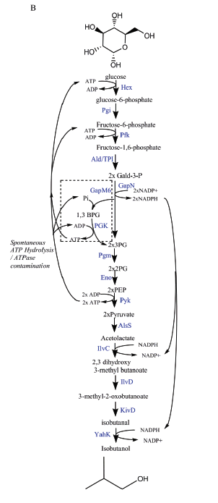
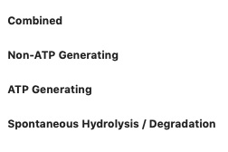
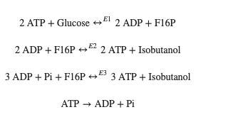
Simplified Model
Stoichiometric
Rheostat

Slide 4
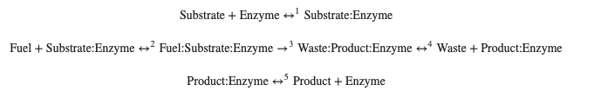
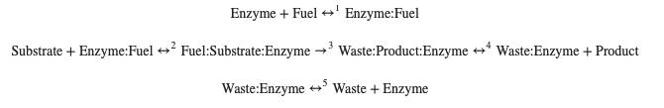
3 Enzyme Reaction Models

Slide 5
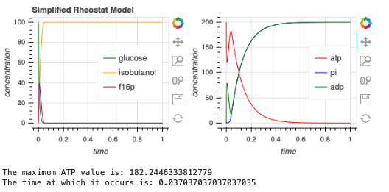
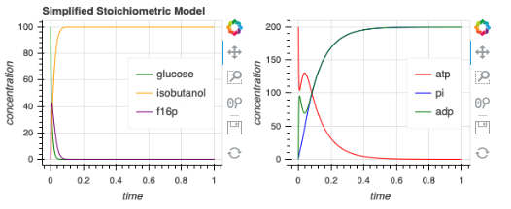
Simplified rheostat model shows quicker approach to higher ATP level

Slide 6
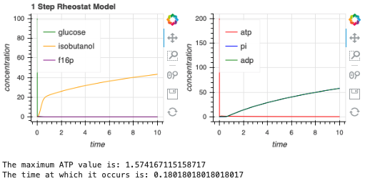
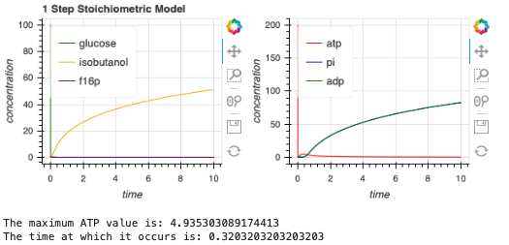
1-Step Model shows slower rate of isobutanol production but higher steady state value

Slide 7
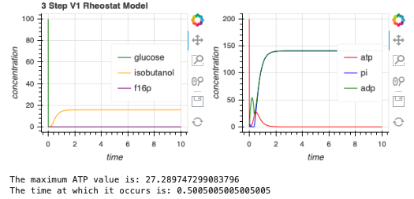
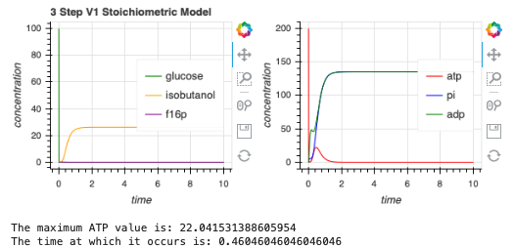
3-Step Model V1 shows quicker approach to higher ATP value yet decreased isobutanol production

Slide 8
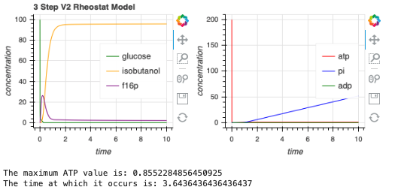
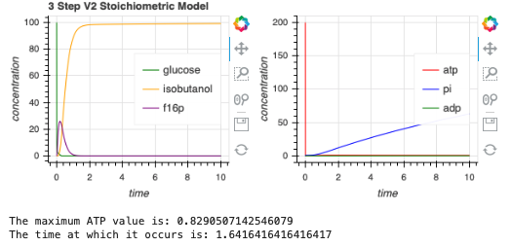
3-Step Model V2 shows strange Pi activity (some negative values)

Slide 9
Future Directions
BioCRNpyler troubleshooting
Model some with M-M kinetics?
Photosensitive/compartmentalized options
Notes:
Photosensitive one up to 2.5 hours

Slide 10
SURF 2020

Slide 11
Original Approach
Adapted Approach
Implement TX/TL into liposomes
Quantify activity and lifetime
Use ATP rheostat with TX/TL to create functioning metabolic pathway in liposomes
Study protein production with and without rheostat
Quantify rate of activity with rheostat
Quantify lifetime of activity with rheostat
Explore experiment conditions, protocols, and parameters to optimize protein production ate and lifetime
Model TX/TL in liposomes
Quantify activity and lifetime
Model ATP rheostat with TX/TL in liposomes

Slide 12
Research labs near me
Murat Acar (Yale)
”Saccharomyces cerevisiae as a model organism, we are interested in understanding and controlling aging and replicative lifespan at the single-cell level.”
Farren Isaacs (Yale)
Few cell-free protein synthesis papers
UCONN

Slide 13
Any chance of on-campus work?

