Slide 1
ATP Life Extension in Synthetic Cells
Ankita Roychoudhury
Murray Lab
6.1.2020

Slide 2
Outline
Overall goal
Paper and proposal
Simplified model
Enzyme models
Enzyme choices
Parameter choices
Biocrnpyler description - show all parts u coded
Biocrnpyler comparison with simple model
Biocrnpyler implement complex model
Future directions

Slide 3
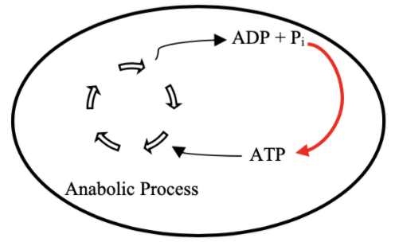
Goal: ATP Life Extension in Synthetic Cells by Regeneration
TX/TL

Slide 4
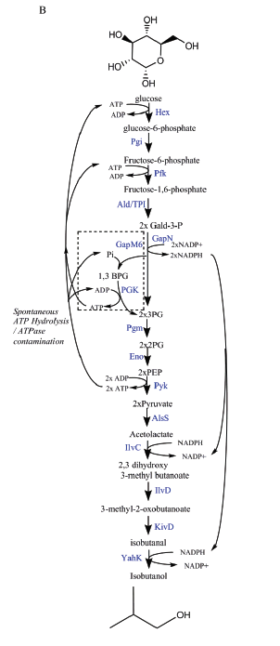
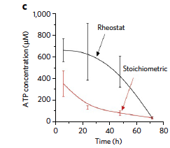
Proposed Model: Rheostat Machinery
Notes:
Shown in buffer
We want to show with txtl

Slide 5
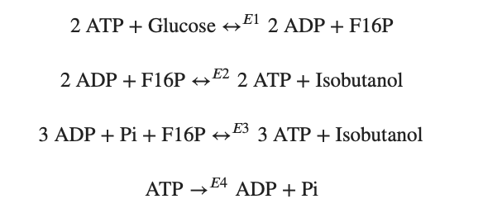
Modelling Approach
1) Simple pathway - bioscrape
Choose an enzymatic mechanism
2) Simple pathway – biocrnpyler
3) Entire pathway - biocrnpyler
Notes:
We have shown the simplified pathway on the right that we will use for the simplified modeling for convenience

Slide 6
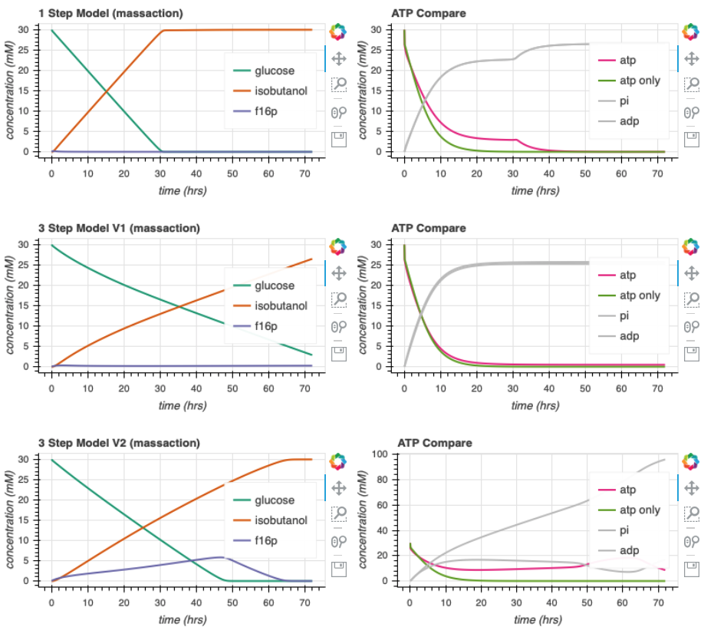
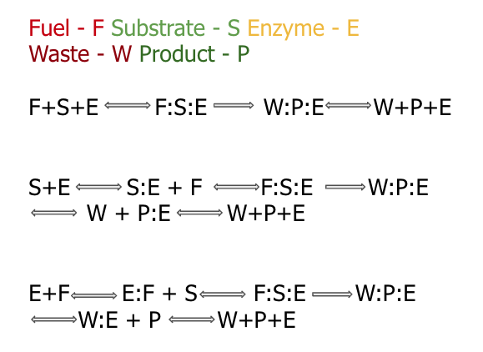

Enzymatic Models
Notes:
Here, we show the different enzymatic models we’ve tried to study
<click>
At this point, I chose slightly arbitrary parameters. They are generally on the correct order of magnitude but not entirely accurate. There is a large oversimplification

Slide 7
Biocrnpyler

Slide 8

Mechanism
Component
Mixture
Called FuelMichaelisMenten
Type ‘catalysis’
Takes in enzyme, fuel_list, substrate_list, product_list, waste_list
Binding, catalysis, and unbinding reaction
Called Enzyme
Uses mechanism ‘catalysis’
Also takes in $k_{uf}, k_{bf}, k_{cat}$
Called EnergyTxTl
Use mechanism ‘catalysis’

Slide 9
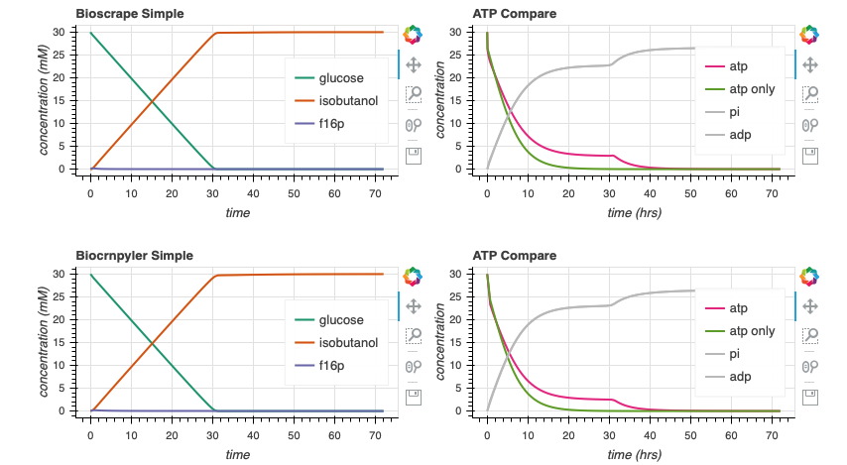

Bioscrape Biocrnpyler Comparison

Slide 10
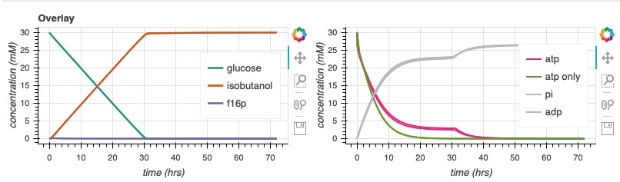
Bioscrape Biocrnpyler Comparison
Notes:
Why is it thicker?

Slide 11
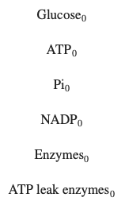





Parameter Estimates edit slide
$$k_{bf}$$
$$k_{cat}$$
$$k_{uf}$$
$$k_{br}$$
$$k_{ur}$$

Slide 12
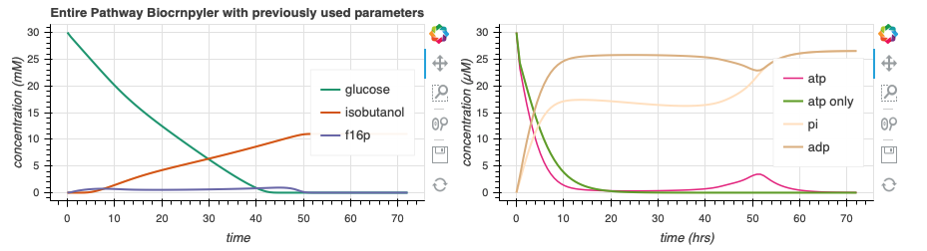
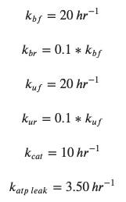
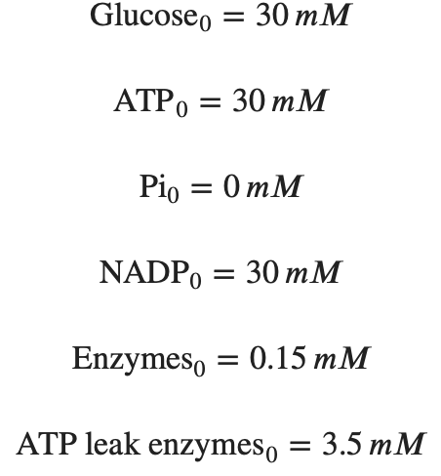
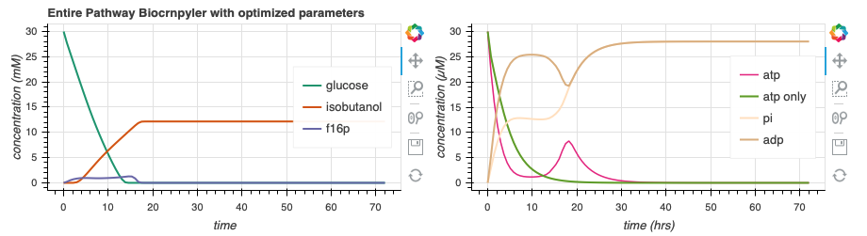
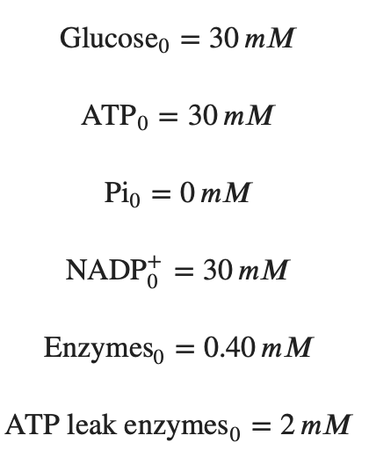
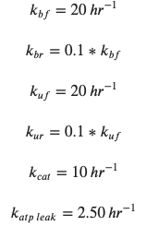

Simulate Entire Pathway - Biocrnpyler
44.4
130.7
Adjusting the rate of atp leak and the initial conditions of enzymes can lead to more optimal dynamics
Notes:
Fix animation make params bigger
Add animations to circle the things

Slide 13
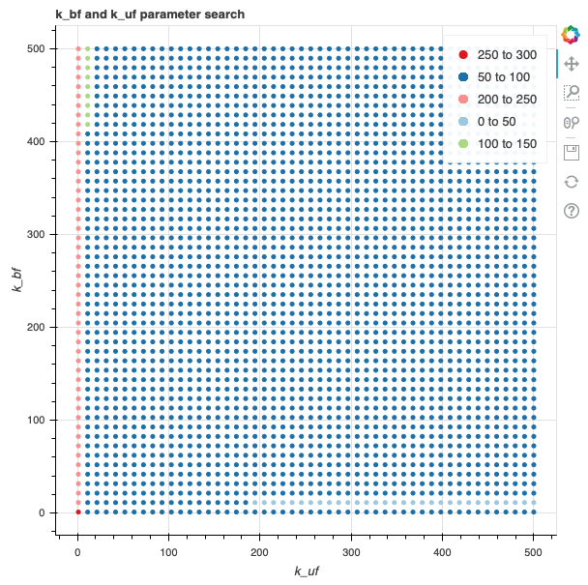
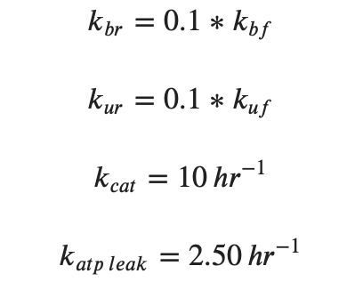
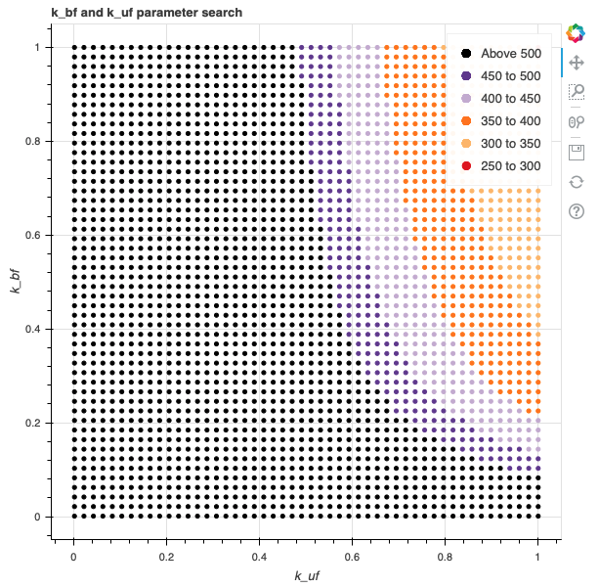
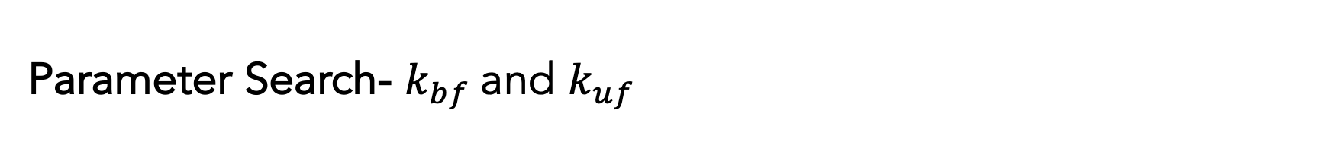
Parameter Search- $k_{bf}$and $k_{uf}$
Slower rates tend to cause prolonged ATP life extension, as expected.
Notes:
Remove red lines

Slide 14
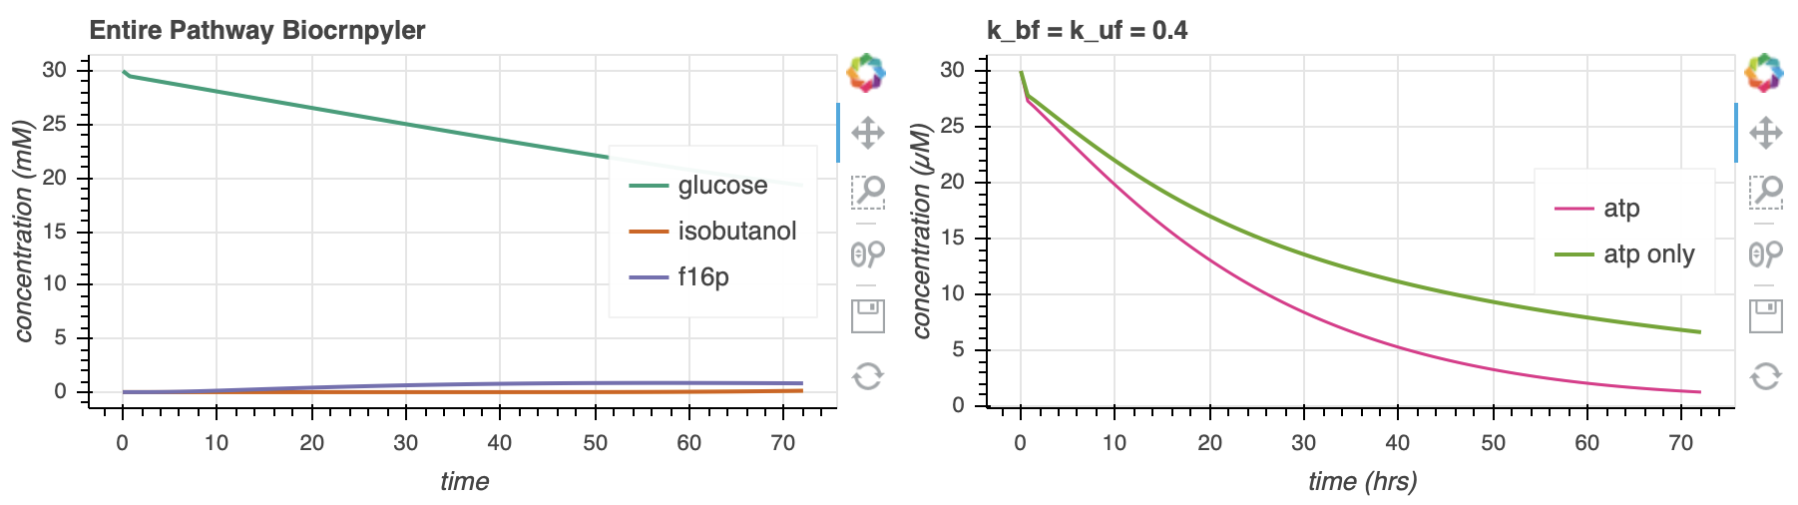
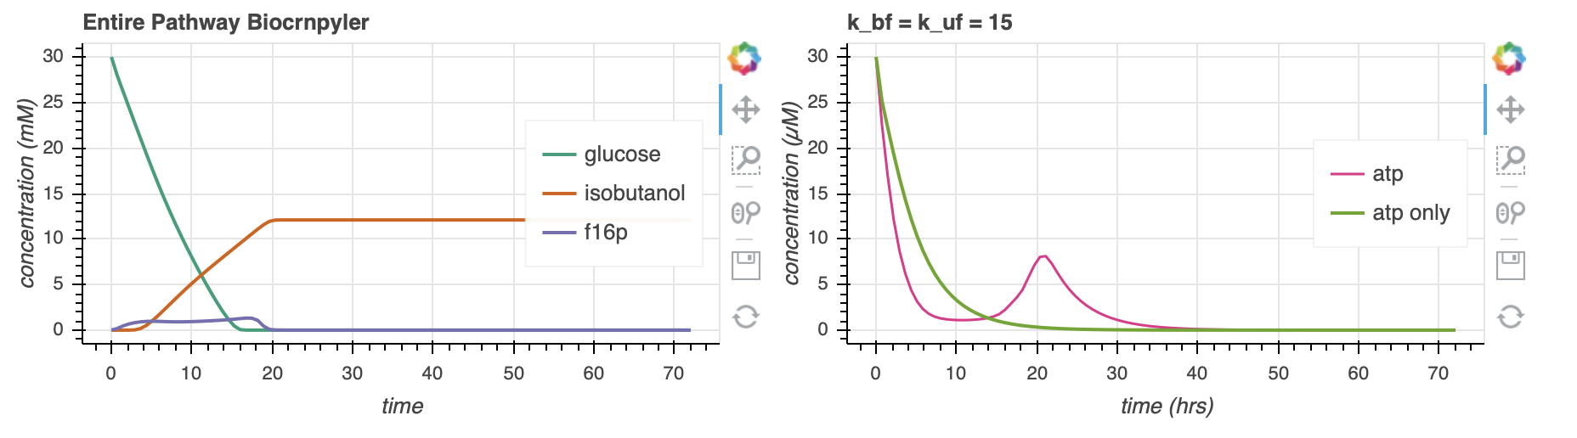
Parameter Search- $k_{bf}$and $k_{uf}$
662.9
144.2
Notes:
Area under curve of green

Slide 15
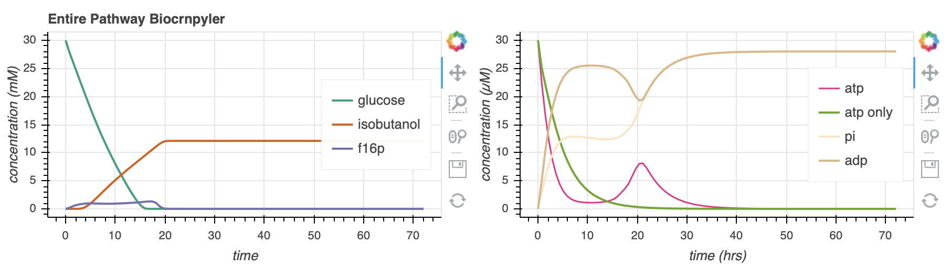
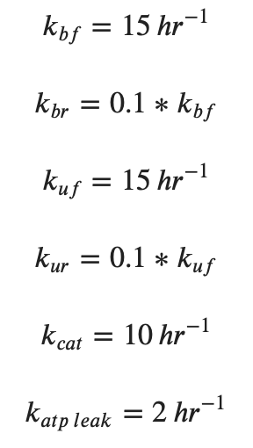
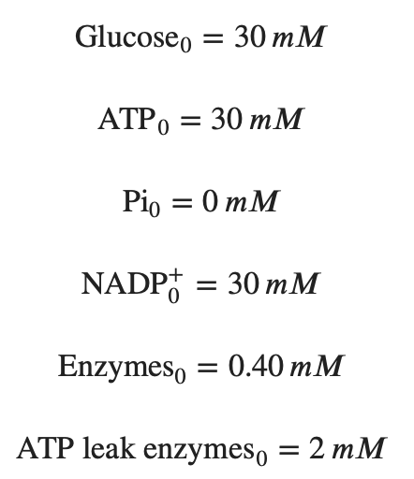
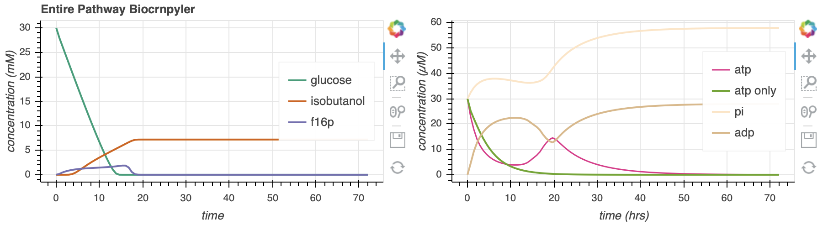
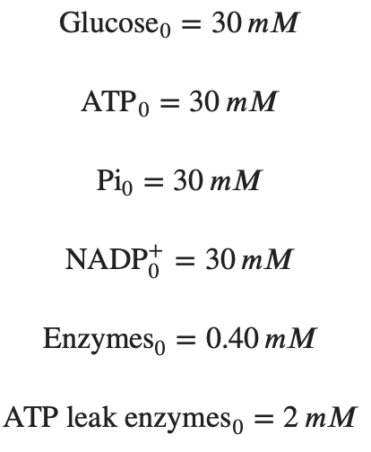
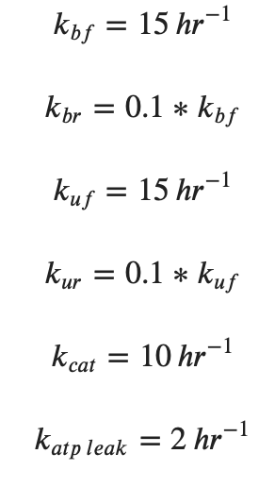
Increasing [Pi]₀ extends ATP lifetime
144.2
291.3
Notes:
Fix animations

Slide 16
Independent of Other things, it seems like this pathway could work to extend lifetime! Now, how about we compare to Opgenworth et al to see if there’s a difference?

Slide 17
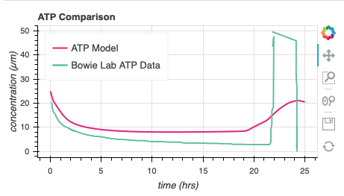
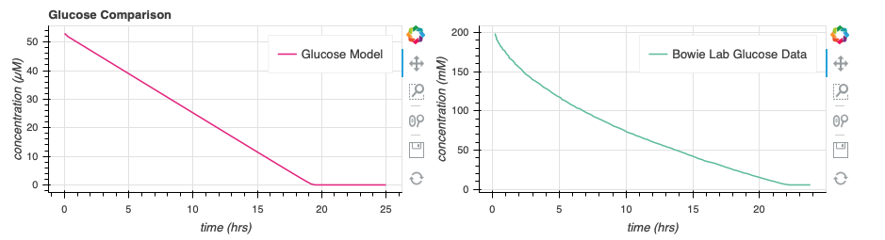
Compare to Data from Paper

Slide 18
Supplementary

