Slide 1


Slide 2
ATP Life Extension in Synthetic Cells
Ankita Roychoudhury
Murray Lab
6.21.2020

Slide 3
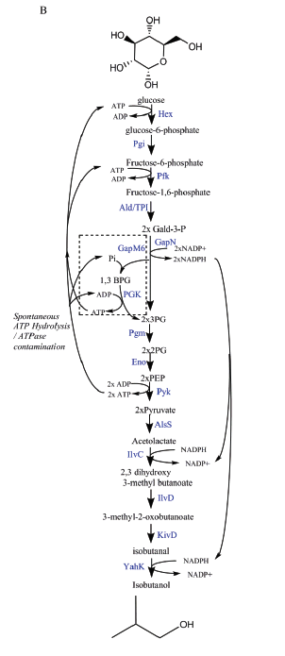
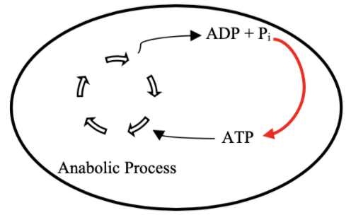
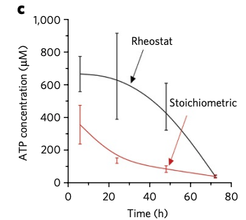
Goal: ATP Life Extension in Synthetic Cells by Regeneration
Proposal 1: Rheostat Machinery
TX/TL

Slide 4
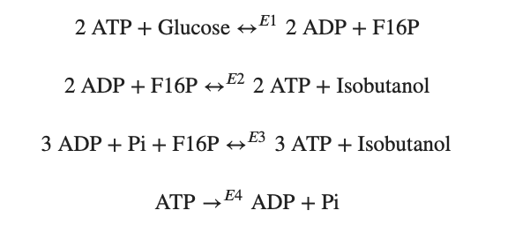
Modelling Approach
1) Simple pathway - bioscrape
Choose an enzymatic mechanism
2) Simple pathway – biocrnpyler
3) Entire pathway - biocrnpyler

Slide 5
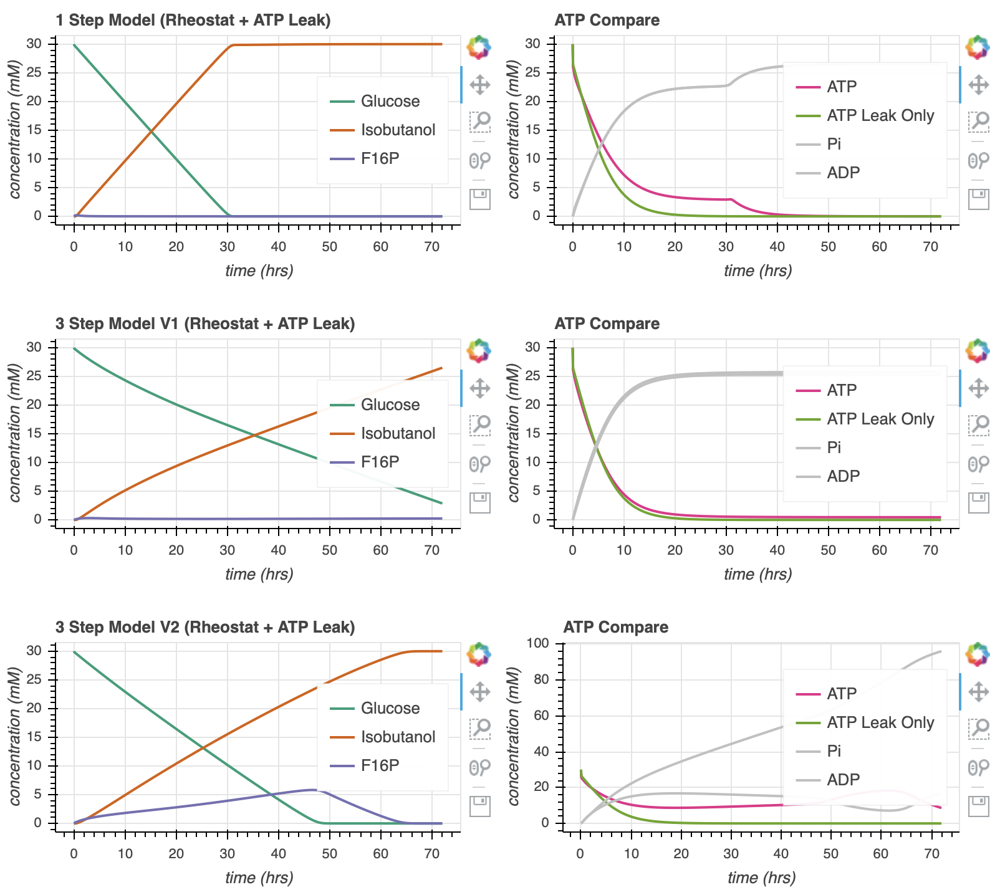
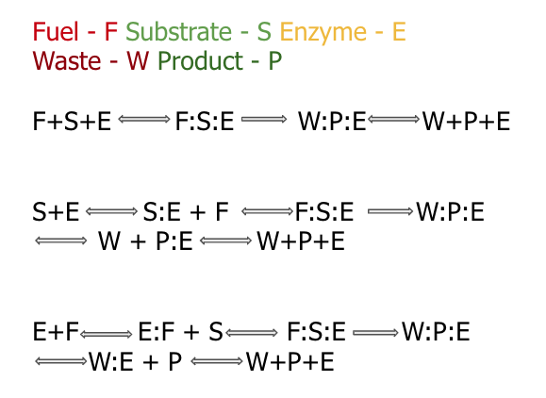

Enzymatic Models

