Slide 1
Collaborations
Ankita Roychoudhury
Murray Lab

Slide 2
With Agrima’s Export/Fusion Model
8.2.2020

Slide 3
Ankita’s ATP Regeneration (Rheostat) Model
Input: ATP, NADPH, Pi, Glucose, enzyme initial conditions
Outputs: Isobutanol production, ATP
Add pictures here
Add timescale comments/plots here

Slide 4
Export/Fusion + ATP Rheostat

Slide 5
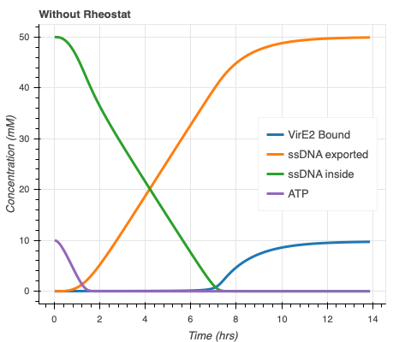
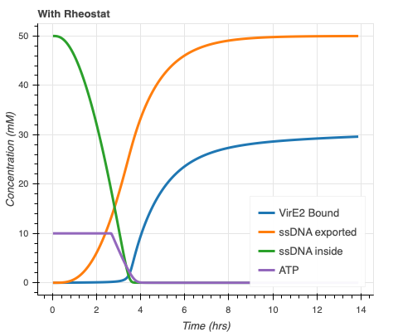
More membrane-bound VirE2 and faster ssDNA export with ATP Rheostat

Slide 6
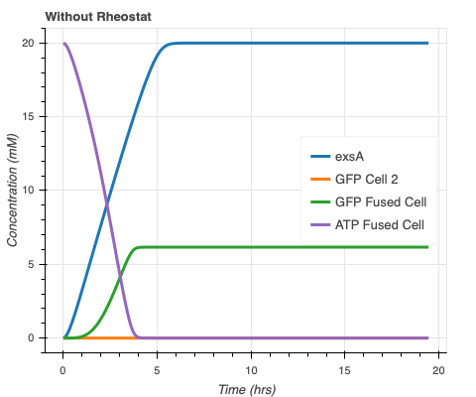
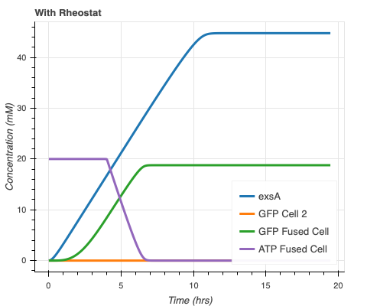
More GFP(?) with ATP Rheostat

Slide 7
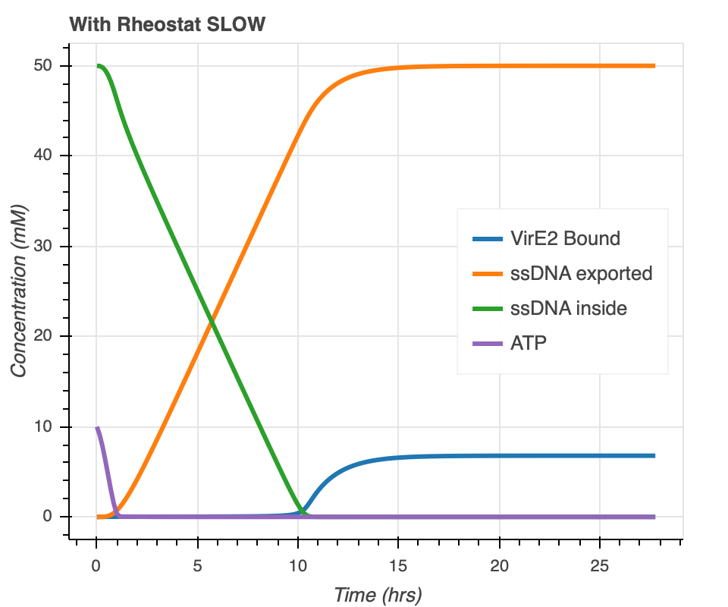
Obstacle – ATP Regeneration Timeline
Notes:
Slower, quicker use because rheostat pathway uses some of it but it never regenerates, just gets stuck, atp used faster than can supply energy to trigger regeneration
Original parameters were chosen because that’s what mimicked what was seen experimentally, slow regeneration results in longer lifetime extension, might not be accurate though!

