Slide 1

Project Updates
Ankita Roychoudhury
10.12.2020
Murray Lab

Slide 2
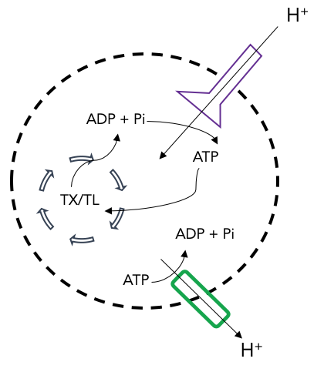
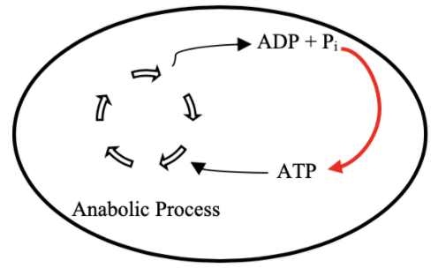
Goal: ATP Life Extension in Synthetic Cells
Proposal: Regeneration by ATP Synthase
TX/TL
Ankita Roychoudhury

Slide 3

Today
Summer Takeaways
Experimental Plans

Slide 4
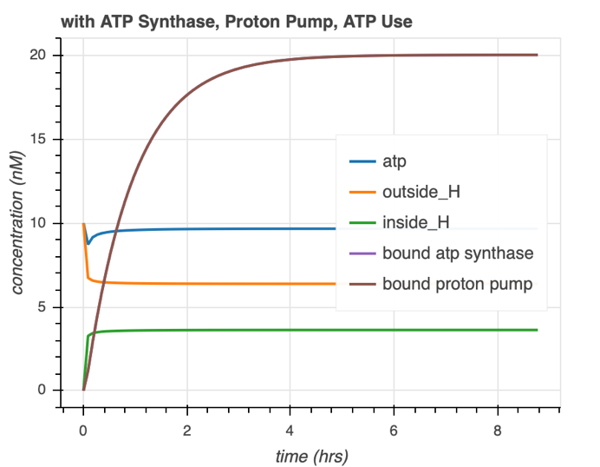
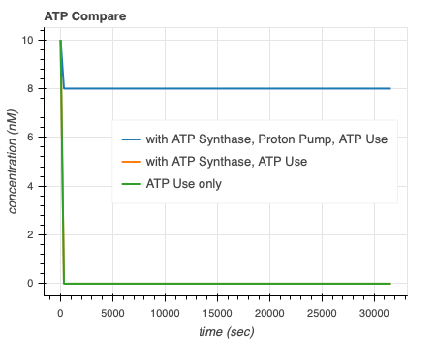
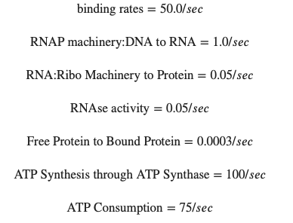
Summer Conclusion Plots ATP Synthase
ATP is regenerated and maintained. Consistent desired proton gradient at these parameters.
Proton Pump is necessary.

Slide 5
Takeaways from Simulations
What I Learnt
Limitations/Questions
Necessary elements for ATP synthase system to maintain ATP levels
Parameter sets with ideal results
Are these the accurate parameter sets in vitro?
Are the CRN description to high/low level?
How complex is the protein membrane integration process?
Can a proton gradient be maintained?

Slide 6
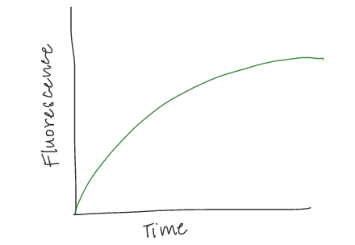
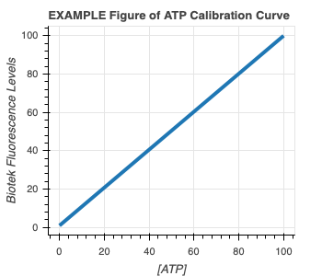
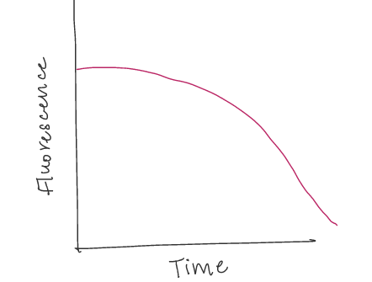
Experimental Plans
1) ATP Calibration Curve 2) Quantify GFP and ATP in bulk TX-TL with DNA
EXAMPLE GFP Curve
EXAMPLE ATP Curve

Slide 7
#2 cont.) Proposed Controls
In all cases, GFP and ATP will be measured
Exp # | deGFP DNA | Energy Buffer | TXTL Extract | Salt | Why?
1 | ✔️ | ✔️ | ✔️ |  | Positive Control
2 |  |  | ✔️ | ✔️ | Negative Control for background fluorescence
3 |  | ✔️ | ✔️ |  | Quantify ATP depletion due to metabolic leak
4 | ✔️ |  | ✔️ | ✔️ | How does the system perform without energy? How quickly does energy run out?
5 | ✔️ | ✔️ |  | ✔️ | How does the system perform with only energy?

Slide 8
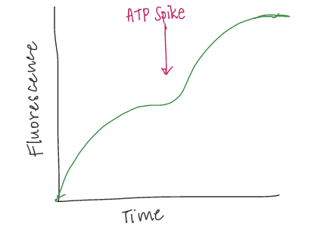
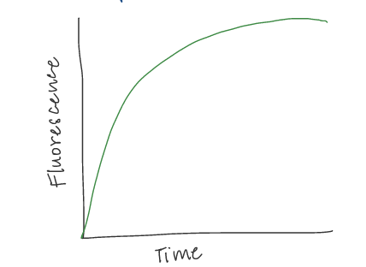
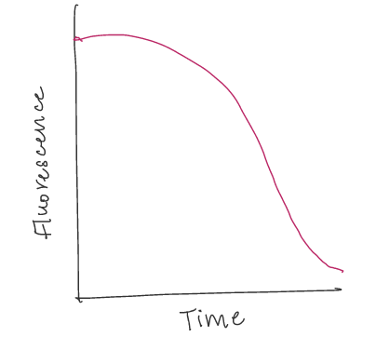
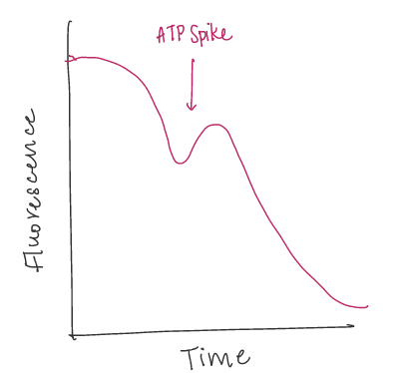
3) Add more ATP at start 4) Add more ATP in middle
PREDICTED GFP Curve
EXAMPLE GFP Curve
PREDICTED GFP Curve
EXAMPLE ATP Curve
PREDICTED ATP Curve
PREDICTED ATP Curve
Hypothesis: Proportionally more protein production with more initial ATP
Hypothesis: Can revive protein production with ATP spike

Slide 9
After that…
5) Greater Initial Concentration and Spike Experiments with 3PGA, Energy Mix, and/or DNA to see if any are the limiting factor
6) Characterize GFP and ATP with TXTL Extract, Buffer, & DNA in vesicles
7) Add ATP Synthase, Proton Pump, and Test!

Slide 10
Thank You!

