Slide 1
Project Updates
Jan 22 2021
Ankita Roychoudhury
Murray Lab

Slide 2
Outline
Goal₀ progress (ATP synthase)
Goal₁ proposal
Senior Thesis Timeline
Misc.

Slide 3
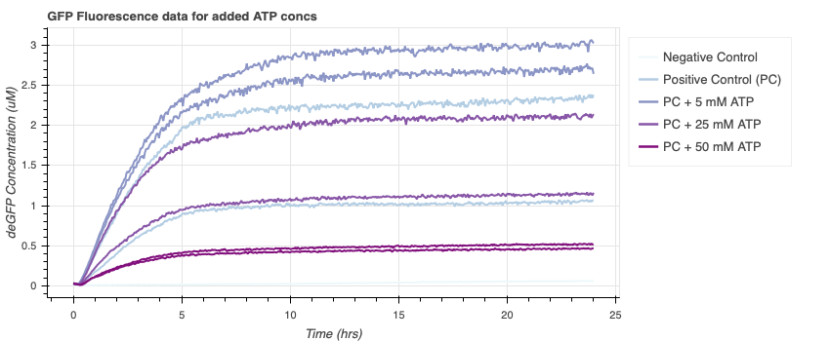
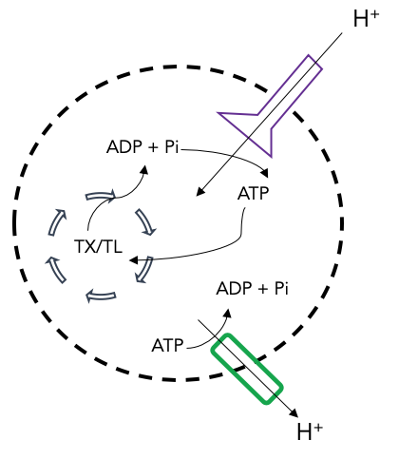
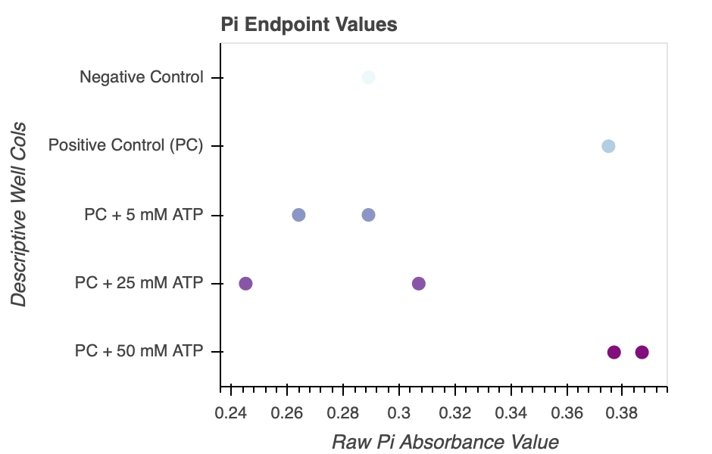
Goal₀: ATP Regeneration in Synthetic Cells via ATP Synthase/Proton Pump Mechanism
Adding more ATP does not necessarily increase speed/rate of protein production
Toxic Pi buildup

Slide 4
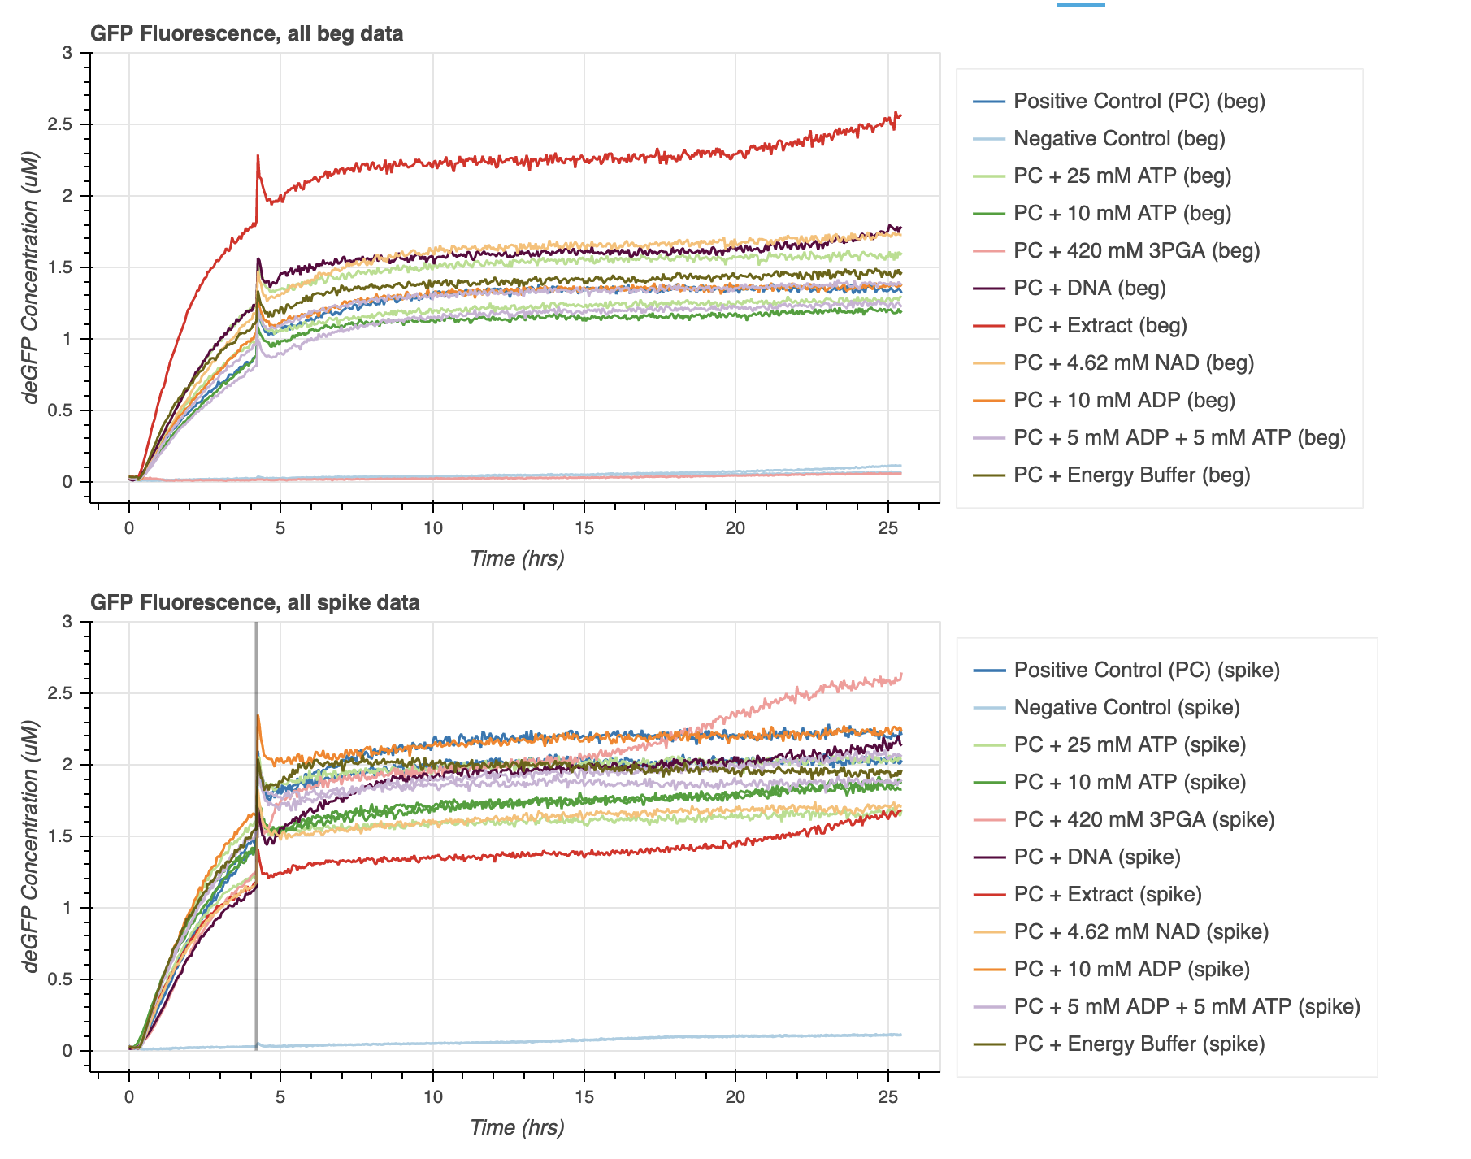
ATP is not the limiting factor
Adding DNA, Extract, 3PGA makes a bigger impact on steady state values

Slide 5
Issues
ATP regeneration may not cause lifetime extension
ATP synthase membrane integration will be challenging

Slide 6
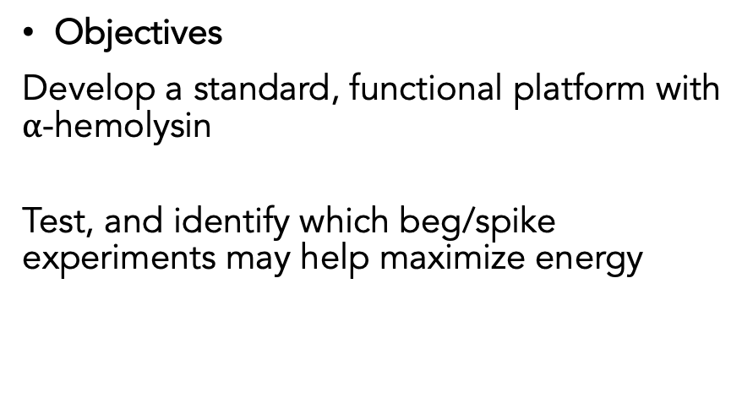
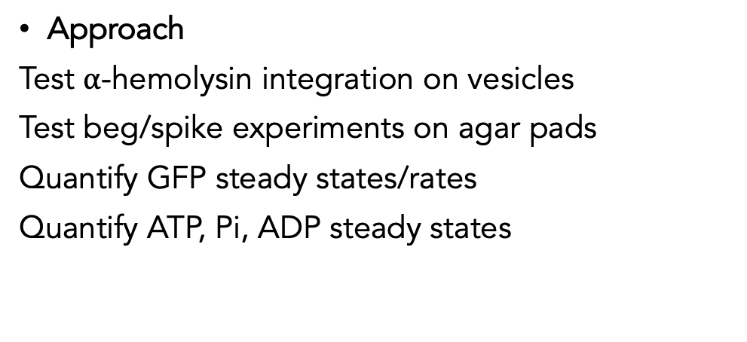
Goal₁: Understanding flux of molecules in encapsulated protein synthesis to maximize energy use
Goals
Keep desired molecules (ribosomes, polymerases, ATP, etc.) within a vesicle and remove toxic ones (Pi).
Extends the lifetime of protein synthesis by utilizing compartments. Maximize energy use
Technical Challenges
Acquiring the same vesicle over time on microscope
Flow of materials on agar pads
Objectives
Develop a standard, functional platform with $α$-hemolysin
Test, and identify which beg/spike experiments may help maximize energy
Approach
Test $α$-hemolysin integration on vesicles
Test beg/spike experiments on agar pads
Quantify GFP steady states/rates
Quantify ATP, Pi, ADP steady states
Notes:
Uncovering something useful/novel?

Slide 7
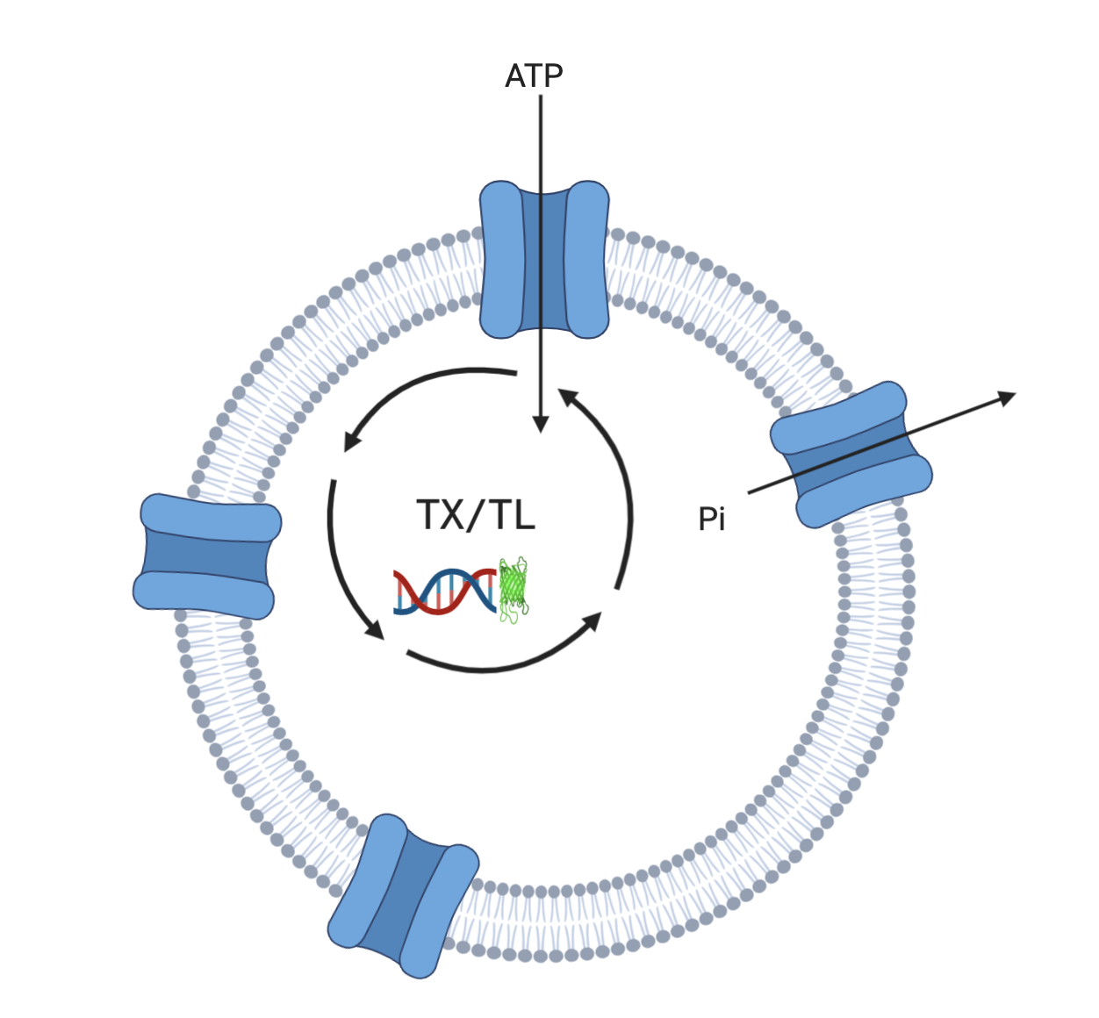
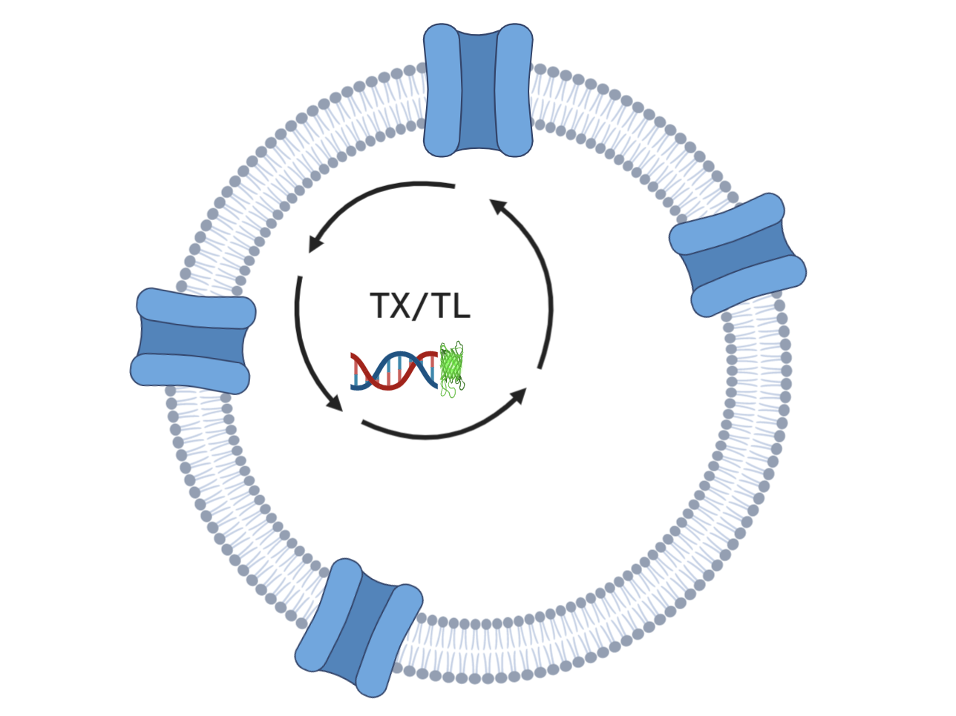

An example:
$α$-hemolysin
DNA: Positive Control with GFP

Slide 8
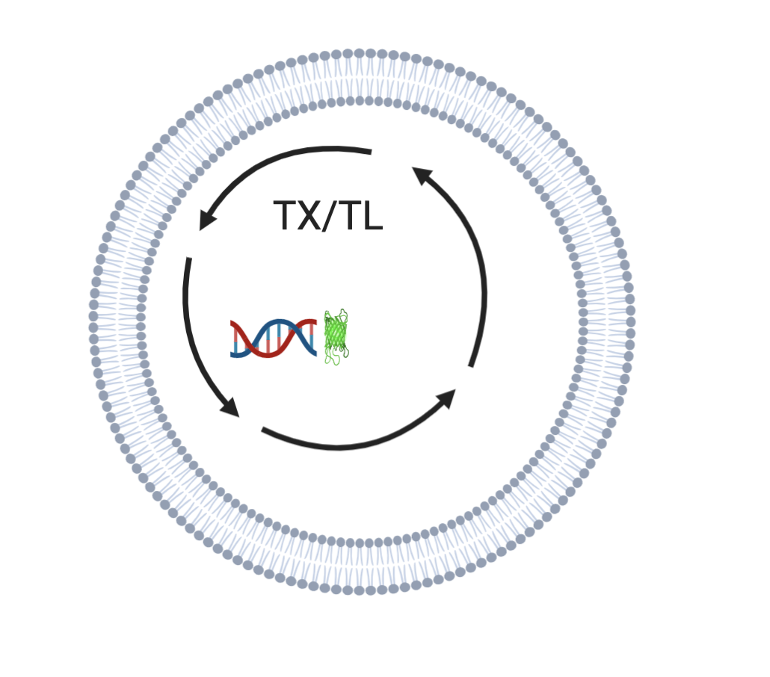
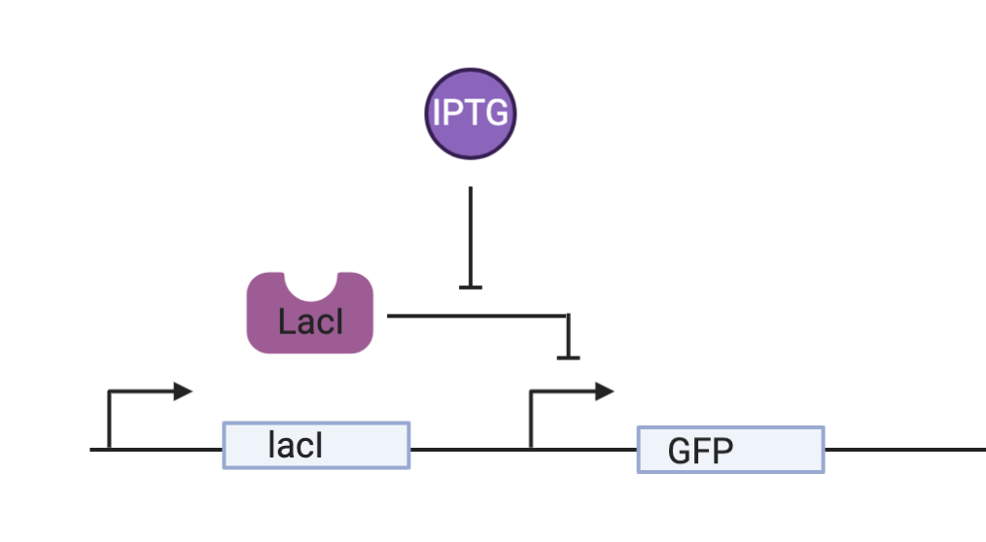

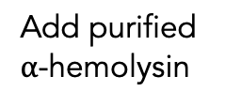
Experiment Design: Test $α$-hemolysin integration
+/- IPTG, Quantify fluorescence
Add purified $α$-hemolysin
DNA: lacI construct with GFP

Slide 9
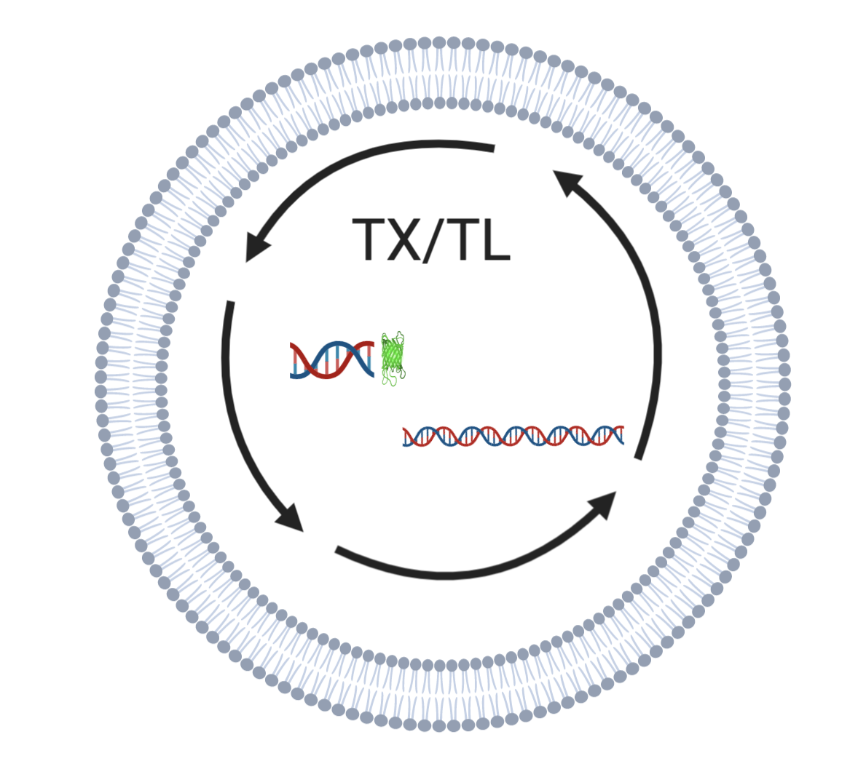

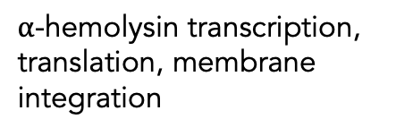
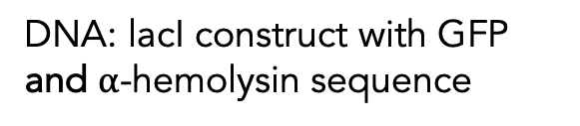
Experiment Design (Zoila): Test $α$-hemolysin integration
+/- IPTG, Quantify fluorescence
$α$-hemolysin transcription, translation, membrane integration
DNA: lacI construct with GFP and $α$-hemolysin sequence

Slide 10
Experiment Design: Test flow on agar pads
+/- IPTG to vesicle outer solution
+/- IPTG to agar pads with ‘dried’ vesicles

Slide 11
Senior Thesis Timeline
Jan: Finalize New Project Direction
Feb/Mar: Platform design and test
Mar/Apr: Beg/spike experiments on platform. ATP/ADP/Pi data collection
May: Re-evaluate with data
Jun: Defend and graduate
Notes:
Worst case timeline, I hope to move faster than this.
This term im taking lulu’s and aaron aames’ nonlinear class.
Next timer I’ll be TAing and maybe taking a few random classes, but after this term I finish my requirements

Slide 12
Misc.
Extract Learn?
Grad updates

