Slide 1
Collaborations
Ankita Roychoudhury
Murray Lab

Slide 2
With Agrima’s Export/Fusion Model
8.2.2020

Slide 3
Ankita’s ATP Regeneration (Rheostat) Model
Input: ATP, NADPH, Pi, Glucose, enzyme initial conditions
Outputs: Isobutanol production, ATP
Add pictures here
Add timescale comments/plots here

Slide 4
Export/Fusion + ATP Rheostat

Slide 5
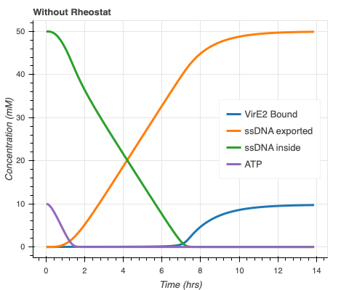
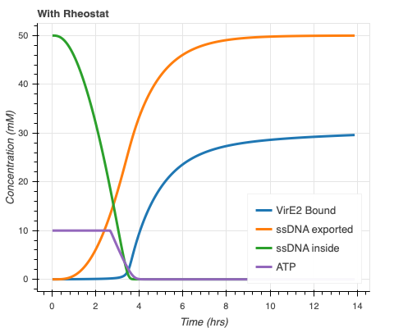
More membrane-bound VirE2 and faster ssDNA export with ATP Rheostat

Slide 6
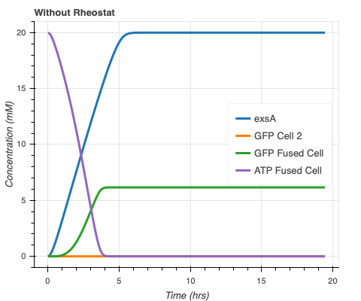
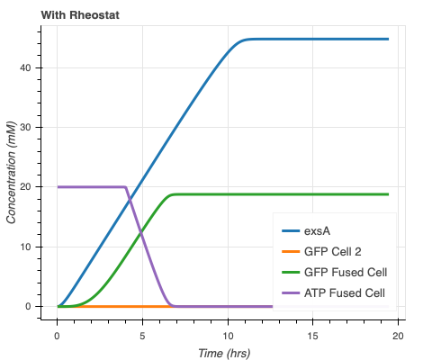
More GFP(?) with ATP Rheostat

