Slide 1

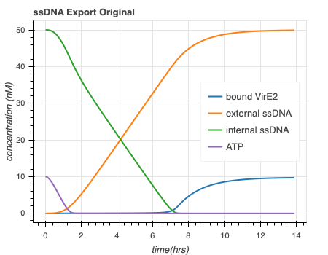
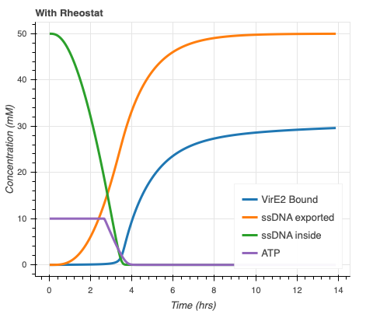
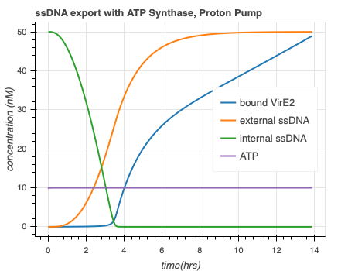
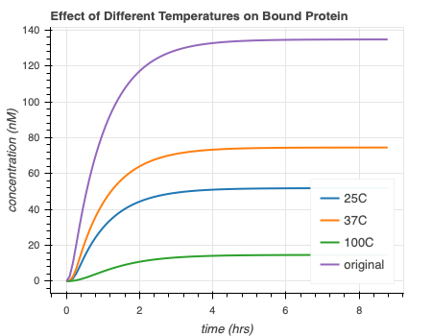
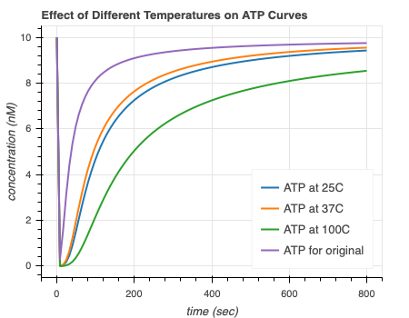
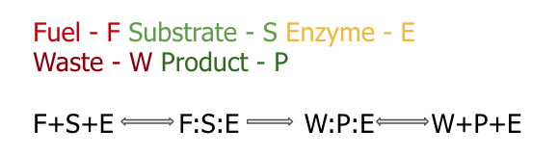
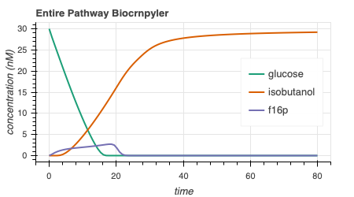
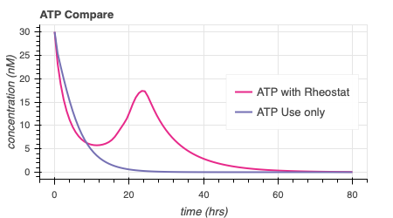
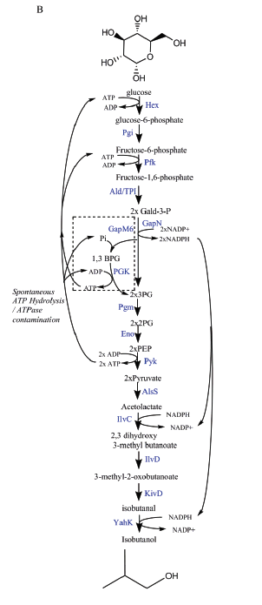
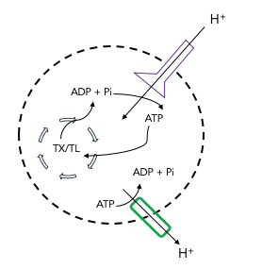
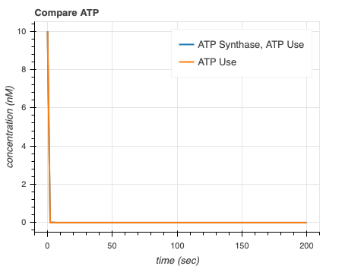
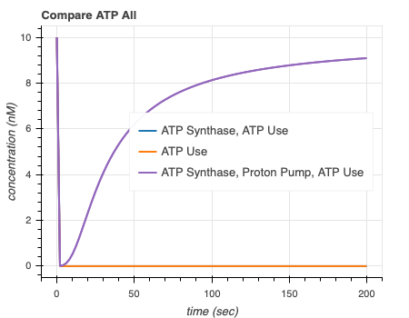
Modeling a Glucose Pathway and an ATP Synthase Mechanism to show ATP Life Extension in Synthetic Cells
REPLACE THIS BOX WITH YOUR ORGANIZATION’S
HIGH RESOLUTION LOGO
REPLACE THIS BOX WITH YOUR ORGANIZATION’S
HIGH RESOLUTION LOGO
Ankita Roychoudhury¹; Richard Murray, PhD¹;
¹California Institute of Technology
Abstract
Methods and Materials
6a
6b
6c
In synthetic cell protein synthesis, a common limiting factor is the energy supply for transcription and translation. By studying computational and mathematical models of various ATP regeneration mechanisms in synthetic cells, we aim to propose experimental methods for ATP life extension. We use available software tools to study two models. These allow us to develop and study mass action models by implementing simple chemical reaction networks. Our simulations show that a glucose metabolic pathway can extend lifetime of ATP up to about 60 hours. Integrating ATP synthase can also independently lengthen the lifetime of ATP to various times depending on the implemented proton gradient mechanism. To ensure prolonged synthetic cell protein synthesis, either the glucose pathway or ATP synthase mechanism can be used. In the future, it will be useful to perform wet-lab experiments in order to compare our model to data.
We used multiple software packages in order to test the hypothesis in silico. In particular, we used BioCRNpyler, bioscrape, autoReduce, SBML, and sub-sbml. Various software packages, such as BioCRNpyler, bioscrape, and autoReduce are being actively developed by members of Murray Lab. Biocrnpyler is an object-oriented framework (written in Python). Given simple descriptions, the software can generate chemical reaction networks, or CRNs. These are outputted as SBML files. SBML is a model representation format, which uses the language XML and commonly used in systems and synthetic biology. We then used bioscrape as a CRN simulator. Given an SBML file, bioscrape can solve the system and returns an output of results that can be simply visualized. Sub-sbml was also used because it can combine and model interactions between more than one SBML model. More specifically, sub-sbml allows for the creation of subsystems, the ability to combine multiple subsystems, and the ability to model interactions like the molecule transport and membrane diffusion.
AutoReduce is a Python-based tool that is used for model reduction of input-controlled biological circuits [15]. This tool helped with parameter extraction that is relevant to biological experiments with the assumptions made (such as time-scale separation with the quasi-steady state assumption).
ssDNA export original
ssDNA export with ATP Rheostat
ssDNA export with ATP Synthase and Proton Pump
Figure 6. Combination of ssDNA export and ATP life extension models. 6a) Original ssDNA export model. 6b) ssDNA export model with ATP Rheostat shows quicker ssDNA export and more bound VirE2. 6c) ssDNA export model with entire ATP synthase model shows quicker ssDNA export than original and more bound VirE2.
7a
7b
Figure 7. Different temperatures affects the amount of bound protein (7a) and ATP regeneration timescale (7b) of the ATP synthase model.
Introduction
Results
Discussion
Synthetic biology focuses on the engineering of devices, pathways, networks, and systems that utilize tools which already exist in biology. There is a growing interest in the development and application of genetically-programmed synthetic cells for future use. These cell-free systems can be used as environments in which more complex engineered systems can be implemented and designed [9].
When building synthetic cells, there are five main subsystems to be considered. These are: spatial organization, metabolic subsystems, sensing and signaling, regulation and computation, and actuation. The problem we have chosen to tackle involves the metabolic subsystems, specifically the power supply and energy lifetime [11]. We aim to extend the lifetimes of synthetic cells derived from liposomes by implementing an ATP life extension mechanism. This mechanism can be a biochemical ATP regeneration pathway, a directed transporter, etc. An efficient, longer-lasting method to provide energy required for internal reactions will allow us to carry out more complex, sustainable experiments. We will be able to broaden the range of possible research in synthetic cells if we can measure responses, production, etc. for longer time periods.
The two mechanisms we studied are an ATP rheostat mechanism and an ATP synthase mechanism. The ATP rheostat was published by James Bowie Lab at UCLA. It can maintain ATP concentrations for up to 70 hours in buffer. See Figure 1 below for the reaction pathway. We want to explore whether the rheostat can extend ATP levels in synthetic cells with TX/TL, a transcription/translation system that creates protein from linear DNA templates [1,6,7]. Secondly, we investigated an ATP synthase model. This is a membrane protein that synthesizes ATP from ADP and Pi when there is a proton gradient (protons flow into the liposome). We also include a proton pump that pumps out H+ ions so that we can maintain the proton gradient necessary for ATP synthesis. A schematic shown below in Figure 2.
In regards to the ATP rheostat model, we were able to show that ATP life extension can be achieved. First, we chose to implement an enzymatic mechanism by which every step of the pathway would follow, shown in Figure 3 below. After choosing parameters based on literature, we simulated the pathway by using BioCRNpyler, bioscrape, and sbml. The simulations are shown in Figure 4 below. We can see that there is isobutanol production and glucose consumption, as expected (Fig 4a). There is also extended ATP lifetime when the rheostat is implemented compared to when we only model ATP hydrolysis (Fig 4b). The ATP use case is included in all simulations to represent ATP consumed by TX/TL.
We are also able to show ATP life extension via the ATP synthase model. The three main components of this model are ATP synthesis via ATP synthase, proton gradient maintenance via a proton pump, and ATP use (that is representative of ATP consumed by TX/TL). When we compare the simulation with ATP synthase + ATP use vs ATP use only (Fig 5a), we see that there is practically no ATP life extension (the lines completely overlap). Then, when we include the proton pump, ATP is completely regenerated and can reach a higher steady state (Fig 5b).
It is important to combine these models with others, such as ssDNA export or liposome fusion models, to understand and confirm the effects ATP life extension may have. This was done with Agrima Deedwania’s (IIT Delhi) single-stranded DNA (ssDNA) export model. Her model included the integration of a membrane protein (VirE2) by which ssDNA could be exported. We notice that when both the ATP rheostat model is combined with the export model, there is more bound VirE2 and faster ssDNA export (Fig 6b). We notice more significant effects when combined with the ATP synthase model since the self-sufficient capability of this model ensure a longer timeline of ATP life extension (Fig 6c).
We also investigated how the ATP synthase model may be effected by different temperatures – A collaboration with Ayush Venkatesh Bindlish’s Model (IIT Delhi). Results are shown in Figure 7.
Going forward, it will be useful to validate and test these claims with experiments.
4a
Figure 3. Chosen Enzymatic Mechanism.
Conclusions
4b
In conclusion, we can
Figure 4. Simulations of the ATP rheostat pathway. We see stoichiometric production of isobutanol (4a) and extended ATP production with the rheostat (4b).
5a
5b
Figure 1. Entire Rheostat pathway as shown in the Opgenorth et al paper [7].
Figure 2. ATP Synthase (purple) Model schematic. We include a proton pump (green) to maintain the proton gradient
Figure 5. Simulations of the ATP synthase model. Without the proton pump, there is not enough regeneration (5a). When the proton gradient is maintained, we see a higher steady state of ATP (5b).
Contact
References THANK YOU TO SAMEL KRON AND FELLOW
[name]
[organization]
[address]
[email]
[phone]

