Slide 1

Research Updates
Ankita Roychoudhury
8.17.2020

Slide 2
Things to talk about
Senior thesis project
Current progress on the presentations and what I’m working on
Get a preprint in the works and ask about what he thinks I should include / not include

Slide 3

Agenda
ATP Synthase Model Progress
ATP Rheostat Model Progress
Senior Thesis Project Discussion
Ankita Roychoudhury 8.17.2020

Slide 4
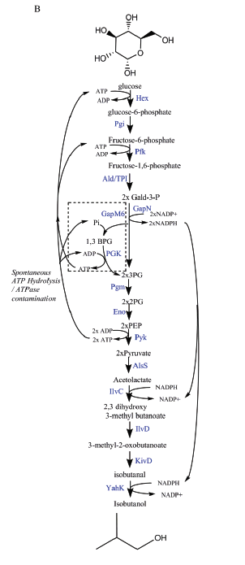
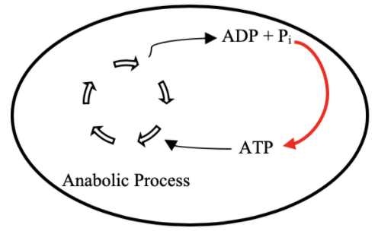
Goal: ATP Life Extension in Synthetic Cells
Proposal 1: Regeneration by Rheostat Machinery
Proposal 2: Regeneration by ATP Synthase
H⁺
ADP + Pi
TX/TL
ATP + H₂0
TX/TL
Ankita Roychoudhury 8.17.2020
Opgenorth et al., Nature Chemical Biology, 2017

Slide 5
Roadmap
Model entire rheostat in BioCRNPyler
Investigate reduced (autoReduce) and minimal models
Study an ATP Synthase Model
Parameter experimentation to understand pathway and optimize
Collaborate with other projects
Experimental Planning
Ankita Roychoudhury 8.17.2020

Slide 6
Roadmap for ATP Synthase Model
Model basics in BioCRNpyler
Study Effect of Temperature Dependent Transcription (Ayush B)
Experimental Planning
Choose & Implement Proton Gradient Maintenance Mechanism
Combine Model with ssDNA Export (Agrima D)
Ankita Roychoudhury 8.17.2020

Slide 7
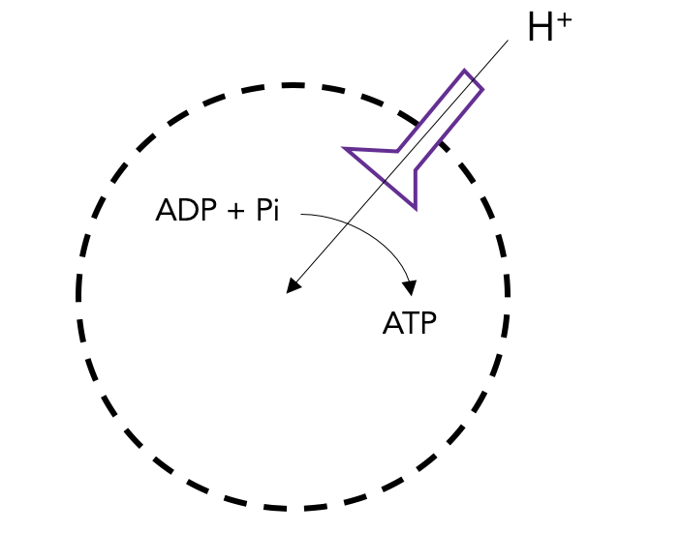
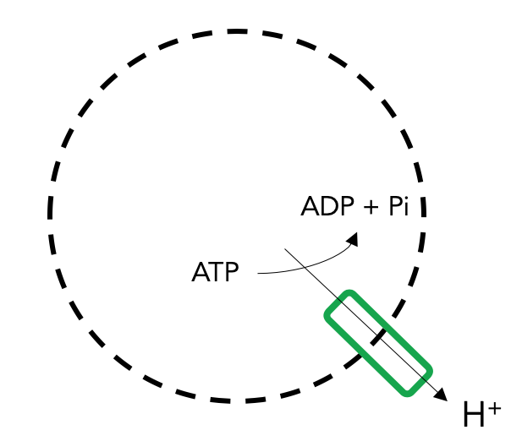
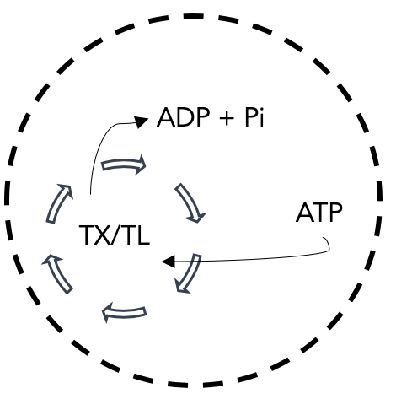
ATP Synthase Components
ATP Synthase Transcription & Translation
ATP Synthase Membrane Integration
ATP Synthesis through ATP Synthase
ATP Synthesis
Proton Pump Transcription & Translation
Proton Pump Membrane Integration
Proton movement through Proton Pump
Maintain Proton Gradient
ATP Use
ATP Hydrolysis
Ankita Roychoudhury 8.17.2020
Notes:
Proton pump = Plasma membrane H+-ATPase
P-type proton ATPase
found in the plasma membrane of plants, fungi, protists and many prokaryotes.

Slide 8
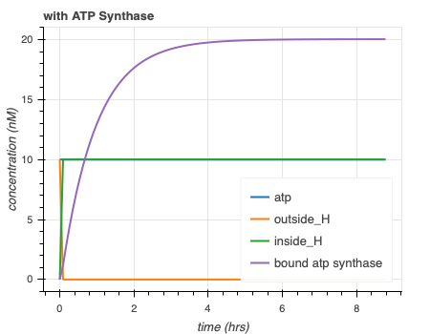
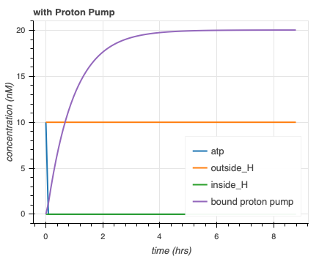
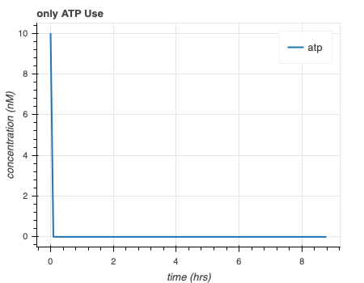
Separate simulations for ATP synthase model are as expected
H⁺
ADP + Pi
ADP + Pi
ADP + Pi
TX/TL
ATP
ATP
ATP
H⁺
Ankita Roychoudhury 8.17.2020
Notes:
WHAT kIND OF Proton PUMP MORE DETAILS

Slide 9
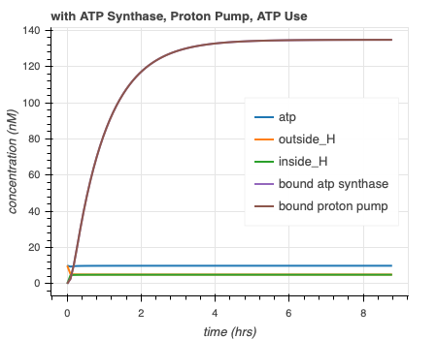
Obstacle: Combined simulations for ATP synthase model have bound protein concentration anomaly
H⁺
ADP + Pi
ATP
TX/TL
ADP + Pi
ATP
H⁺
Ankita Roychoudhury 8.17.2020

Slide 10
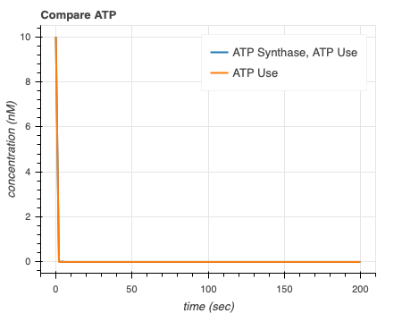
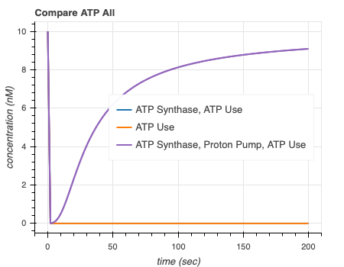
ATP synthase simulations show that proton pump is necessary to extend ATP lifetime
Ankita Roychoudhury 8.17.2020

Slide 11
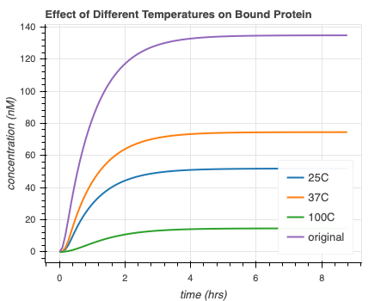
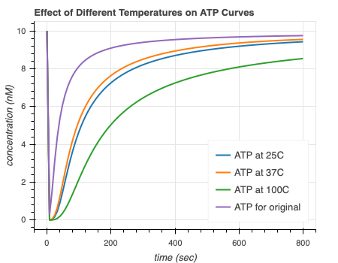
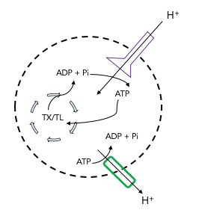
Entire ATP Synthase Model in Different Temperatures
Temperature rate equation courtesy of Ayush Venkatesh Bindlish (IIT Delhi)
Ankita Roychoudhury 8.17.2020

Slide 12
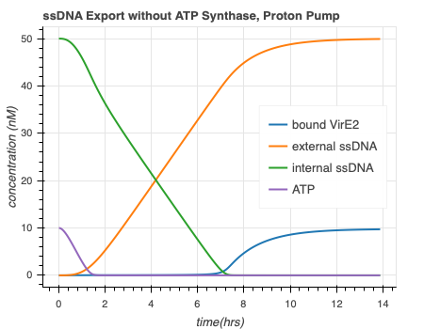
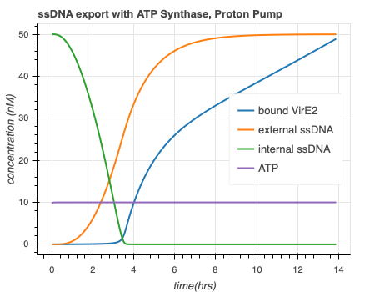
Entire ATP Synthase Model speeds up ssDNA export and causes more bound VirE2
Export model courtesy of Agrima Deedwania (IIT Delhi)
Ankita Roychoudhury 8.17.2020

Slide 13
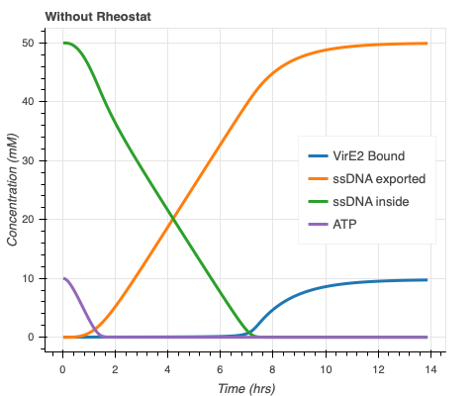
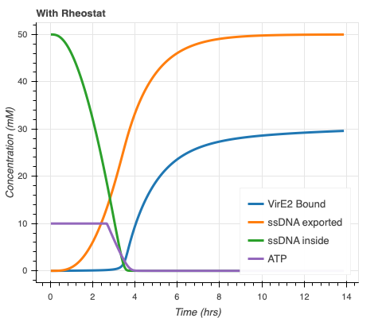
Entire ATP Rheostat Model speeds up ssDNA export and causes more bound VirE2
Export model courtesy of Agrima Deedwania (IIT Delhi)
Ankita Roychoudhury 8.17.2020

Slide 14
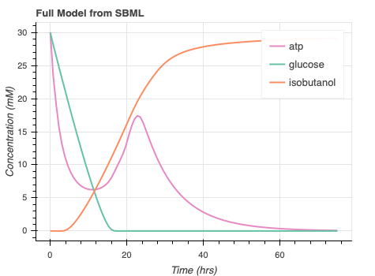
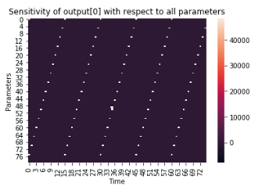
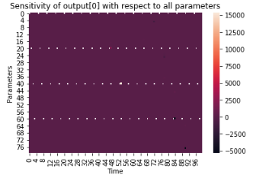
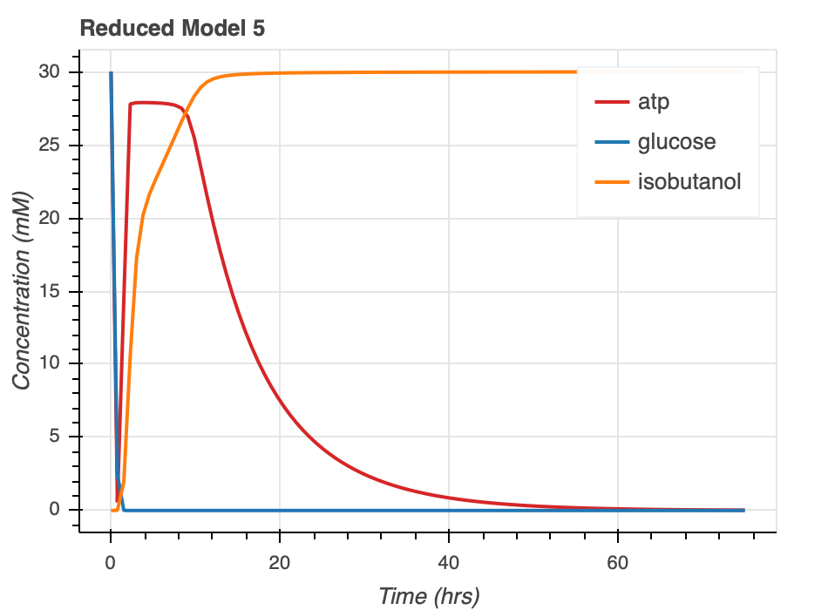
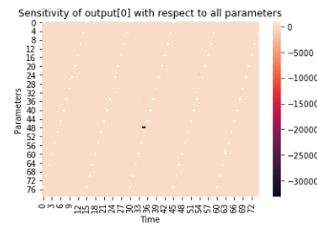
ATP Rheostat Reduced Model Parameter Sensitivity
Analysis
Ankita Roychoudhury 8.17.2020

Slide 15
Future Directions
Identify issue (?) with protein concentration for combined model
Prepare final presentations/reports
Incorporate ATP synthase reverse direction
Ankita Roychoudhury 8.17.2020

Slide 16
Senior Thesis Discussion
Contingency plan for remote
Integrase projects?
# | Options | Projects | Housing
1 | Allowed in Lab in Oct | ATP Synthase, Integrase | Pasadena
2 | Allowed in Lab Later (Dec/Jan) | ATP Synthase, Integrase | Pasadena
3 | Not Allowed in Lab (A) | ATP Synthase, New in silico Murray Lab Project | Connecticut
4 | Not Allowed in Lab (B) | ATP Synthase?, New Project?, Experimentally done at Yale (Farren Isaacs Lab) | Connecticut
Ankita Roychoudhury 8.17.2020

