Slide 1
Project Updates
Ankita Roychoudhury
Murray Lab
11.13.2020

Slide 2
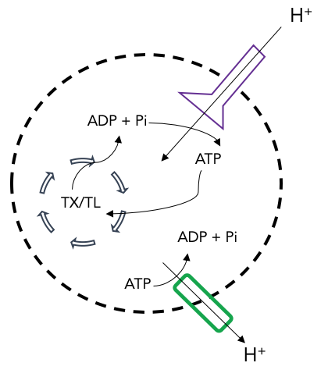
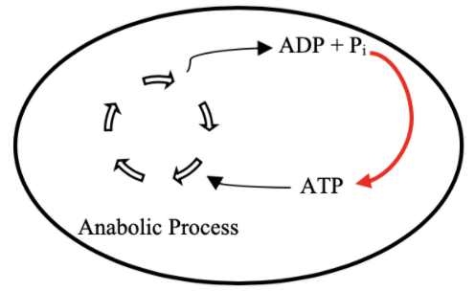

Goal: Cell-free Mitochondrial Mimics
Proposal: ATP Regeneration by ATP Synthase
TX/TL
Ankita Roychoudhury

Slide 3
Outline
Project Updates
Random Proposal
Future Plans

Slide 4
Project Updates

Slide 5
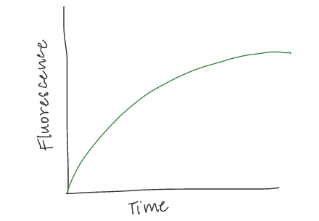
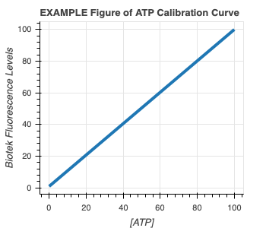
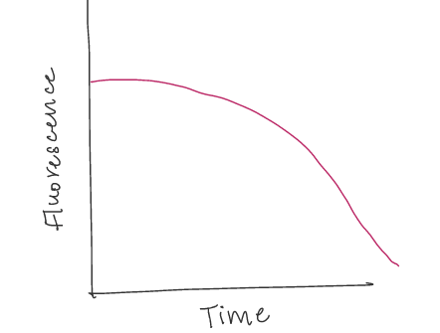

Experimental Plans
1) ATP Calibration Curve 2) Quantify GFP and ATP in bulk TX-TL with DNA
EXAMPLE GFP Curve
EXAMPLE ATP Curve

Slide 6
#2 cont.) Proposed Controls
In all cases, GFP and ATP will be measured
Exp # | deGFP DNA | Energy Buffer | TXTL Extract | Salt | Why?
1 | ✔️ | ✔️ | ✔️ |  | Positive Control
2 |  |  | ✔️ | ✔️ | Negative Control for background fluorescence
3 |  | ✔️ | ✔️ |  | Quantify ATP depletion due to metabolic leak
4 | ✔️ |  | ✔️ | ✔️ | How does the system perform without energy? How quickly does energy run out?
5 | ✔️ | ✔️ |  | ✔️ | How does the system perform with only energy?

Slide 7
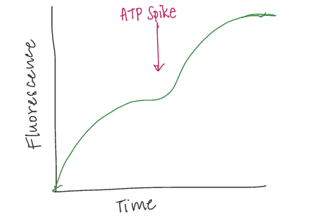
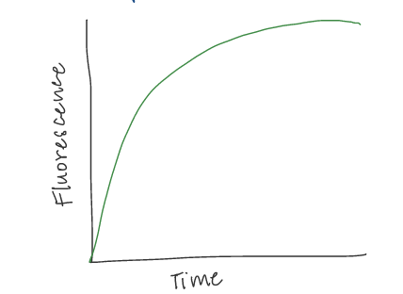
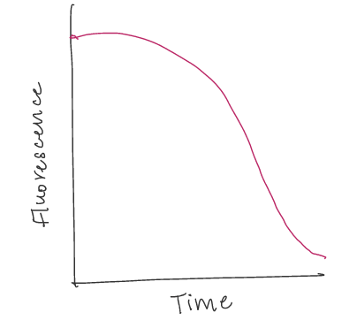
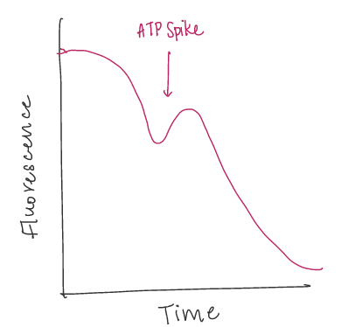
3) Add more reagents at start 4) Add more reagents in the middle
PREDICTED GFP Curve
EXAMPLE GFP Curve
PREDICTED GFP Curve
EXAMPLE ATP Curve
PREDICTED ATP Curve
PREDICTED ATP Curve
Hypothesis: Proportionally more protein production with more initial ATP
Hypothesis: Can revive protein production with ATP spike

Slide 8
Proposal: Semiconductors + DNA

Slide 9
Future Plans
December research access?
Third term off – get hired?

