Slide 1
Project Updates
Ankita Roychoudhury
Murray Lab
5.28.2020

Slide 2
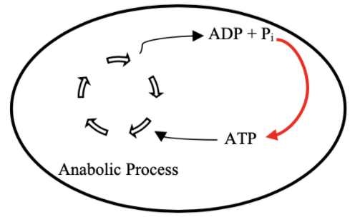
Goal: ATP Life Extension in Synthetic Cells by Regeneration
TX/TL

Slide 3
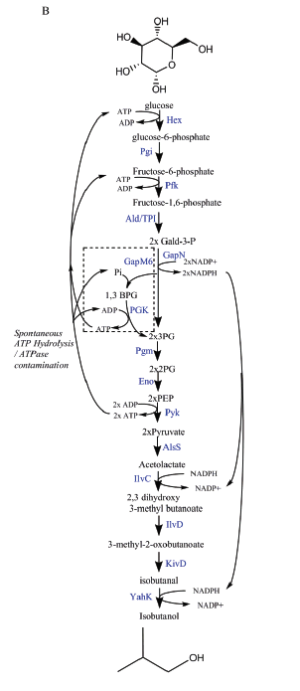
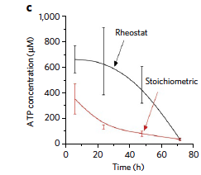
Proposed Model: Rheostat Machinery

Slide 4
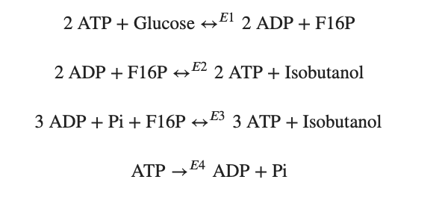
Modelling Approach
1) Simple pathway - bioscrape
Choose an enzymatic mechanism
2) Simple pathway – biocrnpyler
3) Entire pathway - biocrnpyler

Slide 5
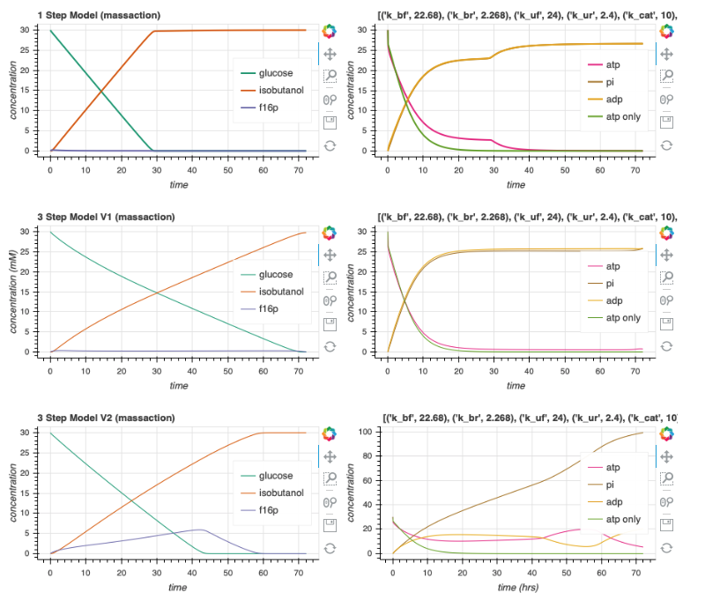
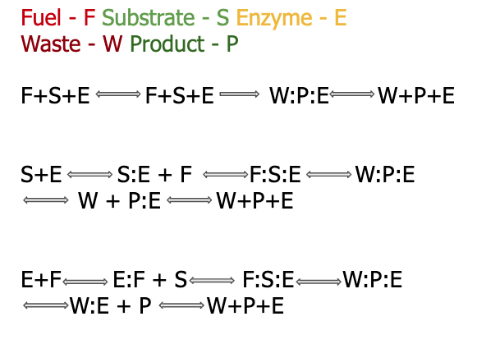
Enzymatic Models

Slide 6
Biocrnpyler

Slide 7

Mechanism
Component
Mixture
Called FuelMichaelisMenten
Type ‘catalysis’
Takes in enzyme, fuel_list, substrate_list, product_list, waste_list
Binding, catalysis, and unbinding reaction
Called Enzyme
Uses mechanism ‘catalysis’
Also takes in $k_{uf}, k_{bf}, k_{cat}$
Called EnergyTxTl
Use mechanism ‘catalysis’

Slide 8
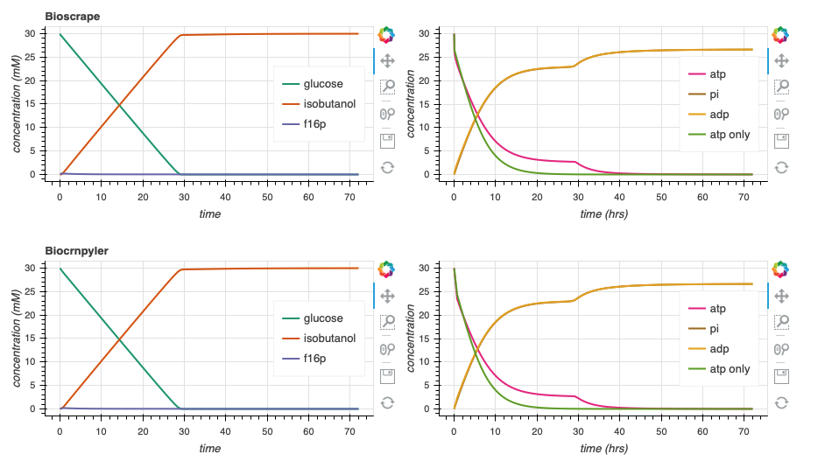
Bioscrape Biocrnpyler Comparison

Slide 9
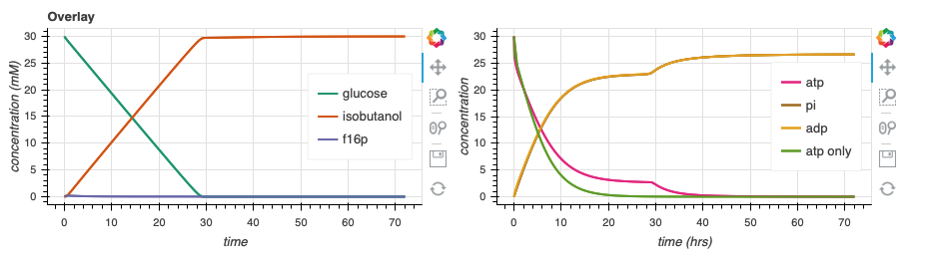
Bioscrape Biocrnpyler Comparison

Slide 10
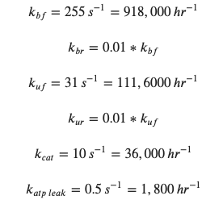
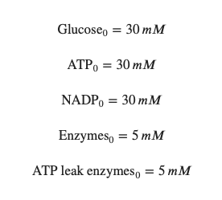





Parameter Estimates
$$k_{bf}$$
$$k_{cat}$$
$$k_{uf}$$
$$k_{br}$$
$$k_{ur}$$

Slide 11
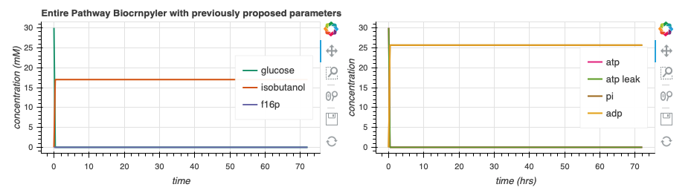
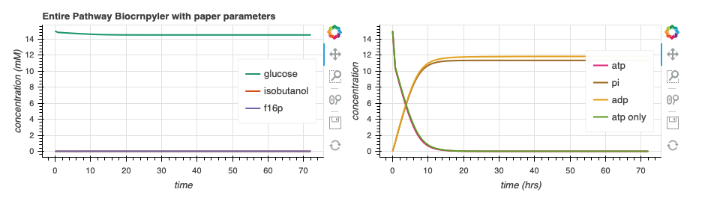

Simulate Entire Pathway

Slide 12
Supplementary

Slide 13
