Slide 1
ATP Life Extension in Synthetic Cells
Ankita Roychoudhury
Murray Lab
6.1.2020

Slide 2
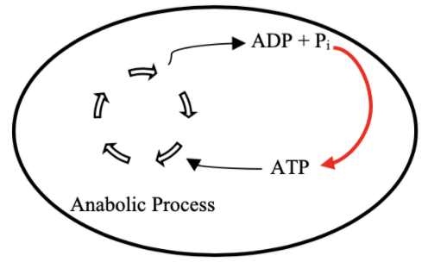
Goal: ATP Life Extension in Synthetic Cells by Regeneration
TX/TL

Slide 3
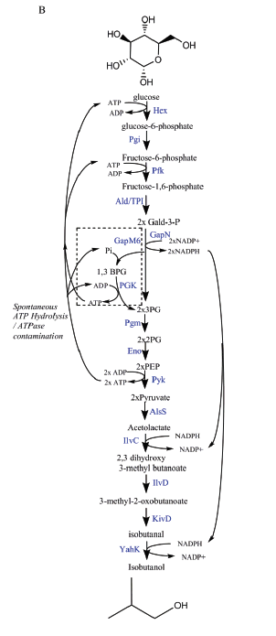
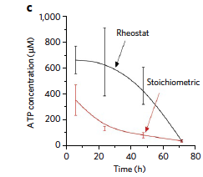
Proposed Model: Rheostat Machinery

Slide 4
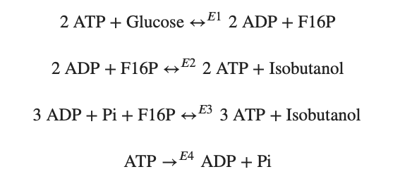
Modelling Approach
1) Simple pathway - bioscrape
Choose an enzymatic mechanism
2) Simple pathway – biocrnpyler
3) Entire pathway - biocrnpyler

Slide 5
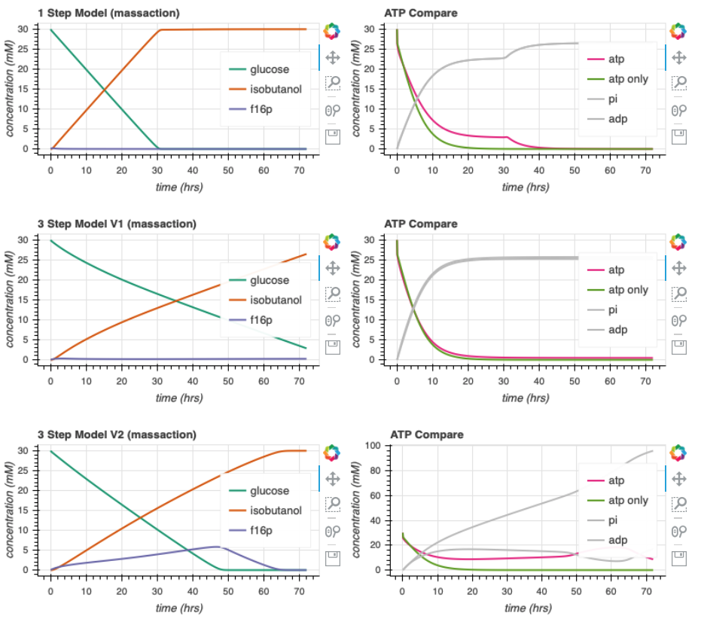
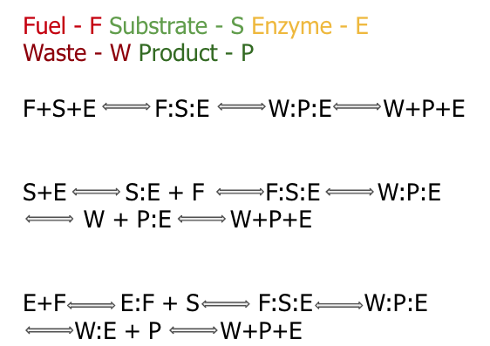

Enzymatic Models

Slide 6
Biocrnpyler

Slide 7

Mechanism
Component
Mixture
Called FuelMichaelisMenten
Type ‘catalysis’
Takes in enzyme, fuel_list, substrate_list, product_list, waste_list
Binding, catalysis, and unbinding reaction
Called Enzyme
Uses mechanism ‘catalysis’
Also takes in $k_{uf}, k_{bf}, k_{cat}$
Called EnergyTxTl
Use mechanism ‘catalysis’

Slide 8
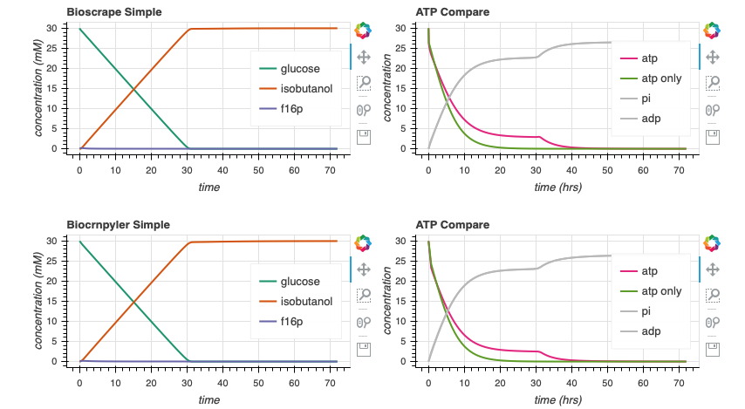

Bioscrape Biocrnpyler Comparison

Slide 9
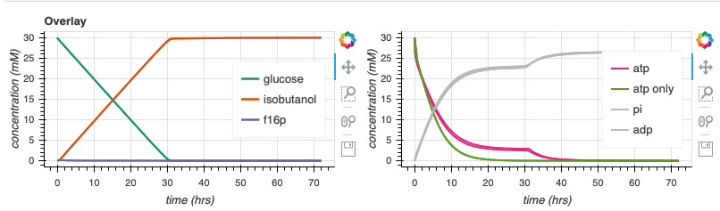
Bioscrape Biocrnpyler Comparison
Notes:
Why is it thicker?

Slide 10





Parameter Estimates
$$k_{bf}$$
$$k_{cat}$$
$$k_{uf}$$
$$k_{br}$$
$$k_{ur}$$

Slide 11
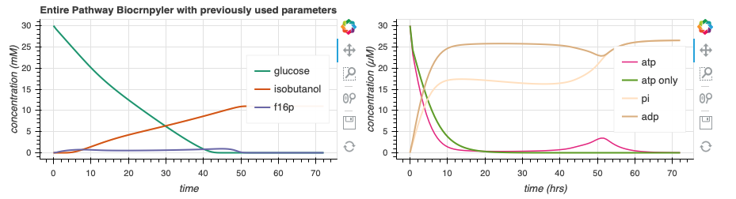
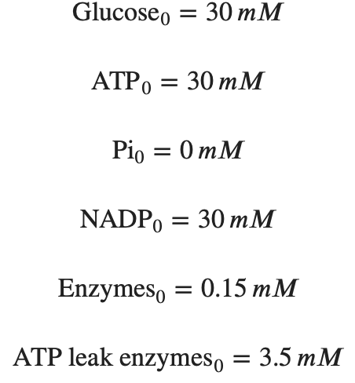
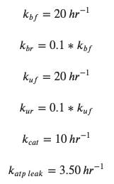
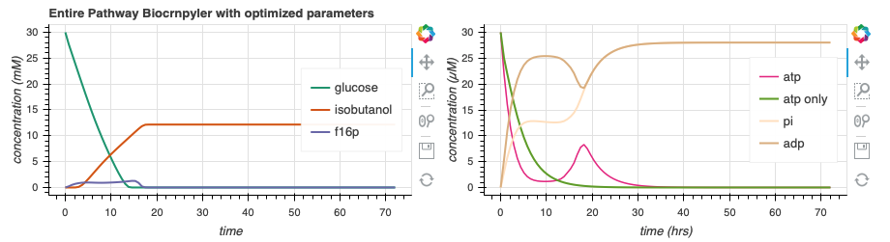
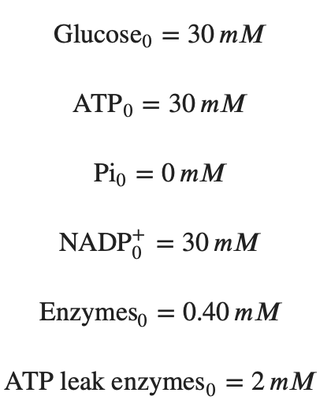
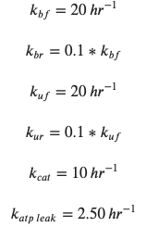
Simulate Entire Pathway - Biocrnpyler
44.4
130.7
Adjusting the rate of atp leak and the initial concentrations of enzymes can lead to more optimal dynamics.
Notes:
make params bigger
Add animations to circle the things

Slide 12
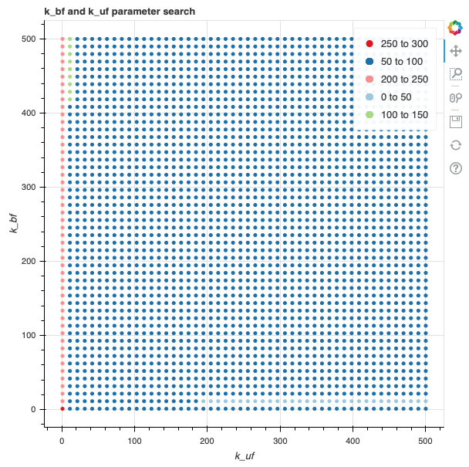
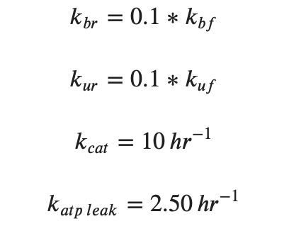
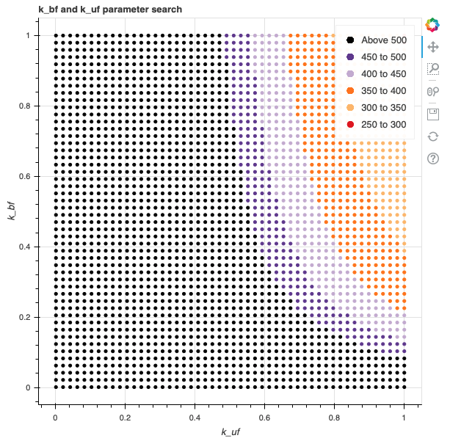
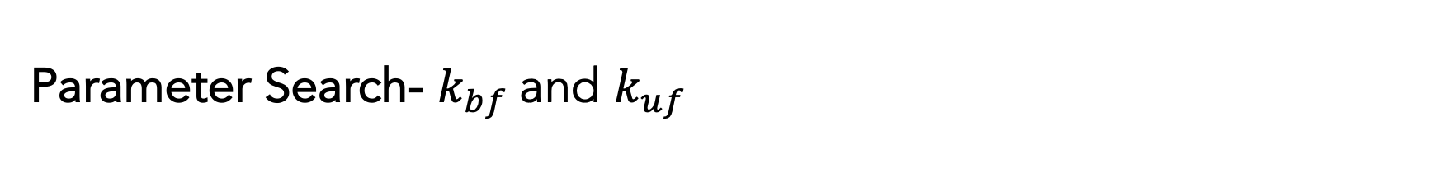
Parameter Search- $k_{bf}$and $k_{uf}$
Slower rates tend to cause prolonged ATP life extension, as expected.
Notes:
Remove red lines

Slide 13
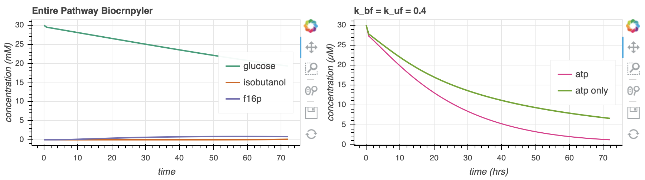
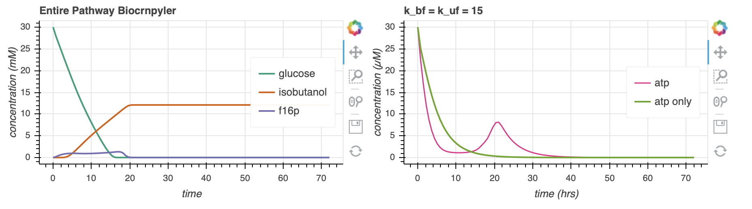
Parameter Search- $k_{bf}$and $k_{uf}$
662.9
144.2
139.2
Notes:
Area under curve of green

Slide 14
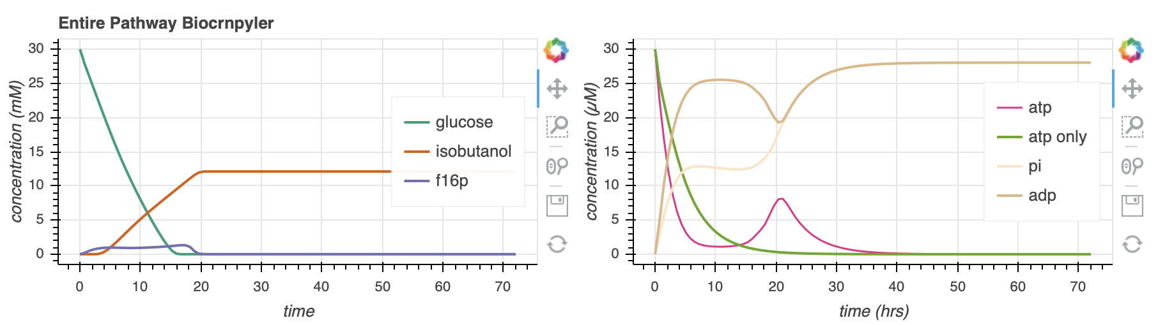
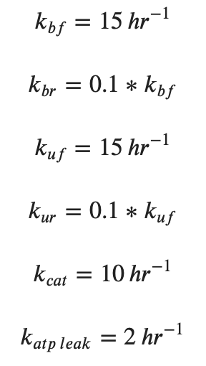
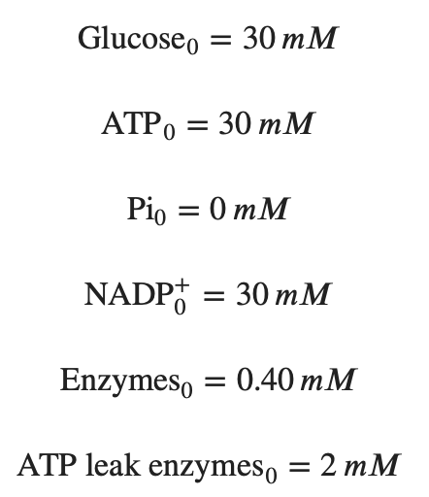
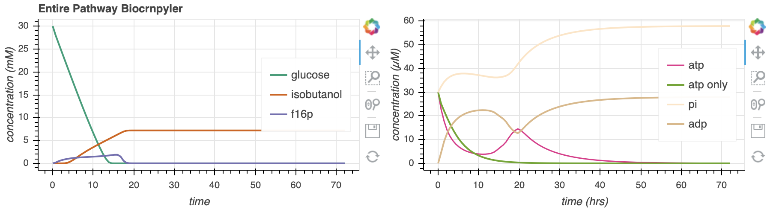
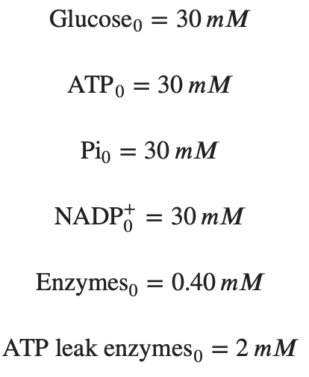
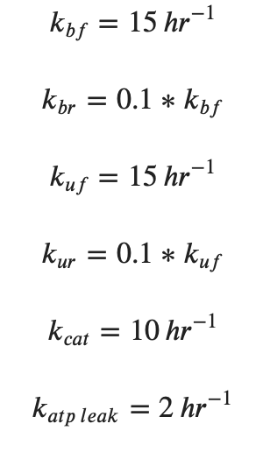
Increasing [Pi]₀ extends ATP lifetime
144.2
330.7
163.8
Notes:
Sacrifices isobutanol production
Too much phosphate becomes inhibitory

Slide 15
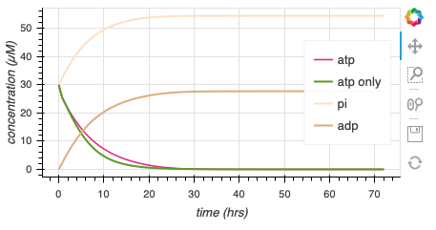
Compare with Experimental Rates

Slide 16
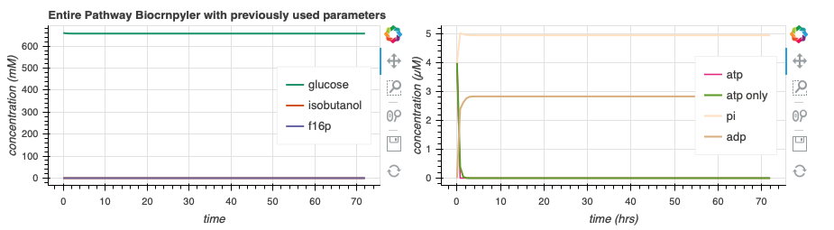
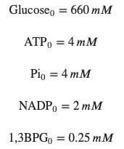
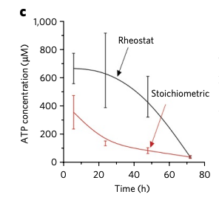
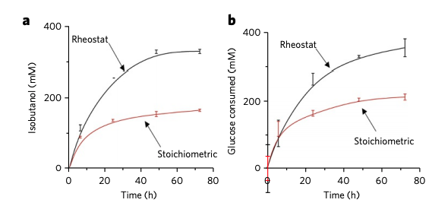
Compare to Experimental Data?
How to study their rate constants/equations to compare?
Their experimental data and simulations don’t entirely match
Analytical extrapolation?
Using their experimental initial conditions: (omit enzyme conc, rate constants)

Slide 17
Supplementary

Slide 18
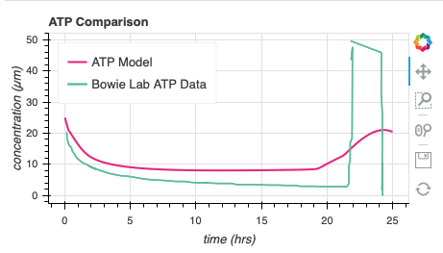
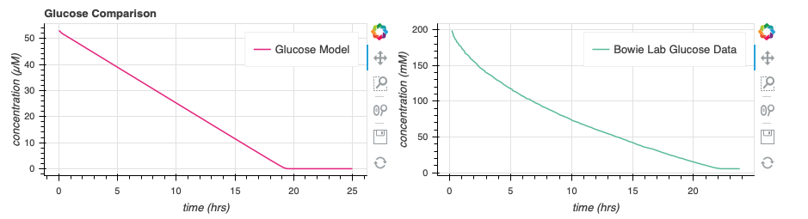
Weak Data Comparison

