Slide 1
Project Updates
Ankita Roychoudhury
Murray Lab
6.15.2020

Slide 2
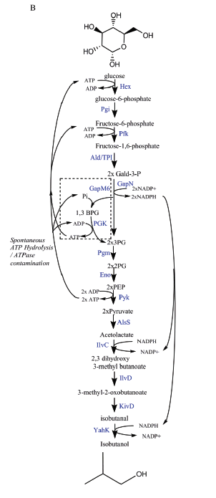
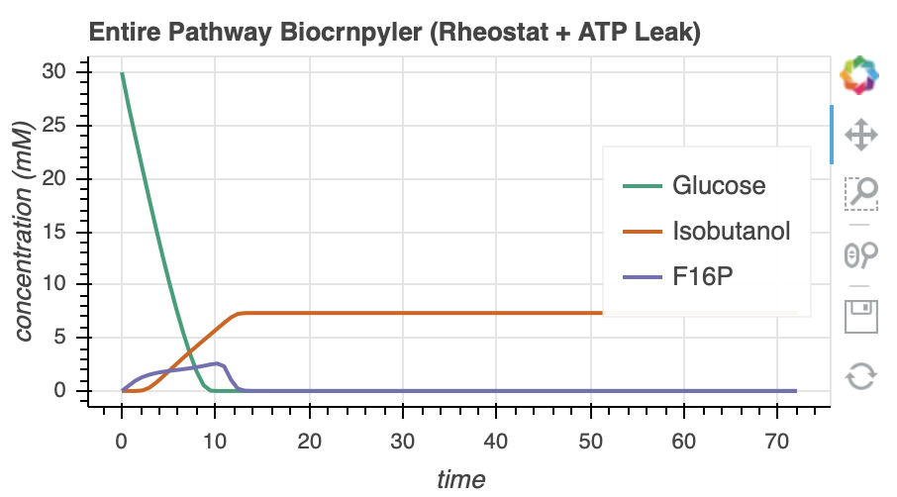
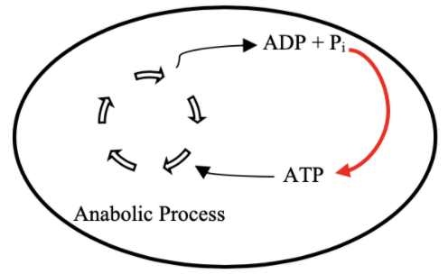
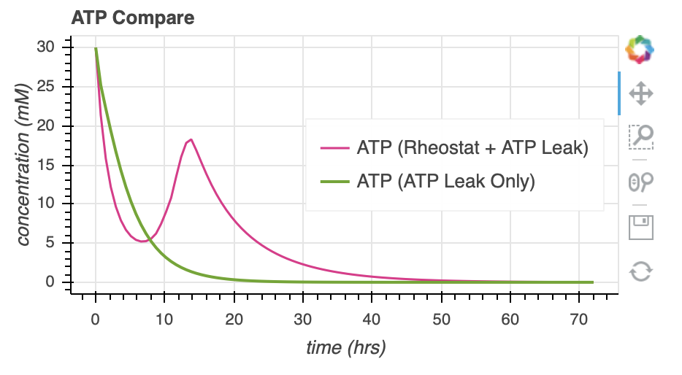
Goal: ATP Life Extension in Synthetic Cells by Regeneration
Ankita Roychoudhury
Caltech
6.15.2020
TX/TL
Rheostat pathway image: Opgenorth et al., 2017, Nature Chemical Biology

Slide 3
Future Directions
Use txtl conditions
Plot the time course of enzymes
Try to understand why there is that delay, second revival
Why the hump?
Should I implement some type of delay?
20 min lag of TXTL – with warmup buffer, problem is removed, with extract, no DNA, 27degC for 20 min, no lag
Melissa takahashi paper – why 20 min lag
Take their model, see if we match it better
Reach out to Bowie
Is it a problem that my rates stay constant, I’m assuming there’s always excess substrate in relation to how much gets used

