Slide 1

ATP Life Extension in Synthetic Cells
Ankita Roychoudhury
Murray Lab
6.25.2020

Slide 2
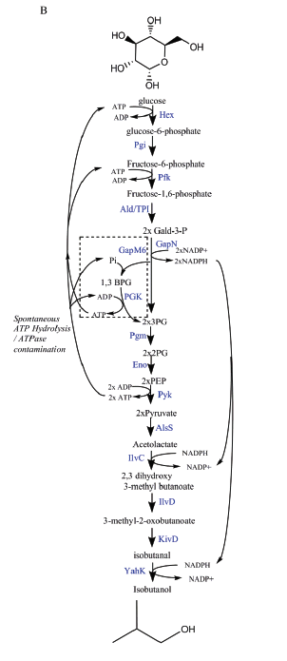
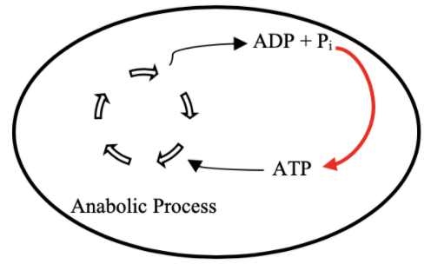
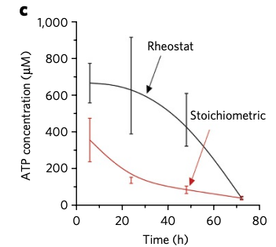

Goal: ATP Life Extension in Synthetic Cells
Proposal 1: Regeneration by Rheostat Machinery
TX/TL

Slide 3
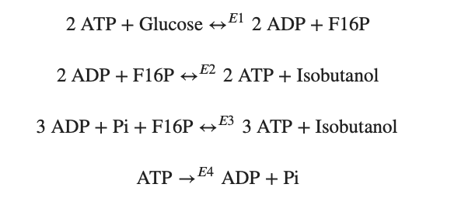
Modelling Approach
1) Simple pathway - bioscrape
Choose an enzymatic mechanism
2) Simple pathway – biocrnpyler
3) Entire pathway - biocrnpyler
Notes:
We have shown the simplified pathway on the right that we will use for the simplified modeling for convenience

Slide 4
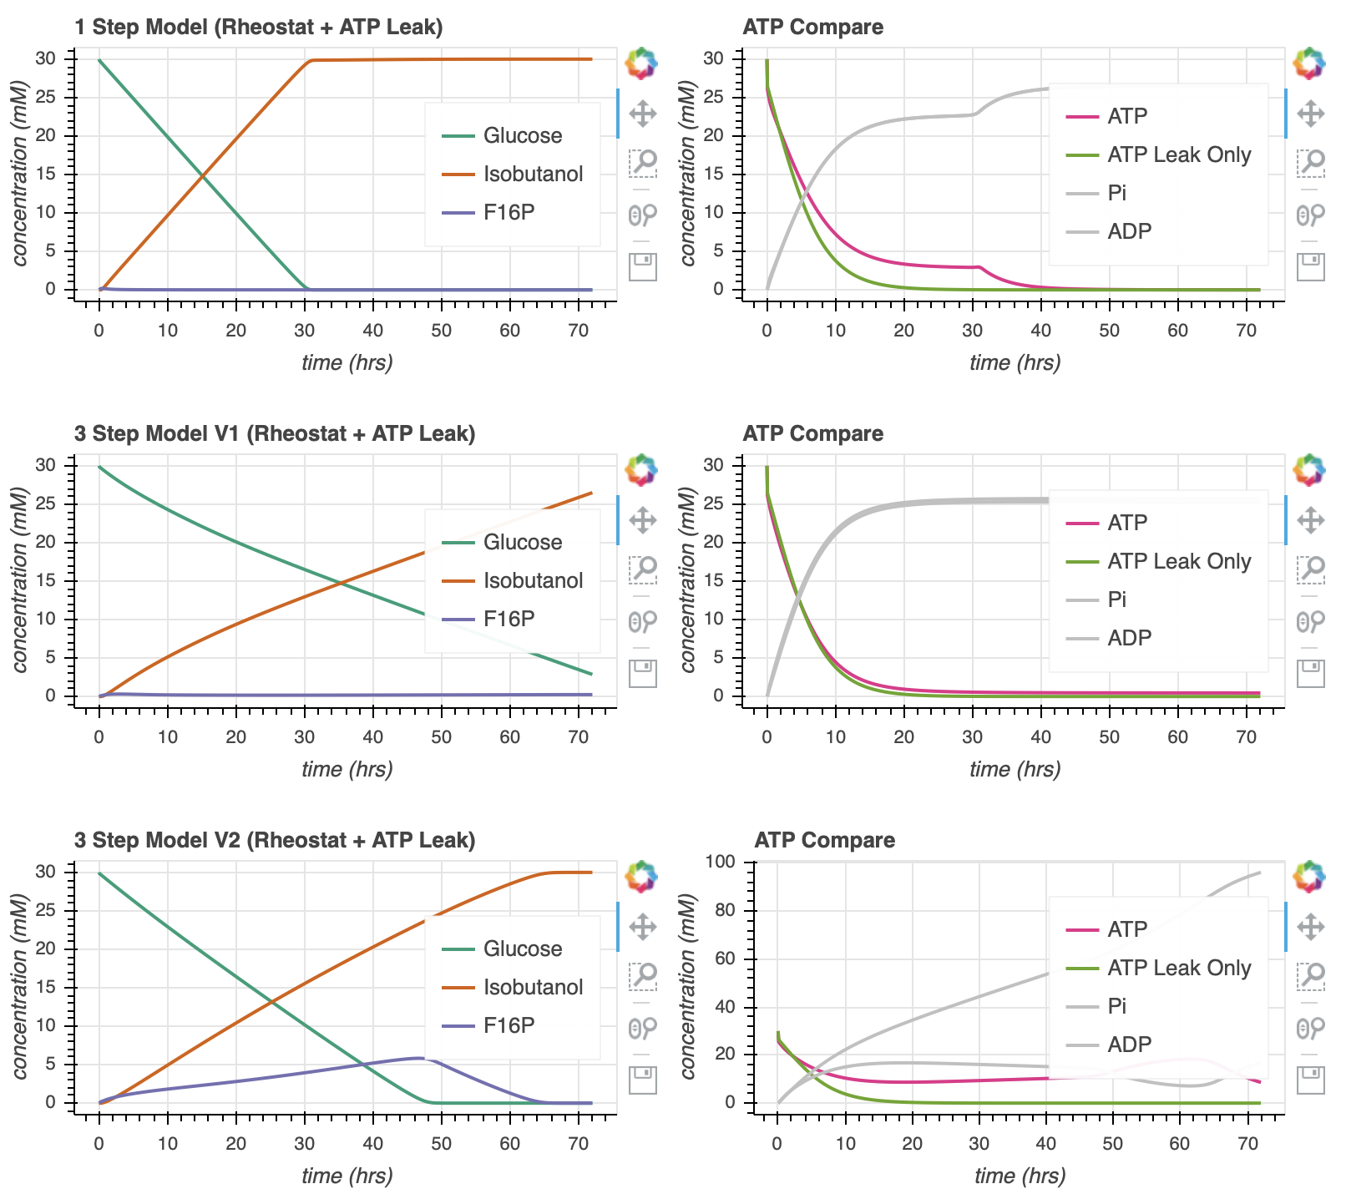
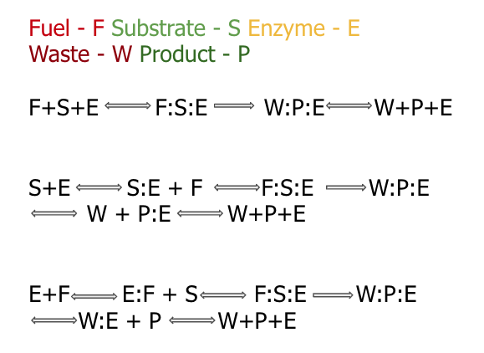

Enzymatic Models
Notes:
Here, we show the different enzymatic models we’ve tried to study
<click>
At this point, I chose slightly arbitrary parameters. They are generally on the correct order of magnitude but they may not entirely accurate.
Go through the graphs
ATP leak curve is a large oversimplification to try to account for the atp hydrolysis by atpase activity and the atp used in tx/tl
we make sure that these parameters ensure use of atp by time 20 in the simulations that only consider atp (experimental evidence)

Slide 5
Mechanism
Biocrnpyler Development
Component
Mixture
Called MichalisMentenReversible
Type ‘catalysis’
Takes in enzyme, substrate_list, product_list (fuel and waste included)
Binding, catalysis, and unbinding reaction
Called MultiEnzyme
Uses mechanism ‘catalysis’
Takes in rate parameters
Use mechanism ‘catalysis’

Slide 6
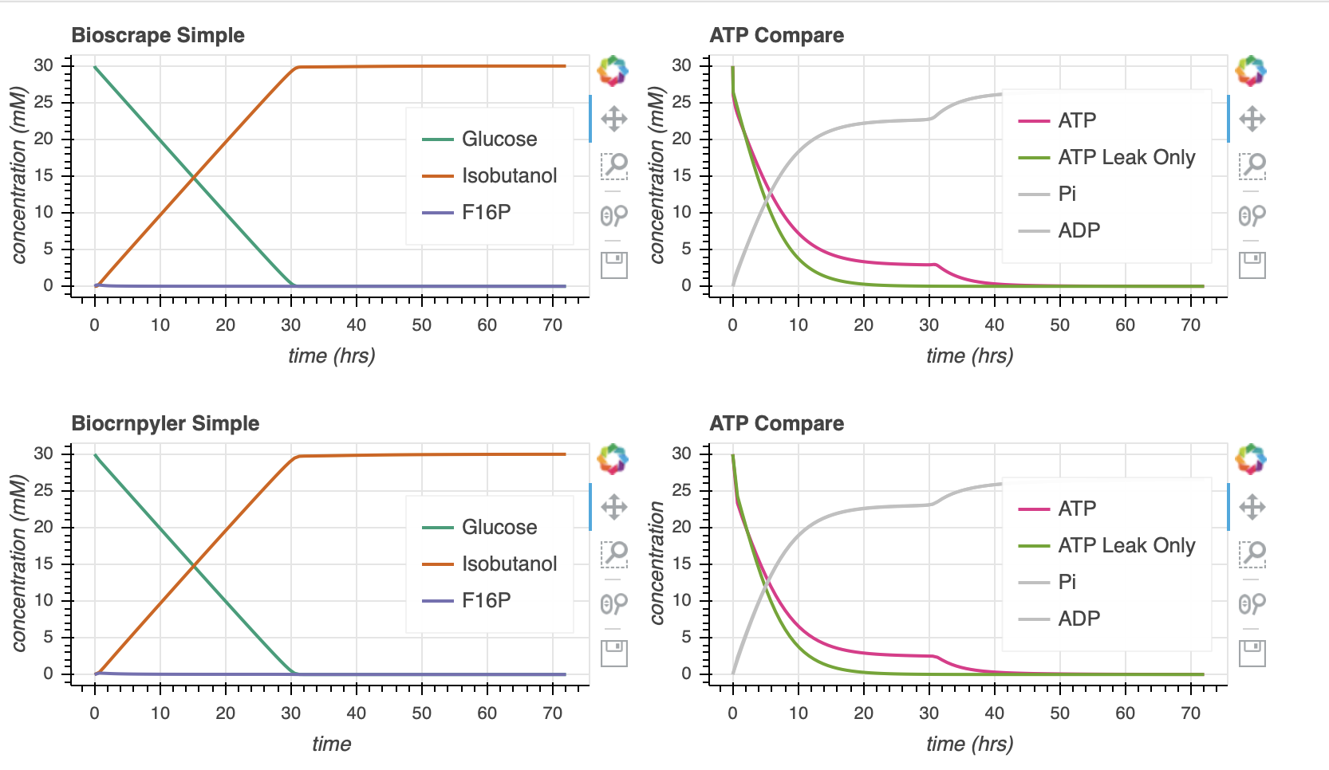

Bioscrape Biocrnpyler Comparison

Slide 7
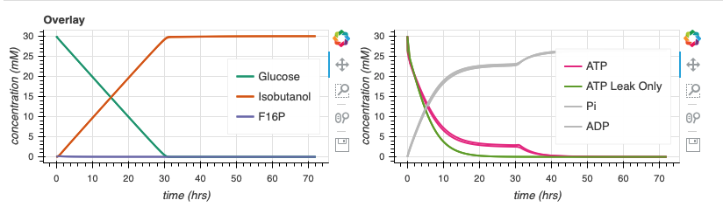
Bioscrape Biocrnpyler Comparison

Slide 8






Parameter Estimates
$$k_{bf}$$
$$k_{cat}$$
$$k_{uf}$$
$$k_{br}$$
$$k_{ur}$$
Notes:
In attempt to explore the dynamics of the pathway, I made some parameter generalizations to begin with.
All the k for all the enzymes in the pathway are the same
We assume that we put the same amount of each enzyme in the mixture.
ATP leak enzymes is a large oversimplification to try to account for the atp hydrolysis by atpase activity and the atp used in tx/tl
we make sure that these parameters ensure use of atp by time 20 in the simulations that only consider atp (experimental evidence)

Slide 9
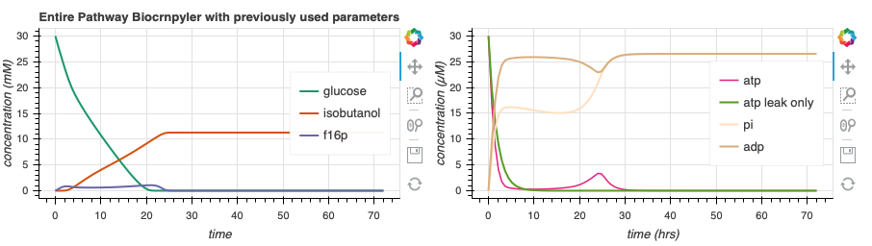
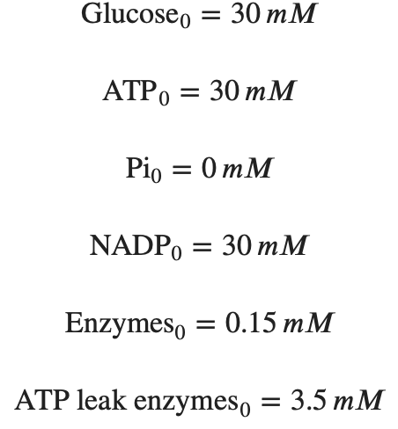
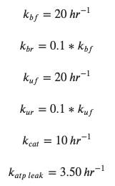
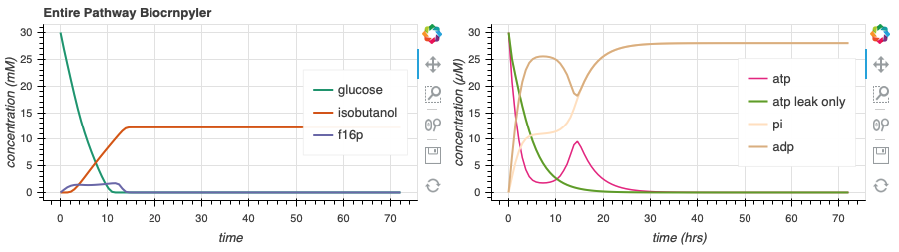
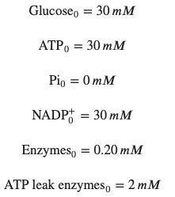
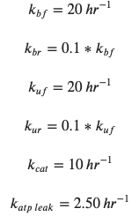
Simulate Entire Pathway - Biocrnpyler
59.6
s⁻¹
129.0
s⁻¹
Adjusting the rate of atp leak and the initial concentrations of enzymes can lead to more optimal dynamics.
Notes:
Now, we incorporate this entire pathway in biocrnpyler.
On the top here, we have used very similar parameters from before. Now, I will begin to do a bit of parameter search to try to find cases where there may be more optimal dynamics and to try an gain a better intuition of the pathway .
<click>
On the bottom, I’ve changed the initial amount of enzymes (CLICKS!) and the rate of atp leak a bit in attempt to move the ‘hump’ of atp production. Note that the green line represents the simulation with only atp leak, no rheostat machinery. We would ideally like the pink ‘atp’ line to be right-shifted in comparison to the green atp only line.
<click>
Moving forward, I will perform a parameter search to try to optimize the area underneath the curve of the pink atp line and also try to gain a better intuition of why we see what we see. While doing the optimizations, we must keep in mind that the green atp_only line should continue to reach 0 around time 20. For reference, here are the integral values of the atp line.

Slide 10
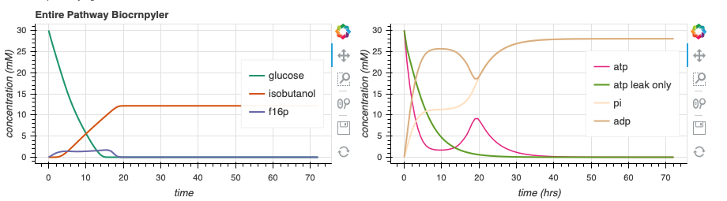
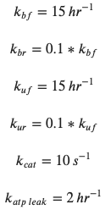
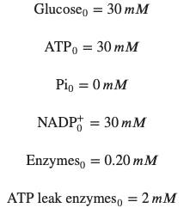
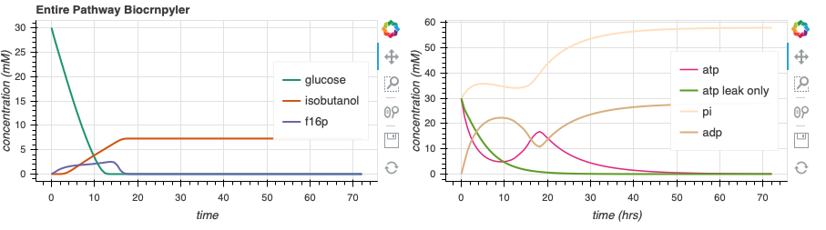
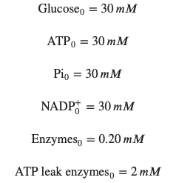
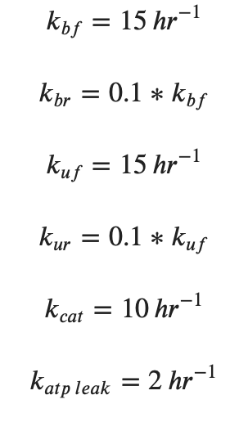
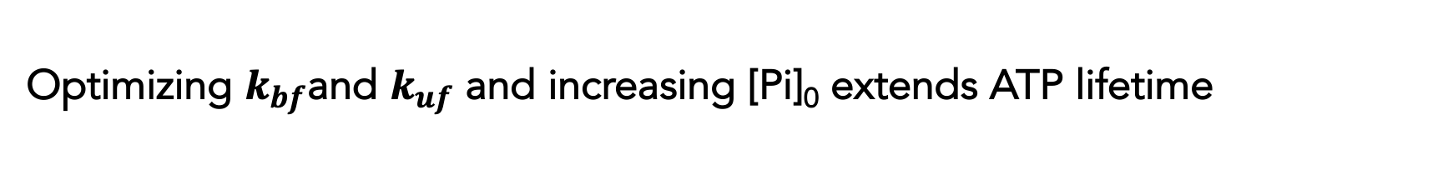
Optimizing $k_{bf}$and $k_{uf}$ and increasing [Pi]₀ extends ATP lifetime
164.5
s⁻¹
336.3
s⁻¹
Notes:
I also see that increasing the initial free phosphate concentration can increase the amount of atp produced without affecting the atp_only curve.
In the context of simulations, this is relatively positive since we do indeed see that we can get extended atp lifetime, up to about 40 hours. However, the parameter estimates and assumptions we have made may be a bit concerning. NEXT
Going forward, we will be using the parameters shown on the bottom plot, unless otherwise stated

Slide 11
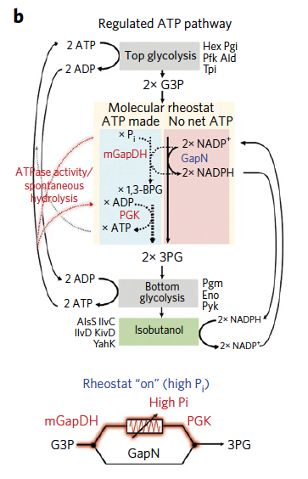
Hypothesis: Hump due to flux through GapM6 and Pgk pathway with increased [Pi]
Ways to test this hypothesis
Take out gapm6 and pgk completely- should see no hump
Know it is due to that pathway
Vary Pi concentrations – 0, 30, 1000
See what changes – if only hump length, space and not other factors we may be able to attribute that it’s our hypothesis
Evaluate enzyme plots for these different conditions

Slide 12
Hypothesis: Hump due to flux through GapM6 and Pgk enzymes with increased [Pi]
Rheostat pathway images: Opgenorth et al., 2017, Nature Chemical Biology

Slide 13
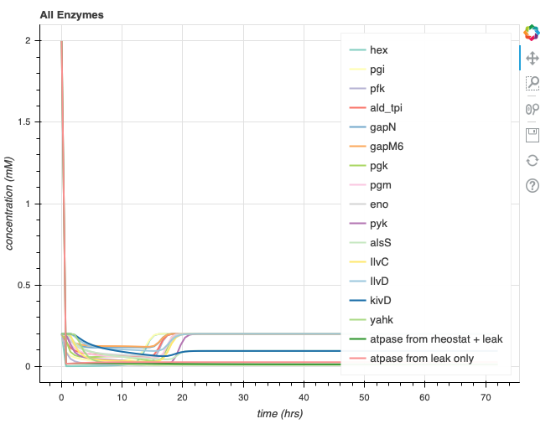
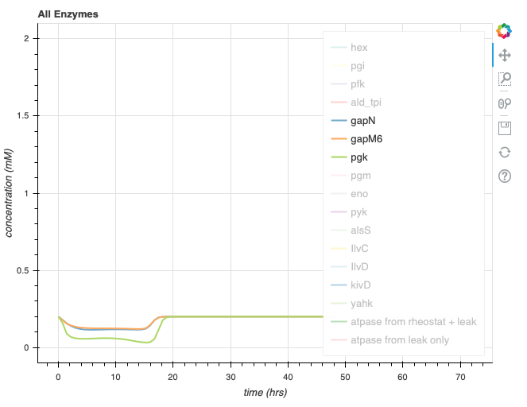
Entire pathway simulation
336.3
Lack of complete isobutanol production (7.5 mM) due to lack of NADPH
Presence of ATP hump
Notes:
Hump is not entirely gone – because of ATP regeneration pathway, second half of pathway
Glucose stored in acetolactate and isobutanol because the gapN pathway is not as favored and it makes NADPH and NADPH is needed to make those reactions go forward

Slide 14
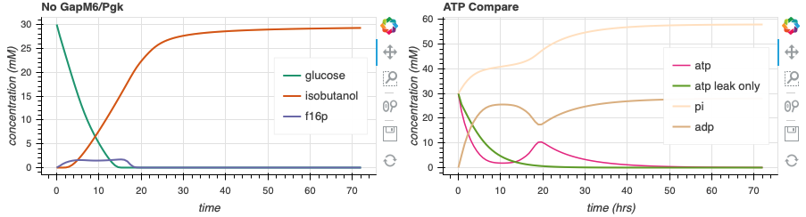
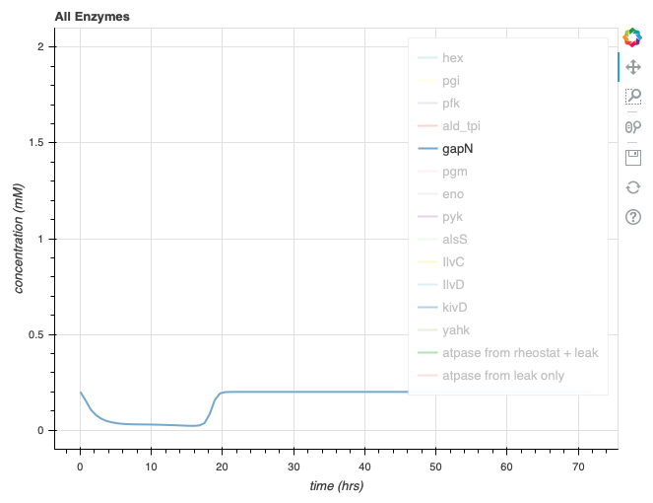
Removing GapM6 and Pgk from simulation (GapN pathway is used)
225.2
More gapN activity
Lower magnitude hump
Isobutanol reaches 30 mM
Notes:
Hump is not entirely gone – because of ATP regeneration pathway, second half of pathway

Slide 15
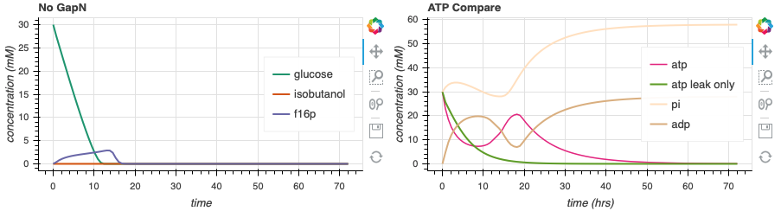
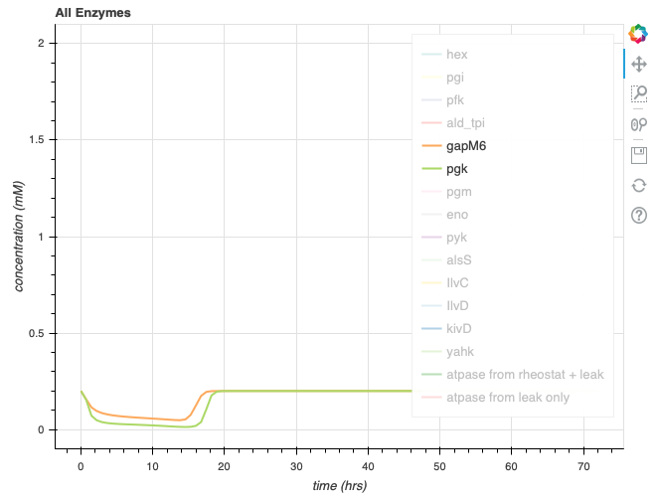
Remove GapN from simulation (GapM6 and Pgk pathway is used)
420.6
Slightly more enzyme activity
Higher magnitude hump
Isobutanol stays at 0 mM
Notes:
Hump is not entirely gone – because of ATP regeneration pathway, second half of pathway
Entirely stuck at acetolactate – not enough nadph to get past because that enzyme is gone - expected

Slide 16
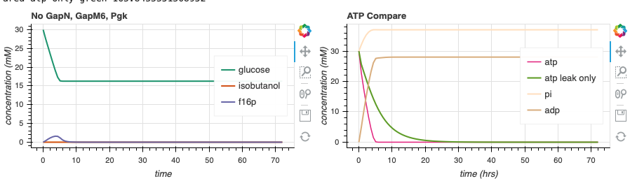
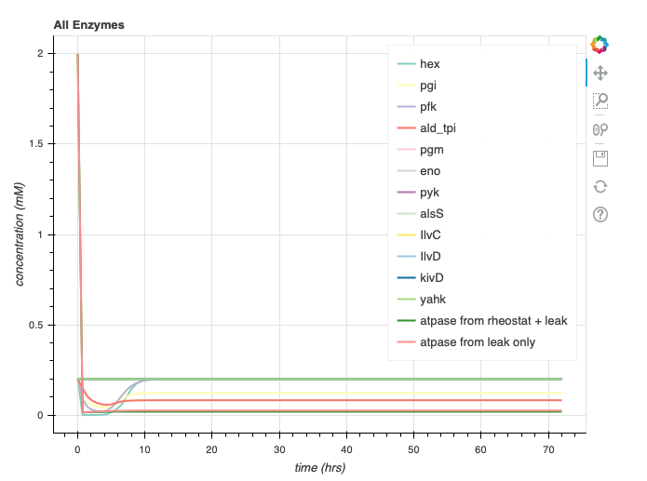
Remove GapN, GapM6, and Pgk from simulation (Incomplete pathway)
60.1
No hump
No isobutanol
Notes:
Hump is not entirely gone – because of ATP regeneration pathway, second half of pathway
Entirely stuck at acetolactate – not enough nadph to get past because that enzyme is gone - expected

Slide 17
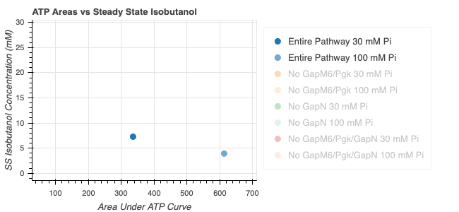
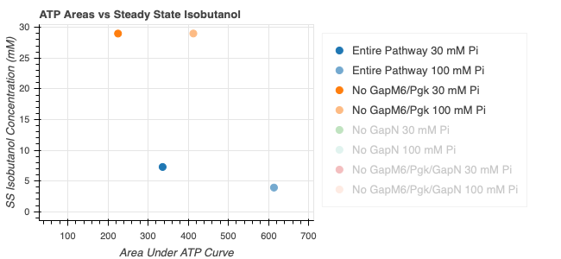
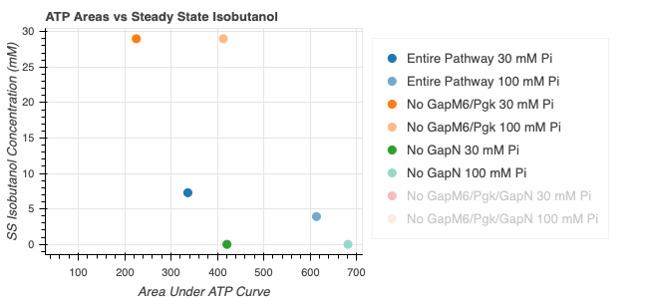
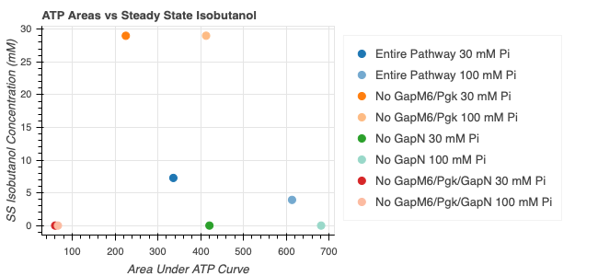
Entire pathway is necessary for optimal isobutanol steady state value and ATP area

Slide 18
Show enzyme concentrations – perhaps related to hump stuff
Done?

Slide 19
Maybe write out ODE’s? And perform linear stability analysis?
ODE’s written out
Reached out to john to discuss whether or not this would actually be useful
Would want limit cycles to show constant atp regeneration(??)
Find from other pathways, this pathway too compliex

Slide 20
Enzyme Kinetics Issue (dynamics)
Why aren’t we getting 1:1 at optimal parameters
Find out where the issue lies, where is it pooling up
Find conditions that allow for 1:1 dynamics?
Maybe some things are wrong with the enzyme kinetics that need to be further played with
Try slider to see when we get complete/ wait/ do they even get complete

Slide 21
Model 20 minute tx tl lag (additional things to model in this)
Delay in model?
Would I just start it at time 20 with a rule
Doees this change the concentratinos, enzyme kinetics other stuff? Questions to ask – not sure how to answer them
Need more effort-sliders do this sunday

Slide 22
Any Qssa? Look into automated model reduction

Slide 23
Match to Bowie Lab Experimental Data (compare what I think is complete to data)
Do this once you get complete data
No hump??????blargh
Make some fun panels!

Slide 24
Now, consider other options. Consider shorter/other pathways. Glycolysis??
research

Slide 25
Vesicle fusion, light activation, outline other proposed models
Draw a diagram hypothesis (ipad if necessary)

Slide 26
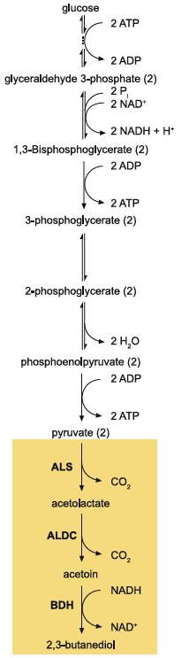
Glucose to Pyruvate
Jennifer E. Kay, Michael C, Jewett, Metabolic Engineering, 2015

Slide 27
Transporter Model
ATP Synthase Model
ADP + Pi
ADP + Pi
TX/TL
ATP
ATP

Slide 28
Vesicle Fusion Model
ADP + Pi
TX/TL
Excess ATP
ATP

Slide 29
Vesicle Fusion Model
Fusion by ssDNA
Concentrations are ½
ADP, Pi toxic accumulation?
Slower reaction rates governed by diffusion
Other considerations
ADP + Pi
TX/TL
Excess ATP
ATP

Slide 30
Other Ideas/concerns
Combined models
Introduce lag somehow

Slide 31
Thank You!
William Poole
David Garcia
Ayush Pandey
John Marken
Chelsea Hu
Richard Murray

Slide 32
Routine for today
Use panels to find out how this model can match experiments
Basically fruitless – their initial conditions are confusing
Glucose is not being consumed if I don’t give the model enough atp
Use 103ab tools to find out how model can match experiment
Come back to later to see if it’s useful – maybe this is how I should have started???
I don’t know how to do the story matching – the story is a time course of molecules being used. It is being used with probability theta I guess. But theta is dependent on so much more
Use panels to find out when/if/how you can model 20 min txtl
I don’t think it’s working
Use panels to find out if you can have isobutanol 1:1
Most reasoning figured out – this wouldn’t add much
Look into automated model reduction
Look up other options / pathways
Draw some vesicle fusion proposals

Slide 33
Things left to explore
Some kind of model validation??
Other atp regen options
Both biochem and other

