Slide 1

Project Updates
Ankita Roychoudhury
Murray Lab
6.26.2020

Slide 2

Outline
Current parameter inference steps
Other ATP life extension models
Miscellaneous

Slide 3
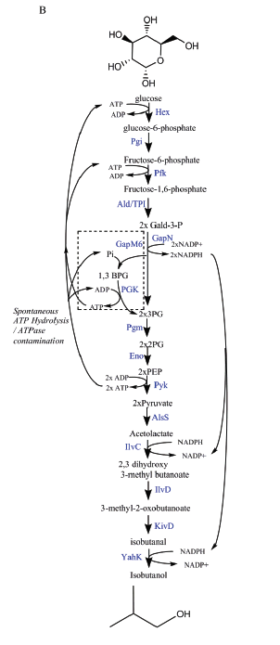
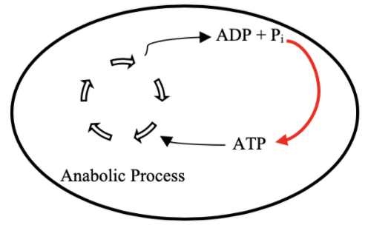
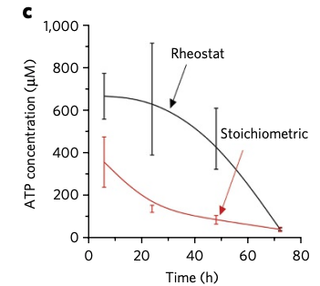
Goal: ATP Life Extension in Synthetic Cells
Proposal 1: Regeneration by Rheostat Machinery
TX/TL
Opgenorth et al., 2017, Nature Chemical Biology

Slide 4
Reconsidered Modelling Approach
Full Model
CRN Mass action
(k_{bf1}, k_{br1}, k_{uf1}, k_{ur1},k_{cat1},k_{bf2},…)
Minimal Model
Coarse-grained
(k₁, k₂ = k)
Lumped parameters
Extracted from experimental data
Effective relations to help argue values of reduced model
Include assumptions
Conservation laws
QSSA
Generalize binding/unbinding
Reduced Model
(k₁, k₂,…)
More relevant to experimental data
Notes:
Full model has all reaction rate parameters
This makes sense – I’ve optimized the full model, but how can I come up with some biological relevance

Slide 5
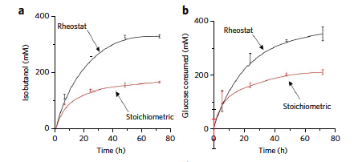
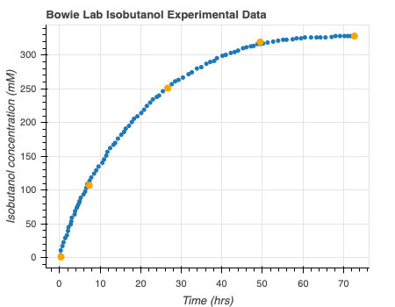
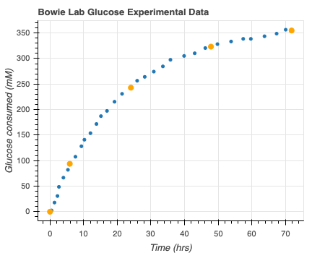
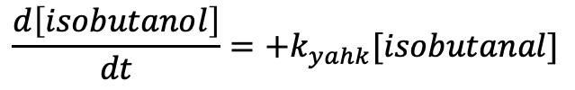
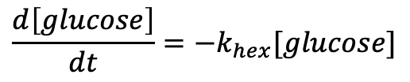
Get Minimal Model from Bowie Lab Experimental Data
Digitizeit
$$\frac{d\left[glucose\right]}{dt}=−k_{hex}[glucose]$$
$$\frac{d\left[isobutanol\right]}{dt}=+k_{yahk}[isobutanal]$$
Rheostat pathway data: Opgenorth et al., 2017, Nature Chemical Biology
Notes:
Use digitize it to get the consumption over time – subtract times and rates to get rates (mM/hr) – perform MLE on this data
Bootstrapping from all the confidence intervals
Need help – not sure that negative binomial approach is correct? Should I take Bayesian approach? Is this necessary? Should I use binomial model? Is Glucose production rate that right thing to be looking at? How to extrapolate to my data?

Slide 6
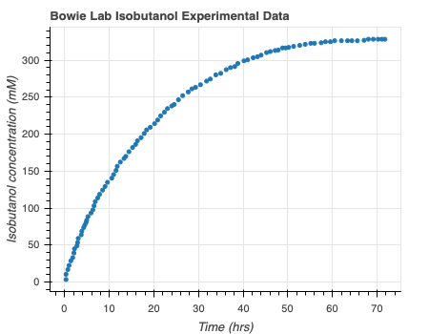
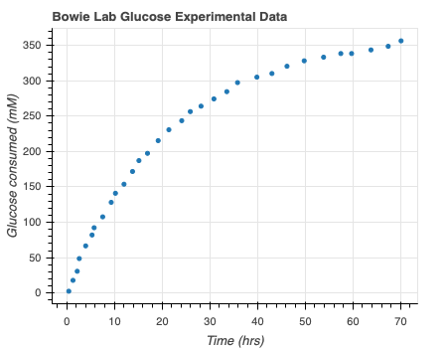
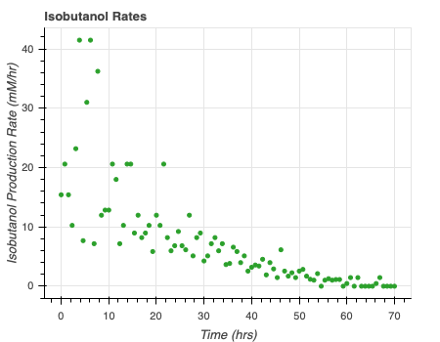
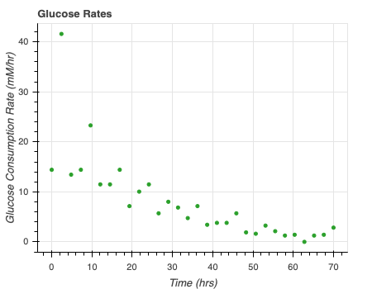

Get Minimal Model from Bowie Lab Experimental Data
Rate = $\frac{d[c]}{dt}$
Rheostat pathway data: Opgenorth et al., 2017, Nature Chemical Biology
Notes:
Use digitize it to get the consumption over time – subtract times and rates to get rates (mM/hr) – perform MLE on this data
Bootstrapping from all the confidence intervals
Need help – not sure that negative binomial approach is correct? Should I take Bayesian approach? Is this necessary? Should I use binomial model? Is Glucose production rate that right thing to be looking at? How to extrapolate to my data?

Slide 7
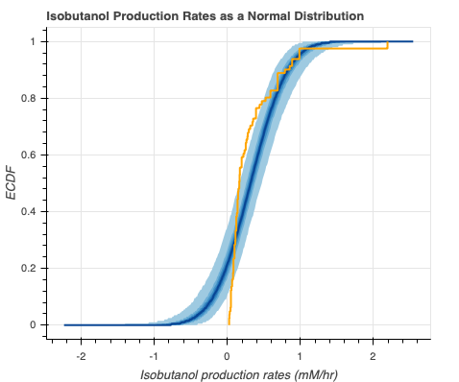
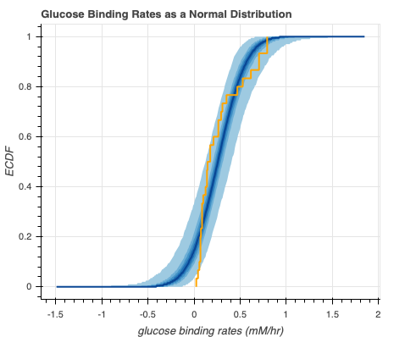



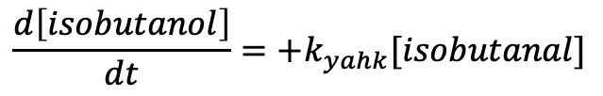
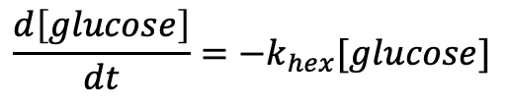
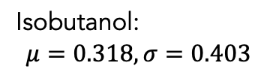
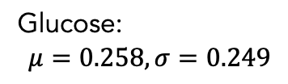
Get Minimal Model from Bowie Lab Experimental Data – Normal Distribution
$$\frac{d\left[isobutanol\right]}{dt}=+k_{yahk}[isobutanal]$$
$$k_{yahk}=0.318$$
$$\frac{d\left[glucose\right]}{dt}=−k_{hex}[glucose]$$
$$k_{hex}=0.258$$
Isobutanol:
$$μ=0.318, σ=0.403$$
Glucose:
$$μ=0.258, σ=0.249$$
Notes:
Normal – continuous distributinG

Slide 8
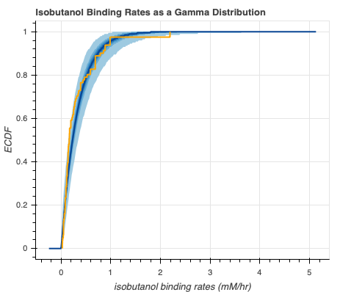
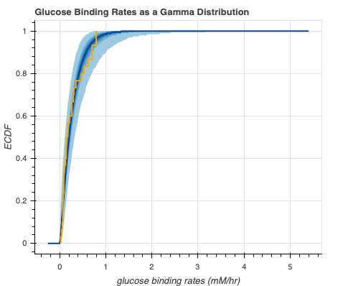

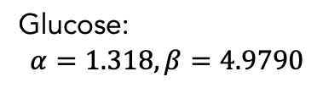


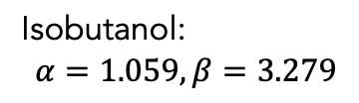
Get Minimal Model from Bowie Lab Experimental Data – Gamma Distribution
$$\frac{d\left[isobutanol\right]}{dt}=+k_{yahk}[isobutanal]$$
$$k_{yahk}= ?$$
$$\frac{d\left[glucose\right]}{dt}=−k_{hex}[glucose]$$
$$k_{hex}= ?$$
Isobutanol:
$$α=1.059, β=3.279$$
Glucose:
$$α=1.318, β=4.9790$$
Notes:
Normal – continuous distributinG

Slide 9


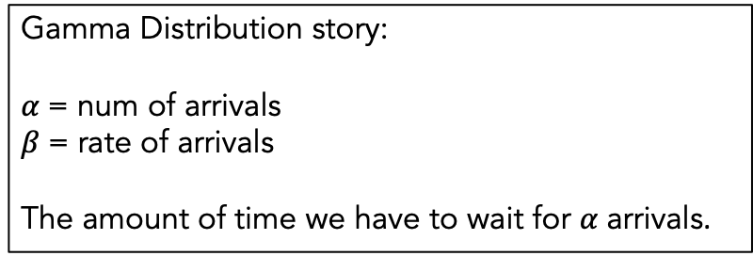
Model Comparison with LOO
Isobutanol
Glucose
Gamma Distribution story:
$α$= num of arrivals
$β$= rate of arrivals
The amount of time we have to wait for $α$ arrivals.
Gamma wins in both cases
How can I extract the rate parameters from the
Gamma distribution?

Slide 10
Questions/Concerns
Data Limitation (only 5 points)
Extract parameters
Compare to Reduced/Full Model
Hierarchical Modelling
Compare to other distributions?

Slide 11
Other Proposed Models
TX/TL

Slide 12
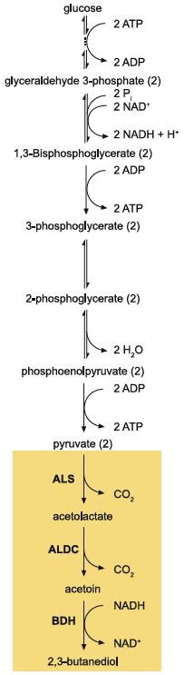
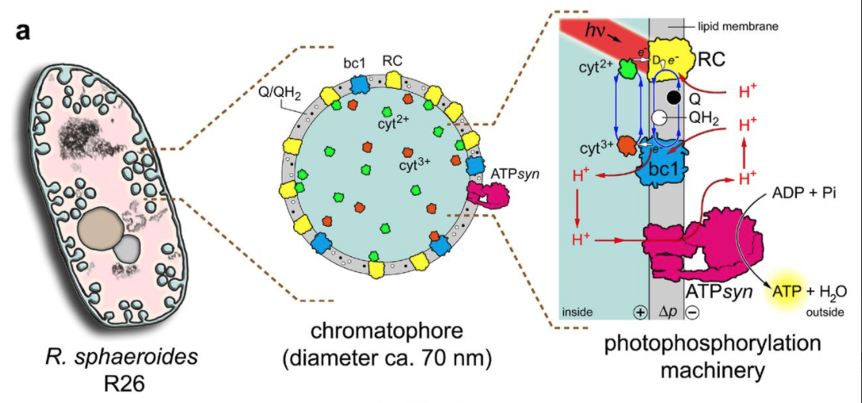
Other pathways with glucose
Light-activated systems
Jennifer E. Kay, Michael C Jewett, Metabolic Engineering, 2015
Altamura et al., biorxiv, 2020
Notes:
Using glucose as starting point can be a problem – in e coli extract, it is rapidly consumed (Jewett 2015
preferred to more expensive phosphorylated proteins
Light activated systems – used in Artifical Simplified-Autotroph Protocells – sphere of lipids (100 atp/s per atp synthase). Were able to show mrna biosynthesis inside individual vesicles

Slide 13
Transporter Model
ATP Synthase Model
ADP + Pi
H⁺
ADP + Pi
ADP + Pi
TX/TL
ATP + H₂0
ATP
ATP
TX/TL

Slide 14
Vesicle Fusion Model
ADP + Pi
TX/TL
Excess ATP
ATP

Slide 15
Vesicle Fusion Model
Fusion by ssDNA
Concentrations are ½
ADP, Pi toxic accumulation?
Include transporter
Other considerations
ADP + Pi
TX/TL
Excess ATP
ATP
Lipid Vesicle fusion by linker DNA:Yee-Hung M. Chan, Bettina van Lengerich, and Steven G. Boxer, PNAS, 2009
Notes:
Linker sequences = https://www.pnas.org/content/106/4/979
Other considerations – such as diffusion

Slide 16
Future Directions
Complete Exhaustive Rheostat Modelling
Utilize subsbml and compartments to look at other models
Add fusion functionality to biocrnpyler

Slide 17
Final questions
Contact Bowie Lab
Grad school suggestions
CDS 131
Notes:
You ask bowie who I should contact

Slide 18
Thank You!
William Poole
David Garcia
Ayush Pandey
John Marken
Chelsea Hu
Richard Murray

Slide 19
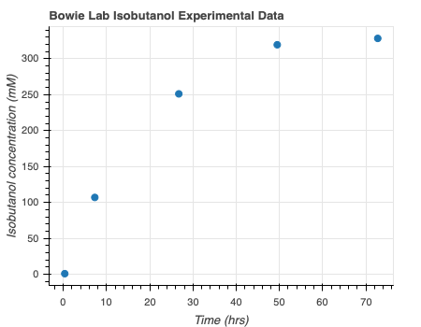
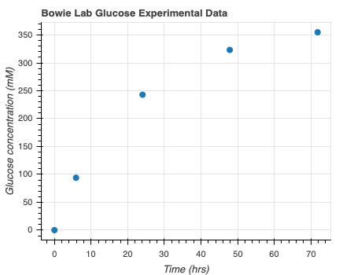
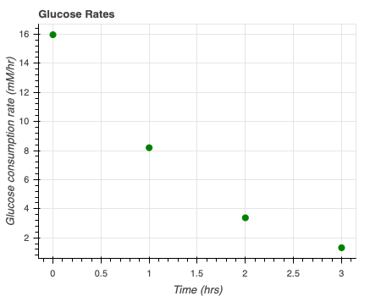
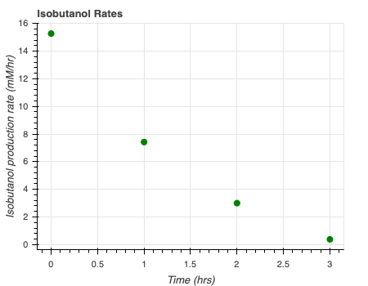

Get Minimal Model from Bowie Lab Experimental Data – only use the 5 data points
Rate = $\frac{d[x]}{dt}$
Rheostat pathway data: Opgenorth et al., 2017, Nature Chemical Biology
Notes:
Use digitize it to get the consumption over time – subtract times and rates to get rates (mM/hr) – perform MLE on this data
Bootstrapping from all the confidence intervals
Need help – not sure that negative binomial approach is correct? Should I take Bayesian approach? Is this necessary? Should I use binomial model? Is Glucose production rate that right thing to be looking at? How to extrapolate to my data?

Slide 20
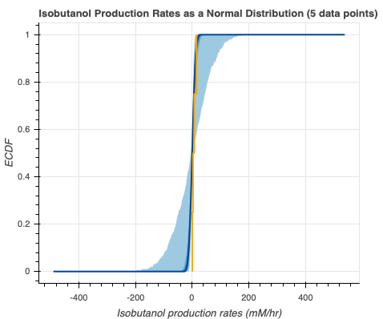
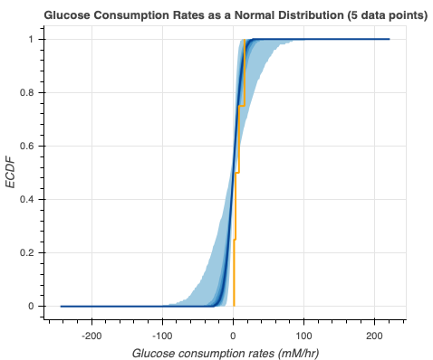
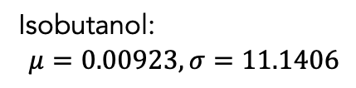


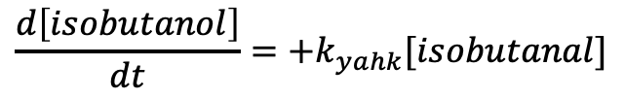
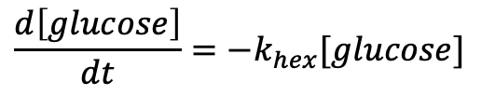
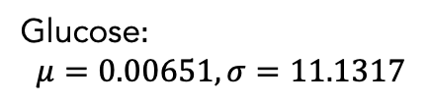
Get Minimal Model from Bowie Lab Experimental Data – only use the 5 data points
$$\frac{d\left[isobutanol\right]}{dt}=+k_{yahk}[isobutanal]$$
$$k_{yahk}=0.00923$$
$$\frac{d\left[glucose\right]}{dt}=−k_{hex}[glucose]$$
$$k_{hex}=0.00651$$
Isobutanol:
$$μ=\text{0}.00923, σ=\text{11.1406}$$
Glucose:
$$μ=\text{0.00651}, σ=\text{11.1317}$$
Notes:
Tough question – if they had multiple data points – would need to model hierarchically

