Slide 1
Project Updates
Ankita Roychoudhury
Murray Lab

Slide 2
Rheostat Machinery - Bioscrape
5.7.2020

Slide 3
Bioscrape Modeling
Look at all 3 enzymatic models
Understand and get valid parameter values
Get units of time and concentration
Try to find parameter values where the models look the same
Try to pick a model

Slide 4
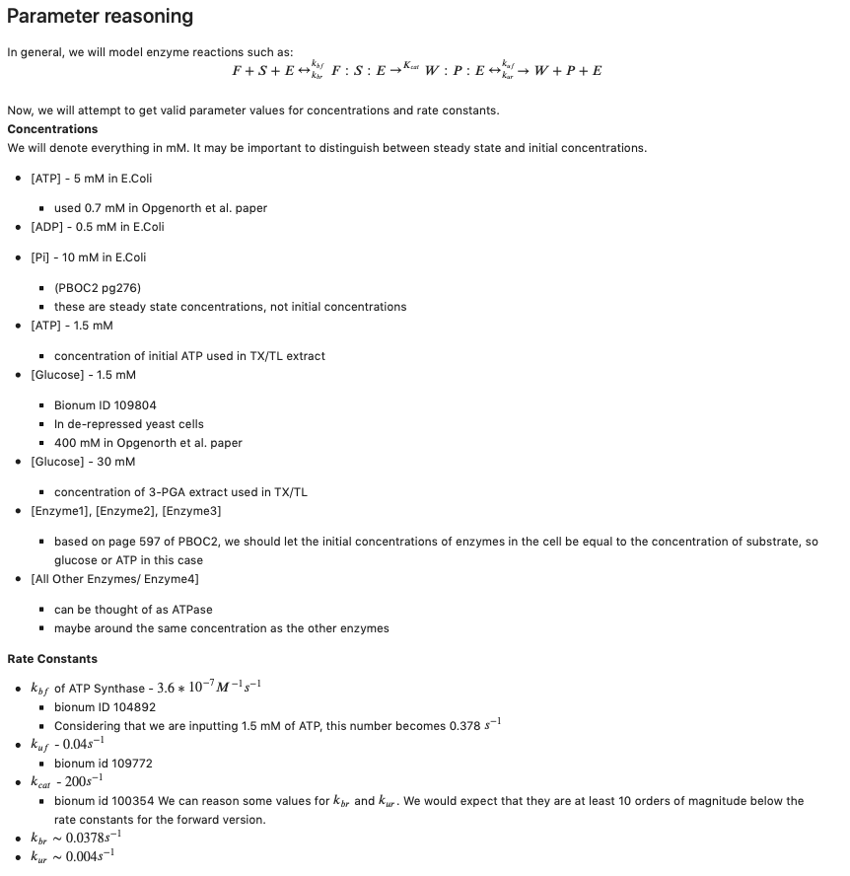

Slide 5
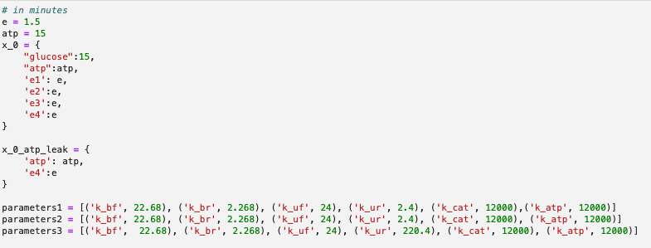
Parameter Inputs

Slide 6
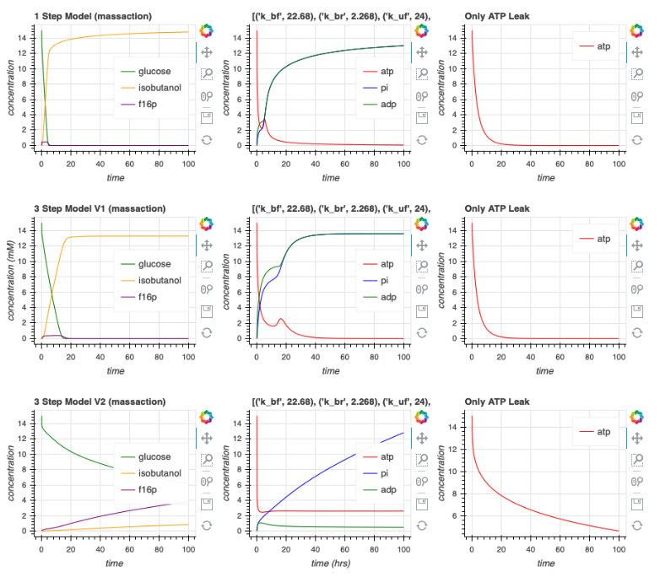
Plots

Slide 7
Future Directions
Model to match data

Slide 8
Simplified Rheostat Machinery - Bioscrape
5.14.2020

Slide 9
Some parameter edits
In extract, concentration of enzyme should be much less than substrate
For this reason, we choose e1=e2=e3=0.15
Atp = glucose = 15
We choose the activity of all other enzymes (e4) = 3.4
K_bf = 22.68, k_br = 2.268
K_uf = 24, k_ur = 2.4
K_cat = 10
K_atp = 0.5

Slide 10
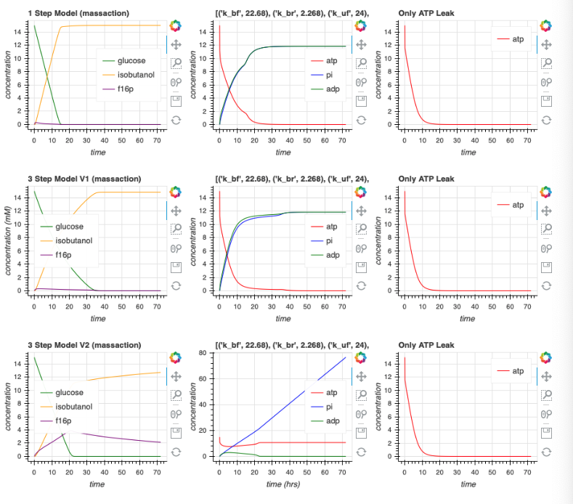

Slide 11
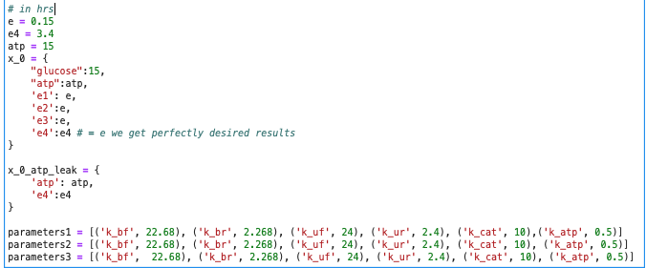

Slide 12
Quick Class Update
5.19.2020

Slide 13
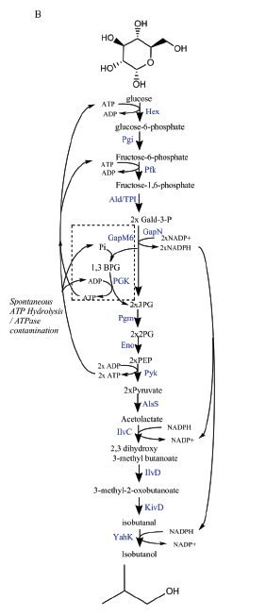
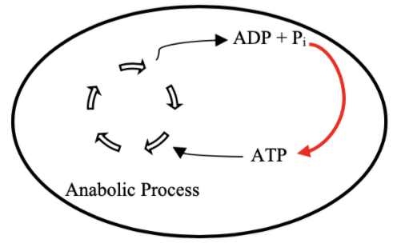
Goal

Slide 14
Bioscrape

Slide 15
Biocrnpyler
Adding a new mechanism, component, and mixture
Simulate simplified model
Simulate complex model

Slide 16
Parameter optimization, entire pathway biocrnpyler all done
Refer to 20200602_lab_mtg powerpoint for more details

Slide 17
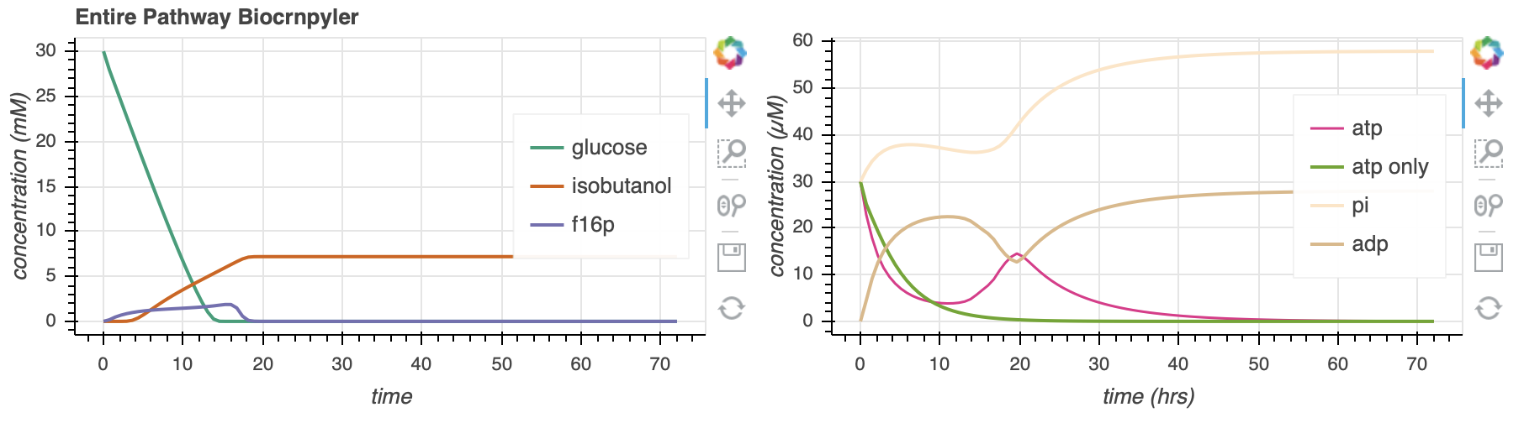
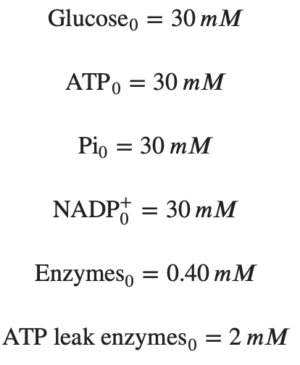
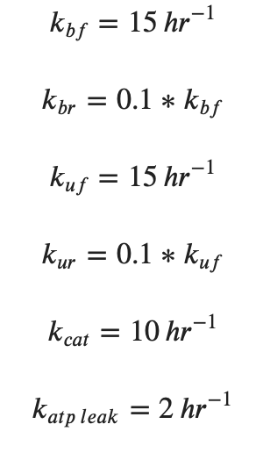
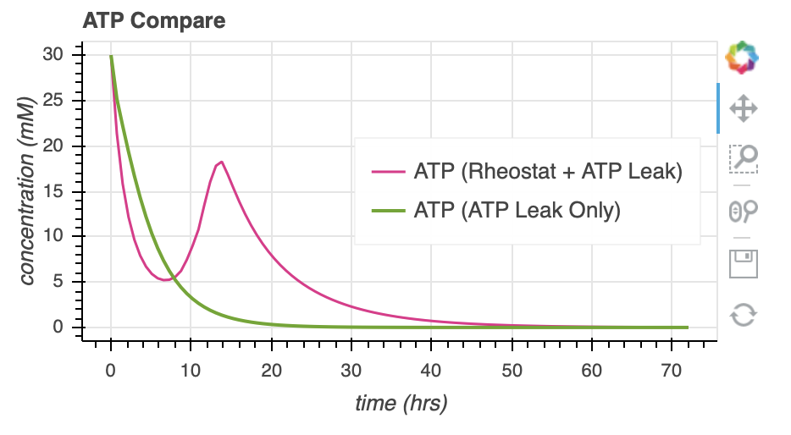
291.3

Slide 18
Studying/Optimization/Accuracy
6/18/2020

Slide 19
Why is there a hump?
Look at flux through enzymes (enzyme activity)
Related to rheostat design?

Slide 20
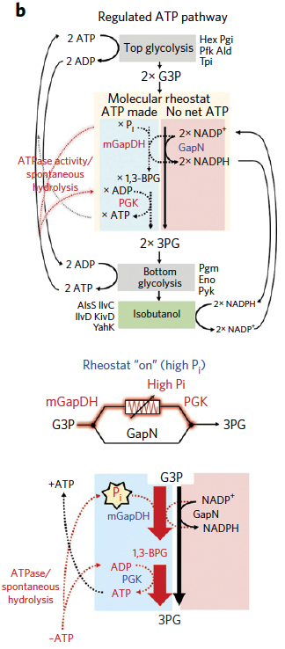
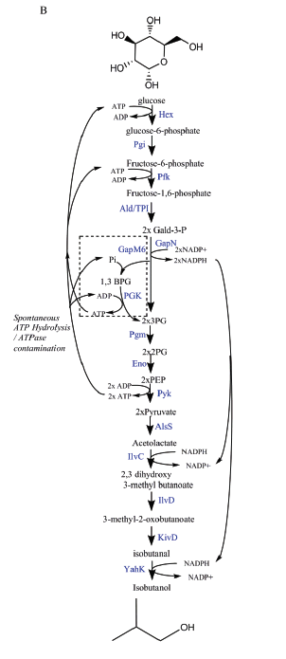
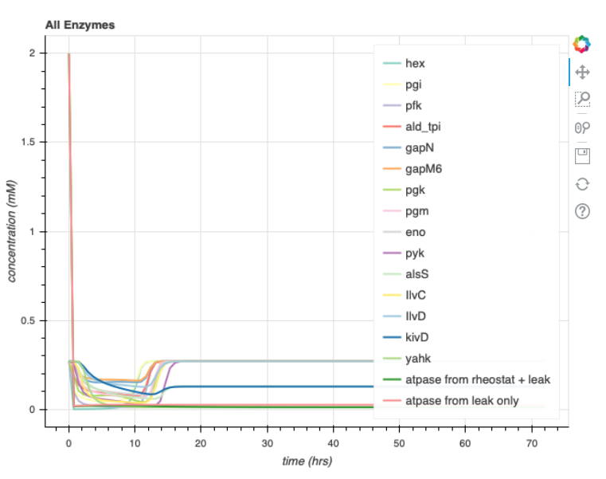
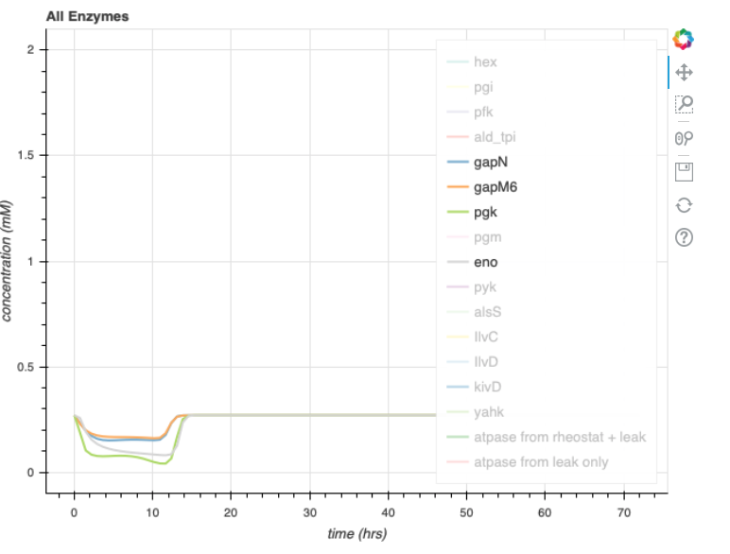
Rheostat pathway images: Opgenorth et al., 2017, Nature Chemical Biology

Slide 21
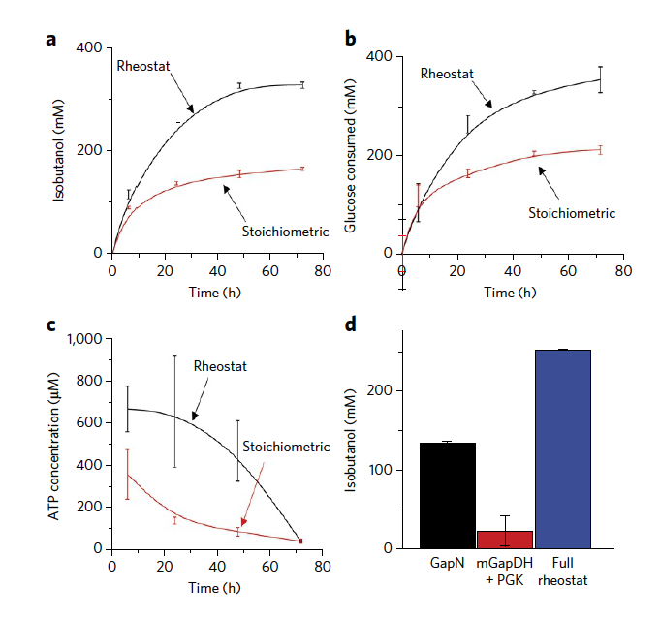
Compare to Bowie Lab Experimental Data
Continue to use pure mass-action model
Use their initial conditions
Play with parameters as desired

Slide 22
Consider sink reactions/pooling
Is pooling more of a spatial consideration?

Slide 23
Experimental Steps
Purified enzymes vs crude extract

Slide 24
Other Considerations
Resource depletion effects (Takahashi 2014)
20 min lag due to time needed for activation of extract core machinery after mixing with buffer (Hu 2015)
Pre incubation extract and buffer together at 37C for 20 min more closely matched model
Consider lag – with/without incubation? Both?
Time delay in biocrnpyler?

Slide 25
Other Models
Long pathway – many components
Look into simpler pathways
Boil down what’s happening and only use that?
Different starting point (3-PGA as opposed to glucose)
Other approaches
vesicle fusion
targeted vesicle transport with atp in, adp & pi out
Light activated

Slide 26
Things to consider post DG meeting
6.19.2020

Slide 27
Tips
Purifying takes a lot of effort
Consider resource depletion – rate of enzymatic changes as concentration changes
Find enzymes rates dependent on concentrations
Can you get rate kinetics from conc of reactants
K is changing
Allosterically regulated by ATP and other parts of glycolysis
Rate of reaction slows down with more ATP and others
Look into Vincent noireaux
3pga regen system in a model
ATPs per aa – for every atp used in txtl (per amino acid), Make another one
Test out different systems –
Crude extract – there is a leak that draws away ATP
Redesign glycolystic pathway to continuously give ATP
Couple CFPS to Atp regeneration
So the output (isobutanol) is something that can actually be used
START USING SUB SBML AND CONSIDER THOSE MODELS
Consider purified vs crude extract
Describe the different requirements/experimental restrictions for each
Consider refueling the vesicles through the membrane
Remember: want self perpetuation of atp (constant energy reserve)
Maybe look at just pyruvate
Compare the amount of glucose and isobutanol
This will give you insight into whether or not your enzyme kinetics are correct
You want 1:1 glucose:isobutanol. If not, find where it get’s lost
Need a good carbon balance
Start and end to what is in the paper
Related to/figure out concentration of inner metabolites
Consider kinetics to understand how this functions inside of a vesicle

Slide 28
Goals for Mon Presentation
Have all things from old lab meeting
Take out whatever you think is not necessary or go through it quicker
Shorten parameter search
Fix legend labels (specify rheostat and atp leak)
Add reasoning for hump
Add attempt at modeling lag
Add attempt to match to bowie lab data
Explain the issues with enzyme kinetics
Consider shorter / other pathways
Vesicle fusion options

Slide 29
Post Ayush Meeting
6.24.2020

Slide 30
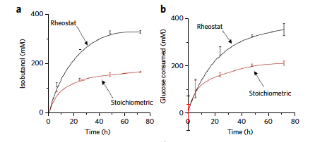
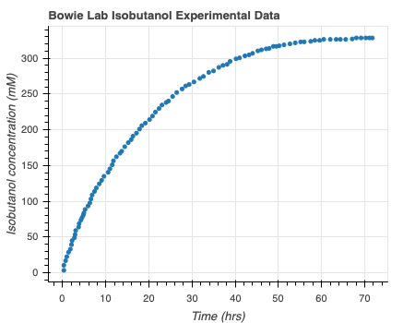
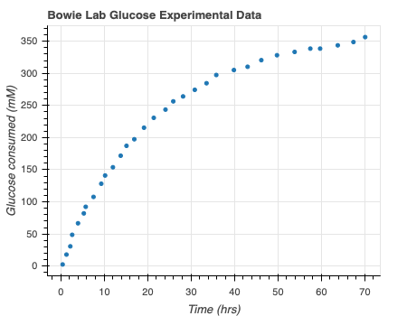

Model Bowie Lab Experimental Data
Digitizeit
Rheostat pathway data: Opgenorth et al., 2017, Nature Chemical Biology
Notes:
Use digitize it to get the consumption over time – subtract times and rates to get rates (mM/hr) – perform MLE on this data
Bootstrapping from all the confidence intervals
Need help – not sure that negative binomial approach is correct? Should I take Bayesian approach? Is this necessary? Should I use binomial model? Is Glucose production rate that right thing to be looking at? How to extrapolate to my data?

Slide 31
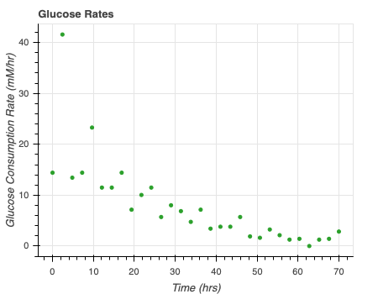
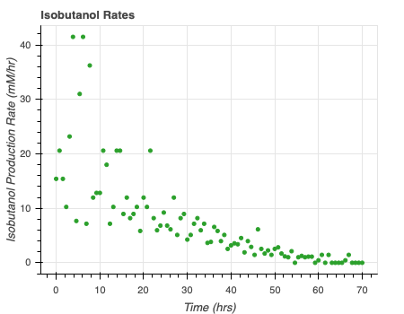

Model Bowie Lab Experimental Data
Rate = $\frac{d[x]}{dt}$
Rheostat pathway data: Opgenorth et al., 2017, Nature Chemical Biology
Notes:
Use digitize it to get the consumption over time – subtract times and rates to get rates (mM/hr) – perform MLE on this data
Bootstrapping from all the confidence intervals
Need help – not sure that negative binomial approach is correct? Should I take Bayesian approach? Is this necessary? Should I use binomial model? Is Glucose production rate that right thing to be looking at? How to extrapolate to my data?

Slide 32
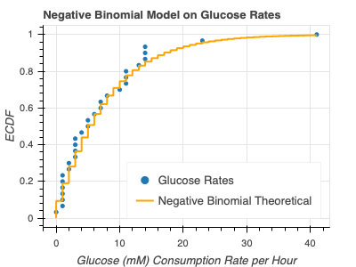
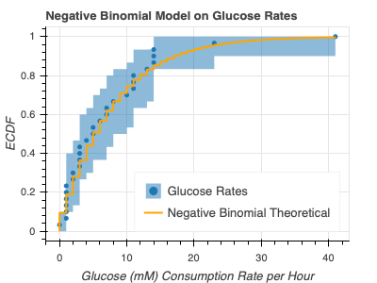
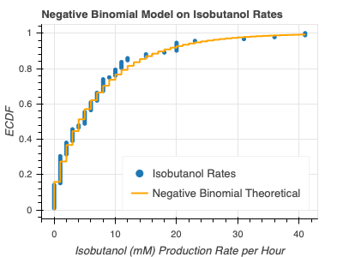
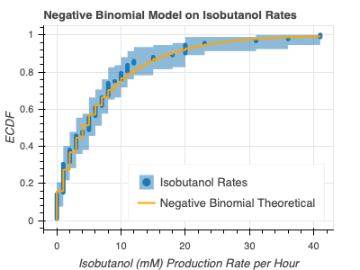
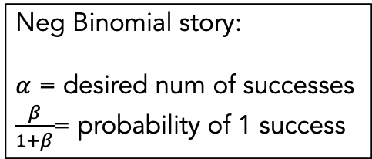
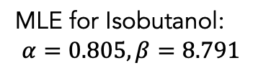
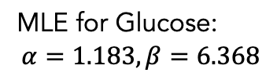
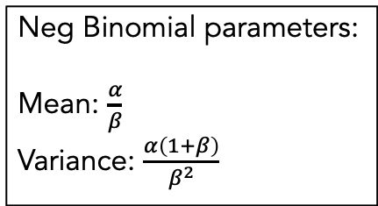
Model Bowie Lab Experimental Data
Neg Binomial parameters:
Mean: $\frac{α}{β}$
Variance: $\frac{α\left(1+β\right)}{β^{2}}$
MLE for Glucose:
$$α=1.183, β=6.368$$
Neg Binomial story:
$α$ = desired num of successes
$\frac{β}{1+β}$= probability of 1 success
MLE for Isobutanol:
$$α=0.805, β=8.791$$
Ok maybe this will work, but reconsider model approach again
Notes:
Use digitize it to get the consumption over time – subtract times and rates to get rates (mM/hr) – perform MLE on this data
Bootstrapping from all the confidence intervals
Need help – not sure that negative binomial approach is correct? Should I take Bayesian approach? Is this necessary? Should I use binomial model? Is Glucose production rate that right thing to be looking at? How to extrapolate to my data?

Slide 33
Reconsidered Modelling Approach
Full Model
CRN Mass action
(k_{bf1}, k_{br1}, k_{uf1}, k_{ur1},k_{cat1},k_{bf2},…)
Minimal Model
Coarse-grained
(k₁, k₂ = k)
Lumped parameters
Extracted from experimental data
Effective relations to help argue values of reduced model
Include assumptions
Conservation laws
QSSA
Generalize binding/unbinding
Reduced Model
(k₁, k₂,…)
More relevant to experimental data
Notes:
Full model has all reaction rate parameters
This makes sense – I’ve optimized the full model, but how can I come up with some biological relevance

Slide 34
Syn cell group meeting
6.25.2020
Saved as 20200624_syncell_mtg

Slide 35
Use to find enzyme parameters?
https://www.uniprot.org/uniprot/P75691

Slide 36
Tips
Are the bioscrape comparisons fair? Try to do model reductions. Extract parameters for simpler models from more complicated models
Parameters for each – use things at same rate
Good if you know what species you are collapsing
Biocrnpyler
Turn on use of energy
Mechanism to use- does it break
No ATP hump in the experimental data
Maybe red – black line
Or because so few data points
Something we experimentally test
Isobutanol, pi actual protein production
Mike? CFME?
Isobutanol and pi export?? Combine models
Vire2 transport membrane: for ssdna production
Temperature dependence – include with ayush? Implement generic rules
Question: fusion in biocrnpyler, hacking – switch to 2 models with 1 model
How does autoreduce work – sbml in fusion, bringing 2 compartments, or biocrnpyler

