Slide 1
Project Ideas
Ankita Roychoudhury
2.9.21
William Meeting

Slide 2
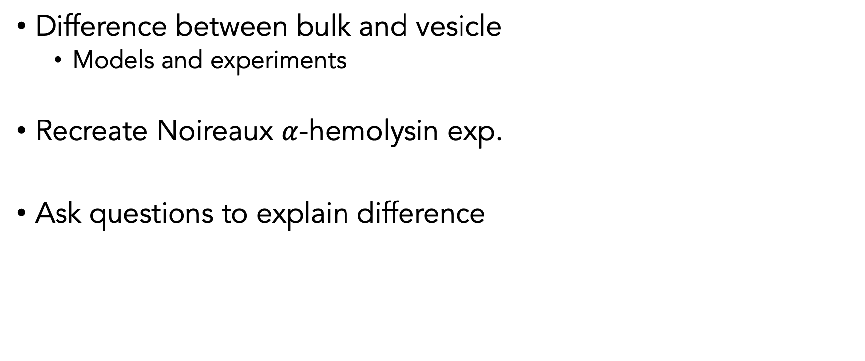
Goal
Difference between bulk and vesicle
Models and experiments
Recreate Noireaux $α$-hemolysin exp.
Ask questions to explain difference

Slide 3
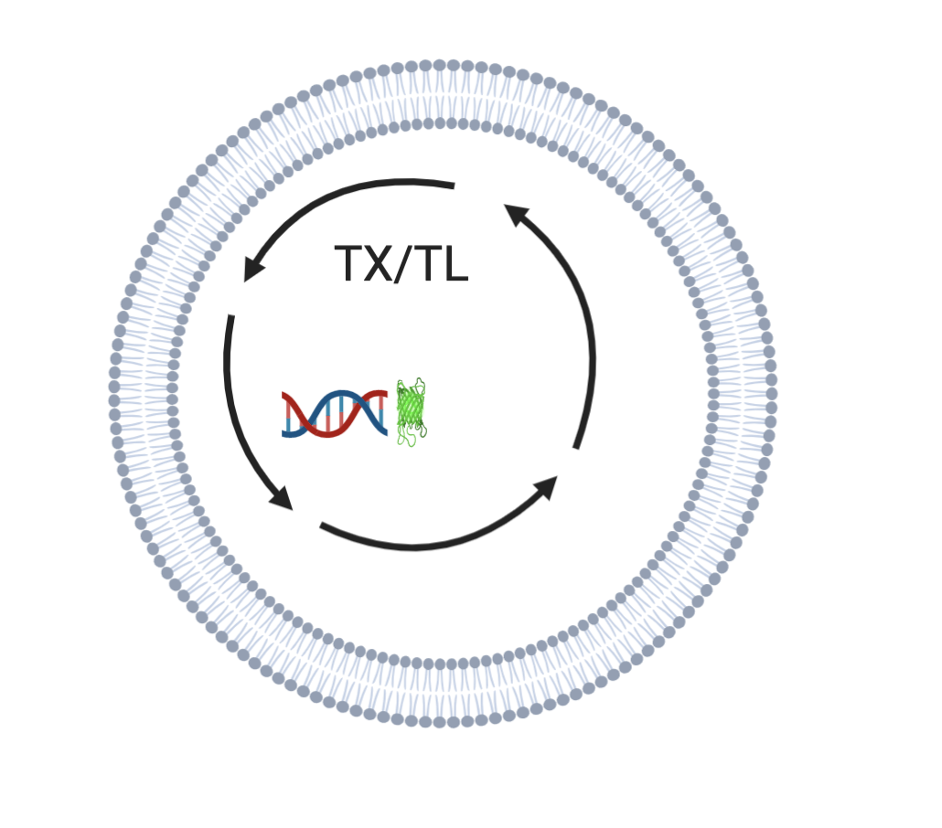
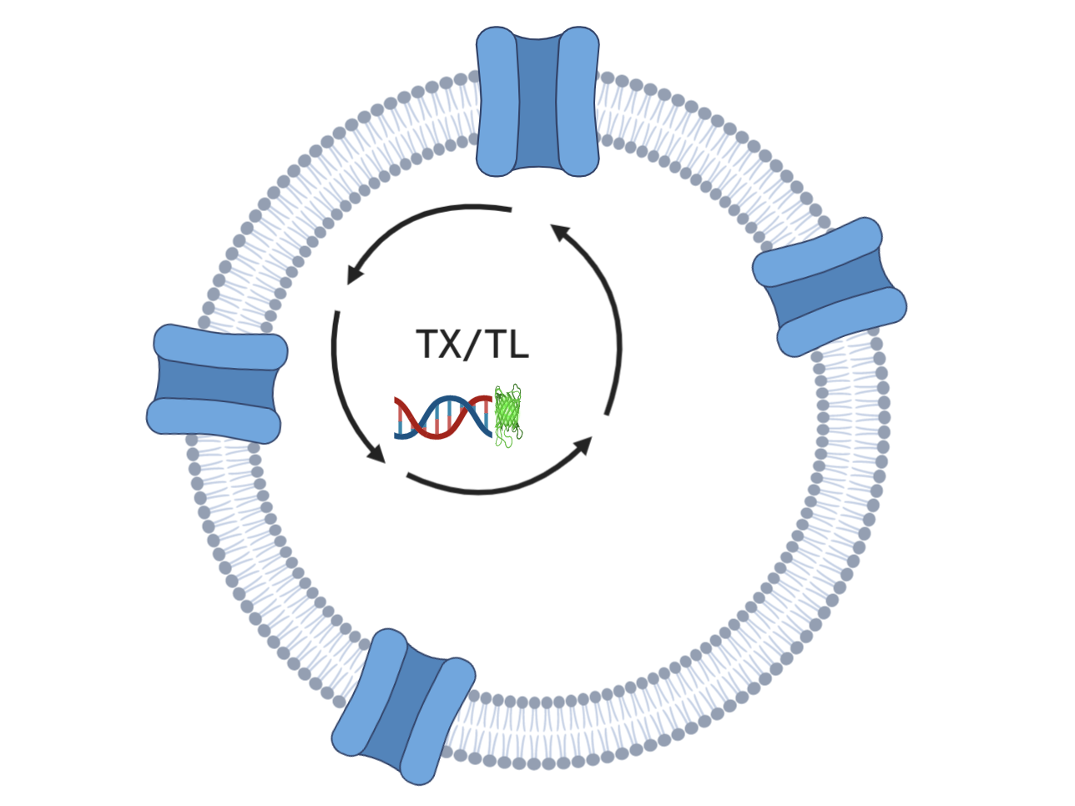
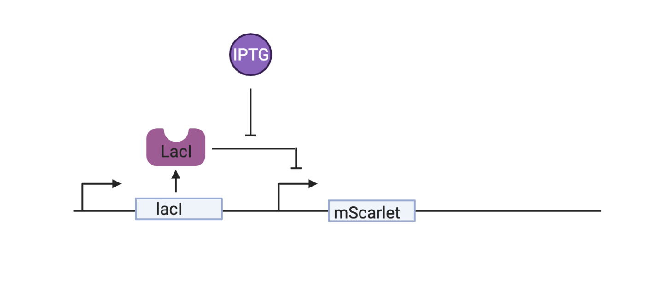

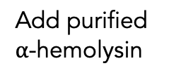
Experiment Design: Test $α$-hemolysin integration
+/- IPTG, Quantify fluorescence
Add purified $α$-hemolysin
DNA: lacI construct with mScarlet

Slide 4

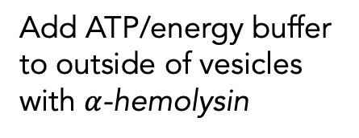
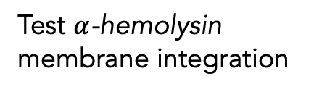
Coarse Senior Thesis Timeline
Beg/spike experiments in bulk
Model previous beg/spike data. Begin whole syn cell model
Develop whole syn cell model with exp. data
Hypothesize and test
Test $α$-hemolysin membrane integration
Add ATP/energy buffer to outside of vesicles with $α$-hemolysin
Highlight discrepancies between model/experiments and vesicle/bulk
Ankita Roychoudhury 8.13.2020
Notes:
Happy to do more bulk atp

Slide 5
Help with Vivarium?

