Slide 1

ATP Life Extension in Synthetic Cells
Synthetic Cell Meeting 7.15.2020
Ankita Roychoudhury
Murray Lab

Slide 2

Things to include in this
Autoreduce progress (reduced model)
Comparison between outputs of reduced and unreduced model not good
Model reduced model with appropriate parameters?
Should you try this in biocrnpyler/bioscrape for the time being?
Maybe show some minimal model things
IMPORTANT
Other people you can colab with
How other’s can use this model (subSBML)
Do ATP Synthase Model
Gro?chemostat?
Gro simulation for fun
Includes dilution/division, doesn’t happen in liposomes
Include phases like peter (roadmap)
Notes:
Bigger context of synthetic cell
How link to other peoples
Other things for syn cell that could integrate, subsystem of component within a syn cell that has other stuff going on (from DOD PROPOSAL)
Have to try to get someone else’s model and get it to work
peter + Ankita? Reach out to see energy regeneration
One slide with whatever your project is about

Slide 3
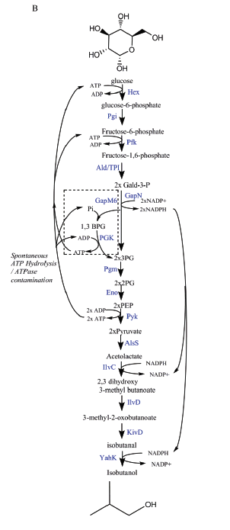
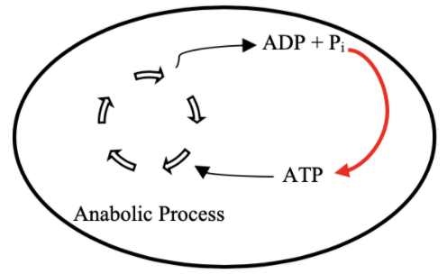
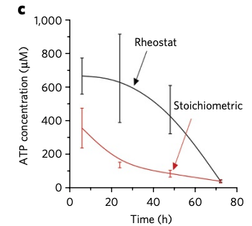
Goal: ATP Life Extension in Synthetic Cells
Proposal 1: Regeneration by Rheostat Machinery
TX/TL
Opgenorth et al., 2017, Nature Chemical Biology

Slide 4
Roadmap
Model entire rheostat in BioCRNPyler
Investigate reduced (autoReduce) and minimal models
Study an ATP Synthase Model
Parameter experimentation to understand pathway and optimize
Collaborate with other projects
Experimental Planning (?)

Slide 5
Model Overview
Full Model
CRN Mass action
(k_{bf1}, k_{br1}, k_{uf1}, k_{ur1},k_{cat1},k_{bf2},…)
Minimal Model
Coarse-grained
(k₁, k₂ = k)
Lumped parameters
Extracted from experimental data
Effective relations to help argue values of reduced model
Include assumptions
Conservation laws
QSSA
Generalize binding/unbinding
Reduced Model
(k₁, k₂,…)
More relevant to experimental data
Notes:
Full model has all reaction rate parameters
This makes sense – I’ve optimized the full model, but how can I come up with some biological relevance

Slide 6
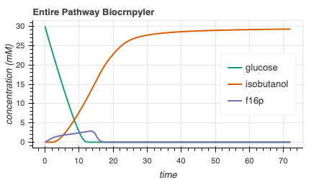
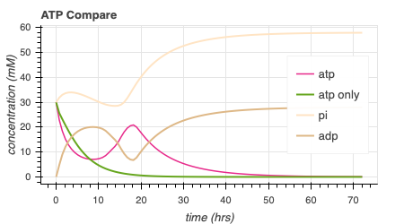
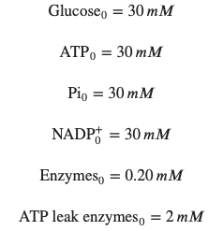
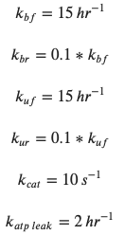
Rheostat Model Output add isob toxicity to membrane protein folding/txtl here
414.6
Notes:
Isobutanol toxicity - once around 180 mM, cells stopped growing
https://www.ncbi.nlm.nih.gov/pmc/articles/PMC3242789/
Concentrations of 1-2 % v/v isobutanol can induce toxic effects in microbial production host, reducing growth rates and precursor synthesis – low product yields
E coli = volume = 1 umeter^3 , length – 1-2 umeter = 1000 nanometer
GUV = 300 nanometer , volume = 0.3 umeter^3
Conc of isobutanol – 30 mM
Isobutanol toxicity: n-butanol can interact with the cell by altering the lipid composition and fluidity of the membrane, decreasing intracellular pH and ATP concentration, inhibiting the uptake of glucose. Isobutanol stress response in E.coli is quantitively similar to that of n-butanol with respect to transcriptional levels, except for increased repression of amino acid biosynthesis by n-butanolhttps://www.embopress.org/doi/full/10.1038/msb.2010.98

Slide 7
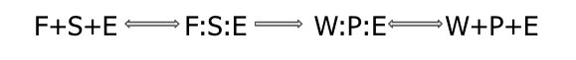
Attempted Reduced Models
1: Remove all complexes
2: Remove 1/2 complexes
3: Remove 1 complex
4: Remove all except atp, isobutanol, glucose
Complexes

Slide 8
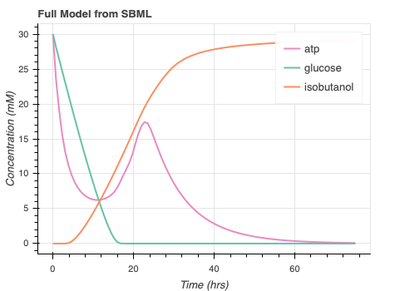
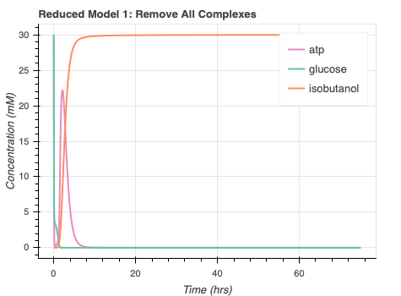
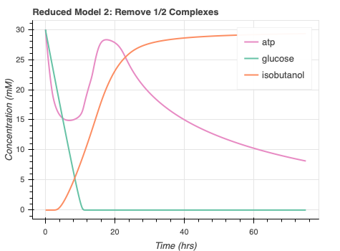
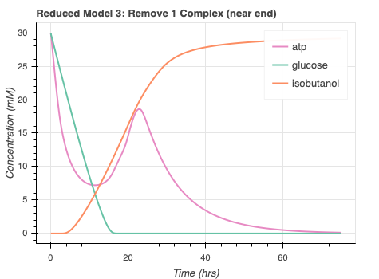
autoReduce progress/issues
Automate SBML to ODE
High error for some proposed reduced models
Long runtime for Reduced Model 4
Notes:
Seems like all the models reach the appropriate steady state value
Concerns include the sacrificed dynamics. Not sure why remov ing all complexes quickens all the dynamics and why removing ½ complexes seems to only delay atp dynamics.
Have to find a compromise between having curves close to the full model but also reducing the amount of species and corresponding parameters required

Slide 9
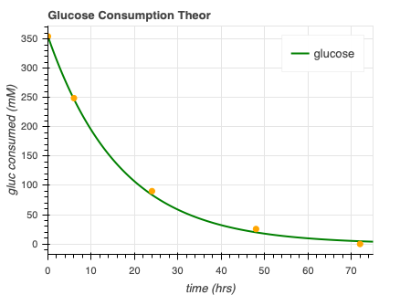
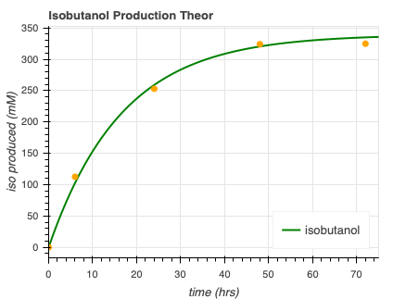


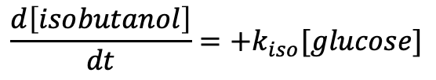
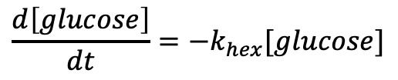


Minimal model progress
$$\frac{d\left[isobutanol\right]}{dt}=+k_{iso}[glucose]$$
$$\frac{d\left[glucose\right]}{dt}=−k_{hex}[glucose]$$
$glucose →^{k_{hex}}$ ⌀
$$glucose →^{k_{iso}}isobutanol$$
$$k_{hex}=0.06$$
$$k_{iso}=0.057$$
Opgenorth et al., 2017, Nature Chemical Biology
Notes:
Kind of gives us a guide on the timescale of glucose/isobutanol consumption but this minimal model seems quite disconnected from underlying dynamics since there is only one state.

Slide 10
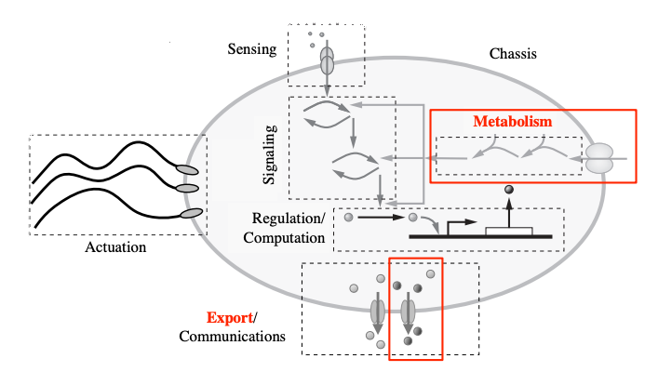
Collaboration
Subsbml model
”rheostat_sbml_model.xml”
Input [enzymes]₀, [glucose]₀, [atp]₀, [pi]₀, [nadp]₀
Murray, Richard, Towards Genetically-Programmed Synthetic Cells and Multi-Cellular Machines, July 2017. PowerPoint Presentation.
Notes:
Working on metabolism! Can work with any of these other processes, like export, signaling, regulation, etc as long as atp consumption is modelled! Have to input some initial concentrations once the sbml model is downloaded and then you’re good to go!
I’m happy to work with anyone’s models and look into this.

Slide 11
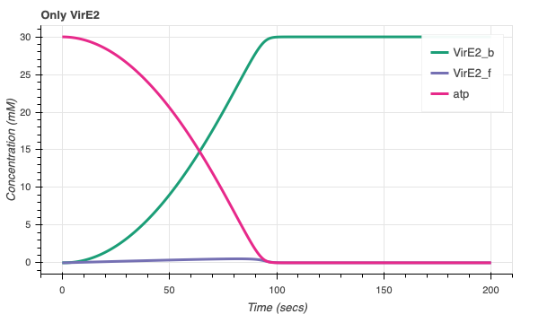
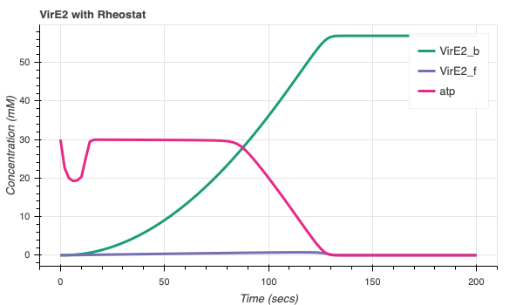
Collaboration with Agrima (VirE2)
More bound VirE2!
VirE2 model/code courtesy of Agrima Deedwania
Notes:
One that we’ve tried, that you’ve already kind of heard about, is my collab with Agrima. One issue is that my regeneration was on timescale of 50 hrs and Agrima’s process is on order of 1 minute. For this reason, when the models were initially combined, there was no effect to the amt/rate of vire2 bound. Once I lowered the timescale of my system so atp regeneration could happen quicker, I was able to see effects. Something to consider moving forward. Find what’s accurate.

Slide 12
Rheostat concerns
Accurate enzyme kinetics
Limited information
Many enzymes
How may these enzymes/byproducts affect transcription translation
Timescale separation
Parameter estimation

Slide 13
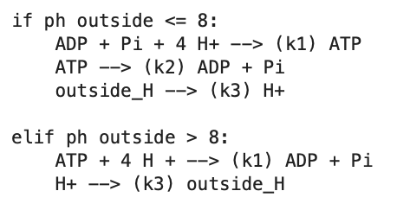
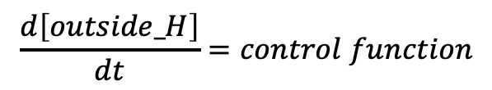
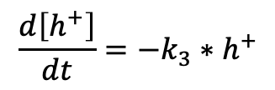

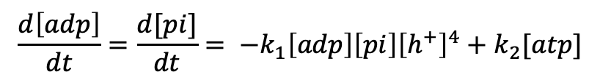
ATP synthase model progress – ATP synthesis
H⁺
ADP + Pi
ATP
TX/TL
$$\frac{d\left[atp\right]}{dt}=k_{1}\left[adp\right]\left[pi\right]{\left[h^{+}\right]}^{4}−k_{2}[atp]$$
$$\frac{d\left[adp\right]}{dt}={\frac{d[pi]}{dt}= −k}_{1}\left[adp\right]\left[pi\right]{\left[h^{+}\right]}^{4}+k_{2}[atp]$$
$$\frac{d\left[h^{+}\right]}{dt}=−k_{3}∗h^{+}$$
$$\frac{d\left[outside_H\right]}{dt}=control function$$

Slide 14
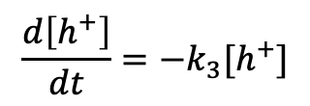
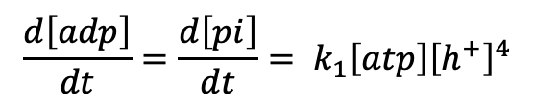
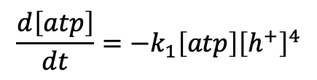
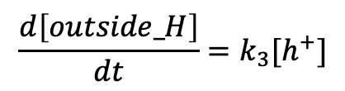
ATP synthase model progress – ATP hydrolysis
H⁺
ADP + Pi
ATP
TX/TL
$$\frac{d\left[atp\right]}{dt}=−k_{1}\left[atp\right]{\left[h^{+}\right]}^{4}$$
$$\frac{d\left[adp\right]}{dt}=\frac{d\left[pi\right]}{dt}= k_{1}\left[atp\right]{\left[h^{+}\right]}^{4}$$
$$\frac{d\left[h^{+}\right]}{dt}=−k_{3}[h^{+}]$$
$$\frac{d\left[outside_H\right]}{dt}=k_{3}[h^{+}]$$

Slide 15
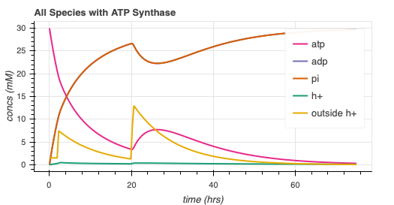
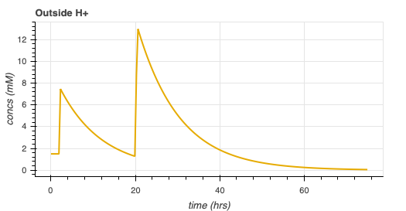
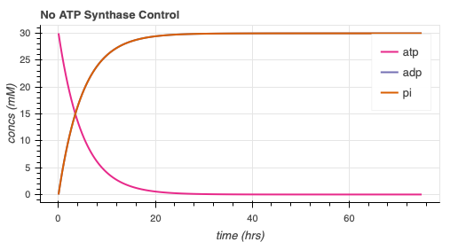
ATP synthase simulation
Arbitrary parameters
Add complexity
Protein folding
Membrane integration

Slide 16
Future directions
Rheostat Model
More collaboration!
Develop autoReduce
More work with minimal/reduced models
ATP synthase model develop

Slide 17
Thank You!
William Poole
David Garcia
Ayush Pandey
Richard Murray

