Slide 1


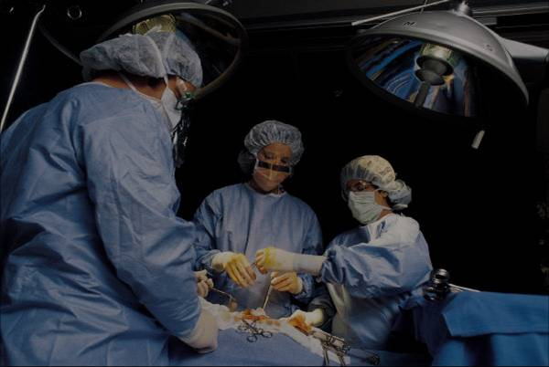
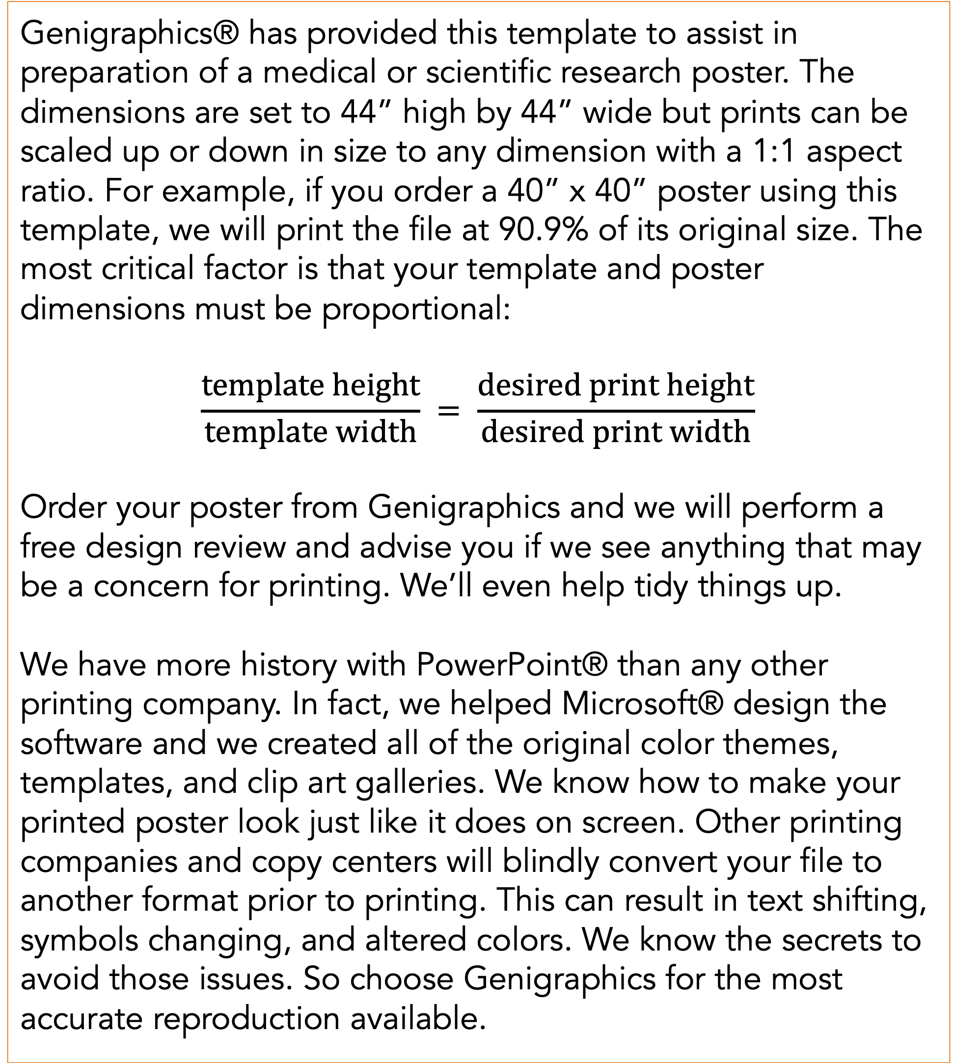
Modeling a Glucose Pathway and an ATP Synthase Mechanism shows ATP Life Extension in Synthetic Cells
REPLACE THIS BOX WITH YOUR ORGANIZATION’S
HIGH RESOLUTION LOGO
REPLACE THIS BOX WITH YOUR ORGANIZATION’S
HIGH RESOLUTION LOGO
Ankita Roychoudhury¹; Richard Murray, PhD¹;
¹California Institute of Technology
Abstract
Methods and Materials
In synthetic cell protein synthesis, a common limiting factor is the energy supply for transcription and translation. By studying computational and mathematical models of various ATP regeneration mechanisms in synthetic cells, we aim to propose experimental methods for ATP life extension. We use available software tools to study two models. These allow us to develop and study mass action models by implementing simple chemical reaction networks. Our simulations show that a glucose metabolic pathway can extend lifetime of ATP up to about 60 hours. Integrating ATP synthase can also independently lengthen the lifetime of ATP to various times depending on the implemented proton gradient mechanism. To ensure prolonged synthetic cell protein synthesis, either the glucose pathway or ATP synthase mechanism can be used. In the future, it will be useful to perform wet-lab experiments in order to compare our model to data.
We used multiple software packages in order to test the hypothesis in silico. In particular we used BioCRNpyler, bioscrape, autoReduce, SBML, and sub-sbml. Various software packages, such as BioCRNPyler, bioscrape, and autoReduce are being actively developed by members of Murray Lab. Biocrnpyler is an object oriented framework (written in Python). Given simple descriptions, the software can generate chemical reaction networks, or CRNs. These are outputted as SBML files. SBML is a model representation format, which uses the language XML and commonly used in systems and synthetic biology. We then used bioscrape as a CRN simulator. Given an SBML file, bioscrape can solve the system and returns an output of results that can be simply visualized. Sub-sbml was also used because it can combine and model interactions between more than one SBML model. More specifically, sub-sbml allows for the creation of subsystems, the ability to combine multiple subsystems, and the ability to model interactions like the molecule transport and membrane diffusion.
AutoReduce is a Python-based tool that is used for model reduction of input-controlled biological circuits [15]. This tool helped with parameter extraction that is relevant to biological experiments with the assumptions made (such as time-scale separation with the quasi-steady state assumption).
Chart 1. Label in 28pt Calibri.
Introduction
Results
Discussion
Genigraphics® has provided this template to assist in preparation of a medical or scientific research poster. The dimensions are set to 44” high by 44” wide but prints can be scaled up or down in size to any dimension with a 1:1 aspect ratio. For example, if you order a 40” x 40” poster using this template, we will print the file at 90.9% of its original size. The most critical factor is that your template and poster dimensions must be proportional:
$$\frac{template height}{template width} = \frac{desired print height}{desired print width}$$
Order your poster from Genigraphics and we will perform a free design review and advise you if we see anything that may be a concern for printing. We’ll even help tidy things up.
We have more history with PowerPoint® than any other printing company. In fact, we helped Microsoft® design the software and we created all of the original color themes, templates, and clip art galleries. We know how to make your printed poster look just like it does on screen. Other printing companies and copy centers will blindly convert your file to another format prior to printing. This can result in text shifting, symbols changing, and altered colors. We know the secrets to avoid those issues. So choose Genigraphics for the most accurate reproduction available.
Click here to insert your Results text. Type it in or copy and paste from your Word document or other source.
This text box will automatically re-size to your text. To turn off that feature, right click inside this box and go to Format Shape, Text Box, Autofit, and select the “Do Not Autofit” radio button.
To change the font style of this text box: Click on the border once to highlight the entire text box, then select a different font or font size that suits you. This text is Calibri 32pt and is easily read up to 5 feet away on a 44x44 poster.
Zoom out to 100% to preview what this will look like on your printed poster.
Speaking of Results, yours will look better if you remember to run a spell-check on your poster! After you’ve added your content click on Review, Spelling, or press F7.
Click here to insert your Discussion text. Type it in or copy and paste from your Word document or other source.
This text box will automatically re-size to your text. To turn off that feature, right click inside this box and go to Format Shape, Text Box, Autofit, and select the “Do Not Autofit” radio button.
To change the font style of this text box: Click on the border once to highlight the entire text box, then select a different font or font size that suits you. This text is Calibri 32pt and is easily read up to 5 feet away on a 44x44 poster.
Zoom out to 100% to preview what this will look like on your printed poster.
Conclusions
Click here to insert your Conclusions text. Type it in or copy and paste from your Word document or other source.
This text box will automatically re-size to your text. To turn off that feature, right click inside this box and go to Format Shape, Text Box, Autofit, and select the “Do Not Autofit” radio button.
To change the font style of this text box: Click on the border once to highlight the entire text box, then select a different font or font size that suits you. This text is Calibri 32pt and is easily read up to 5 feet away on a 44x44 poster.
Zoom out to 100% to preview what this will look like on your printed poster.
Table 1. Label in 28pt Calibri.
 | Heading | Heading | Heading
Item | 800 | 790 | 4001
Item | 356 | 856 | 290
Item | 228 | 134 | 238
Item | 954 | 875 | 976
Item | 324 | 325 | 301
Total | 199 | 137 | 186
Figure 1. Label in 28pt Calibri.
Figure 2. Label in 28pt Calibri.
Contact
References
[name]
[organization]
[address]
[email]
[phone]

