Slide 1
Project Summary
Ankita Roychoudhury
Murray Lab

Slide 2
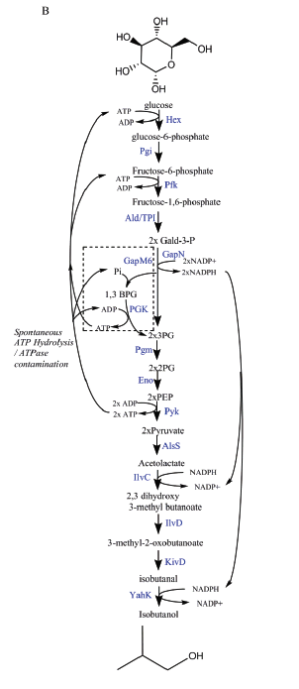
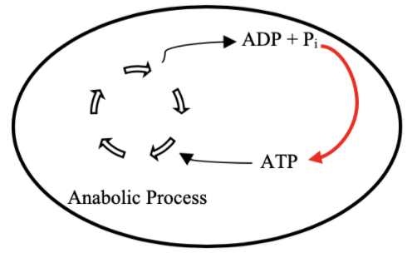
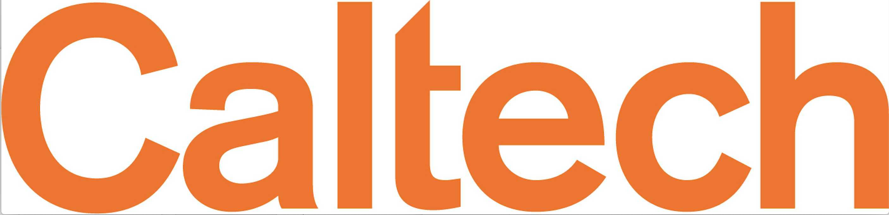
Goal: ATP Life Extension in Synthetic Cells
Proposal 1: Regeneration by Rheostat Machinery
Proposal 2: Regeneration by ATP Synthase
H⁺
ADP + Pi
TX/TL
ATP + H₂0
TX/TL
Ankita Roychoudhury 8.13.2020
Opgenorth et al., Nature Chemical Biology, 2017

Slide 3

Roadmap
Model entire rheostat in BioCRNPyler
Investigate reduced (autoReduce) and minimal models
Study an ATP Synthase Model
Parameter experimentation to understand pathway and optimize
Collaborate with other projects
Experimental Planning
Ankita Roychoudhury 8.13.2020

Slide 4
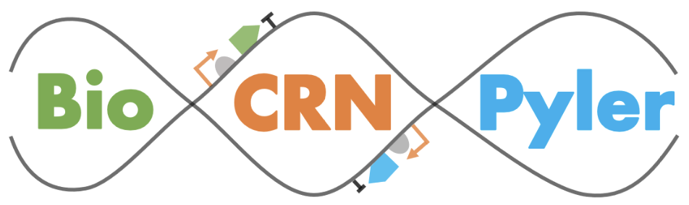

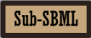
Software Tools
Communicate & Combine!
Simulate!
Create Model!
Bioscrape
Ankita Roychoudhury 8.13.2020
Notes:
Speaker: Ankita
Due to COVID-19, most of the summer projects schedule to be completed in Richard Murray Lab moved to simulation-based experiments rather than wet-lab. For this reason, we looked for particular software tools that would help us not only simulate our own models but also help communicate between models to encourage collaboration and interlinking.
We decided to use BioCRNpyler, SBML,sub-sbml, and bioscrape.
Broadly stated, Biocrnpyler is a chemical reaction network based software. This software is used to write out CRN models given simple descriptions.
SBML was used for communication and model combination purposes. SBML is essentially a model representation format used mostly in systems and synthetic biology. It is mainly used to represent biochemical pathways, such as metabolic pathways, cell-signaling pathway, gene regulation, and the like.
Sub-sbml is useful to model shared resources, compartment combination, and more.
And then we needed to choose a simulator to analyze our CRNs so we chose bioscrape! Which can take an SBML file and will output a dataframe with results for each timepoint, which can easily be visualized.
Both biocrnpyler and sub-sbml were released by various members of Richard Murray Lab at Caltech including Ayush Pandey, William Poole, Zoltan Tuza in 2018.
SBML was released in 2002 by John Doyle lab at Caltech and Hiroaki Kitano, a professor at Okinawa institute of science and technology.
Bioscrape was developed by members of Murray Lab, including Anand Swaminathan, Ayush Pandey, and William Poole in 2017.

Slide 5
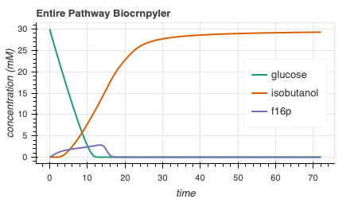
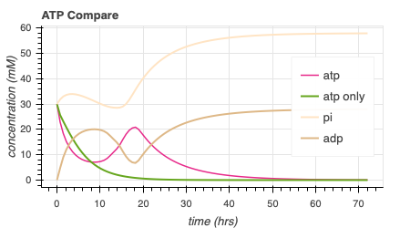
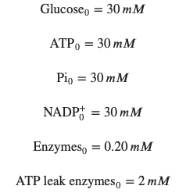
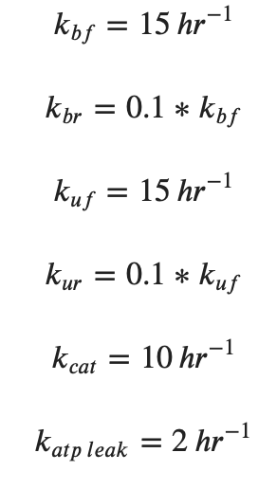
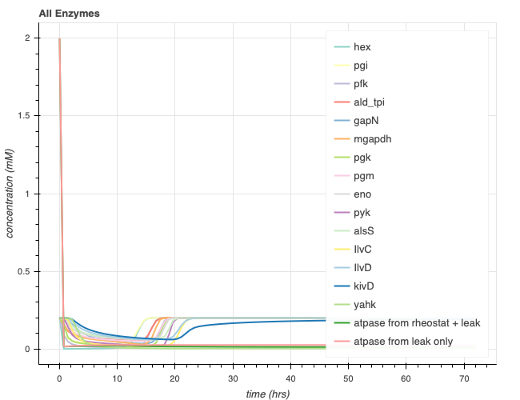
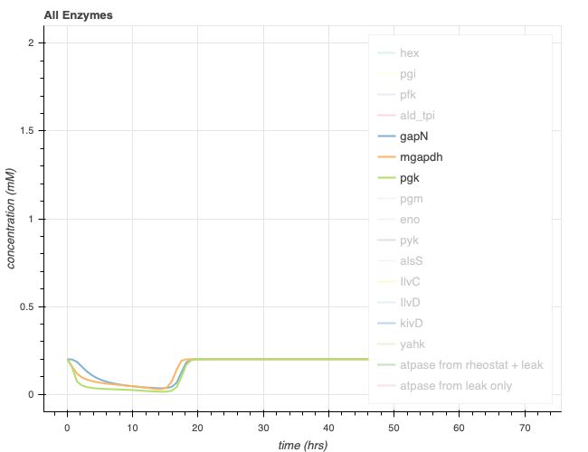
Entire Rheostat Pathway Simulation
414.6
Top glycolysis
Presence of ATP hump
Complete isobutanol production
Molecular rheostat
ATP made
No net ATP
2x NADP⁺ + P_{i}
2x NADP⁺
mGapDH
GapN
2x NADPH
2x NADPH
1,3-BPG
ADP
ATP
PGK
2x 3PG
Bottom glycolysis
Ankita Roychoudhury 8.13.2020
Isobutanol
Notes:
Hump is not entirely gone – because of ATP regeneration pathway, second half of pathway
Glucose stored in acetolactate and isobutanol because the gapN pathway is not as favored and it makes NADPH and NADPH is needed to make those reactions go forward

Slide 6
Reconsidered Modelling Approach
Full Model
CRN Mass action
(k_{bf1}, k_{br1}, k_{uf1}, k_{ur1},k_{cat1},k_{bf2},…)
Minimal Model
Coarse-grained
(k₁, k₂ = k)
Lumped parameters
Extracted from experimental data
Effective relations to help argue values of reduced model
Include assumptions
Conservation laws
QSSA
Generalize binding/unbinding
Reduced Model
(k₁, k₂,…)
More relevant to experimental data
Ankita Roychoudhury 8.13.2020
Notes:
Full model has all reaction rate parameters
This makes sense – I’ve optimized the full model, but how can I come up with some biological relevance

Slide 7
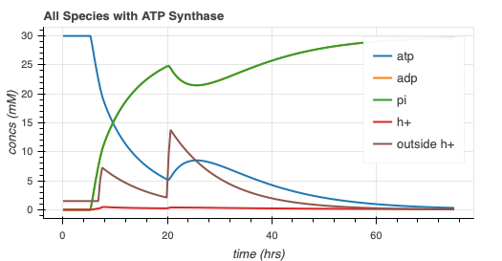
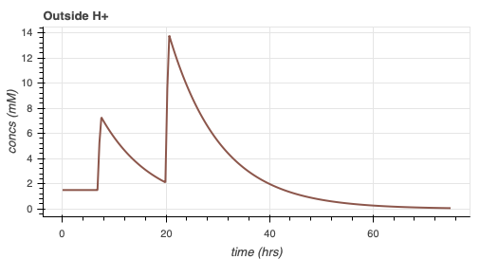
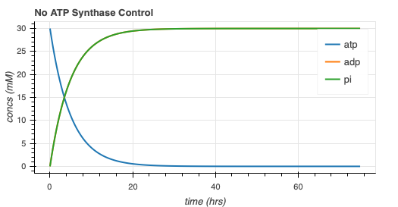
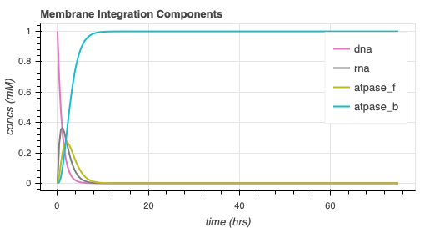
ATP Synthase Model with Gene Expression
Same dynamics, with protein membrane integration delay
Ankita Roychoudhury 8.13.2020

Slide 8
ATP synthase model progress
ATP Synthesis
If pH outside <= 8:
ATP Hydrolysis (unwanted)
If pH outside > 8:
H⁺
H⁺
ADP + Pi
ADP + Pi
ATP
TX/TL
ATP
TX/TL
H⁺
Ankita Roychoudhury 8.13.2020

Slide 9
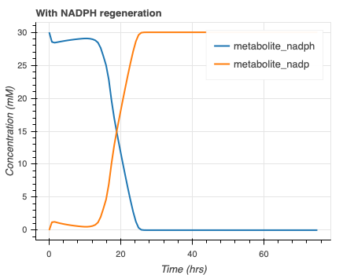
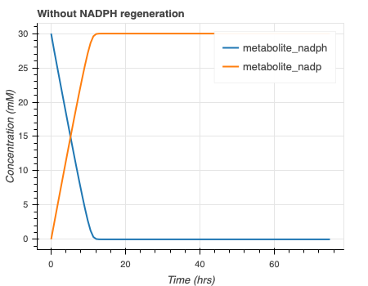
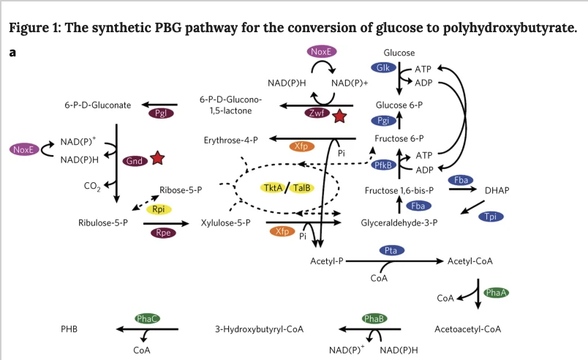
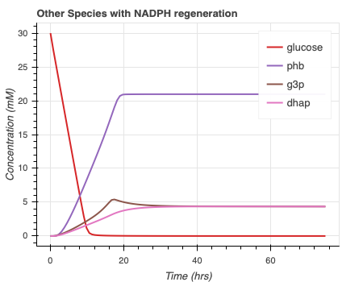
NADPH Regeneration
Opgenorth et al., Nature Chemical Biology, 2016
Ankita Roychoudhury 8.13.2020
Notes:
For albert

Slide 10
Source
Code publicly available on GitHub repository:
https://github.com/AnkitaRoychoudhury/ug_murray

