Slide 1
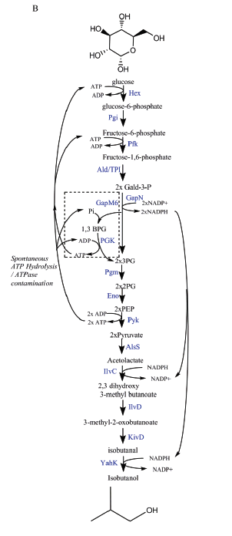
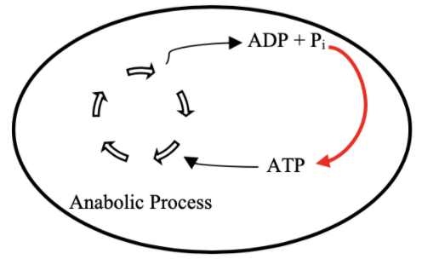

Goal: ATP Life Extension in Synthetic Cells
Proposal 1: Regeneration by Rheostat Machinery
Proposal 2: Regeneration by ATP Synthase
H⁺
ADP + Pi
TX/TL
ATP + H₂0
TX/TL
Ankita Roychoudhury
Opgenorth et al., 2017, Nature Chemical Biology

