Slide 1

Project Updates
Ankita Roychoudhury
8.12.2020
Murray Lab

Slide 2
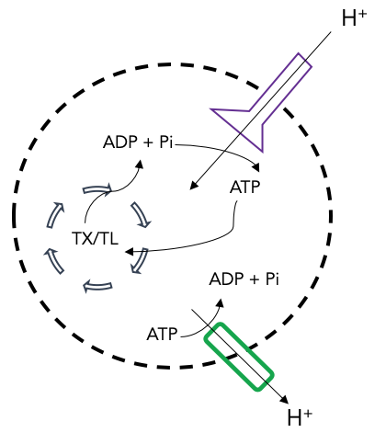
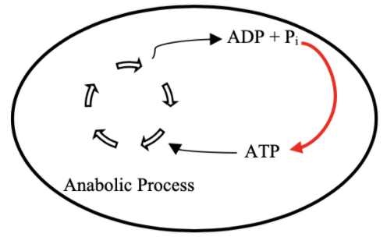
Goal: ATP Life Extension in Synthetic Cells
Proposal: Regeneration by ATP Synthase
TX/TL
Ankita Roychoudhury

Slide 3
For me
Atp regen
Plots from summer work
What I learnt
Biggest drawbacks/limitations
Experimental plans
What I hope to figure out
How I play to do it
How I will analyze difft otucomes

Slide 4

Outline
Conclusions from Summer
Experimental Plans
Ideal Figures

Slide 5
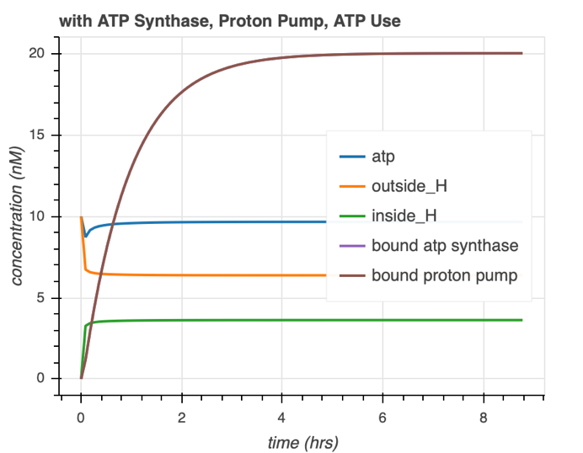
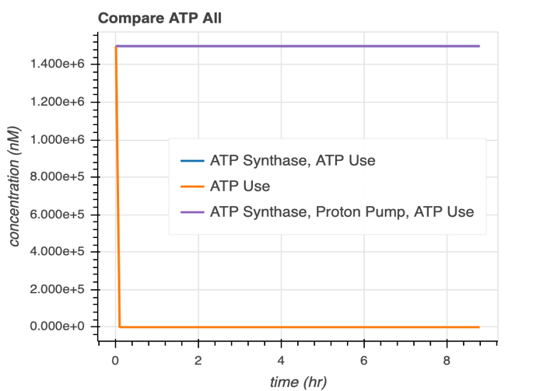
Summer Conclusion Plots ATP Synthase
ATP is regenerated and maintained. Consistent desired proton gradient at these parameters.
Proton Pump is necessary.

Slide 6
Experimental Plans
Calibration
Generate ideal curves

Slide 7
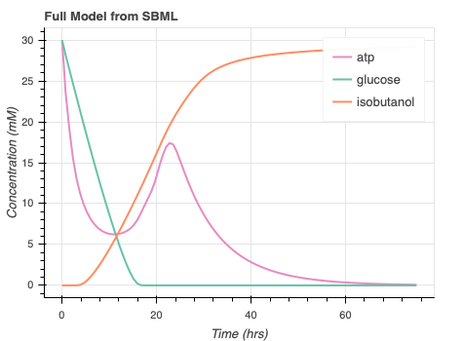
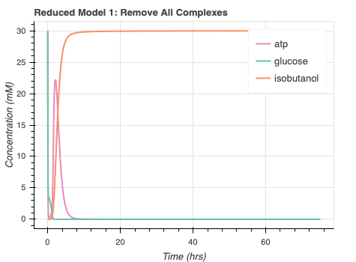
ATP Rheostat
Reduced Model:
Continue to collaborate
Ayush Pandey, R. M. Murray, biorxiv, 2020
Notes:
Benefits: lumped parameters in reduced models, lower num of params to analyze system with. Helps with parameter identification. Without data, a reduced model may be closer to phenomenological model so you can conclude things about model in easier manner because you only have the species that you care about
Param sweeps and simulations with a red model would be more about how outputs are affected by inputs bc you get rid of other states so could guide design choices
Get a better understanding of what really matters from a physical point of view – is it that a particular metabolite affects dynamics or some other species etc – can be helpful information
Am hoping that if more experiments are done with this system, parameters can be extracted and inserted into one of these reduced models compared to the full massaction model

Slide 8
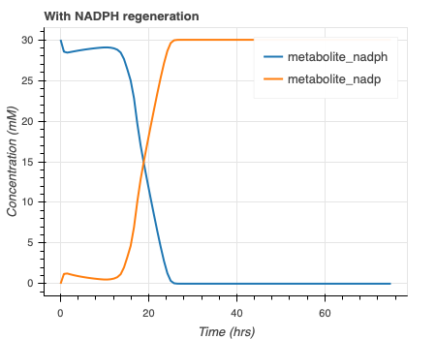
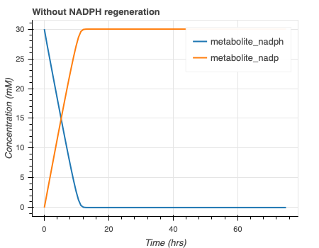
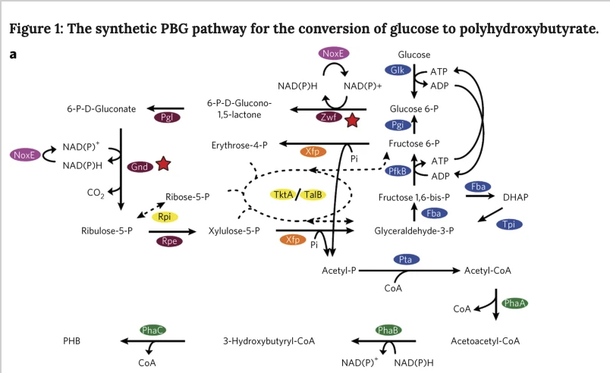
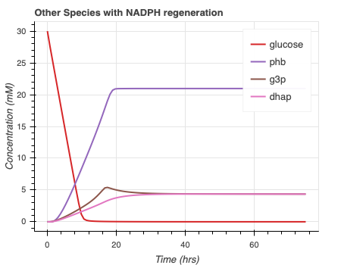
NADPH Regeneration
Opgenorth et al., Nature Chemical Biology, 2016
Notes:
For albert

Slide 9
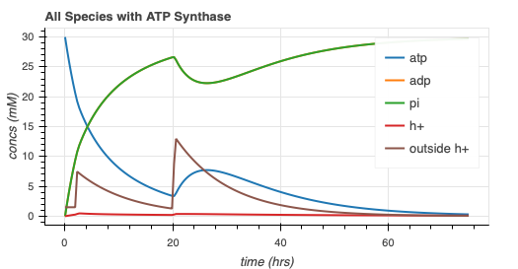
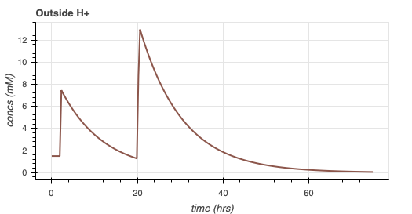
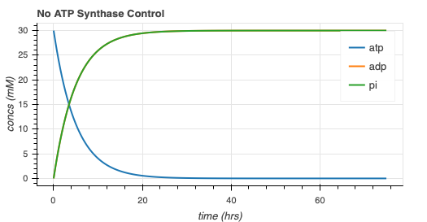
ATP synthase simulation (NO MEMBRANE INTEGRATION)

Slide 10
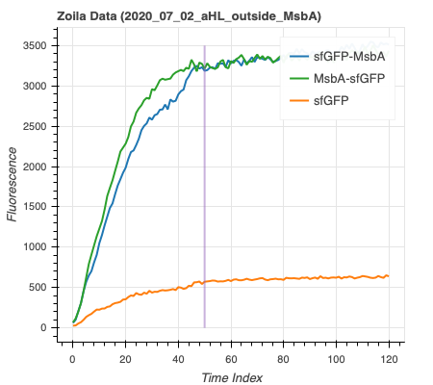
ATP Synthase Model with Gene Expression ZOILA’ DATA
Protein | Size | Dimensions
MsbA | 65 kDa, E.Coli
ATP Synthase | 27 kDa, mitochondrial | Height: 20 nm, Diameter: 10 nm
sfGFP | 26.8 kDa
Membrane integration steady state for MsbA with sfGFP around 6.5 hours
sfGFP size, FPbase superfolder gfp page
ATP Synthase Dimensions, Bionum ID: 111322
Notes:
sfgfp size - https://www.fpbase.org/protein/superfolder-gfp/

Slide 11
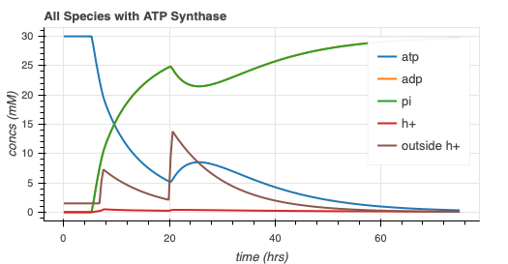
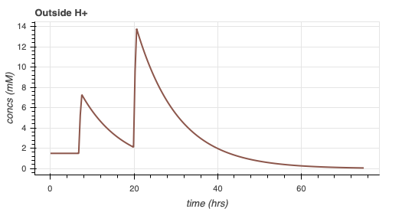
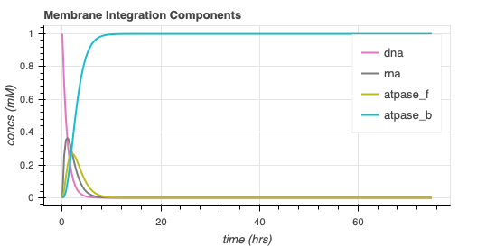
ATP Synthase Model with Gene Expression
Same dynamics, with protein membrane integration delay

Slide 12
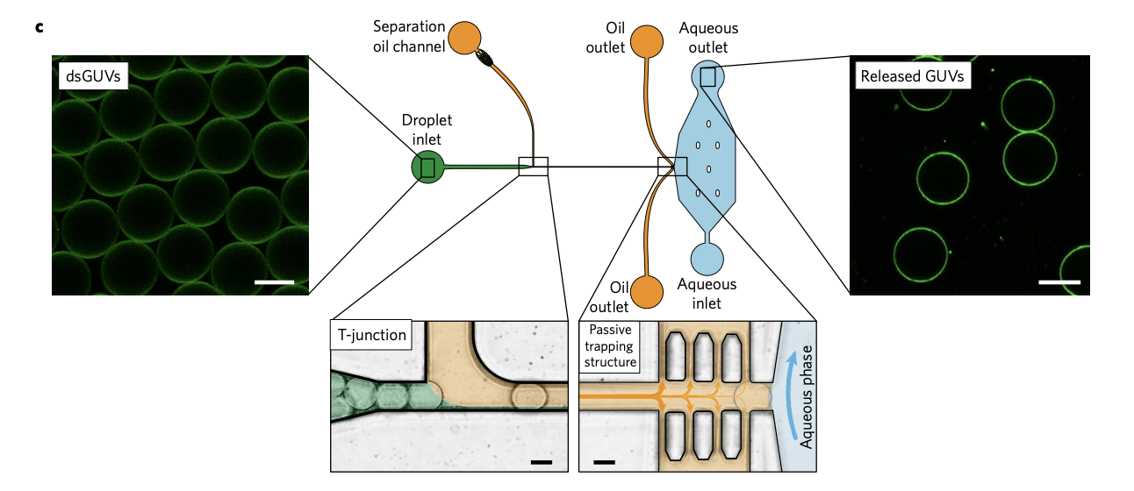
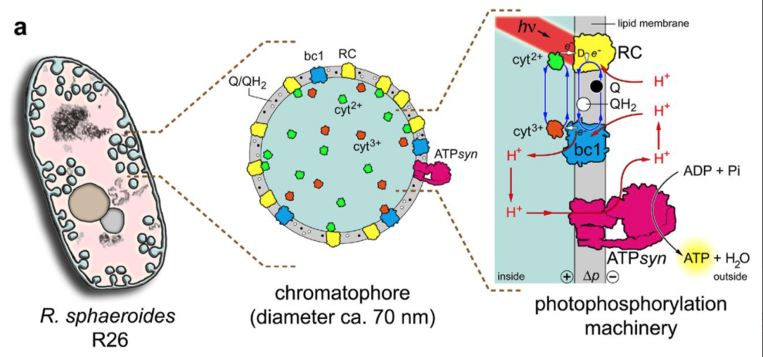
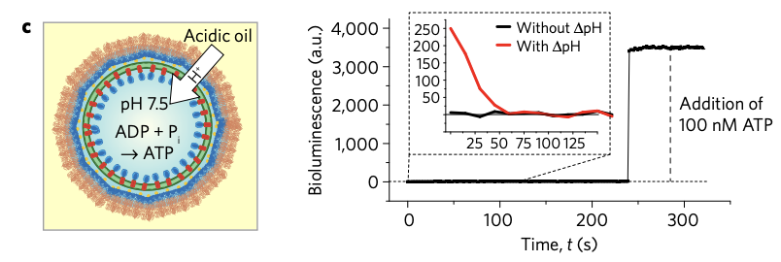
Proton Gradient Mechanisms
Mechanism | Experimental Complexity | Timescale | Comments
Buffer Medium | Low | ~45 mins | (Zgurskaya et al., 1999)
Efflux Pumps | High | ~ 2.3 hrs (Altamura et al., 2020) ~ 15 hrs (Dunlop et al.) | Photosynthetic reaction center – limited by DNA (Altamura et al. 2020)
Adding acidic oil (ex: FC40) | Medium | ~45 mins | Added to oil phase of dsGUV in microfluidic device (M. Weiss et al., 2018)
Buffer Medium
Efflux Pumps
Adding Acidic Oil
pH 6.0
pH 7.0
Notes:
Weiss (oil) - https://www.nature.com/articles/nmat5005#MOESM1
Zgurskaya (buffer) - https://pubmed.ncbi.nlm.nih.gov/10377390/
Dunlop (efflux) - https://www.ncbi.nlm.nih.gov/pmc/articles/PMC3130554/
Altamura - https://www.pnas.org/content/114/15/3837.short
Altamura et al ran out because of mrna biosynthesis (not enough nucleotides left)

Slide 13
Future directions - ATP synthase
Implement proton gradient mechanism
scipy.odeint() custom function to collaborate with BioCRNPyler (through SBML?)
Model reduction / linear stability analysis

Slide 14
Misc.
SURF presentation
Grad school update
Public/private github repo
Concerns: Zoila’s Data, Jewett lab unpublished paper, other downloaded papers
Thank you for sending the email to Dean Nye!
Return to lab plan?
Notes:
Poster or speaking? Last surf I did speaking and did a lot of poster for high school science fairs but not since

Slide 15
Fellowship | Due Date for Recommendation | Comments
Hertz Fellowship | October 2020 | Special form, specific date not yet released
DOD NDSEG | December 2020 | Specific date not yet released
Paul & Daisy Soros Fellowship | October 29 2020 2PM EDT
National Physical Science Consortium | December 2020 | Specific date not yet released
Zonta International Amelia Earhart Fellowship | November 15 2020
American Association of University Women | November 1 2020 December 1 2020
Society of Women’s Engineers | Released in December 2020 | Specific due date not yet released
School | Due Date for Recommendation | Comments
UCSF/Berkeley (and joint) * | N/A (De 1 2020) | Bioengineering
Stanford * | N/A (Dec 1 2020) | Bioengineering
Harvard * | N/A/ (Dec 2020) | Wyss Institute/ Bioengineering/ Systems, Synthetic, and Quantitative Biology
JHU * | Dec 1 2020 | Biomedical Engineering (through School of Medicine and Whiting School of Engineering)
MIT * | N/A (Dec 15 2020) | Biological engineering
Yale | Dec 15 2020 | Biomolecular engineering
Northwestern | Dec 15 2020 | Biomedical engineering
Duke | Dec 15 2020 | Biomedical engineering
Rice | Dec 15 2020
Princeton | Dec 1 2020 | Chemical and Biological Engineering
Notes:
Caltech?
quantitative biology, caltech jenning nanotech

Slide 16
Thank You!
William Poole
David Garcia
Ayush Pandey
Zoila Jurado
Manisha Kapasiawala
Melissa Takahashi
Richard Murray
Samuel P. and Frances Krown SURF Fellow

