Slide 1
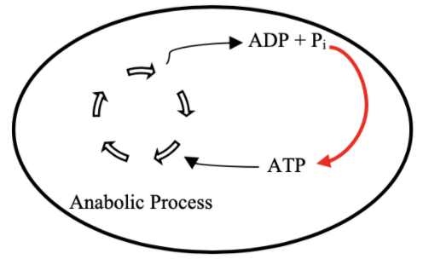
ATP Life Extension in Synthetic Cells
TX/TL
Ankita Roychoudhury
Lab Meeting
8.25.2020

Slide 2
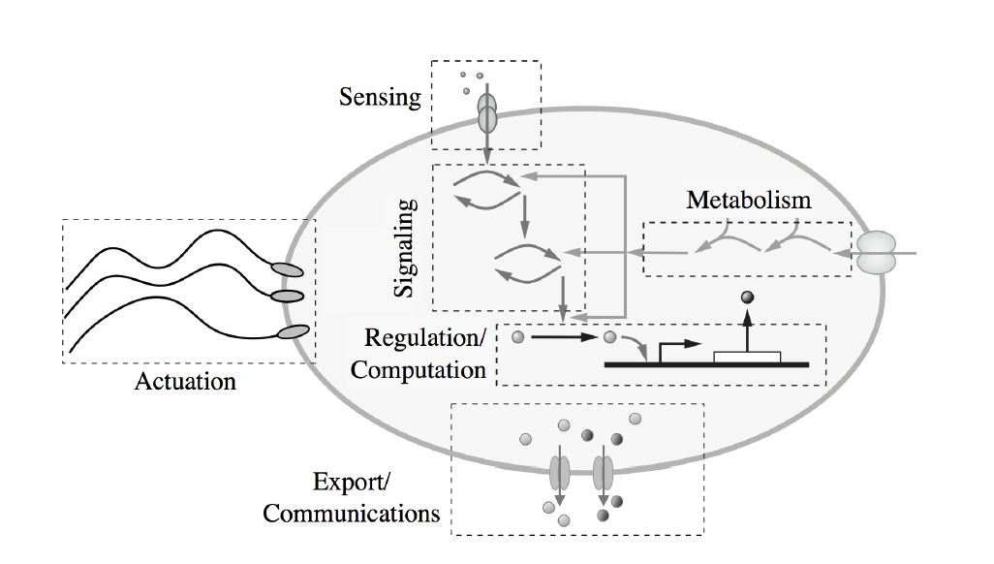

Motivation
Escherichia Coli
Synthetic Cell
Tx
Tx
Tl
Tl

Slide 3
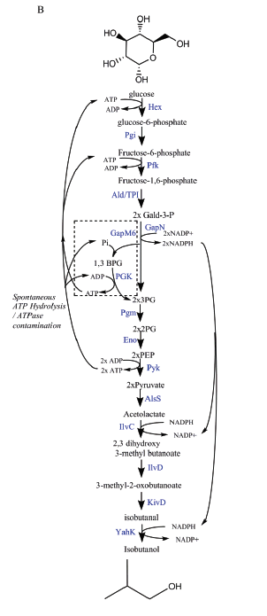
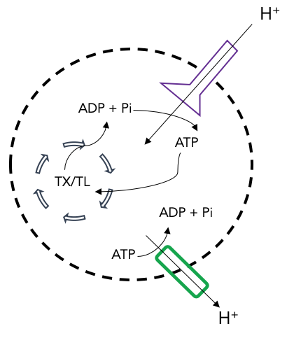
Proposal 1: Regeneration by Rheostat Machinery
Proposal 2: Regeneration by ATP Synthase
Goal: ATP Life Extension in Synthetic Cells
TX/TL
Opgenorth et al., Nature Chemical Biology, 2017

Slide 4


Software Workflow
Design Model
Output!
Bioscrape

Slide 5
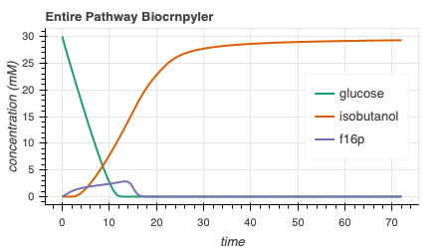
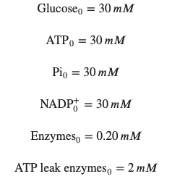

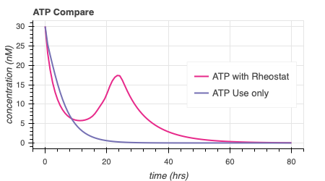
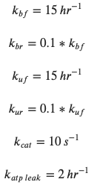
Rheostat Model Output
414.6

Slide 6
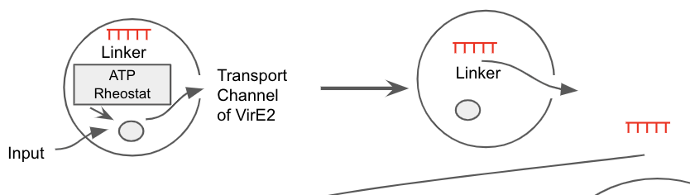
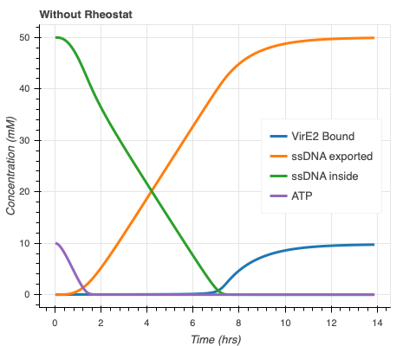
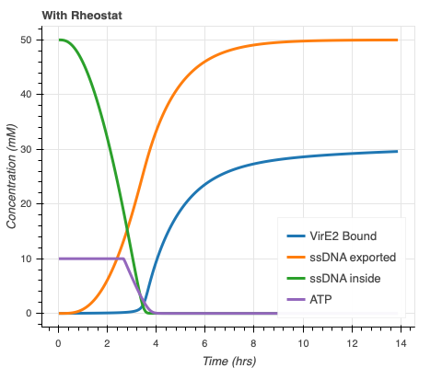
Rheostat Model + ssDNA Export Model
Concentration (nM)
Concentration (nM)
Faster ssDNA export and more bound VirE2!
Export model courtesy of Agrima Deedwania (IIT Delhi)

Slide 7
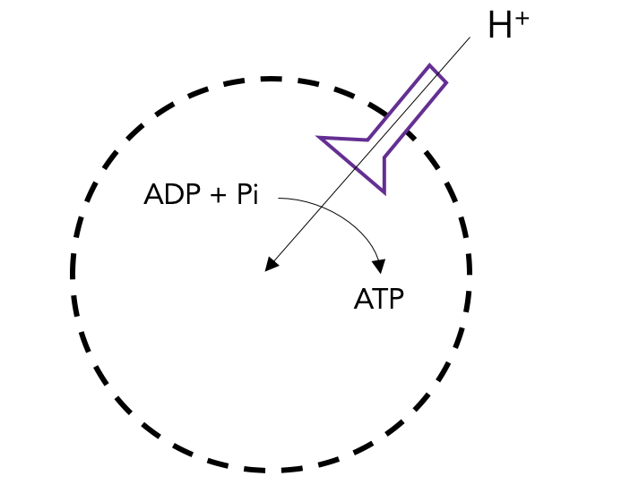
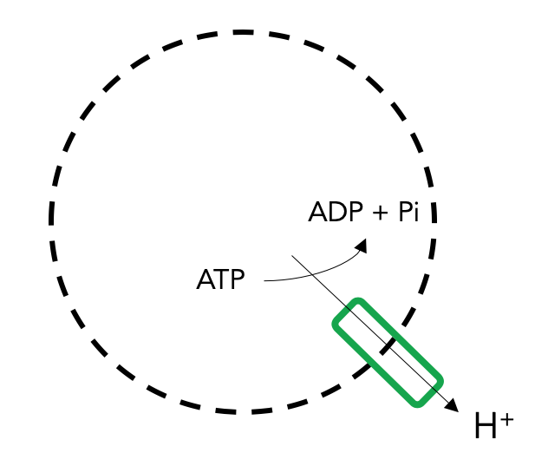
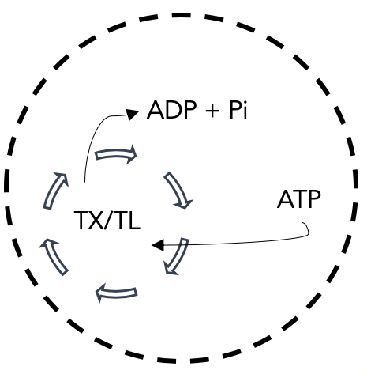
ATP Synthase Components
ATP Synthase Transcription & Translation
ATP Synthase Membrane Integration
ATP Synthesis through ATP Synthase
ATP Synthesis
Proton Pump Transcription & Translation
Proton Pump Membrane Integration
Proton movement through Proton Pump
Maintain Proton Gradient
ATP Use
ATP Hydrolysis
Notes:
Proton pump = Plasma membrane H+-ATPase
P-type proton ATPase
found in the plasma membrane of plants, fungi, protists and many prokaryotes.

Slide 8
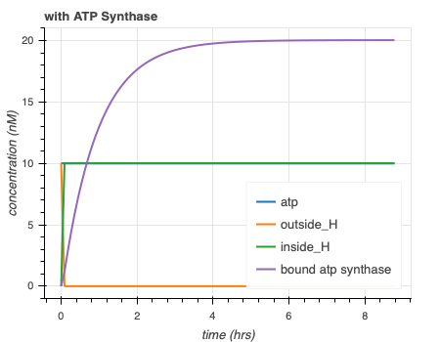
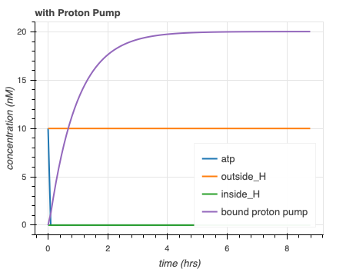
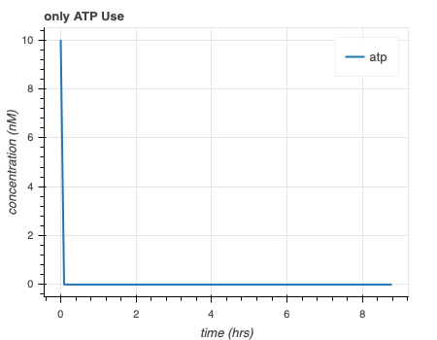
Separate simulations for ATP synthase model are as expected
Initial Conditions - Tx/Tl Machinery, outside_H, dna for protein, ATP: 10 nM
H⁺
ADP + Pi
ADP + Pi
ADP + Pi
TX/TL
ATP
ATP
ATP
H⁺

Slide 9
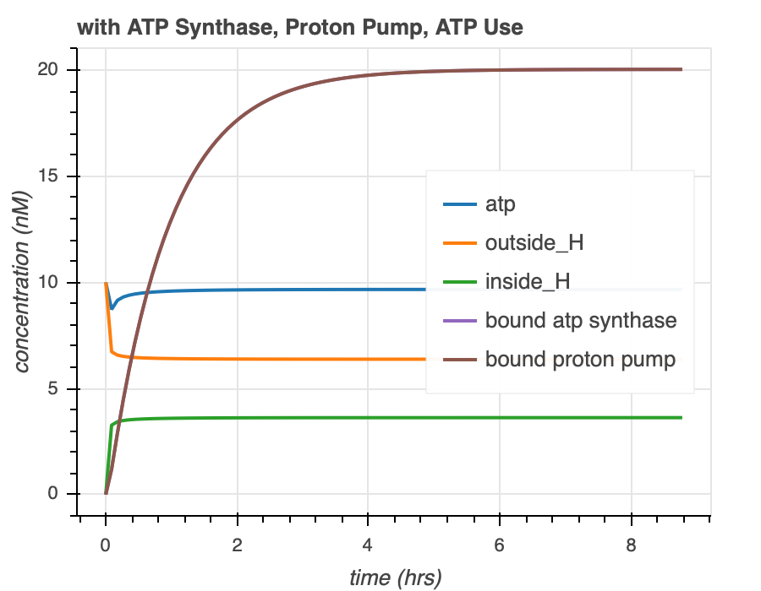
Combined simulations for ATP Synthase Model
H⁺
ADP + Pi
ATP
TX/TL
ADP + Pi
ATP
H⁺

Slide 10
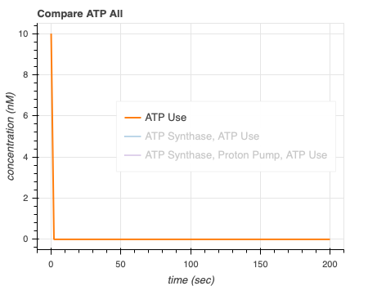
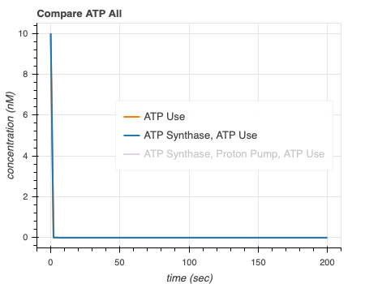
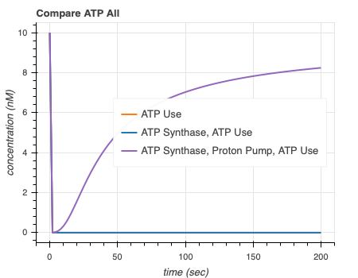
ATP synthase simulations show that proton pump is necessary to extend ATP lifetime
Notes:
Recheck plots

Slide 11
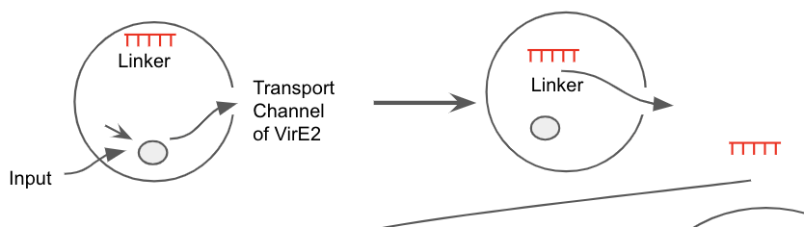
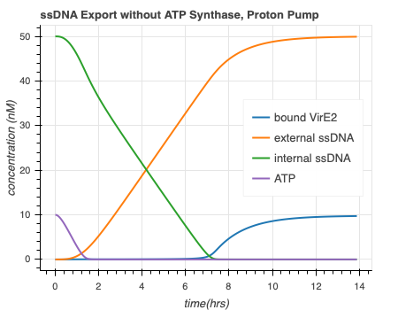
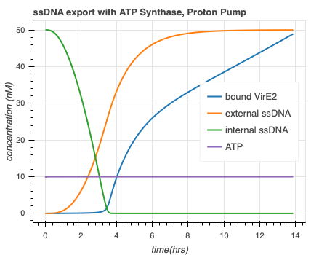
ATP Synthase Model + ssDNA Export Model
ATP
Faster ssDNA export and more bound VirE2!
Export model courtesy of Agrima Deedwania (IIT Delhi)

Slide 12
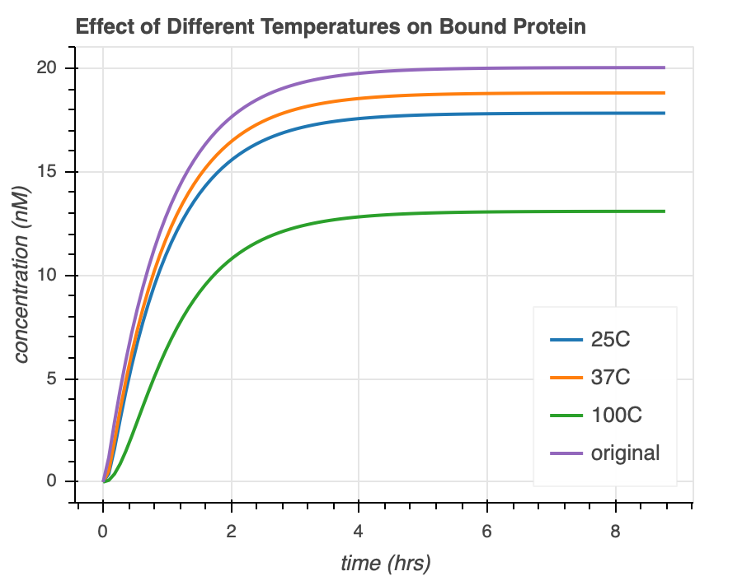
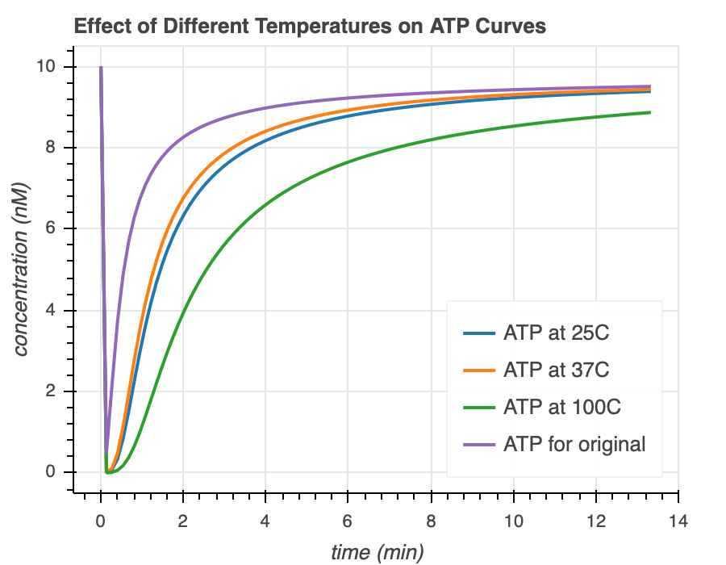
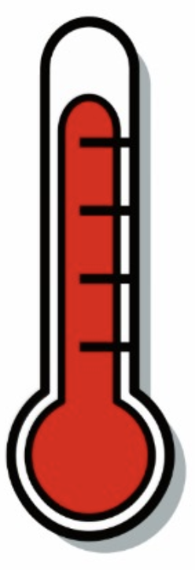
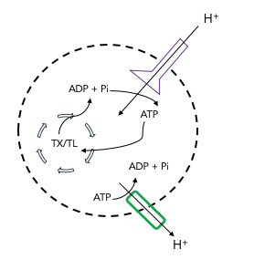

ATP Synthase Model + Temperature Dependence
Temperature Sensitive
Protein Folding
Membrane Integration
DNA
RNA
Temperature rate equation courtesy of Ayush Venkatesh Bindlish (IIT Delhi)

Slide 13
Thank you!
TX/TL
Ayush Pandey
William Poole
David Garcia
Manisha Kapasiawala
Zoila Jurado
Agrima Deedwania
Ayush Bindlish
Richard Murray
Murray Lab!
Samuel P. and Frances Krown SURF Fellow

Slide 14
Summary
Goal
TX/TL
ATP Synthase
ATP Rheostat
Mechanisms
ssDNA export
Temperature Sensitive
ssDNA export
Tests

