Slide 1
E-commerce Analysis
Navigating the Future of Online Shopping
Target Dataset Exploration: An SQL and Python Approach
Internship Project Presentation
~By Ankita Sarkar

Slide 2
1. Project Overview
Objective: analyze and visualize business, sales, product, seller, payment and customer metrics using SQL and Python.
Source data: customers, sellers, orders, order items, payments, products and geolocation datasets.
SQL was used for relational analysis and business queries in MySQL Workbench.
Python (Pandas + Matplotlib) was used for data preparation, analysis and visualization in Google Collab.
The analysis follows the Basic, Intermediate and Advanced questions specified in the internship brief.
Python + SQL E-commerce Analysis

Slide 3
2. Executive Summary
4,119
Customer cities
45,101
Orders in 2017
51.5%
Orders with installments
2.8%
6-month retention
Health & Beauty generated the highest category sales at 1,258,681 in item-price revenue.
São Paulo had the largest customer base with 40,302 unique customers.
January recorded 7,269 orders in 2018; September and October are partial in the source data.
Sales increased from 6,155,807 in 2017 to 7,386,051 in 2018, a 19.99% YoY increase.
Product price vs purchase count correlation was -0.032, indicating a very weak linear relationship.
Python + SQL E-commerce Analysis

Slide 4
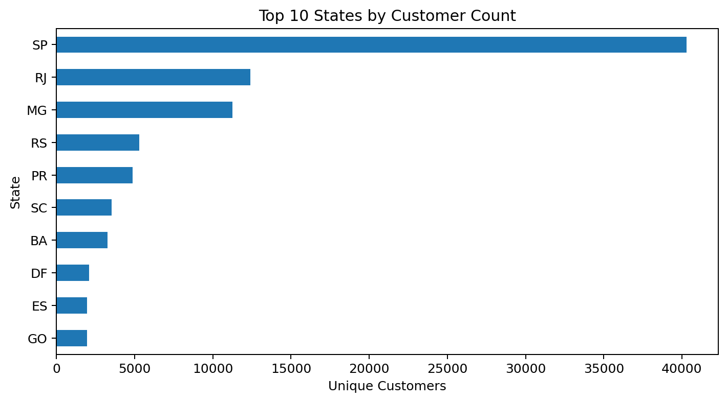
3. Customer Geography
São Paulo (SP): 40,302 unique customers.
Rio de Janeiro (RJ): 12,384.
Minas Gerais (MG): 11,259.
The customer base is concentrated in a small group of major states.
State-level segmentation can support future marketing, service and regional performance analysis.
Python + SQL E-commerce Analysis

Slide 5
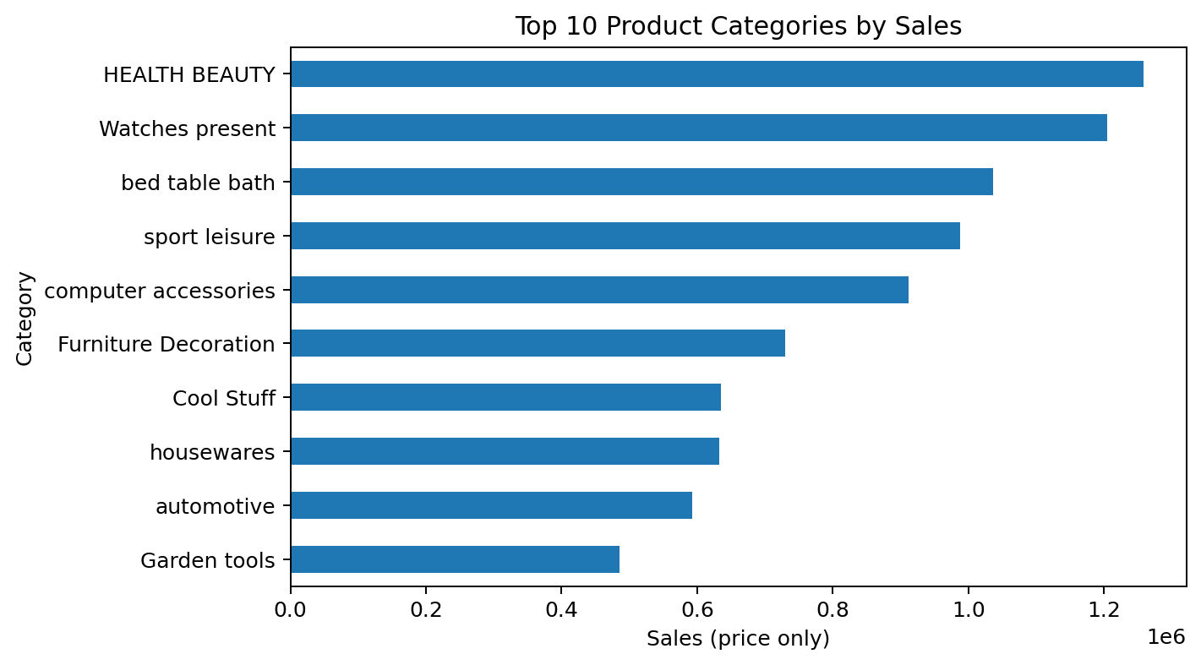
4. Sales and Product Category Performance
Top category: Health & Beauty — 1,258,681 (9.3% of item-price sales).
Second: Watches present — 1,205,006 (8.9%).
Third: Bed Table Bath — 1,036,989 (7.6%).
Category contribution is uneven, with several leading categories accounting for a substantial share of sales.
Revenue is defined as SUM(order_items.price); freight is analyzed separately.
Python + SQL E-commerce Analysis

Slide 6
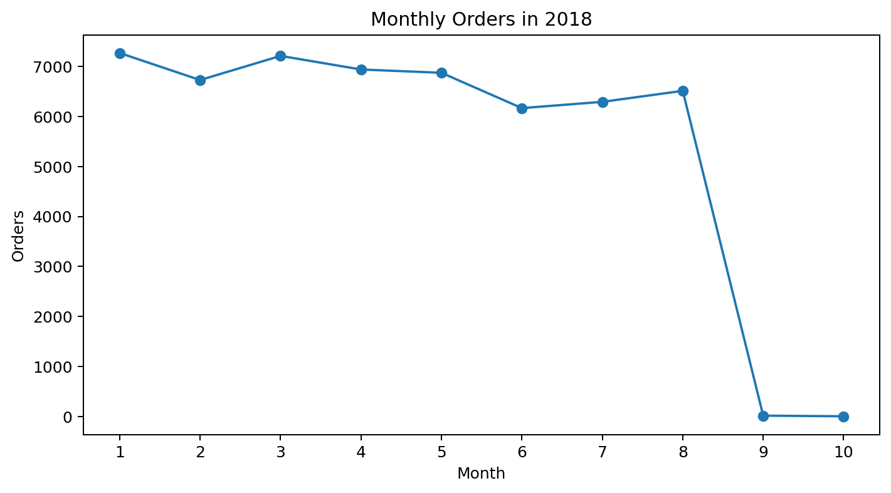
5. Order Trend — 2018
January had the highest available monthly order count: 7,269.
June recorded 6,167 orders and July 6,292.
September and October contain very few records because the source dataset ends during October 2018.
The late-2018 decline should therefore not be interpreted as a full-month demand decline.
Python + SQL E-commerce Analysis

Slide 7
6. Payment Behavior
51.46%
Orders paid in installments
99,440
Orders represented in payments
Installment order = payment_installments > 1.
Distinct order IDs are used so multiple payment records for one order are not double-counted.
Installment usage is a meaningful part of the payment behavior observed in the dataset.
This metric can support future analysis of payment-method preference and customer purchase behavior.
Python + SQL E-commerce Analysis

Slide 8
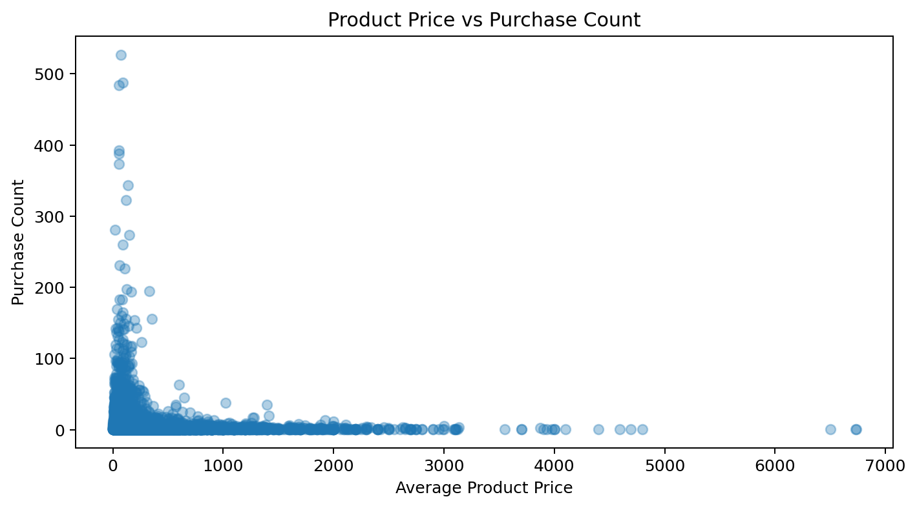
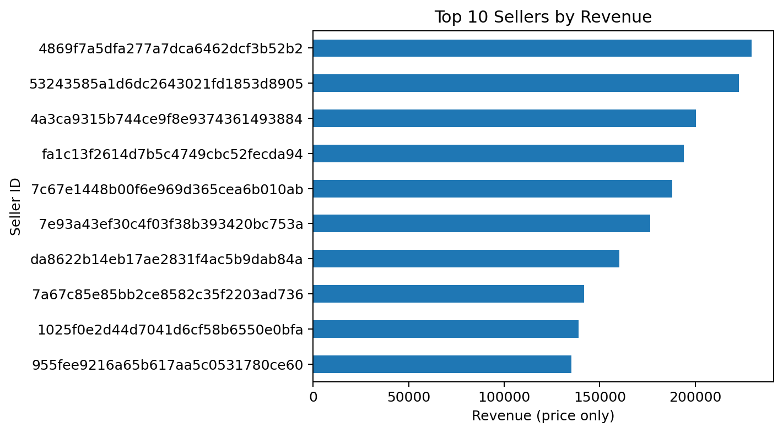
7. Product and Seller Performance
Price vs purchase-count correlation: -0.032, indicating a very weak linear relationship.
Top seller by item-price revenue: 4869f7a5dfa277a7dca6462dcf3b52b2 with 229,473.
Seller revenue is calculated from order-item price and ranked across sellers.
The seller analysis highlights substantial variation in sales contribution.
Python + SQL E-commerce Analysis

Slide 9
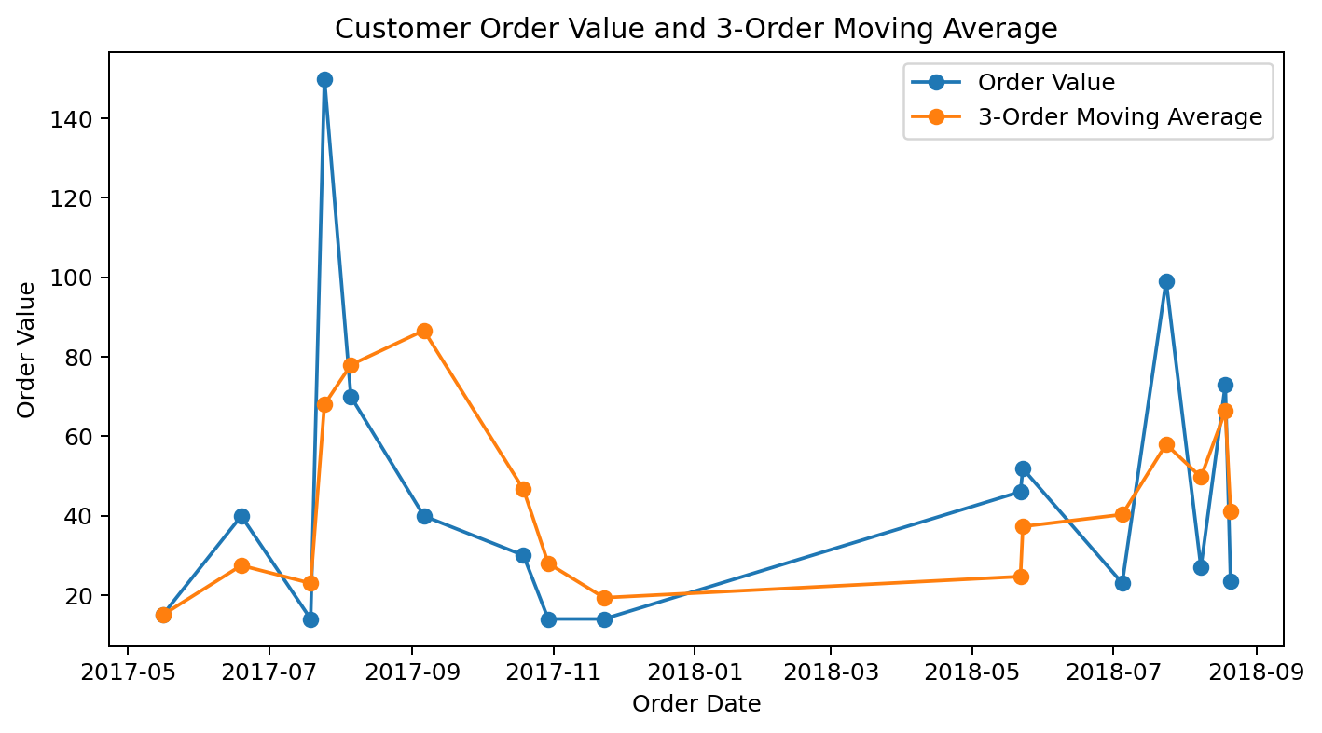
8. Customer Order History — Moving Average
Customer history uses customer_unique_id so repeat purchases are grouped under the same customer.
A 3-order rolling window is used for the moving average.
Early observations use a partial window; later observations use up to the previous three orders.
The moving average smooths order-value fluctuations and makes changes in customer spending easier to inspect.
Python + SQL E-commerce Analysis

Slide 10
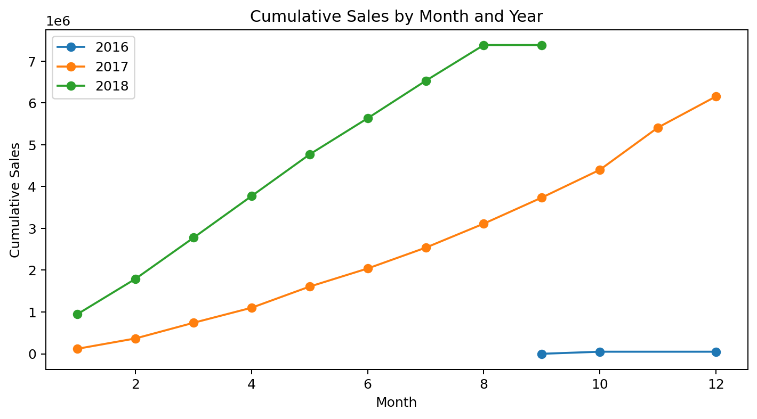
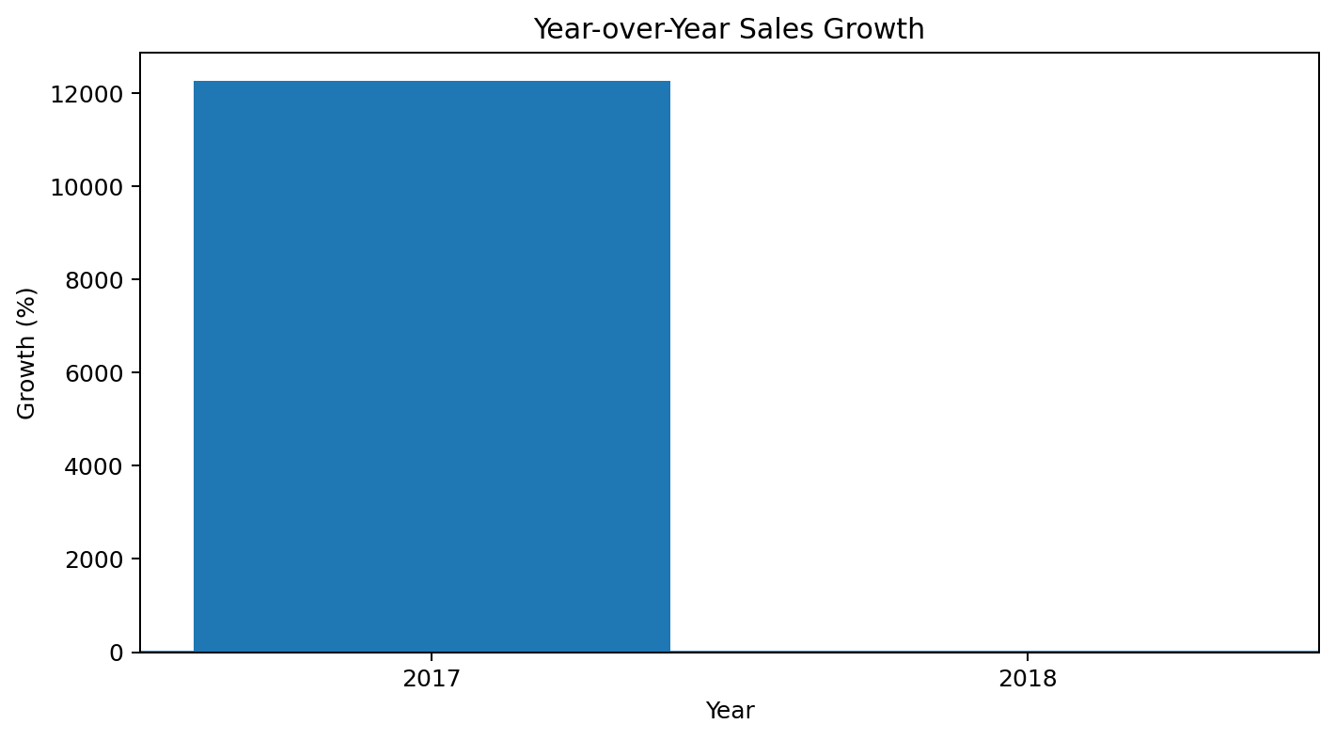
9. Cumulative Sales and YoY Growth
2017 item-price sales: 6,155,807.
2018 item-price sales: 7,386,051.
2018 YoY growth: 19.99%.
The 2016-to-2017 growth percentage is unusually large because 2016 contains only a small partial period.
Python + SQL E-commerce Analysis

Slide 11
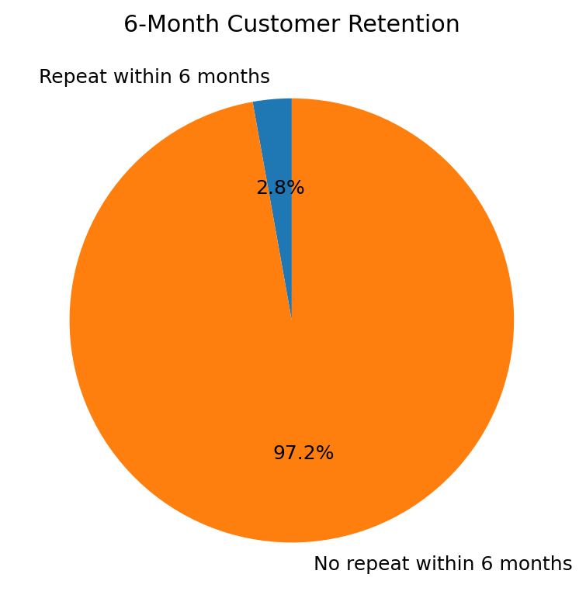
10. Customer Retention and Top Spenders
Eligible customers with a full 6-month observation window: 55,364.
Customers making another purchase within 6 months: 1,560.
6-month retention rate: 2.82%.
Retention is based on delivered orders and excludes first purchases too close to the dataset end.
Top-spender analysis identifies the top three unique customers separately for each year.
Year | Rank | Customer ID | Spend
2016 | 1 | fdaa290acb9e… | 1,399
2016 | 2 | 753bc5d6efa9… | 1,300
2016 | 3 | b92a2e5e8a6e… | 1,199
2017 | 1 | 0a0a92112bd4… | 13,440
2017 | 2 | da122df9eedd… | 7,388
2017 | 3 | dc4802a71eae… | 6,735
2018 | 1 | 763c8b1c9c68… | 7,160
2018 | 2 | 459bef486812… | 6,729
2018 | 3 | 5d0a2980b292… | 4,600

Slide 12
11. Methodology, Assumptions and Conclusion
Data model: customers → orders → order_items → products/sellers; payments linked through order_id.
Sales metric: SUM(order_items.price). Freight is excluded from revenue unless explicitly stated.
Customer-level analysis uses customer_unique_id to capture repeat purchases correctly.
Missing product categories are grouped as 'Unknown'; missing delivery dates are retained rather than fabricated.
Retention: another delivered purchase within six months of first purchase, with a full six-month observation window.
2018 monthly order analysis accounts for the partial September/October coverage in the source data.
Conclusion: the dataset shows strong growth into 2018, concentrated customer geography, differentiated category and seller performance, and relatively limited repeat purchasing within six months.
Prepared using MySQL Workbench, Pandas and Matplotlib

Slide 13
Thank You

