Slide 1
E-commerce Analysis
Project: E-Commerce Sales & Customer Analysis
Tools: SQL & Python
Focus: Data Analysis, Business Insights & Cross-Tool Validation
~By Ankita Sarkar

Slide 2
1. Project Overview
This project analyzes an e-commerce dataset to understand customer behavior, sales performance, product performance, and purchasing patterns using both SQL and Python.
The same analytical questions were solved independently using SQL queries and Python-based data analysis.
2.Objectives
  Analyze customer and order information.
  Evaluate sales and product-category performance.
  Identify customer purchasing patterns.
  Perform advanced sales and customer analysis.
  Reproduce SQL analysis using Python.
  Compare SQL and Python outputs for consistency and accuracy.
  Validate that both approaches produce equivalent results.

Slide 3


2. Executive Summary
4,119
Customer cities
45,101
Orders in 2017
51.5%
Orders with installments
2.8%
6-month retention
  Health & Beauty generated the highest category sales at 1,258,681 in item-price revenue.
  São Paulo had the largest customer base with 40,302 unique customers.
  January recorded 7,269 orders in 2018; September and October are partial in the source data.
  Sales increased from 6,155,807 in 2017 to 7,386,051 in 2018, a 19.99% YoY increase.
  Product price vs purchase count correlation was -0.032, indicating a very weak linear relationship.
Python + SQL E-commerce Analysis

Slide 4
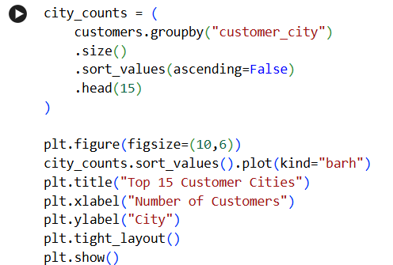
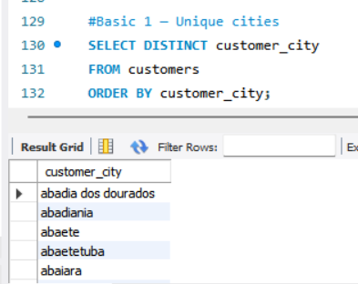
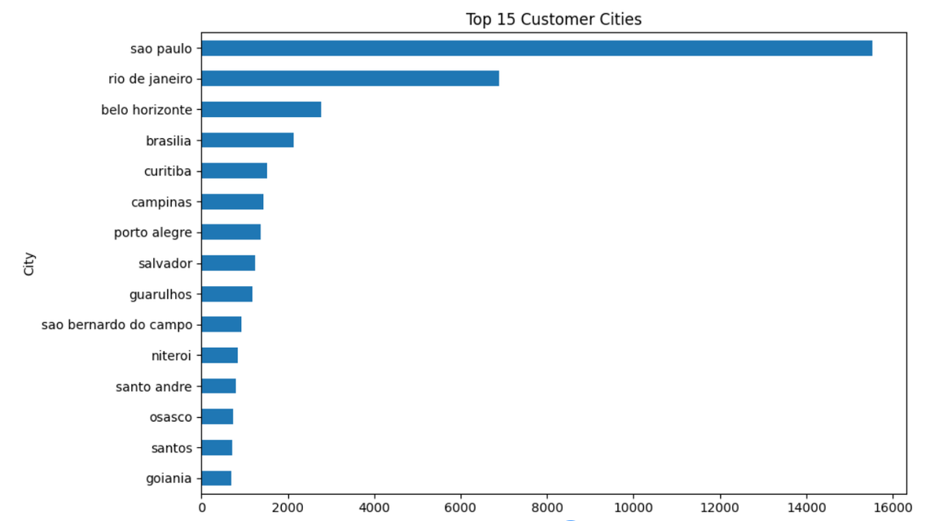
BASIC 1 — Unique Cities Where Customers Are Located
Python + SQL E-commerce Analysis

Slide 5
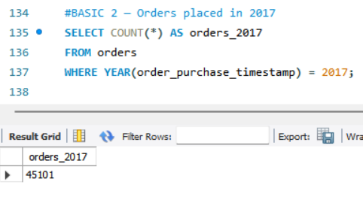
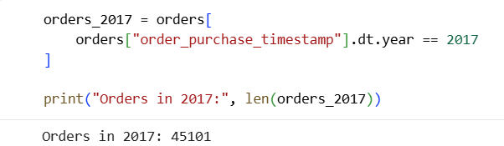
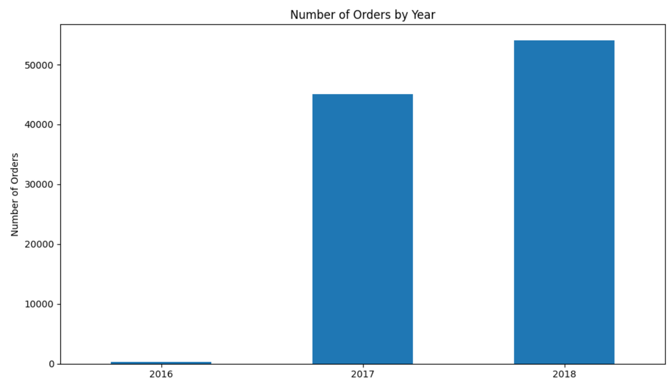
Basic-2 Number of Orders Placed in 2017
Approach:
Filter orders using the 2017 date range and count the resulting orders. The same date filter and counting logic are applied in Python.

Slide 6
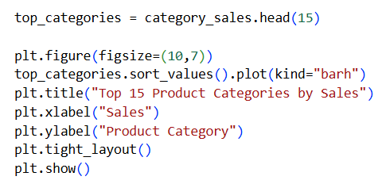
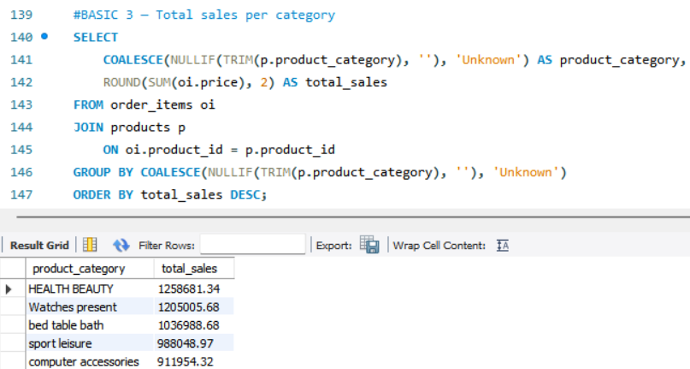
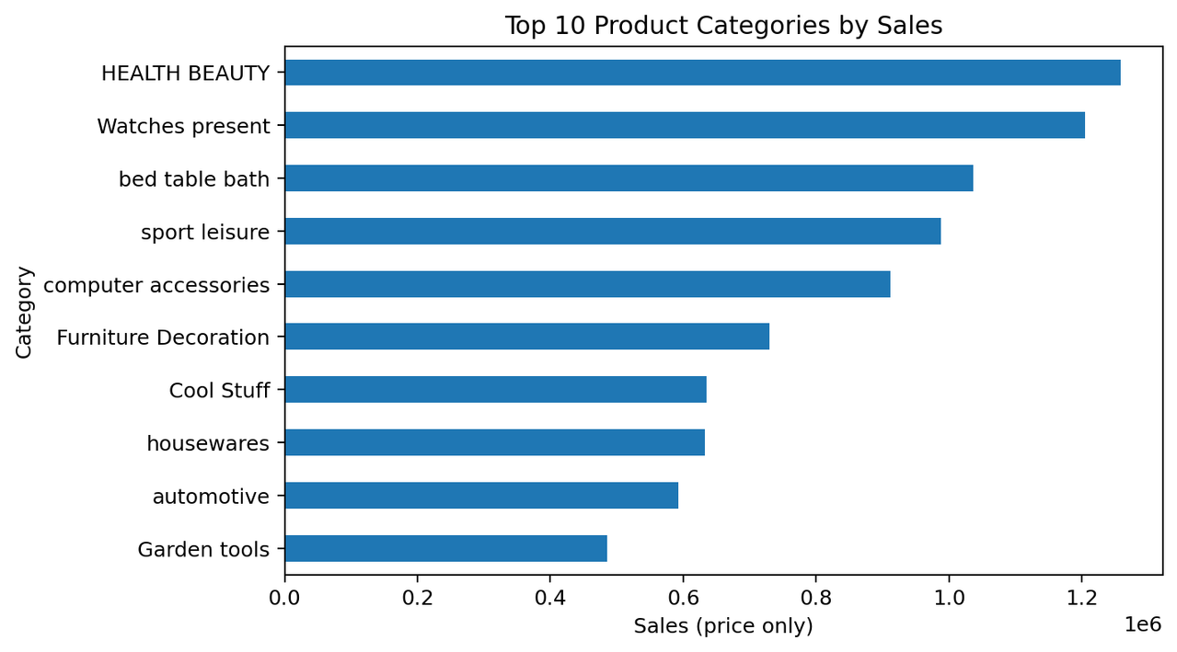
BASIC 3 — Total sales per category

Slide 7
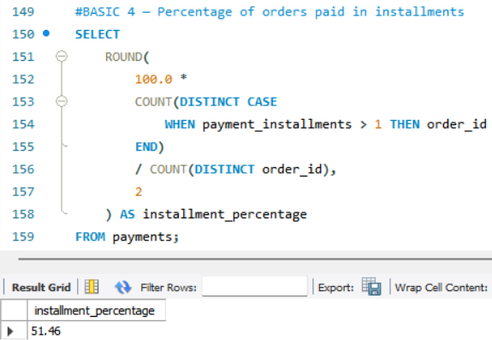
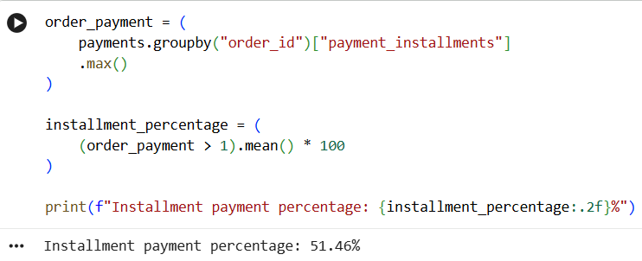
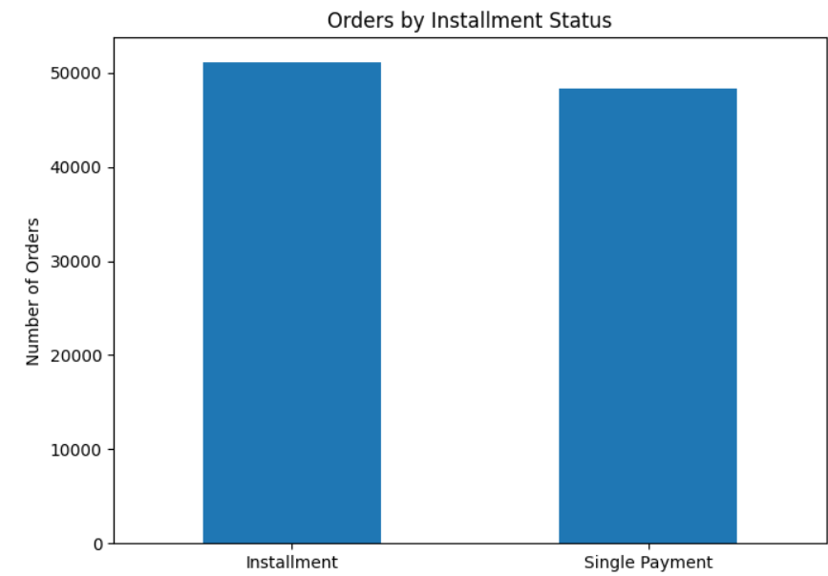
BASIC 4 — Percentage of orders paid in installments

Slide 8
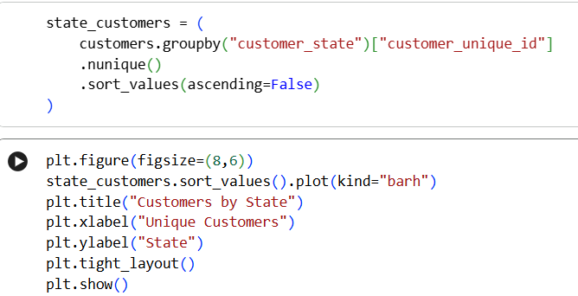
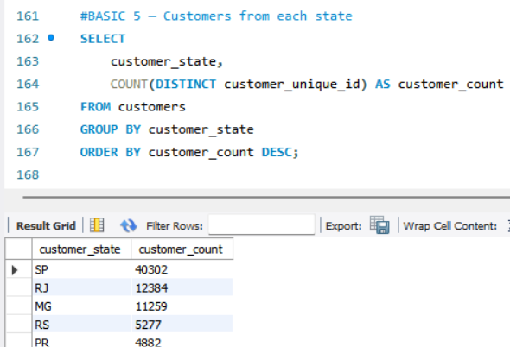
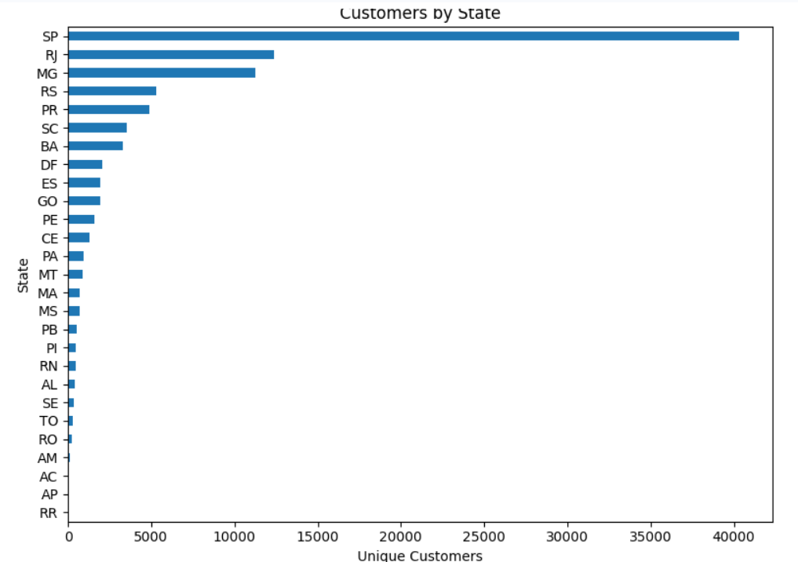
BASIC 5 — Customers from each state

Slide 9
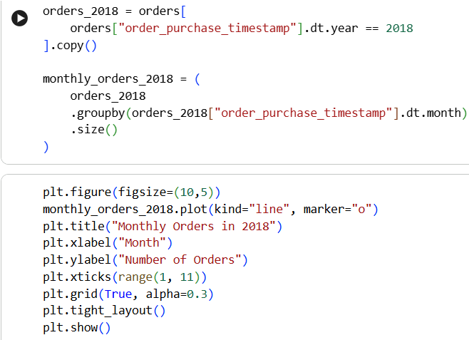
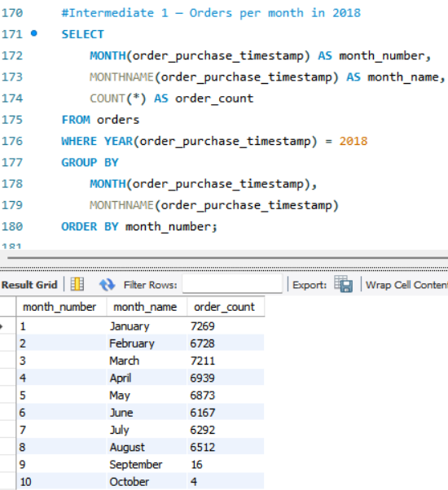
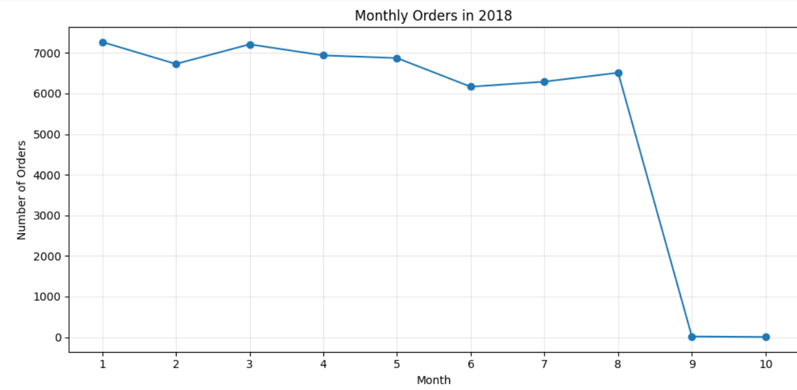
Intermediate 1 — Orders per month in 2018

Slide 10
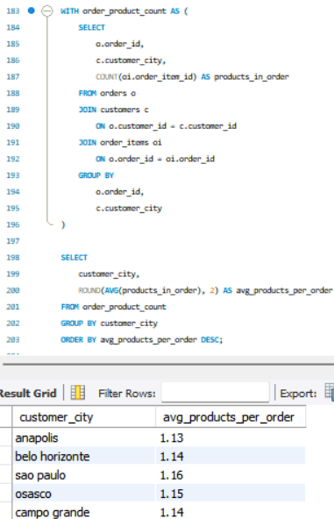
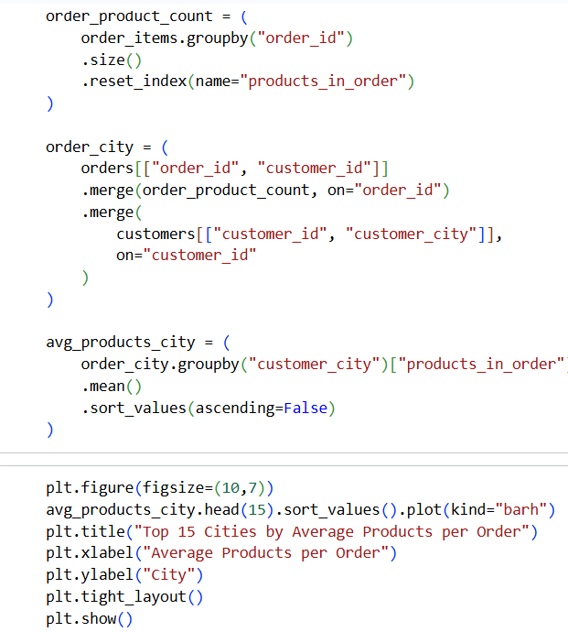
Intermediate 2 — Average products per order by customer city

Slide 11
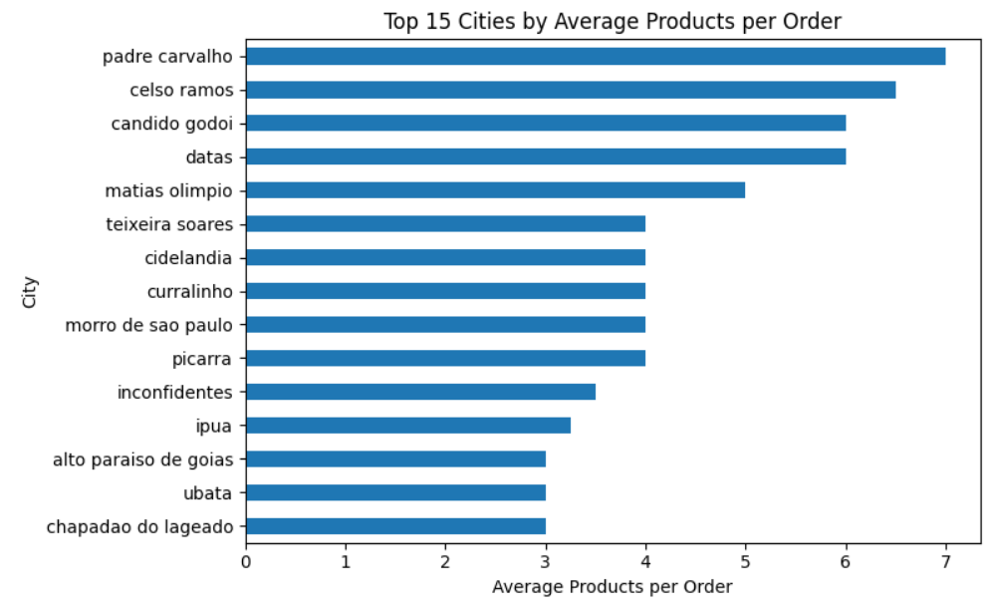
Intermediate 2 — Average products per order by customer city

Slide 12
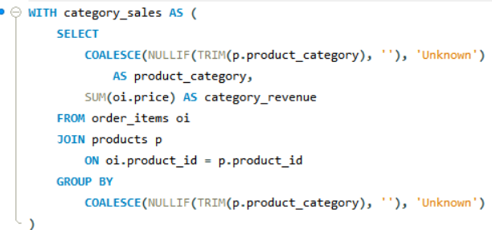
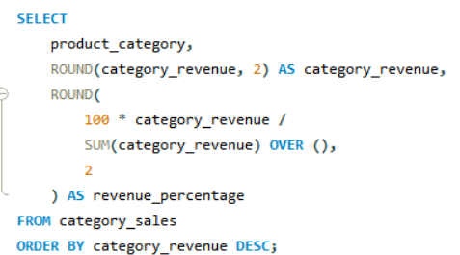
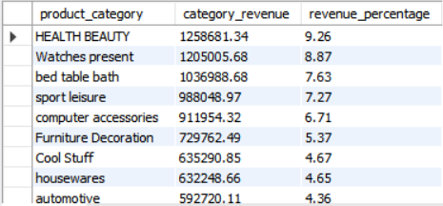
Intermediate 3 — Revenue percentage by category-by SQL
Approach: Join order items with product categories and aggregate the item prices by category. The same merge and aggregation logic is reproduced in Python.

Slide 13
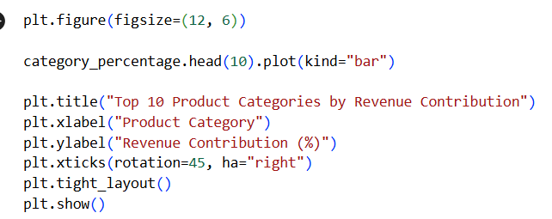
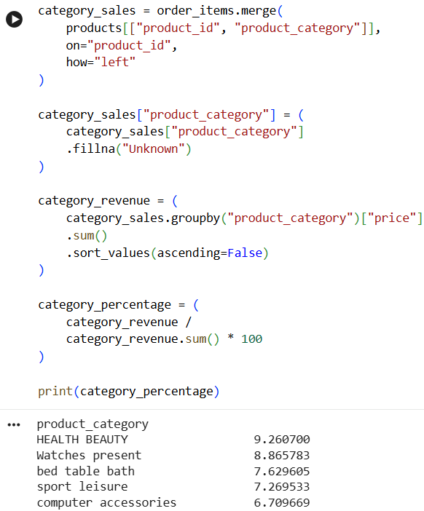
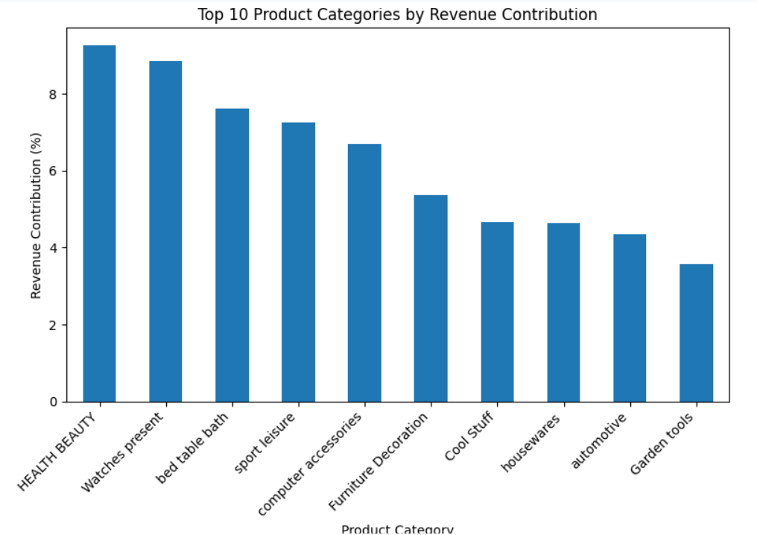
Intermediate 3 — Revenue percentage by category-BY Python

Slide 14
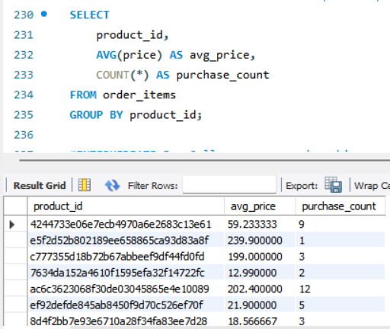
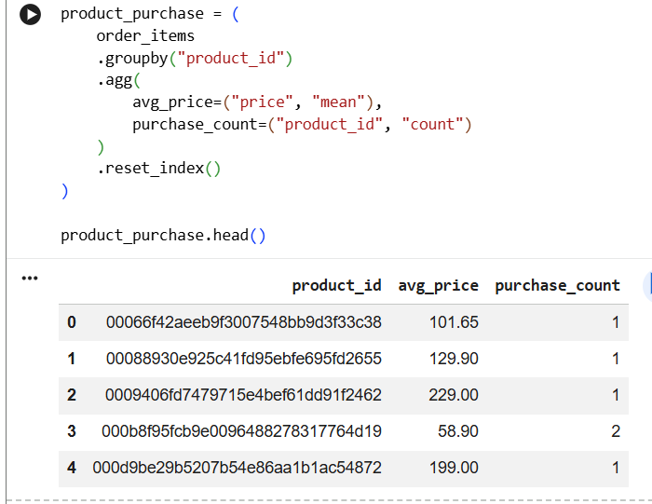
INTERMEDIATE 4 — Correlation between product price and purchase count

Slide 15
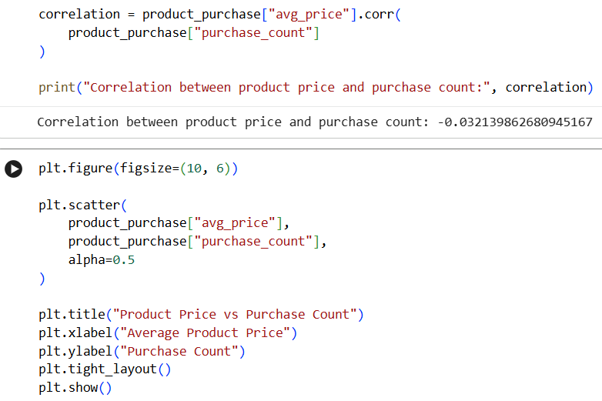
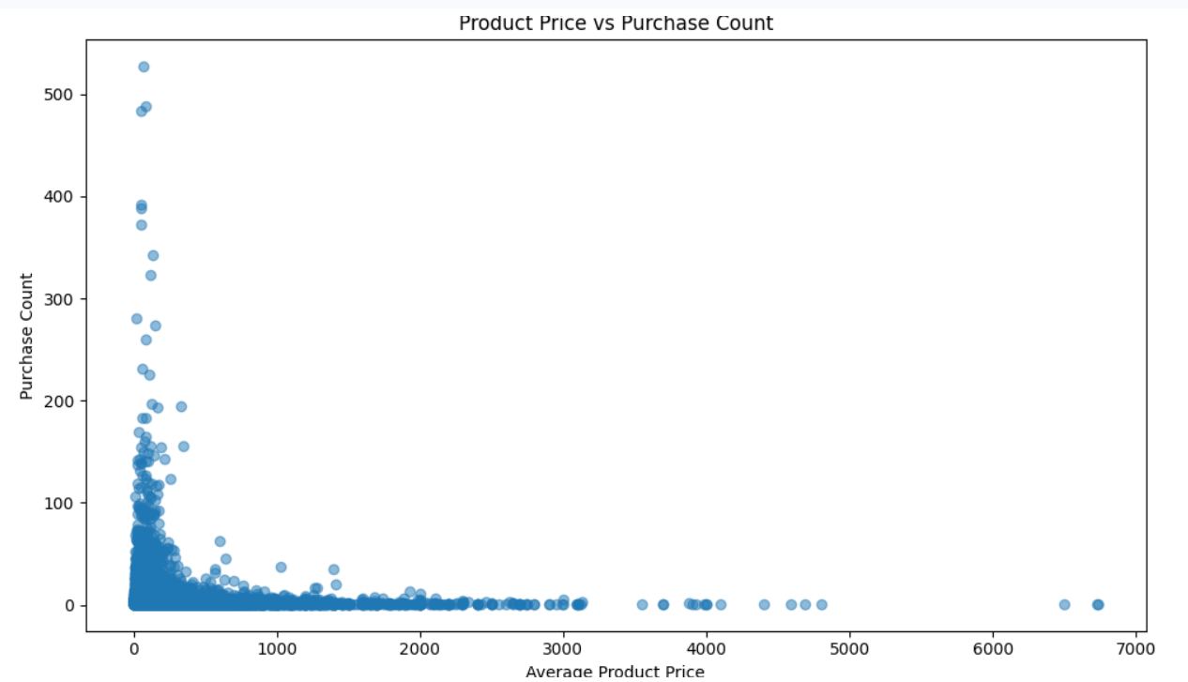
INTERMEDIATE 4 — Correlation between product price and purchase count

Slide 16
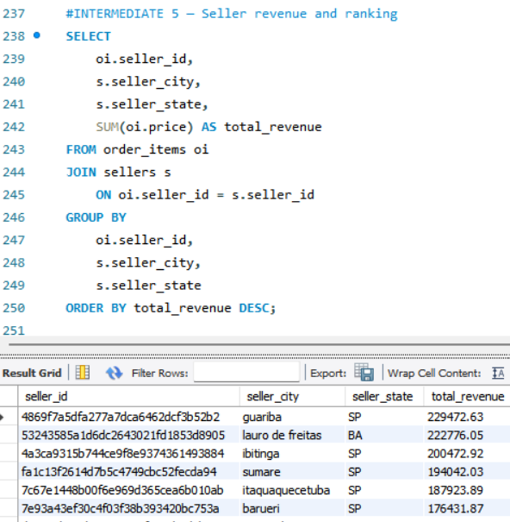
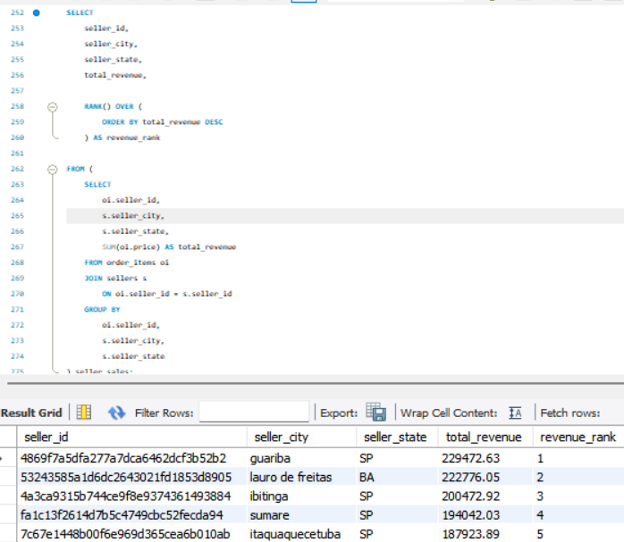
INTERMEDIATE 5 — Top 3 customers by spending in each year

Slide 17
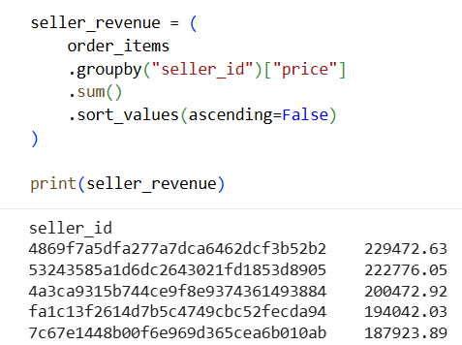
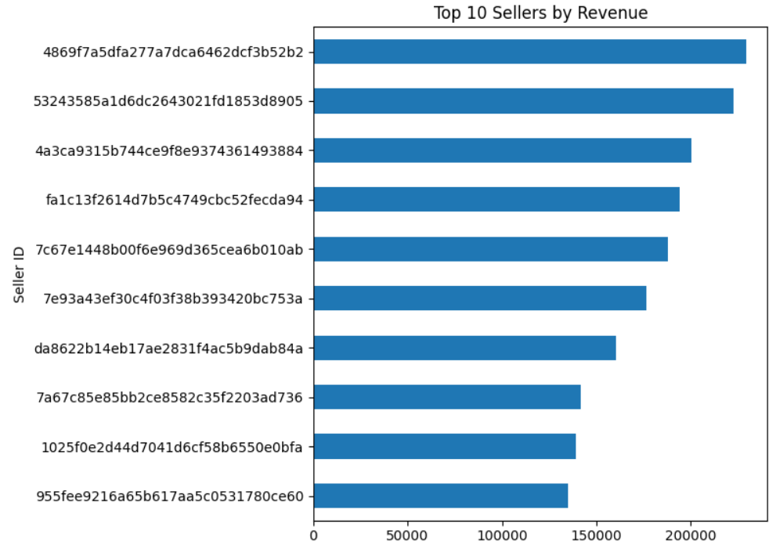
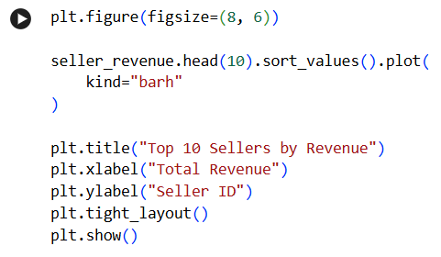
INTERMEDIATE 5 — Top 3 customers by spending in each year

Slide 18
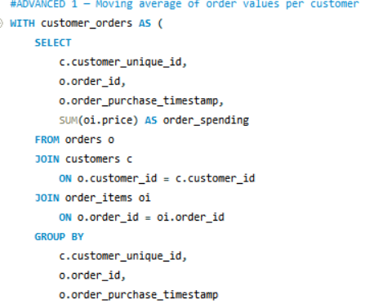
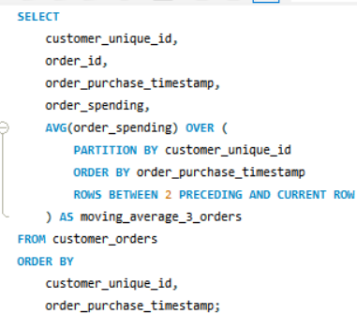
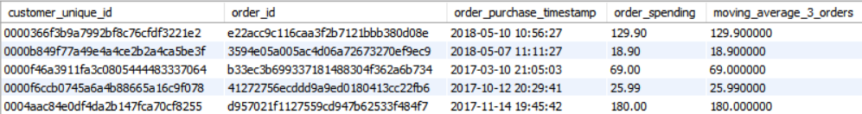
ADVANCED 1 — Moving Average of Order Values for Each Customer

Slide 19
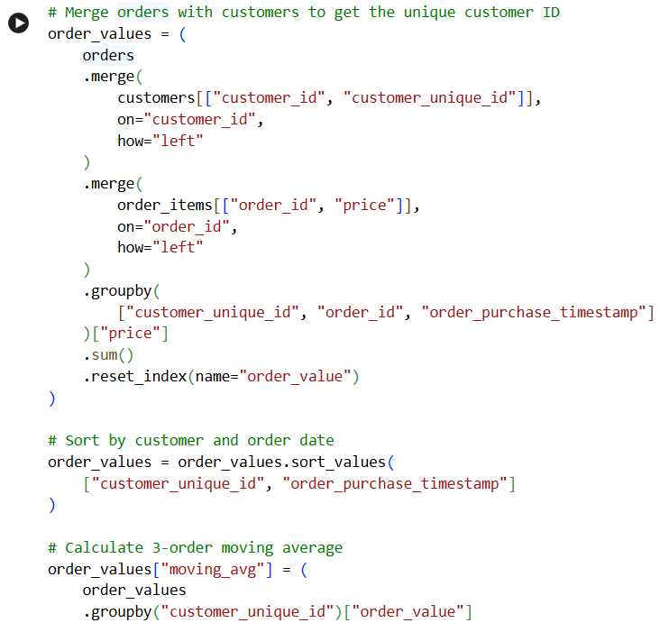
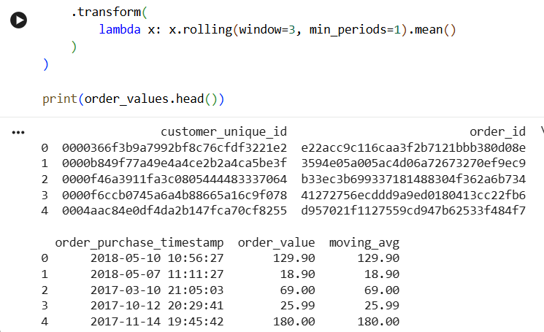
ADVANCED 1 — Moving Average of Order Values for Each Customer

Slide 20
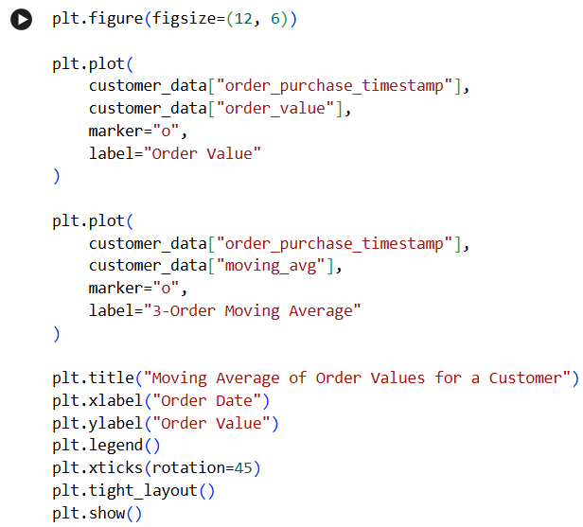
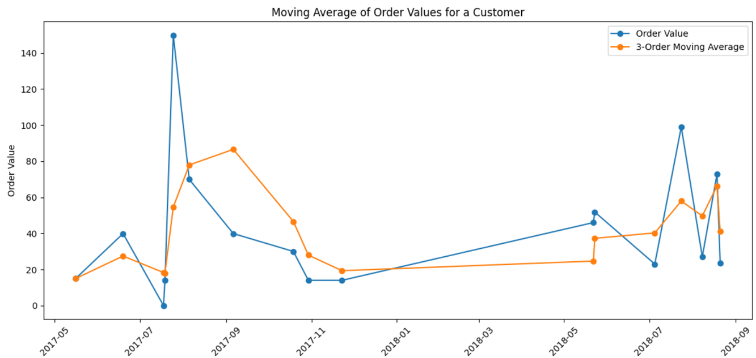
ADVANCED 1 — Moving Average of Order Values for Each Customer
Approach / Logic:
First, order-item prices are aggregated at the order level to calculate total spending for each order. The data is then grouped by customer_unique_id and sorted by purchase date. Finally, the current order and previous two orders are used to calculate the 3-order moving average.

Slide 21
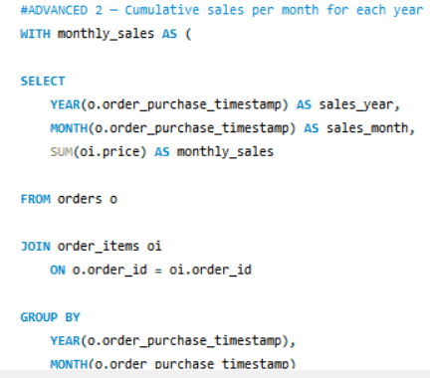
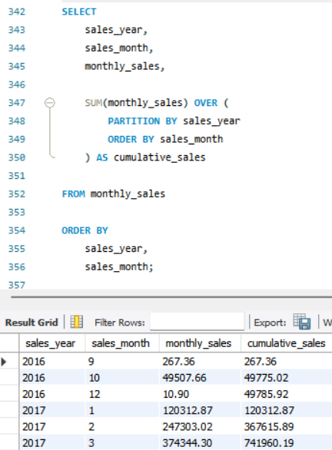
ADVANCED 2 — Cumulative Sales per Month for Each Year

Slide 22
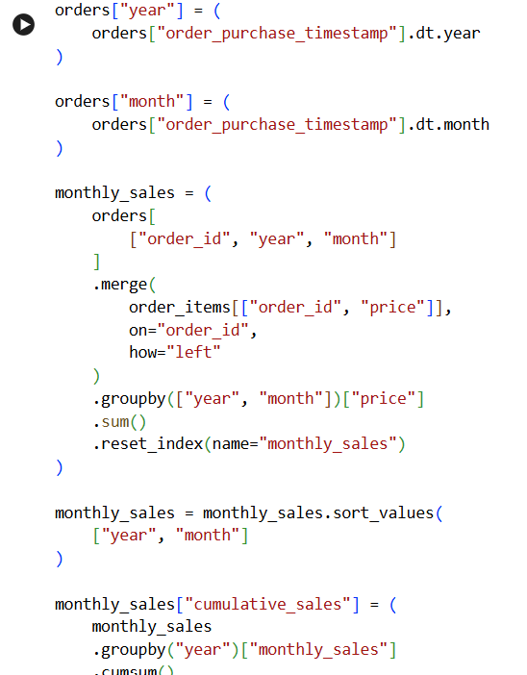
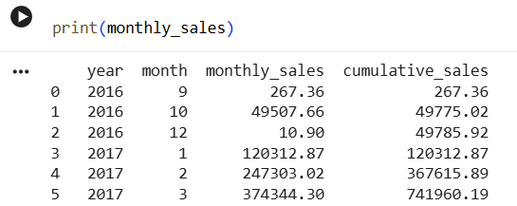
ADVANCED 2 — Cumulative Sales per Month for Each Year

Slide 23
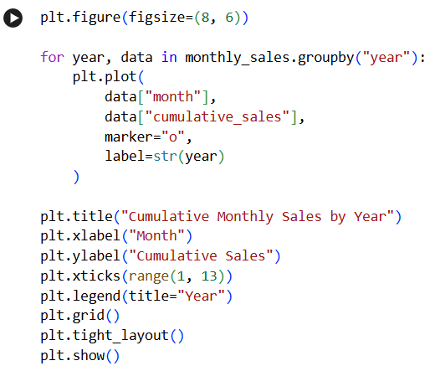
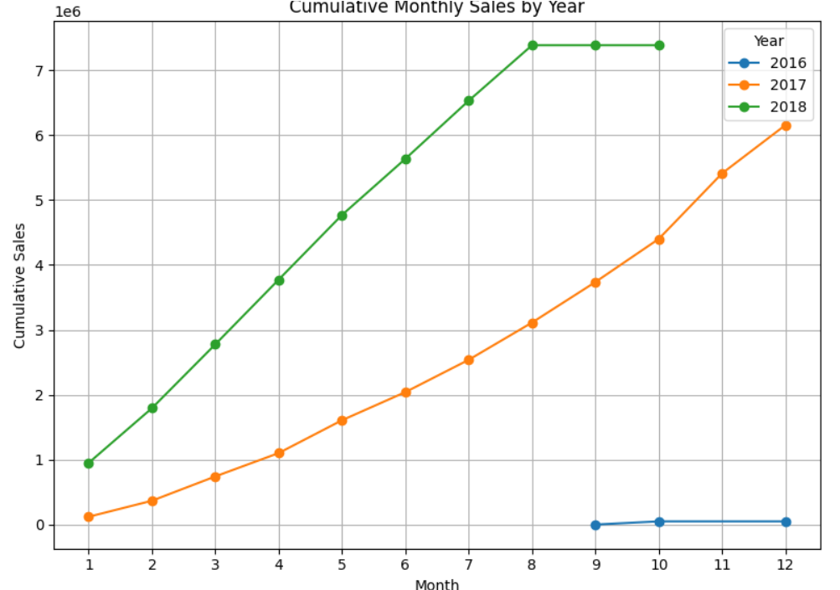
ADVANCED 2 — Cumulative Sales per Month for Each Year

Slide 24
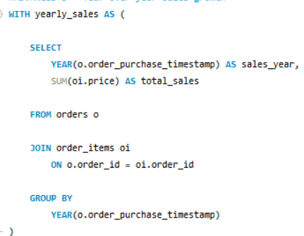


ADVANCED 3 — Year-over-Year Growth Rate of Total Sales

Slide 25



ADVANCED 3 — Year-over-Year Growth Rate of Total Sales

Slide 26



ADVANCED 4 — Customer Retention Rate Within 6 Months

Slide 27


ADVANCED 4 — Customer Retention Rate Within 6 Months

Slide 28



ADVANCED 5 — Top 3 Customers Who Spent the Most Money in Each Year

Slide 29



ADVANCED 5 — Top 3 Customers Who Spent the Most Money in Each Year

Slide 30
Methodology & Assumptions
  Methodology
SQL
Used joins to combine related datasets.
Applied filtering, grouping and aggregation.
Used window functions for advanced analysis.
Used ranking and time-based calculations where required.
Python
Used Pandas for data preparation and analysis.
Performed equivalent filtering, grouping and aggregation.
Used rolling calculations for moving averages.
Used percentage-change calculations for YoY analysis.
Compared Python results with corresponding SQL outputs.
  Key Assumptions
Order-level spending is calculated using the relevant order-item price values.
Customer-level analysis uses customer_unique_id where unique customer identification is required.
Time-based analysis uses the order purchase timestamp.
Retention is evaluated using the defined six-month period.
SQL and Python calculations follow equivalent business logic for validation.

Slide 31
Conclusion
This project demonstrates how SQL and Python can be used together for comprehensive e-commerce data analysis.
The project covered basic, intermediate, and advanced analytical questions involving:
  Sales performance
  Product categories
  Customer behavior
  Revenue trends
  Customer retention
  Spending patterns
  Customer rankings
By implementing the analysis in both SQL and Python and comparing the outputs, the project provides a structured approach to cross-tool validation and analytical accuracy.
The validated results were then used to derive meaningful business insights from the e-commerce dataset.

Slide 32
Thank You
~Ankita Sarkar

