Slide 1
E-commerce Analysis
Project: E-Commerce Sales & Customer Analysis
Tools: SQL & Python
Focus: Data Analysis, Business Insights & Cross-Tool Validation
~By Ankita Sarkar

Slide 2
1. Project Overview
This project analyzes an e-commerce dataset to understand customer behavior, sales performance, product performance, and purchasing patterns using both SQL and Python.
The same analytical questions were solved independently using SQL queries and Python-based data analysis.
2.Objectives
    Analyze customer and order information.
    Evaluate sales and product-category performance.
    Identify customer purchasing patterns.
    Perform advanced sales and customer analysis.
    Reproduce SQL analysis using Python.
    Compare SQL and Python outputs for consistency and accuracy.
    Validate that both approaches produce equivalent results.

Slide 3



2. Executive Summary
4,119
Customer cities
45,101
Orders in 2017
51.5%
Orders with installments
2.8%
6-month retention
    Health & Beauty generated the highest category sales at 1,258,681 in item-price revenue.
    São Paulo had the largest customer base with 40,302 unique customers.
    January recorded 7,269 orders in 2018; September and October are partial in the source data.
    Sales increased from 6,155,807 in 2017 to 7,386,051 in 2018, a 19.99% YoY increase.
    Product price vs purchase count correlation was -0.032, indicating a very weak linear relationship.

Slide 4
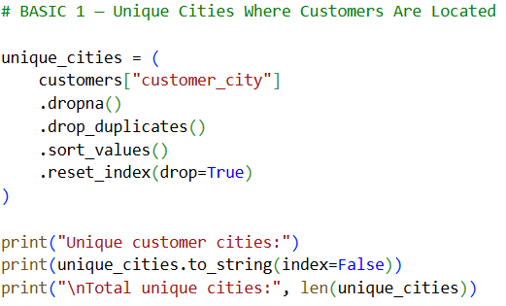
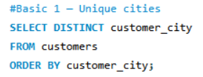
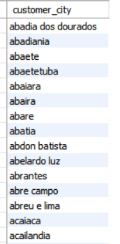
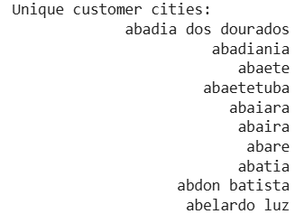
BASIC 1 — Unique Cities Where Customers Are Located
PYTHON Code
SQL Query

Slide 5
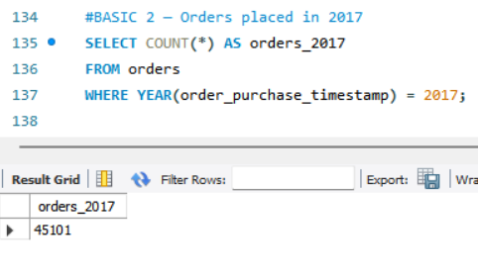
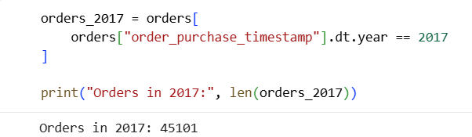
Basic-2 Number of Orders Placed in 2017
SQL Query
PYTHON Code

Slide 6
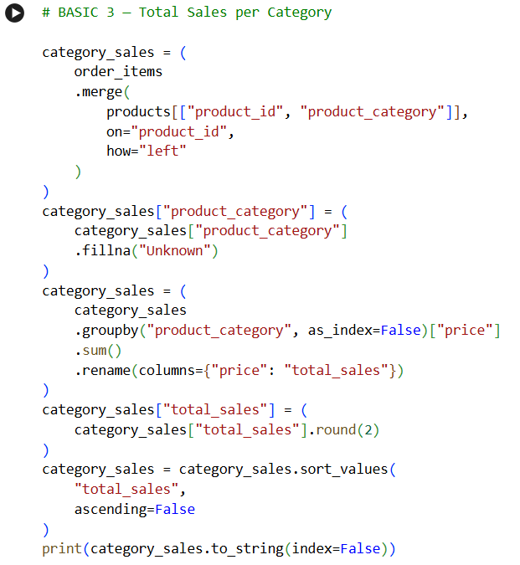
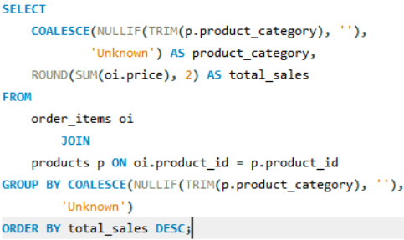
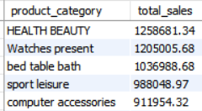
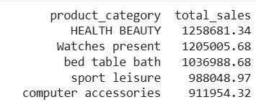
BASIC 3 — Total sales per category
PYTHON Code
SQL Query

Slide 7
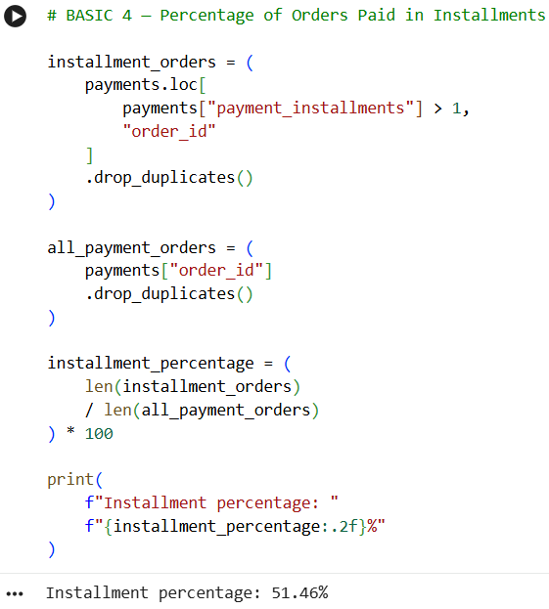
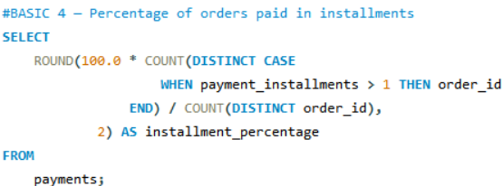

BASIC 4 — Percentage of orders paid in installments
PYTHON Code
SQL Query

Slide 8
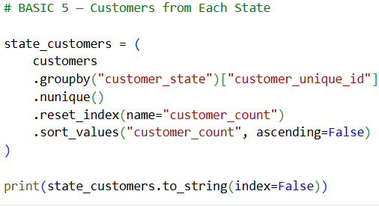
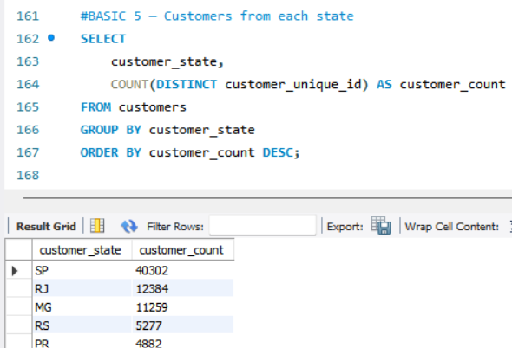
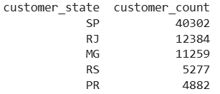
BASIC 5 — Customers from each state
PYTHON Code
SQL Query

Slide 9
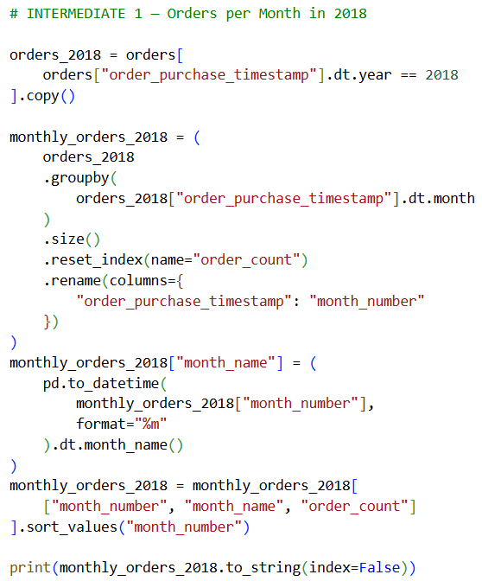
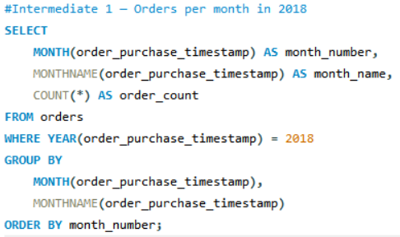
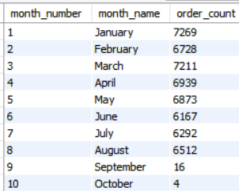
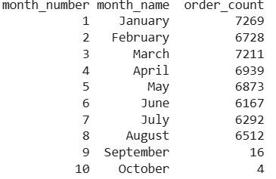
Intermediate 1 — Orders per month in 2018
PYTHON Code
SQL Query

Slide 10
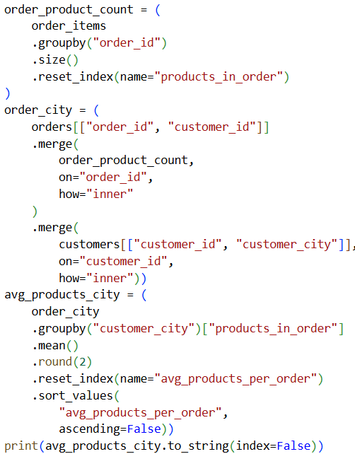
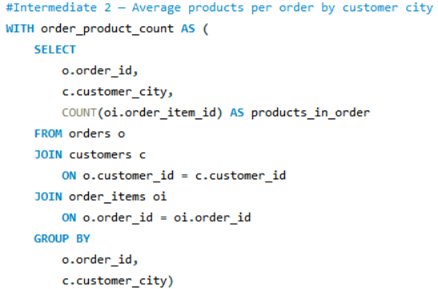
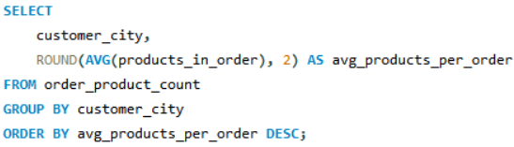
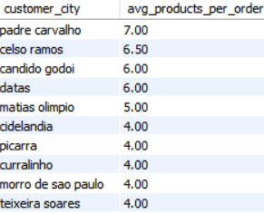
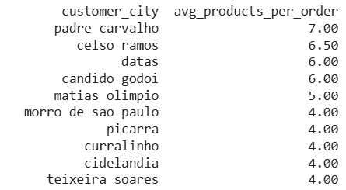
SQL Query
Intermediate 2 — Average products per order by customer city
PYTHON Code

Slide 11
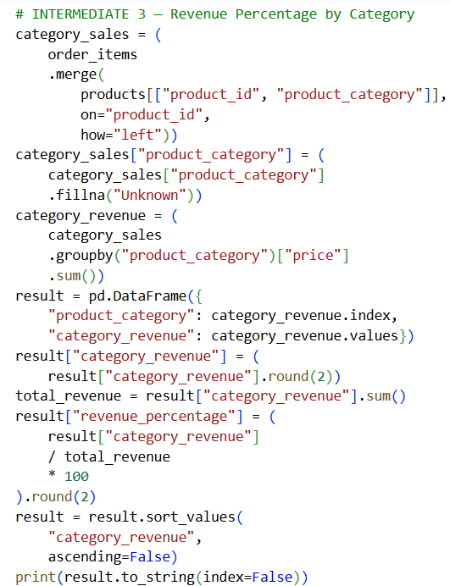
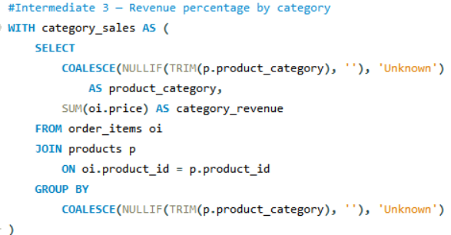
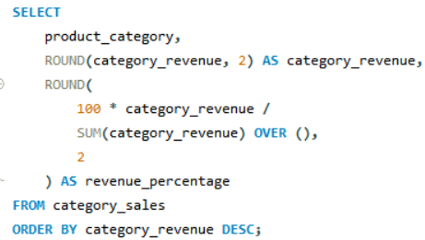
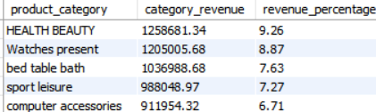
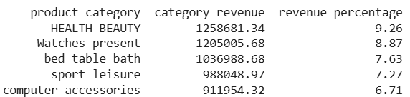
Intermediate 3 — Revenue percentage by category
PYTHON Code
SQL Query

Slide 12
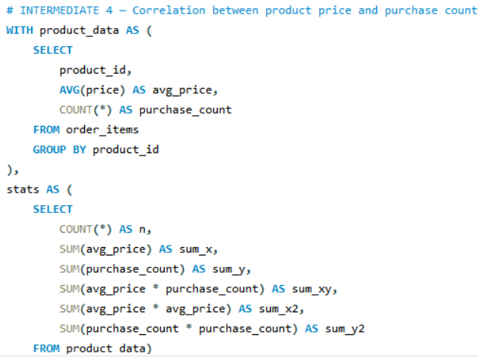
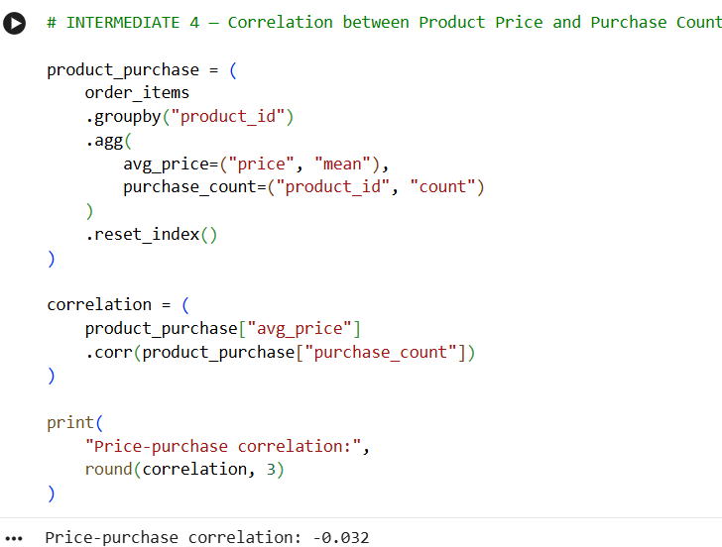
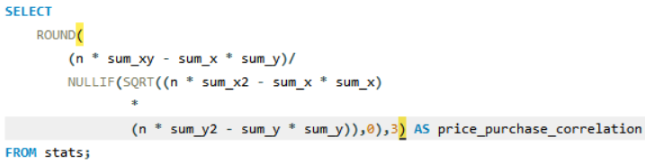

SQL Query
INTERMEDIATE 4 — Correlation between product price and purchase count
PYTHON Code

Slide 13
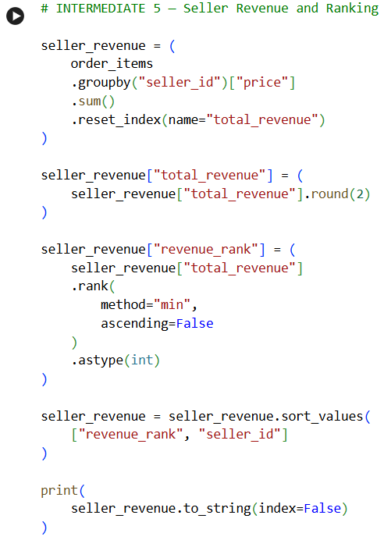
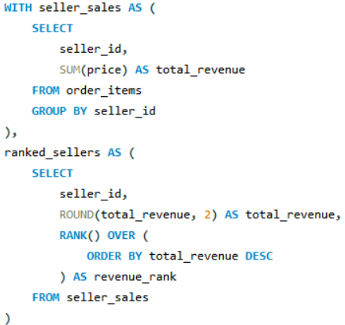
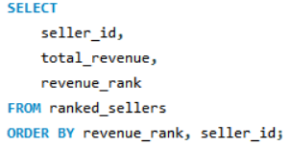
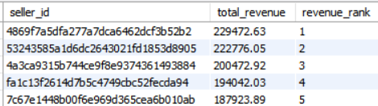
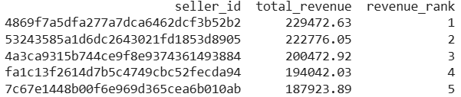
INTERMEDIATE 5 — Seller Revenue & Ranking
PYTHON Code
SQL Query

Slide 14
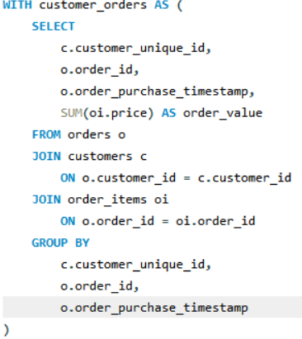
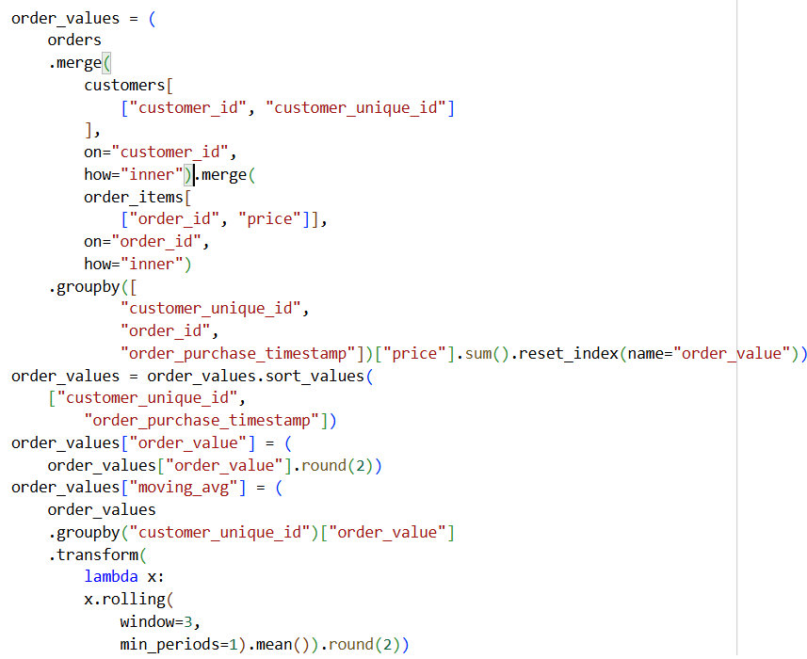
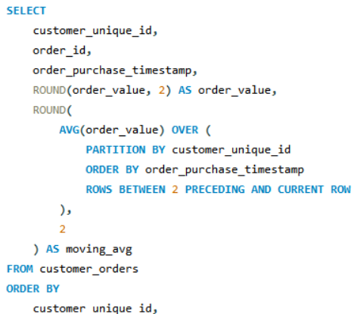
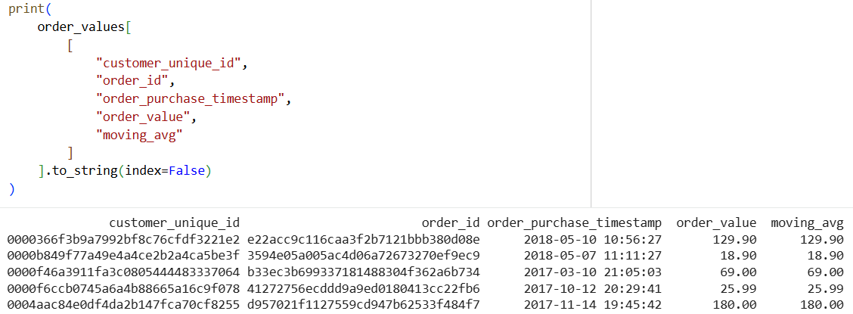
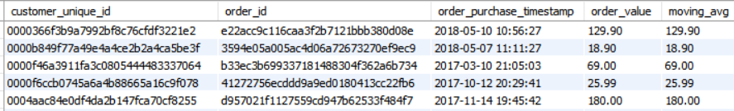
ADVANCED 1 — Moving Average of Order Values for Each Customer
PYTHON Code
SQL Query

Slide 15
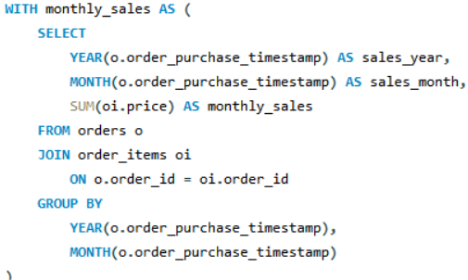
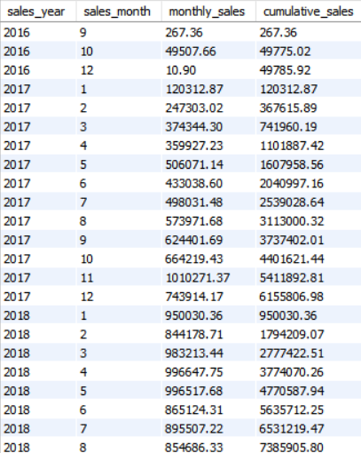
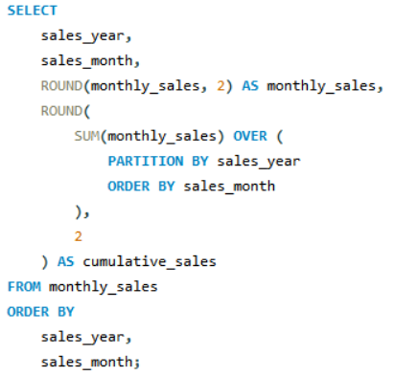
ADVANCED 2 — Cumulative Sales per Month for Each Year- SQL
SQL Query
SQL-Output

Slide 16
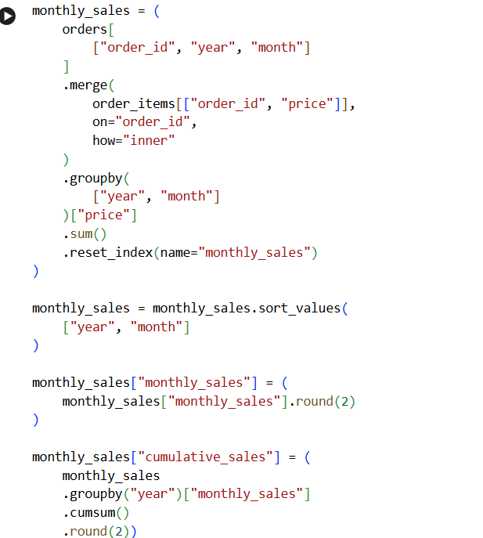
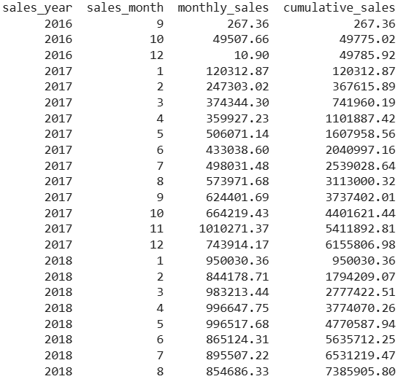
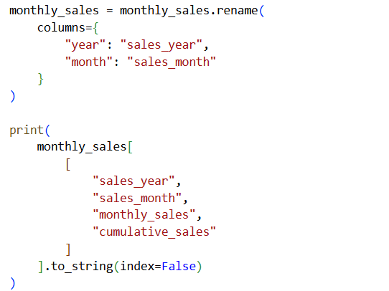
PYTHON Code
ADVANCED 2 — Cumulative Sales per Month for Each Year-PYTHON
PYTHON-Output

Slide 17
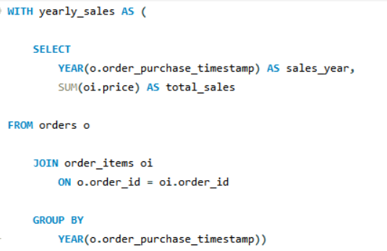
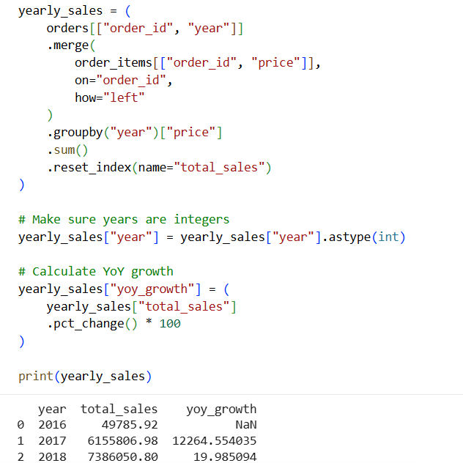


ADVANCED 3 — Year-over-Year Growth Rate of Total Sales
SQL Query
PYTHON Code

Slide 18



ADVANCED 4 — Customer Retention Rate Within 6 Months
PYTHON Code
SQL Query

Slide 19



ADVANCED 5 — Top 3 Customers Who Spent the Most Money in Each Year-SQL
SQL Query
SQL-Output

Slide 20



ADVANCED 5 — Top 3 Customers Who Spent the Most Money in Each Year-PYTHON
PYTHON-Output

Slide 21
Methodology & Assumptions
    Methodology
    SQL
    Used joins to combine related datasets.
    Applied filtering, grouping and aggregation.
    Used window functions for advanced analysis.
    Used ranking and time-based calculations where required.
    Python
    Used Pandas for data preparation and analysis.
    Performed equivalent filtering, grouping and aggregation.
    Used rolling calculations for moving averages.
    Used percentage-change calculations for YoY analysis.
    Compared Python results with corresponding SQL outputs.
    Key Assumptions
    Order-level spending is calculated using the relevant order-item price values.
    Customer-level analysis uses customer_unique_id where unique customer identification is required.
    Time-based analysis uses the order purchase timestamp.
    Retention is evaluated using the defined six-month period.
    SQL and Python calculations follow equivalent business logic for validation.

Slide 22
Conclusion
This project demonstrates how SQL and Python can be used together for comprehensive e-commerce data analysis.
The project covered basic, intermediate, and advanced analytical questions involving:
    Sales performance
    Product categories
    Customer behavior
    Revenue trends
    Customer retention
    Spending patterns
    Customer rankings
    By implementing the analysis in both SQL and Python and comparing the outputs, the project provides a structured approach to cross-tool validation and analytical accuracy.
    The validated results were then used to derive meaningful business insights from the e-commerce dataset.

Slide 23
Thank You
~Ankita Sarkar

