Slide 1
Problem statement
The objective is to develop an integrated web application that provides common services to citizens in various domains such as health, education and finance. Although a lot of information is available online, people still struggle to identify the right services and access them easily in their day-to-day life.

Slide 2

Solution
Creation of a unified platform that centralizes
access to a wide variety of everyday services. Users will be able to easily access these services through an unified interface, with various features. Developed currently for one location, we plan to implement it for 100+ locations in the future.

Slide 3
Features offered
Our website “QuickServe” provides integrated services to common people. This website has comprehensive service coverage for health, education and finance.
Education :- Our website serves as a one-stop resource for students, offering detailed information on educational institutions, a comprehensive scholarship database, and a curated collection of online learning tools.

Slide 4
Health :- Our website empowers users to find healthcare resources conveniently. We provide comprehensive information on nearby hospitals, along with details of highly-rated doctors in various specialties. Additionally, the website facilitates easy access to nearby pharmacies, emergency services, and diagnostic centers.
Finance :- Our website is a comprehensive resource for financial planning. It provides users with up-to-date information on housing loan options from a variety of banks, including their respective interest rates. Additionally, the website explores valuable tax-saving strategies and insurance products to help users make informed financial decisions.

Slide 5

Process flow
Data collection from various sources (APIs, web scraping, etc.)
Data integration and preparation
Development of the web application using MERN stack.
Deployment of the application and performance monitoring (speed, service quality, etc.)

Slide 6
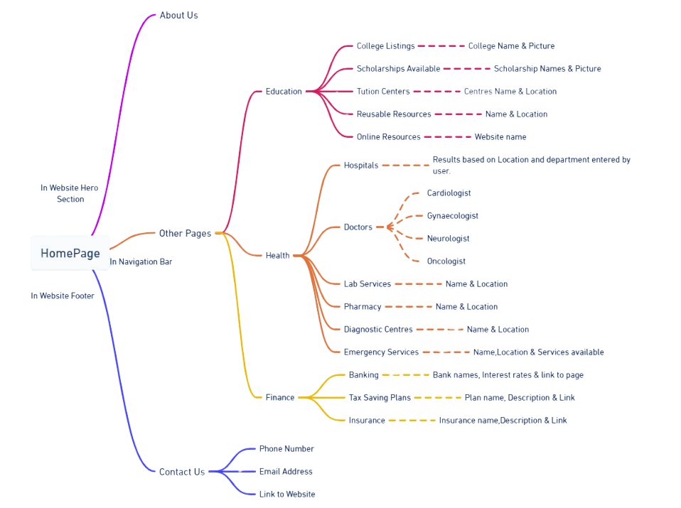
Architechture diagram

Slide 7
Technologies used
Figma : For designing UI/UX of the website.
Whimsical : For architectural design of the website.
API, Web scrapping : For data-collection.
HTML,CSS : For frontend development.
Javascript, Bootstrap : For enhancing functionality.
MERN stack : For overall integration of the website.
Canva : For editing and designing the pictures.

Slide 8
Team members & Contribution
Ankita Satapathy - Made the website Architecture using Whimsical flowchart. Developed the Health Page & Finance Page. Integrated and Deployed the whole website in GitHub.
Asipu Khitesha - Prepared the PPT and documentation of the website. In charge of Data collection for entire website. Worked on editing and designing pictures using canva.
Barsha Baibhabi - Made the initial UI/UX design of the website using Figma. Developed the Landing page & Education page. Involved in writing captions for the website.

Slide 9
Conclusion
We've developed a user-friendly website tailored to the needs of Bhubaneshwar residents. The platform's core functionalities, such as Health, Education and Finance, will be applicable across all locations. We plan to expand by adding location-specific content and features to serve over 100 locations in the future.

